Slide 1
2024 Workshop on Statistics for SDGs
Lessons Learned from Providing Statistics for SDGs
Specialized Technical Committee of the SDG Information System
Arturo Blancas,
National Institute of Statistics and Geography
Mexico
Tirana, 15 October, 2024

Slide 2
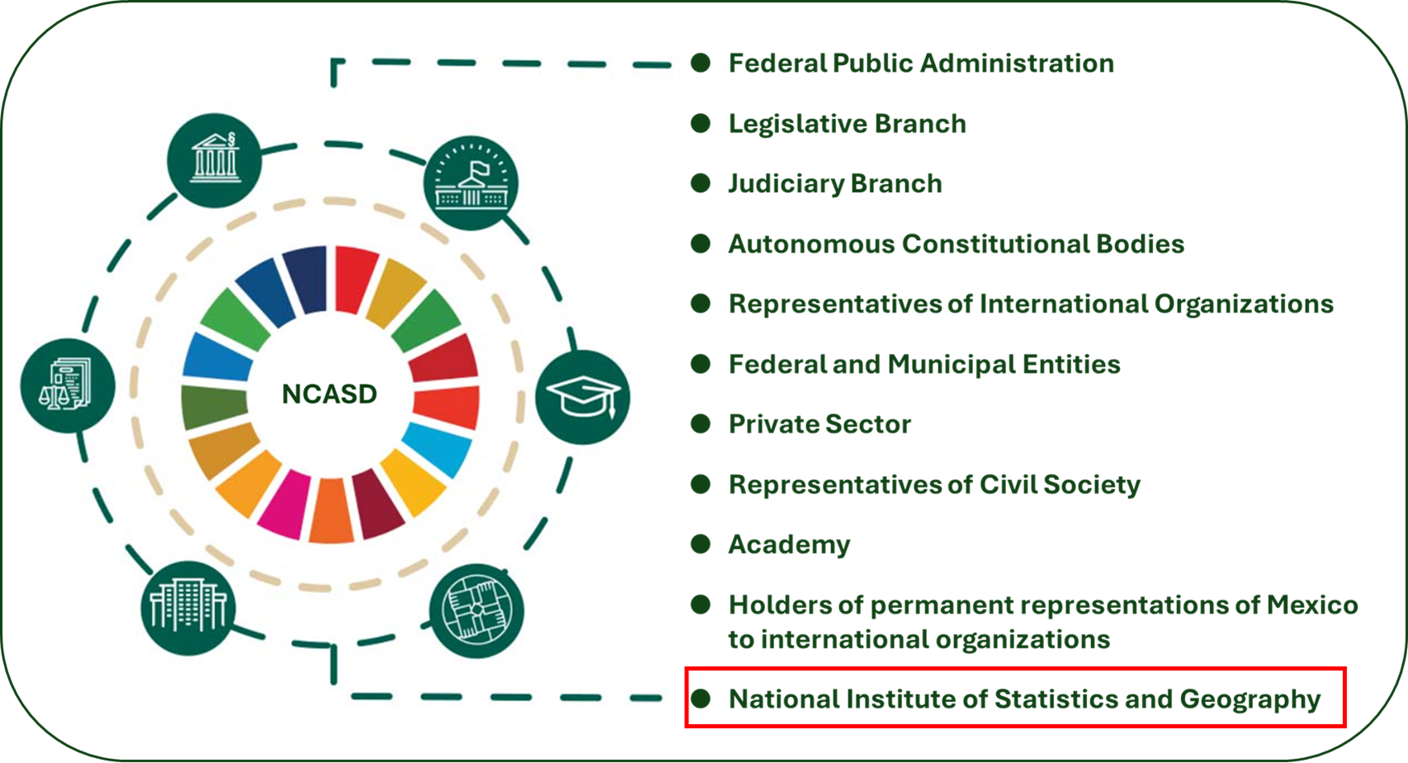
Practice to share
National Council of the 2030 Agenda for Sustainable Development (NCASD)
To define and coordinate the necessary mechanisms for the advancement of the 2030 Agenda.
To formulate policy proposals and actions considering those that emerge from its committees.
To promote collaboration with representatives of civil society, academia and private sector.

Slide 3
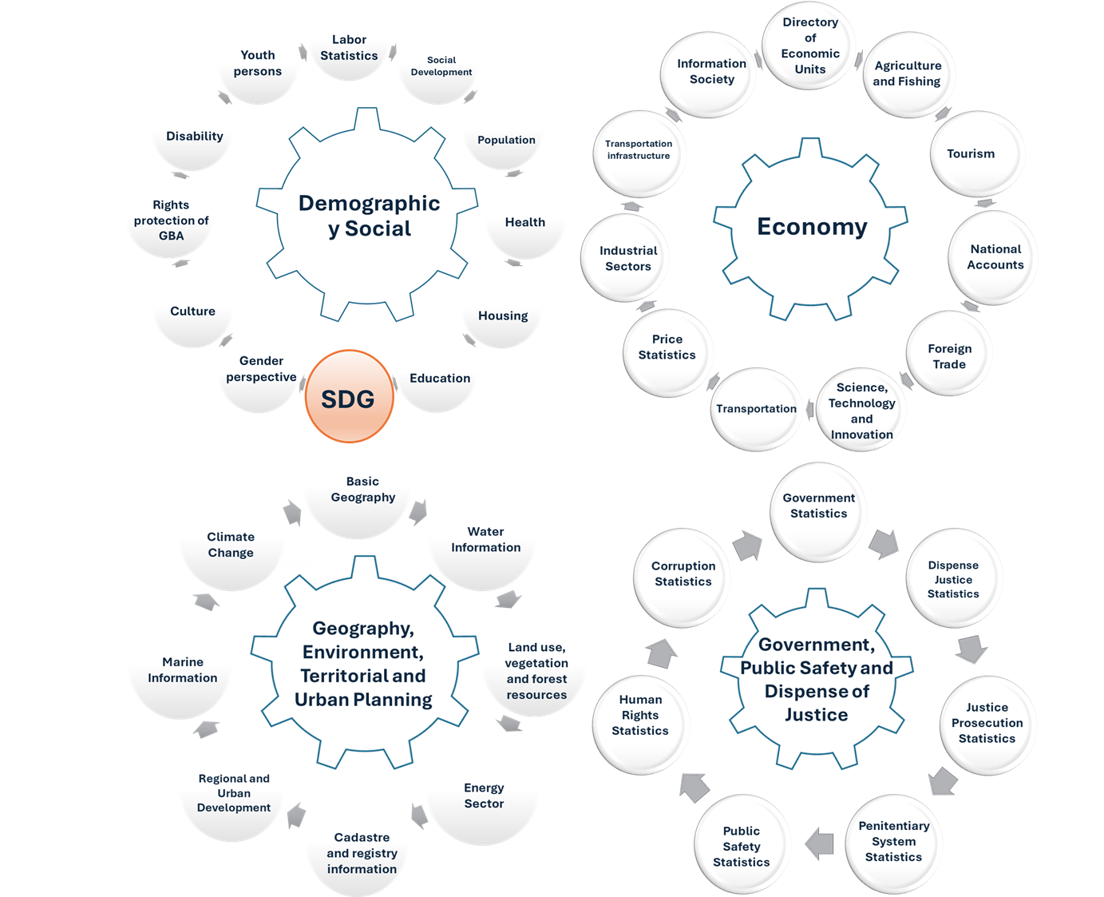
Practice to share
Specialized Technical Committee on Sustainable Development Goals (STCSDG)
Collegiate bodies of participation and consultation created by the Governing Board of the National Institute of Statistics and Geography made up of representatives of the State Units and the Institute itself.
17 Sustainable Development Goals are related to the four national information subsystems that make up the National System of Statistics and Geography Information

Slide 4
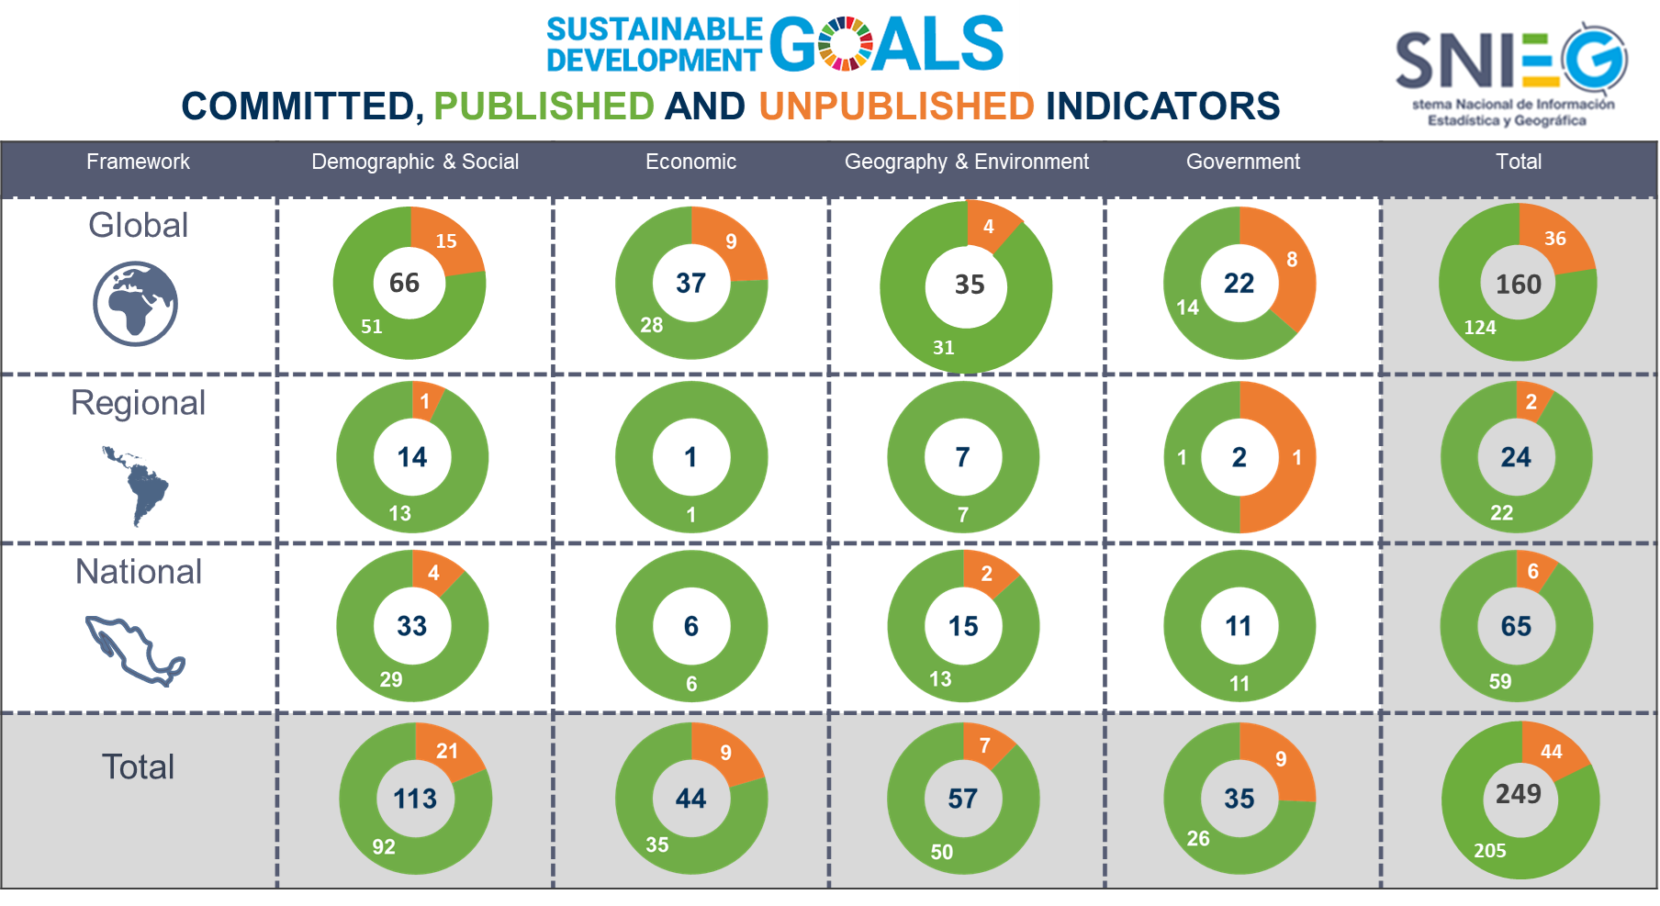
Practice to share
Specialized Technical Committee on Sustainable Development Goals (STCSDG)
STCSDG has the objective of serving as the inter-institutional coordination body to monitor the progress of the State Units regarding the calculation of indicators for monitoring the SDGs of the 2030 Agenda.
Responsibility for the indicators of the SDGs is agreed upon with the State Units responsible for the subject.

Slide 5
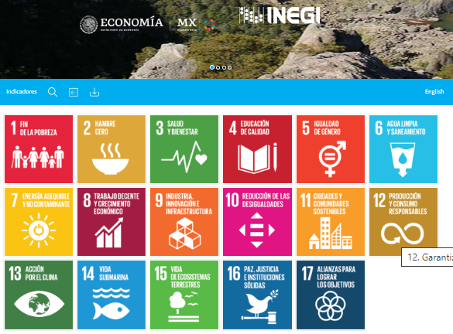
Practice to share
Sustainable Development Goals Information System (SDGIS)
SDGIS data are official and, therefore, must be used for the design of public policies, as well as for international reports submitted by Mexico.
SDGIS was designed for consulting and downloading indicators.
Indicators can be viewed on maps and dynamic graphs.
SDGIS allows downloading time series of data used to calculate indicators and metadata.

Slide 6
Lessons learned and conclusions
Calculating the indicators of the 17 Sustainable Development Goals of the 2030 Agenda requires institutional agreements.
Constitutional autonomy of the National Statistics Office contributes to the technical and methodological review of information sources for calculating indicators.
Sustainable Development Goals Information System contributes to the socialization of data, so as not to leave anyone behind.

