Slide 1
Considerations on a new approach for the ADS Regulation
Submitted by the experts from CLEPA and OICA
Informal document GRVA-WS03-10
3rd GRVA WS on ADS, 15-16 Oct. 2024
- Update -

Slide 2
Benefit of the new Regulation Approach
Modification of registered vehicles, e.g adding new features via software updates (w/o modifying vehicle registration data)
=> Important for ADS deployment
Allow smooth integration of ADS features into ADS vehicle types => e.g. also in cases of different manufacturers (vehicle vs feature)
Reduce administrative burden
=> Double work to be avoided
Improved readability and clustering of requirements
=> Manufacturer/Organization vs. Product related elements
The new Regulation Approach structure supports above mentioned aims

Slide 3
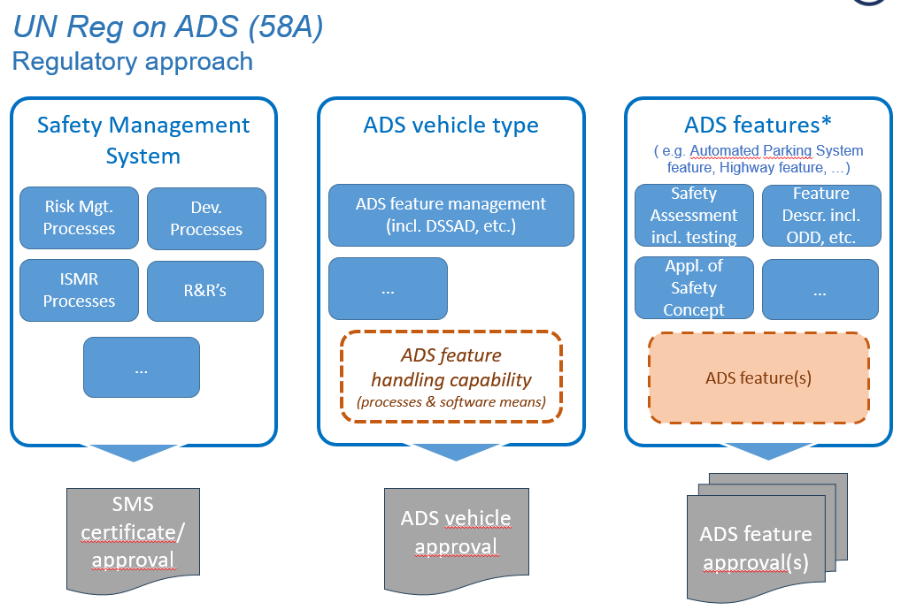
Possibilities the new approach offers
Basic split into three parts with dedicated approvals/certificates
SMS: all manufacturer capabilities incl. processes, etc. are included in this part/ module (similar approach as for CSMS / UN R 155, and SUMS /UN R 156)
ADS vehicle type: description of the ADS relevant architecture (hardware)
ADS feature: Assessment of the ADS application (linked to S/W) for a dedicated ODD and to be operated on a given ADS vehicle type (hardware)

Slide 4
Where might requirements end up?
 | General | Management System (Manufacturer Capability) | ADS Vehicle Type (Architecture) | ADS features (Application) | Comments
Purpose | X
Scope | X
Definitions | X
[Documentation/General] Requirements
General |  |  |  |  | to be clarified
Safety Management System |  | X
Safety Case |  |  |  | X
Demonstrate ADS meets requirements |  |  |  | X
Demonstrate ADS is free of unreasonable risk |  |  |  | X
Reporting |  | X
Other Documentation |  | (X) | (X) | (X) | needs clarification on details
Requirements/Specifications
SMS processes applied to ADS |  |  | X | X | About process application?
ADS performance of the DDT |  |  |  | X
Absence of unreasonable risk |  |  |  | X
ADS interaction with users |  |  |  | X
Cybersecurity |  | (X) | X | (X)
Data storage system |  |  | X
Software updates |  | (X) | X | (X)
Credibility & suitability of tools (Test Environment) |  | X
Monitoring of in-service performance |  | X
Reporting |  | X
Compliance Assessment
Audit of SMS |  | X
Safety Case (Claims, Arguments & Evidence are sound & complete) |  |  |  | X
Reporting system |  | X
Conditions for Track and Real-world testing |  |  |  | X
Verification tests (reproducibility of some safety case evidence) |  |  |  | X
Other tests (minimum mandatory/targeted) |  |  |  | X
Annexes |  |  |  |  | As relevant
Purpose
Scope
Definitions
[Documentation/General] Requirements
General
Safety Management System
Safety Case
Demonstrate ADS meets requirements
Demonstrate ADS is free of unreasonable risk
Reporting
Other Documentation
Requirements/Specifications
SMS processes applied to ADS
ADS performance of the DDT
Absence of unreasonable risk
ADS interaction with users
Cybersecurity
Data storage system
Software updates
Credibility & suitability of tools (Test Environment)
Monitoring of in-service performance
Reporting
Compliance Assessment
Audit of SMS
Safety Case (Claims, Arguments & Evidence are sound & complete)
Reporting system
Conditions for Track and Real-world testing
Verification tests (reproducibility of some safety case evidence)
Other tests (minimum mandatory/targeted)
Annexes
ADS-04-09
+ Administrative chapters (considering needs for GTR and UN R)
+ Additional requirements for the ADS vehicle and ADS feature, e.g. on compatibility of ADS vehicle type and feature

Slide 5
Elements to be considered in context of the new Regulation approach ( if not already included)
Requirement for ADS vehicle type to have a (software) mechanism implemented to ensure that only type approved ADS features (for the considered vehicle type) can operate on the vehicle
Documentation requirement for the ADS vehicle type to describe the ADS architecture (ADS relevant hardware)
Requirement for the ADS feature(s) to have a (software) mechanism implemented to identify the valid ADS vehicle type the feature can operate on

Slide 6
Thank you

