Slide 1
UN No. 73 : Proposal for amendments to LATERAL PROTECTION (GOODS VEHICLE)
Informal document GRSG-128-17
(128th GRSG, 7-11 October 2024, Agenda item 7)
UN-R No. 73: Proposal for amendments of provisions on lateral protection devices for heavy-duty vehicles
MLIT, Japan
GRSG-128-＊＊

Slide 2
1. Background to the Proposal
In Japan, the number of so-called left-turn collision accidents, in which vehicles turning left at an intersection collide with other road users, such as motorcycles, cycles, and pedestrians, coming aside going straight, has been decreasing since the introduction of a regulation on lateral protection device, or LPD, in 1978, but left-turn collisions still occur today.
Source: Japan Traffic Accidents Databases by ITARDA
As we are to incorporate UN-R73 into the Japanese Safety Regulation, we propose improvements to the UN-R73.

Slide 3
2. What We Propose
To improve the effectiveness of LPDs in preventing left- or right-turn collisions, Japan intends to submit the following proposals:
1. Eliminating the exemption for semi-trailer tractors
2. Reducing the lower edge ground clearance of LPDs
3. Clarifying the upper edge structure of LPDs
4. Adding exemption to ensure BSIS requirements

Slide 4
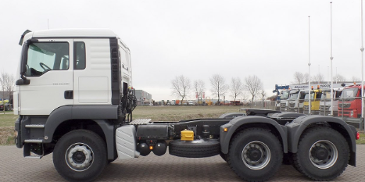
2-1 Eliminating the exemption for semi-trailer tractors
Tractors for semi-trailers, too, may run public roads without a semi-trailer attached, and in such cases, the difference in the inner wheels may lead to collisions involving cycles.
Tractor for semi-trailer
We propose deleting the exemption to tractors for semi-trailers.
→Paragraphs 1.2. to 1.2.1., shall be deleted.

Slide 5
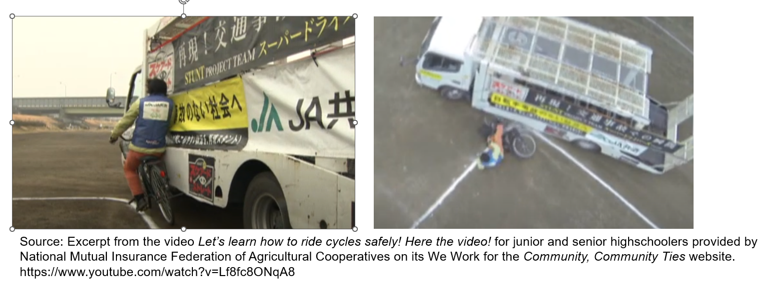
2-2 Reducing the lower edge ground clearance of LPDs
Left-turn* collisions occur when a truck turns left and, due to its inner wheel difference, catches a cyclist running aside going straight, the cyclist tumbling beneath the LPDs.
The collision with cyclists relates to the lower edge ground clearance of LPDs.
*This documents are so worded as to accidents in left-hand traffic.

Slide 6
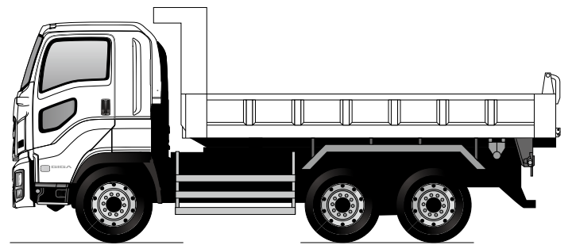
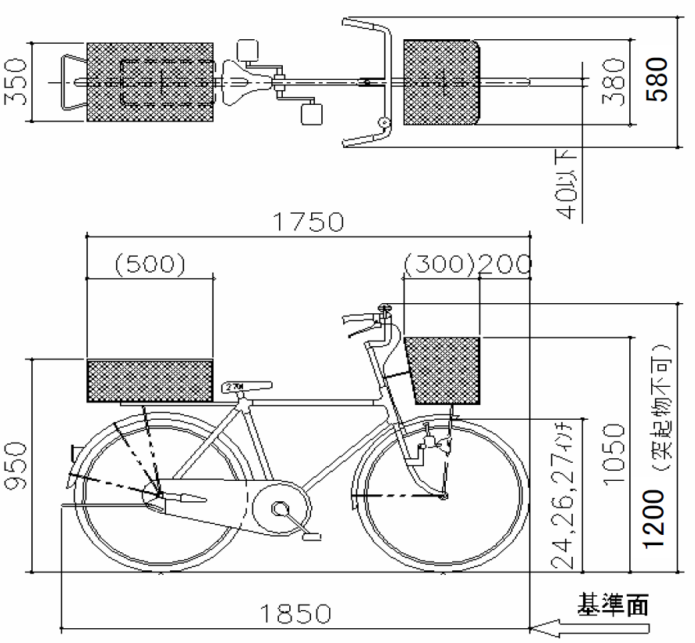
2-2 Reducing the lower edge ground clearance of LPDs
To prevent the cycle structure from diving under the lower part of the LPD when the cyclist fell over, it is appropriate to set LPD’s ground clearance to 450mm or less.
Reference:
- ISO4210 prescribes that the handlebar width of a cycle be 350mm or more.
- JISD 9301 and 9302 prescribe that the handlebar width of a cycle be 350mm or more and 600mm or less.
- The Japanese Road Traffic Act Enforcement Regulation, Article 9-3, prescribes that the maximum width of a cycle be 600mm or less.

Slide 7
2. Proposal for reducing the lower edge ground clearance of LPDs
We propose that the ground clearance in Paragraphs 12.8. and 15.6. be reduced to 450mm.
“12.8./15.6.
The lower edge of LPD shall at no point be more than 450 550 mm above the ground.

Slide 8
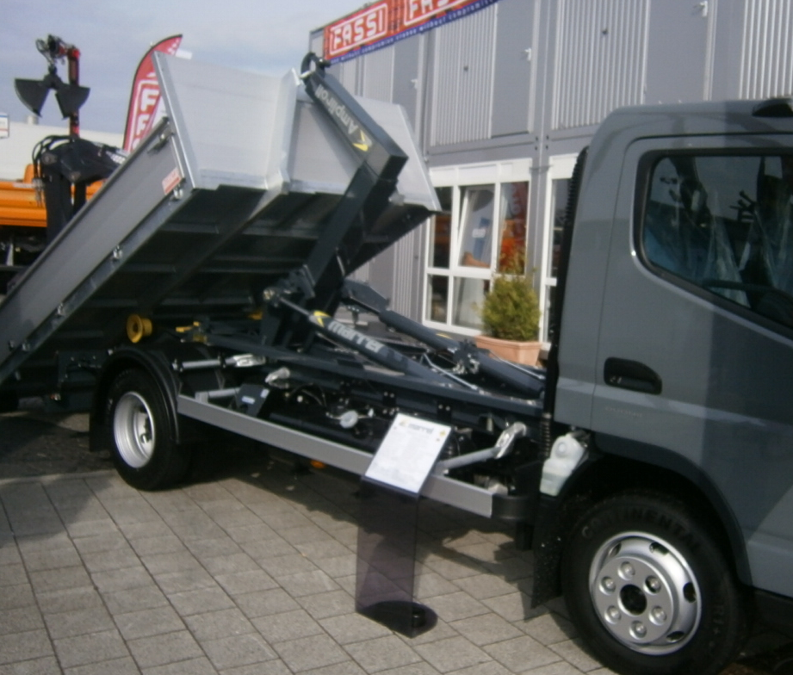
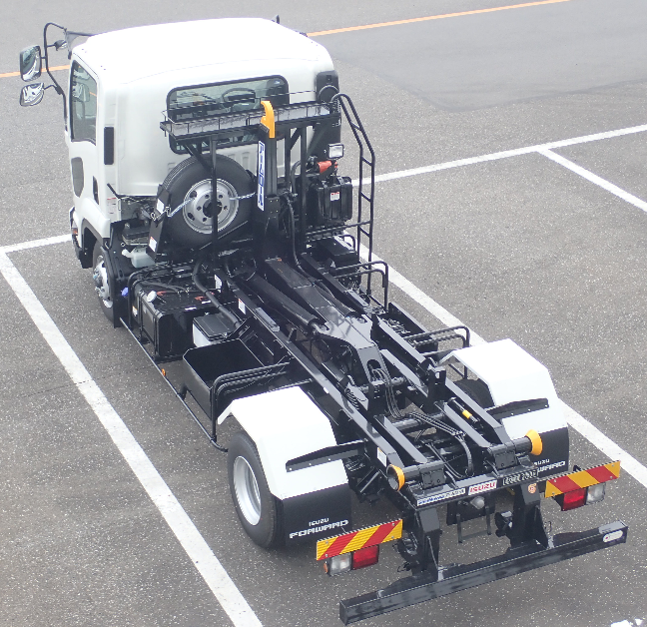
2-3 Clarifying the upper edge structure of LPDs
12.9.3. and 15.7.3. need to be deleted.
The upper edge of LPD shall not be more than 350 mm below that part of the structure of the demountable body.
However, there are cases that trucks with a demountable system are used on the road without loading the demountable body.

Slide 9
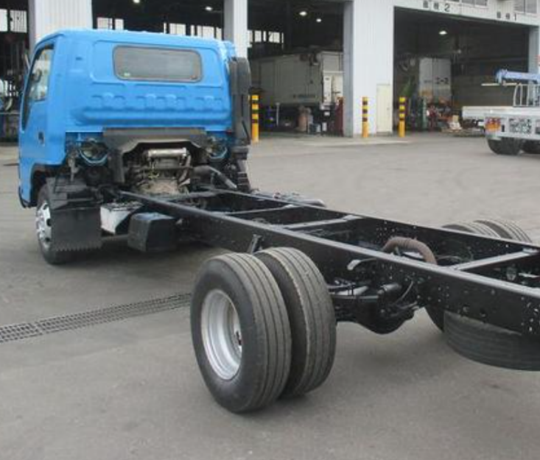
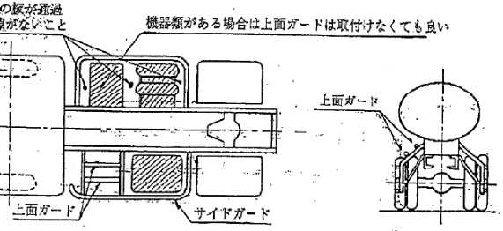
2-3 Clarifying the upper edge structure of LPDs
A truck running without a load-carrying platform is dangerous to other road users, because it doesn’t have Protector between LPD and chassis frame, which would otherwise prevent them, if collided, from diving under the platform.
When a detachable-type load-carrying platform is detached and absent, it wouldn’t be able to, as otherwise it would, prevent a falling cyclist from above with its LPD from tumbling under the chassis.
Without the top guard of LPD, a cyclist may fall inside the LPD and get caught by the rear tyres.

Slide 10
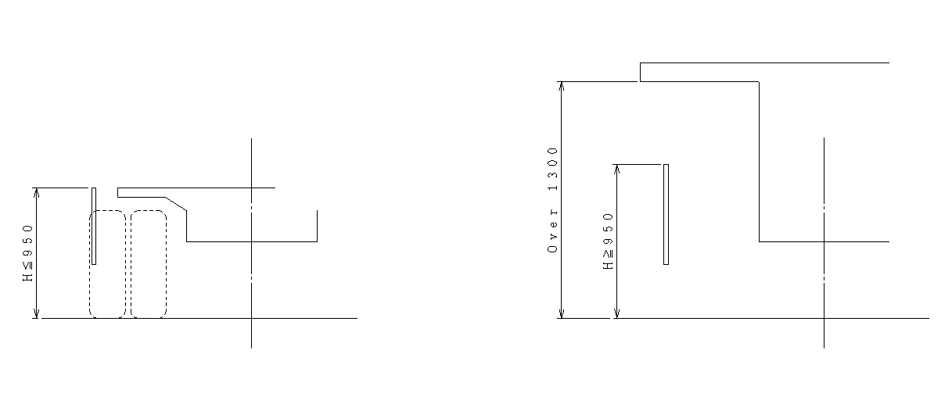
2-3 Proposal for clarifying the upper edge structure of LPDs
We propose that the structure of the current text be reviewed, because deleting 12.9.3. and 15.7.3. will make the content of 12.9.1-2. and 15.7.1.-2. inconsistent.
The Original regulations
12.9.1. and 15.7.1.
12.9.2 and 15.7.2.
LPD upper edge is the same height as surface of the load-carrying platform
paragraph 12.9. cuts the structure of the vehicle

Slide 11
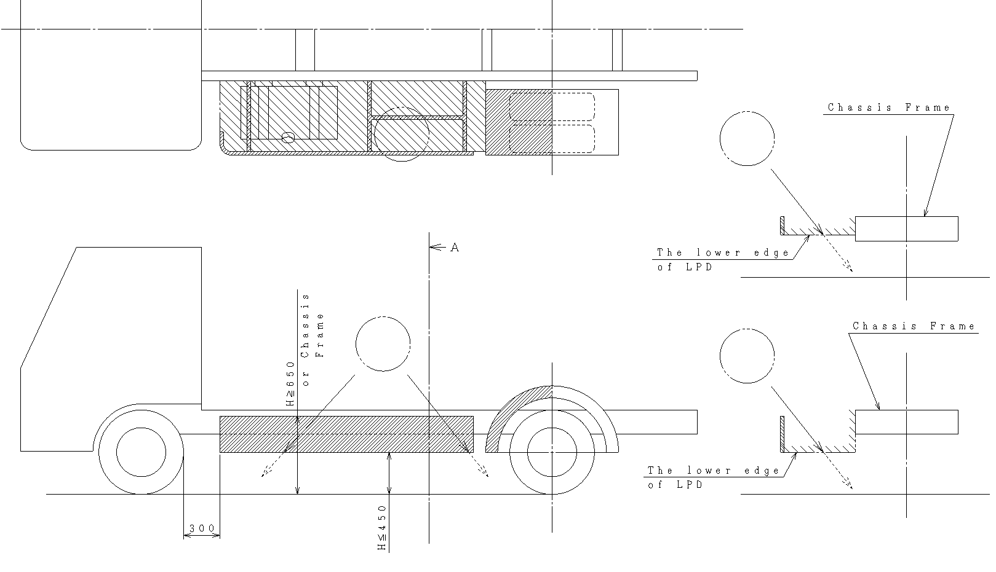
2-3 Proposal for clarifying the upper edge structure of LPDs
Shown below will give you an idea of what 12.9.1-2. and 15.7.1.-2. will be like after reviewing the structure.
12.9.1. and 15.7.1.
12.9.2 and 15.7.2.
The ground clearance of LPDs might be 950mm.
Or, otherwise, a top surface protection might be provided.

Slide 12
2-3 Proposal for clarifying the upper edge structure of LPDs
12.9.&15.7.
The upper edge of LPD shall not be more than 350 mm below that part of the structure of the vehicle, cut or contacted by a vertical plane tangential to the outer surface of the tyres, excluding any bulging close to the ground, except in the following cases
12.9.1.&15.7.1.
Where the plane in paragraph 12.9. does not cut the structure of the vehicle or cuts the structure of the vehicle at a level more than 1.3 m above the ground, then the upper edge shall not be less than, 950 mm above the ground.
12.9.2.&15.7.2.
The upper edge of LPD is [650] mm above the ground, be level with the surface of the chassis frame, whichever is less, and the structure is designed to prevent cyclists from falling under the vehicle fly over the LPD (see Figure 2 below). The fall prevention shall be demonstrated by the structure not allowing the [450] mm sphere to fall to the ground from the area enclosed by the LPD, chassis frame, and fender. Other methods may be adopted to comply with this requirement if a manufacturer so requests. The sufficiency of the fall prevention method shall be established to the satisfaction of the Technical Service.
(As to the appropriateness of 650mm and 450mm, we would like to hear your opinions at the GRSG meetings. The grounds for the figures are given on the following slide.)

Slide 13
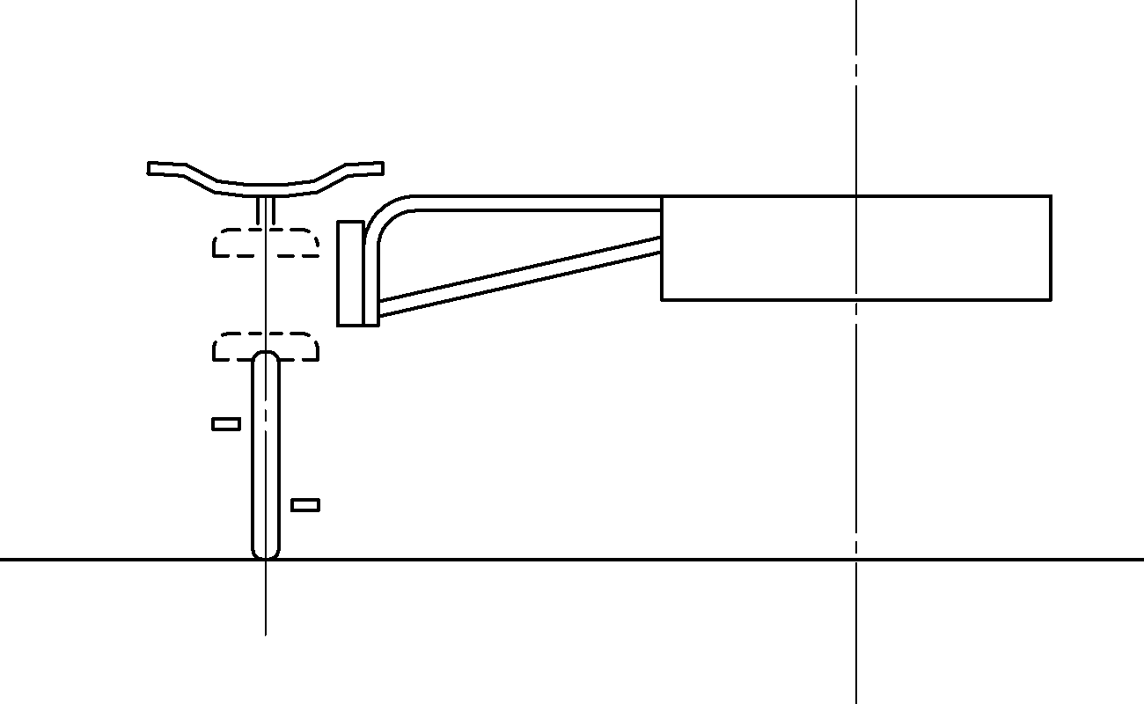
2-3 Clarifying the upper edge structure of LPDs
Grounds for the upper edge ground clearance being 650mm
Considering cases where the cycle rider is a child, the ideal structure of the LPD is one in which the LPD pushes them away around the waist.
Saddle
ISO8098 prescribes that the saddle height of children's cycles be 435mm to 635mm from the ground.
This makes that the effectively designed structure of LPDs is the one that pushes the child away with a flat plane between the height of 450 and 650mm from the ground.

Slide 14
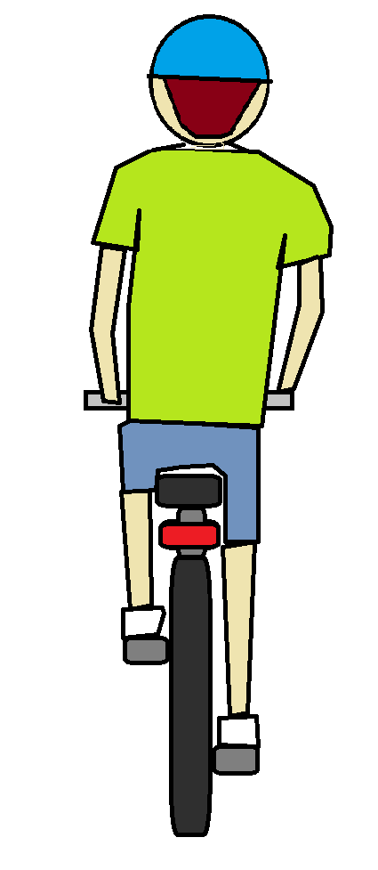
2-3 Clarifying the upper edge structure of LPDs
The grounds for the size of the sphere required to prevent cyclists from tumbling beneath the vehicle being 450mm
If the cyclist collides with the LPD in the lower part of the body, they might fly over the LPD to tumble beneath the chassis.
ISO4210 (Cycles -- Safety requirements for bicycles) prescribes that the minimum saddle height be 635mm. If the ground clearance of LPD is too low, there is a risk that a large person may fly over the LPD to tumble beneath the vehicle.
The gap between the LPD and the chassis frame for a person falling between the LPD and the frame not to fall to the ground was set based on the width of an adult male's shoulders. *The average shoulder width of a person 180cm tall is 450mm (25% of their height).

Slide 15
2-4 Proposal for adding requirements for relaxing BSIS requirements
Adding new paragraphs 13.1.6. and 16.1.6 on requirements for BSIS-related relaxation.
13.1.6. & 16.1.6.
On a vehicle fitted with Blind Spot Information System, making it impracticable to comply with all the requirements of paragraph 12., LPD may be arranged with additional gaps where these are necessary to comply with the requirements for them.

Slide 16
Thank you for your attention.

