Slide 1
Informal document GRSG-128-09_rev.1 (Republic of Korea)
(128th GRSG, 7-11 October 2024, Agenda item 11)
The progress report related to the application
of the Radiant Warmer

Slide 2
Progress history
Oct.
2022
124th UN/ECE GRSG Session
Introduction of Radiant Warmer technology and research results on improving low-temperature driving distance of electric vehicles
- Proposed the amendment of R.122 (Heating Systems)
Mar.
2023
Radiation Warmer Tech seminar
- Demonstration of Radiant Warmer technology and presentation of research results of the safety aspects
- Discussion regarding to the amendment of R.122
- Finalized the revised proposal document
Mar.
2023
125th UN/ECE GRSG Session
- Demonstration of Radiant Warmer technology, Presentation of the safety research results and the
summary report of the Tech seminar
- Releasing the revised proposal document in R.122 (Heating Systems) and adopting

Slide 3
Contents of the adopted amendment
"2. Surface Temperature
The surface temperature of any part of the heating system likely to come into contact with any occupant of the vehicle during normal road use shall be measured with a contact thermometer. No such part or parts shall exceed temperature limits defined in paragraphs below unless the manufacturer can demonstrate during the type approval process that their safety concept covers for higher temperatures without increasing the risk for occupants to get burns compared to the risk caused by the temperatures below. Any such demonstration and documentation shall be appended to the test report. The possibility to exceed these temperatures, does not apply to vehicles of categories M2 and M3 other than for the driver and for passengers seated in the row adjacent to the driver.
2.1. The surface temperature of any part of the heating system likely to come into contact with the driver of the vehicle during normal road use is limited to 70°C for uncoated metal or 80°C for other materials.
2.2. In the case of vehicles of categories M1 and N, any part of the system likely to come into contact with seated passengers during normal road use of the vehicle, with the exception of the outlet grille, is limited to 110 °C.
2.3. In the case of vehicles of categories M2 and M3, any part of the system likely to come into contact with passengers during normal road use of the vehicle is limited to 70 °C for uncoated metal or 80 °C for other materials.

Slide 4
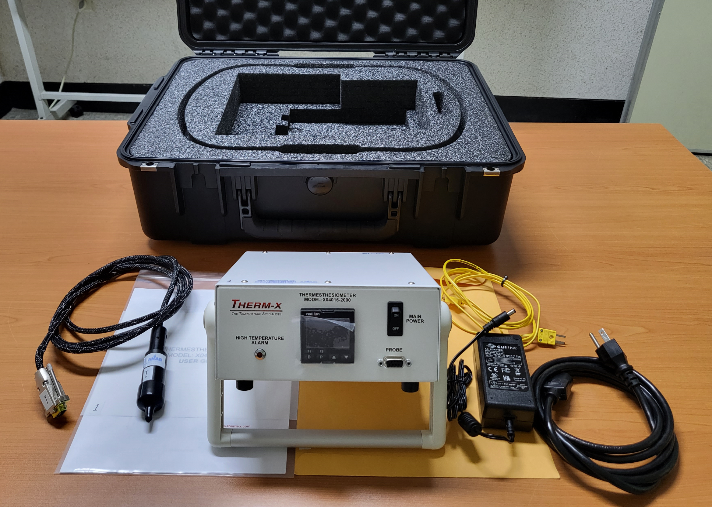
Briefing session on radiant warmer in Korea (19. August. 2024)
Target of the Briefing session
Technical Services in Korea (4 TSs)
Major contents
Demonstration of the Radiant Warmer Technology
- Comparison experience the surface temperature between metal(70℃) , fabric(90℃) and fabric(110℃)
- Experience of the applied radiant warmer technology in the vehicle
Introduction of the Radiant Warmer Technology
Explanation of the revision history of R-122 and background
Presentation of the research study result
- Burn Risk Assessment Method using a Thermesthesiometer for Safety Approval under R-122
Proposed safety concept for real vehicle application of Radiant Warmer

Slide 5
Certification documents will include below contents.
Radiant warmer description
- Radiant warmer system location
- Maximum electrical consumption
- Radiant warmer drawing
- Radiant warmer Target temperature => see the next page
- Radiant warmer safety features description => see the next page
Example of test report related to burn safety for Radiant Warmer
Draft for ILAC-MRA(KOLAS in Korea) Certified Test Report
=> see the another informal document which was presented by Republic of Korea
* ILAC-MRA : International Laboratory Accreditation Cooperation Mutual Recognition Arrangement
Worst case descriptions in the stage of the VTA of R-122

Slide 6
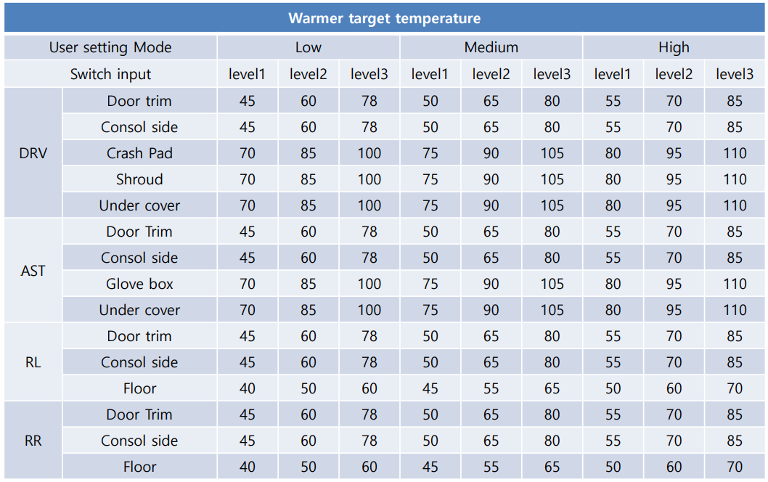
Radiant warmer Target temperature
This target temperature will depend on the model and other aspects.

Slide 7
Radiant warmer safety features description
This additional safety feature is subject to change as technology advances in the future.
When the warmer is turned ON, it automatically turns OFF after 30 mins.
(Regardless of the set levels).
When the warmer is ON and the touch sensors are detacted, the warmer turns OFF.
Driver and passengers can select the temperature level for each part of the warmer from the AVN panel.
- Driver / Passenger select
- Radiant warmer location select
- Temperature level select
This is a non-exhaustive list and other technologies could be developed in the future.

Slide 8
Feedbacks, etc.
Feedbacks from TSs
A : Suggested safety concepts are sufficient for meeting the amended regulation.
B : Proposed safety concepts can cover the amended regulation.
C : The actual evidence from detailed tests, such as organized contents and test reports,
seems to be faithful. It is judged that the overall contents, such as considering the safety of
passengers and drivers, were reasonably written.
D : All technical data and safety concepts are sufficient for obtaining certification.
In other hand, R-122 contains many points that don’t fit the current technology of the vehicle.
Therefore, there is opinion that the regulation needs to be reviewed as a whole.
Opinions on the second step
- It is believed that the second step related to radiant heat warmers can begin in earnest after more
diverse technologies from many manufacturers are released on the market.

Slide 9
Thank you.

