Slide 1
Report from the Informal Working Group on Acceleration Control for Pedal Error (ACPE)
Informal Working Group on ACPE
Informal document GRVA-20-45
20th GRVA, 23-27 September 2024 (Agenda item 6(C))
GRVA-20-46 (Amendment of original series of ACPE regulation)
Chair and Secretary IWG ACPE – GRVA 20

Slide 2
Informal Working Group on ACPE
IWG meeting 9th meeting in Korea (19 - 21 June 2024):
Discussion about parameters for the creeping requirements
Discussion on testability
Discussion for proposal (01 series) of ACPE regulation
IWG meeting 10th meeting in Germany (18 - 20 September 2024):
Updated accidentology and test results
Discussion for amendment of 00 series of ACPE
The results are submitted as GRVA-20-46
Discussion for 01 series of ACPE regulation
The results are submitted as ACPE-11-02
Chair and Secretary IWG ACPE – GRVA 20

Slide 3
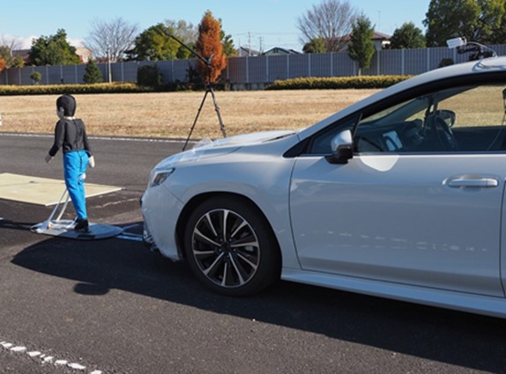
Informal Working Group on ACPE
Discussion for 01 series amendment (ACPE-11-02)
ACPE towards vehicle, wall or pedestrian target
Develop test procedures and requirements to capture moving-off and creeping scenarios (brake release – creeping – accelerator application)
Performance requirements agreed; AEBS-ACPE interaction solved
The IWG request guidance from GRVA about vehicles of category N1 in the scope of the regulation (details shown on next slides)
The IWG will deliver the 01 series amendment of the UN Regulation for the January 2025 session of GRVA.
Pedestrian target
Test procedure
(Standstill - Creeping run – Acceleration)
Chair and Secretary IWG ACPE – GRVA 20

Slide 4
Informal Working Group on ACPE
Guidance for Proposal of 01 series
Scope
1.1. This UN Regulation applies to the type approval of vehicles of Category M₁ [and N₁] equipped with automatic transmission with regard to their Acceleration Control for Pedal Error systems (ACPE).
(a) Acceleration Control for Pedal Error systems (ACPE) for a vehicle and wall.
(b) ACPE for a pedestrian.
1.2. At the request of the manufacturer, vehicles of other categories may be approved under this Regulation.
Request for guidance to GRVA:
CP of IWG support to include N1 vehicles in the scope.
Industry support not include N1 vehicle in the scope, N1 vehicles can be covered by para. 1.2.
ACPE-11-02
Chair and Secretary IWG ACPE – GRVA 20

Slide 5
Positions with regard to N1 vehicles
Informal Working Group on ACPE
Industry (OICA+CLEPA) Position
CP (DE, JP, UK, KR) Position
Accidentology does not support incusion of N1 vehicles in the scope since the risk per milage is much lower for N1 than for M1.
Accident situation with N1 differs between countries.
N1 vehicles are usually driven by professional drivers.
Technical difficulties for sensor mounting anticipated especially to the rear.
Relevant documents for accidentology: GRVA-14-14 (JPN), ACPE-02-02 (DE), ACPE-02-05 (Ind), ACPE-03-11 (Ind), ACPE-04-12 (KOR), ACPE-04-11 (Ind), ACPE-06-10 (KOR), ACPE-10-05 (KOR)
Accidentology for various countries supports the inclusion of N1 vehicles in the scope since the risk per registered vehicle is the same for M1 and N1.
Technical difficulties should be solvable until introduction of the 01 series
ACPE-11-02
Chair and Secretary IWG ACPE – GRVA 20

Slide 6
1998 agreement (GTR) activities of ACPE regulation
Informal Working Group on ACPE
ACPE IWG confirmed the activity of Global Technical Regulation (GTR)
IWG confirmed the discussions on the June session of WP.29.
IWG shared information on confirming the sponsors of GTR activities in 20th GRVA.
6
Chair and Secretary IWG ACPE – GRVA 20

Slide 7
Informal Working Group on ACPE – Next Step -
Schedule of meetings:
IWG meetings 11th meeting in Web
[21/28, 29] October 2024
Date | Meeting | Detail
[21/28-29] October 2024 | 11th Informal meeting in Web | Discussion about requirements and test procedures for 01 series. Deadline for submission of working document to 21st GRVA
20-24 January 2025 | 21st GRVA | Submission of working document and small changes in informal for 01 series and 00 series
Chair and Secretary IWG ACPE – GRVA 20

Slide 8
Informal Working Group on ACPE
Thank you
for your attention
Chair and Secretary IWG ACPE – GRVA 20

