Slide 1
TASK FORCE ON AUTOMATED VEHICLE CATEGORISATION (TF-AVC)
Submitted by the Chairs of the Task Force on Automated Vehicle Categorisation (TF-AVC)
Informal document GRVA-20-18
20th GRVA, 23-27 September 2024
Provisional agenda item 4(e)(ii)
GRVA STATUS REPORT
Copyright 18/09/24, Chairs of TF-AVC, all rights reserved. For reproduction permission and all other issues, please contact geena.rait@dft.gov.uk and thies.weinand@kba.de

Slide 2
TF-AVC progress
Established by WP.29 in November 2023 in their 191st session.
Meeting 1: Jan 2024 (online)
Meeting 2: Feb 2024 (online)
Meeting 3: March 2024 (hybrid)
GRSG status report 1 presentation
Meeting 4: April 2024 (online)
Meeting 5: May 2024 (online)
GRVA status report 1 presentation
Meeting 6: June 2024 (hybrid)
WP 29 status report 1 presentation
Meeting 7: July 2024 (online)
Meeting 8: September 2024 (online)
All relevant documents can be found on the TF-AVC UNECE Wikipage.

Slide 3
TF-AVC future look
Monthly meetings continue, planned until June 2025
Next meeting: hybrid in Hamburg, Germany (01st & 02nd October 2024)
Informal document to GRSG in October 2024 and GRVA in January 2025
Amendment proposal for R.E.3 and S.R.1 to include Category X and Y
Copyright 18/09/24, Chairs of TF-AVC, all rights reserved. For reproduction permission and all other issues, please contact geena.rait@dft.gov.uk and thies.weinand@kba.de

Slide 4
R.E.3 concept for categorisation
The creation of:
Category X – (M, N, [L])
Category Y – (N, [L])
…meeting all of the following conditions:
(a) They are equipped with an ADS​
(b) They are not capable of being driven manually at speeds exceeding [6] km/h
(c) They are designed to carry occupants*
* For Category Y vehicles, this reads: ‘They are not designed to carry occupants’
Designed primarily for the carriage of
occupants
Designed primarily for the carriage of
Goods (with occupants)
Designed primarily for the carriage of
Goods (without occupants)
M₁X
N₁X
N₁Y
M₂X
N₂X
N₂Y
M₃X
N₃X
N₃Y
Concept for categorisation based on R.E.3 designations
Copyright 18/09/24, Chairs of TF-AVC, all rights reserved. For reproduction permission and all other issues, please contact geena.rait@dft.gov.uk and thies.weinand@kba.de

Slide 5
S.R.1 concept for categorisation
Category X vehicles ​
Category X vehicles are vehicles of category 1 or 2 [or 3] which:​
are equipped with an ADS and ​
are not capable of being driven manually at speeds exceeding [6] km/h and ​
they are designed to carry occupants
Category Y vehicles ​
Category Y vehicles are vehicles of category 2 [or 3] which:​
are equipped with an ADS and ​
are not capable of being driven manually at speeds exceeding [6] km/h and ​
they are not designed to carry occupants
The category titles, applicability and definitions are still to be agreed and will match with the agreed proposal for R.E.3.
Copyright 18/09/24, Chairs of TF-AVC, all rights reserved. For reproduction permission and all other issues, please contact geena.rait@dft.gov.uk and thies.weinand@kba.de

Slide 6
Discussion points for 9th session (October 2024)
Agreement on approach to vehicles with an ADS, that are capable of being driven manually at speeds > [6 km/h]
Option A: Introduction of a category [D] (dual mode)
Option B: Introduction of a definition for dual mode vehicles
Option C: Continue using existing M and N categories
Approach to L Category vehicles
Copyright 18/09/24, Chairs of TF-AVC, all rights reserved. For reproduction permission and all other issues, please contact geena.rait@dft.gov.uk and thies.weinand@kba.de

Slide 7
Proposal for next steps
Submit proposals as informal documents to GRSG (128th session, Oct 2024), GRVA (21st session, Jan 2025) and WP.29 (195th session, March 2025)
Submit proposals as formal documents to GRSG (129th session, April 2025), GRVA (22nd session, May 2025) and WP.29 (196th session, June 2025)
Copyright 18/09/24, Chairs of TF-AVC, all rights reserved. For reproduction permission and all other issues, please contact geena.rait@dft.gov.uk and thies.weinand@kba.de

Slide 8
Thank you, any questions?
Copyright 18/09/24, Chairs of TF-AVC, all rights reserved. For reproduction permission and all other issues, please contact geena.rait@dft.gov.uk and thies.weinand@kba.de

Slide 9
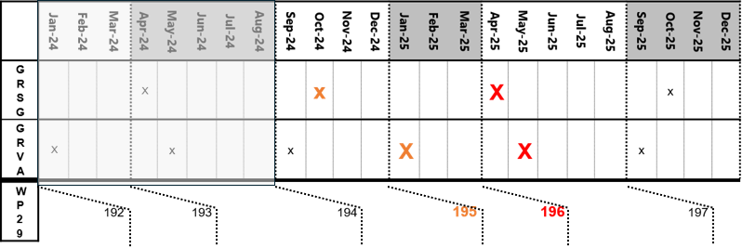
Timeline planning
(below is a tentative timeline; the schedule of meetings, and adoption of working documents, is the prerogative of WP.29 and its subsidiary Working Parties
– Text and table modified from informal document WP.29-192-17 with permission
Formal document to GRSG (129th session)
Formal document to GRVA (22nd session)
Formal document to WP.29 (196th session)

Slide 10
Confirmed Meeting Schedule / Deliverables: July - Dec 2024
7th Meeting
17 July
(Online only)
8th Meeting
16th September
(Online)
9th Meeting
1st & 2nd October
(Hybrid Hamburg)
10th Meeting
7th & 8th November
(Hybrid Shanghai)
11th Meeting
2nd December
(online)
Jul 24
Sep 24
Oct 24
Nov 24
Dec 24
Status report to GRVA
23th – 27th September
Status report and informal document
GRSG
7th – 11th October
Status report and informal document
WP.29
December

Slide 11
Provisional Meeting Schedule / Deliverables: Jan - June 2025
12th Meeting
20th January
(online)
13th Meeting
17th & 18th February
(hybrid | tbd)
15th Meeting
24th March
(online)
16th Meeting
? April
(online)
15th Meeting
? May
(online)
Jan 25
Feb 25
Mar 25
Apr 25
May 25
GRVA
WP.29
GRSG
GRVA

