Slide 1
Submitted by the experts from The International Automotive Lighting and Light Signalling Expert Group (GTB)
Informal document GRE-91-04
91st GRE, 22-25 October 2024,
agenda item 7 (b)
GTB analysis of the Chinese questions submitted at the 90th GRE session (doc. GRE-90-29) regarding the interpretation of UN R149

Slide 2
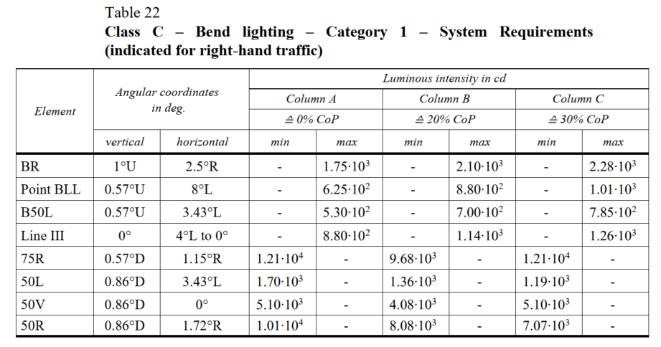
ECE R149-01
12100*(1-30%)=8470
8.47•10³
3.57•10³
5100*(1-30%)=3570
These are clearly “copy/paste” errors.
The proposed modifications were adopted at GRE-90 and are now in doc. WP.29/2024/100

Slide 3
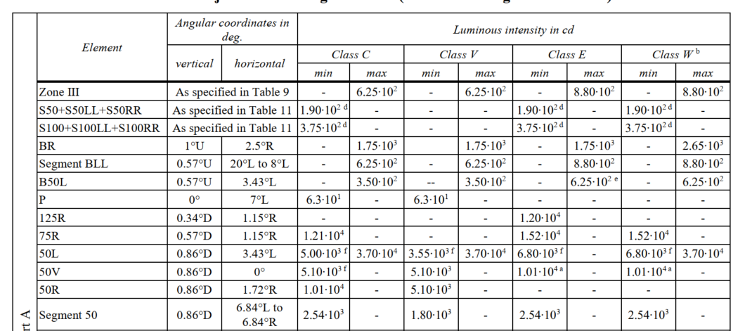
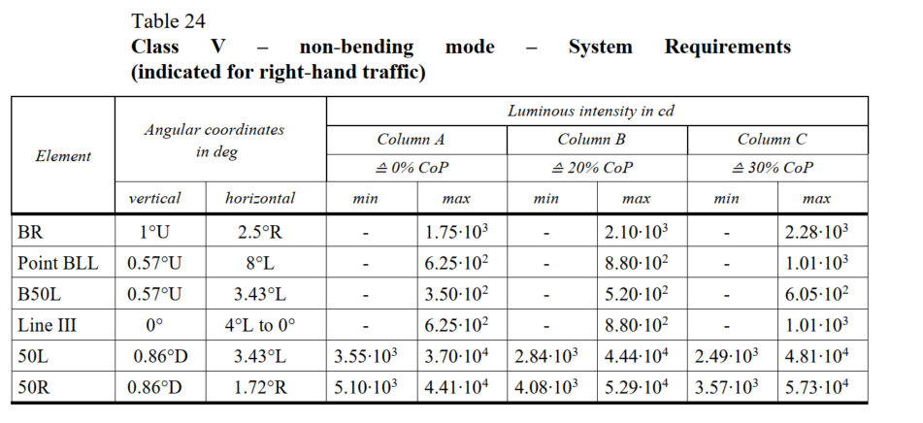
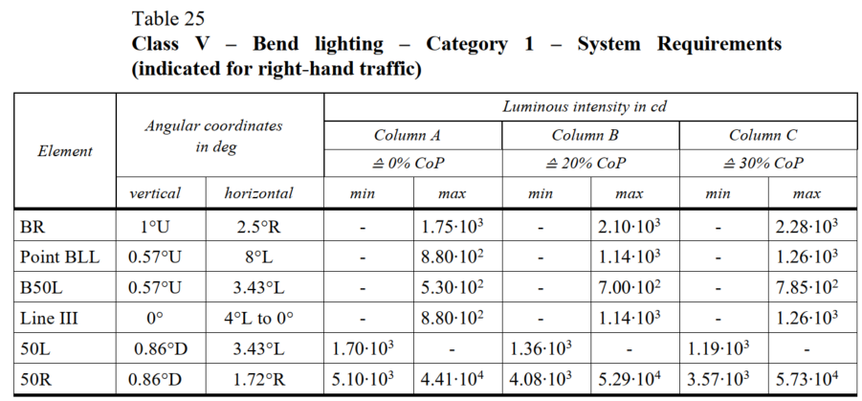
ECE R149-01
For type approval :
The Max value for class V is specified in the Zone Imax
There is no maximum value requirement for the 50R point of V class in low beam light distribution table 7, but there is a maximum value requirement for V class in production consistency.
It is recommended to cancel the maximum value requirement for V class production consistency in Table 24 and Table 25.
For COP :
The checking of Imax performance is intentionally reduced to one point (50R) in order to limit the time for measurement.
No correction is needed

Slide 4
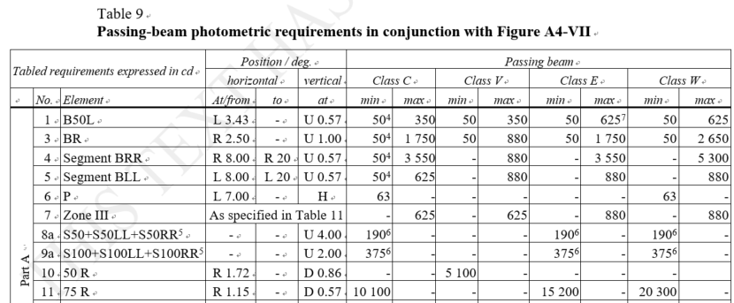
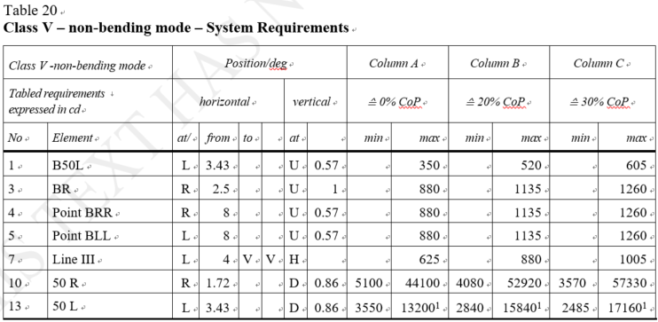
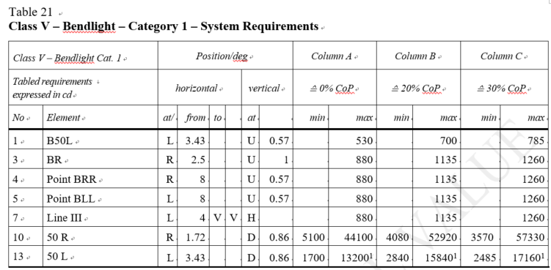
ECE R149-00
There is no maximum value requirement for the 50R point of V class in the adaptive low-beam light distribution table 9, but there is a maximum value requirement for V class in production consistency.
It is recommended to cancel the maximum value requirement for V class production consistency in Table 20 and Table 21.
No correction is needed
(Same reason as for previous slide)

Slide 5
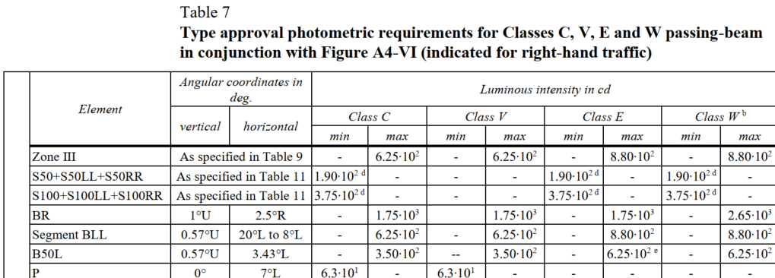
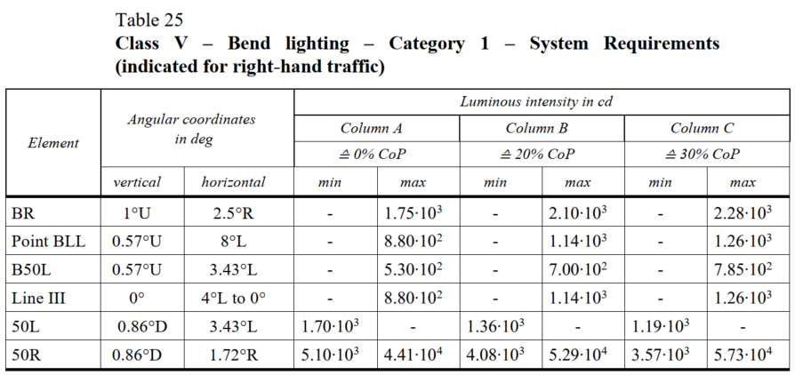
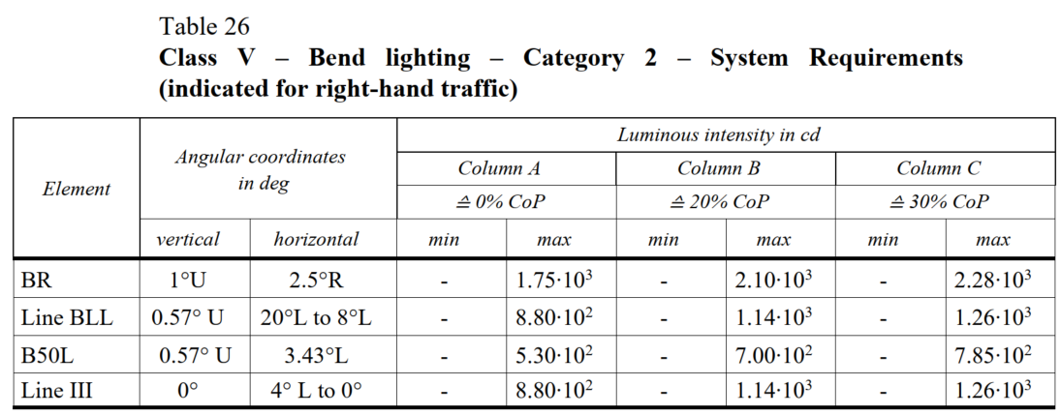
ECE R149-01
For type approval:
Max value for BLL was changed from R123/R149-00 (880 cd) to R149-01 (625 cd) – this change was intentional
The maximum Segment BLL requirement for class V in the adaptive low-beam light distribution table 7 is 6.25·10², but the maximum requirement for 0%CoP of class V in the production consistency tables 25 and 26 is 8.80·10².
It is recommended to update Tables 25 and 26 The maximum value requirement for class V production consistency in Table 26 is 6.25·10², and its corresponding 20%CoP and 30%CoP values.
Correction of R149-01 in Tables 25 and 26 is required. → See doc. GRE/2024/19 from GTB
This change was not reported to the class V bend lighting cat1 and cat2.

