Slide 1
Transmitted by the IWG on IWVTA
Informal document WP.29-193-15*
193rd WP.29, 25-28 June 2024
Agenda item 4.3
Report to the 193rd WP.29 session
from the 45th IWG on IWVTA
* Reissued on 2 July 2024 for technical reasons

Slide 2
◼Please consider the following item.
  IWVTA IWG submitted a Formal Document regarding amendments to Transitional Provisions Guidelines.
    The term “preceding series” as singular or plural
    C.9. and C.9.bis. Amendment
    Special case 1-1,1-2,1-3
  IWVTA IWG submitted an Informal proposal regarding amendments to UN R0/07 series. It is an annual update on UN Regulations applicable to IWVTA.

Slide 3
◼Please take note of the following items.
  Consulted by DETA IWG, IWVTA IWG is considering amending the 1958 Agreement (Schedule 5):
  “the approval markings required by UN Regulations may be replaced by a Unique Identifier (UI) preceded by the symbol ,if unless explicitly specified otherwise in the UN Regulations and subject to the availability of the corresponding feature in the secure internet database.”
  IWVTA IWG agreed the method how to notify the acceptance of L-IWVTA in case the concerned UN R is “unnecessary for L-IWVTA” using Doc343, specifically its columns and footnotes.
UI

Slide 4
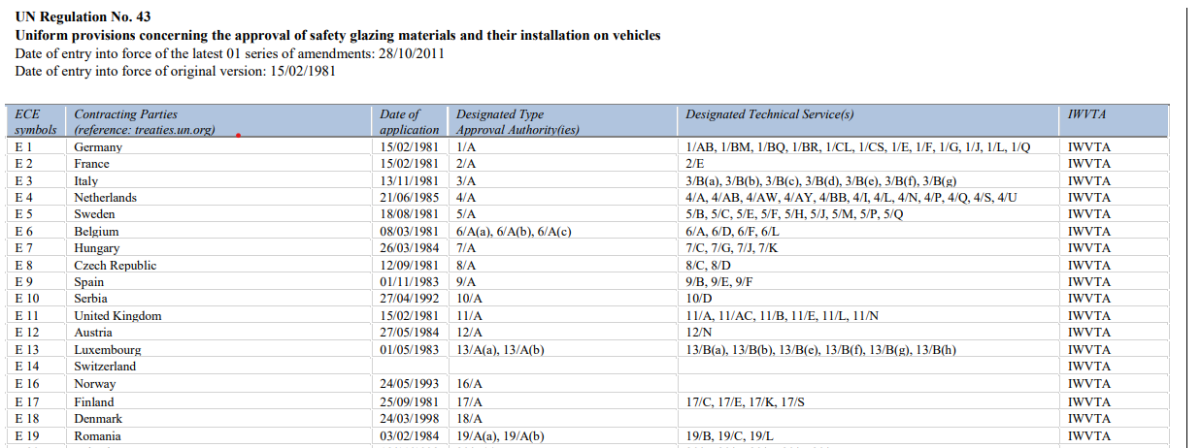
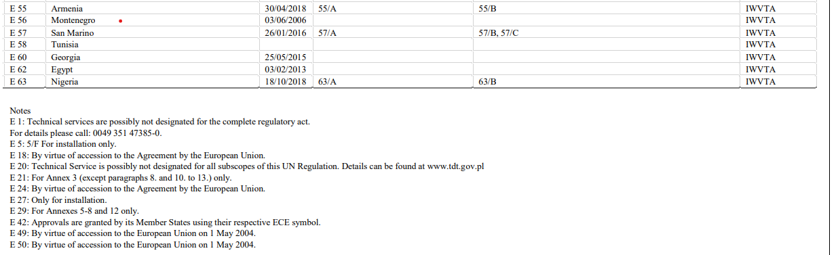
(Example Screen of Doc343 Platform)
Footnotes
Column
“unnecessary
for L-IWVTA”
“IWVTA”

