Slide 1
Item 4: Outcome of recent capacity-building workshops
(12 December 2023 &
23 January 2024)
Paul Vare Academic Advisor to UNECE Steering Committee on ESD
Chair of National Association for Environmental Education, UK
UNECE Steering Committee on Education for Sustainable Development
Nineteenth meeting
Geneva, 29, 30 and 31 May 2024

Slide 2
Workshop 1
We introduced the revised reporting format
Issues with reporting were discussed with examples from completed NIRs
We worked in groups to discuss the ‘four strands’

Slide 3
Some key points from former reports:
Start early – be sure you have the latest version of the format
Be concise – avoid unnecessary detail
Explain why you are leaving a question unanswered
Complete the appendices
Don’t forget ISCED Levels 4 and 5 (TVET)
Think beyond ‘environmental’ examples
Involve a wide range of stakeholders… but…
…if you share questions, always explain and discuss them

Slide 4
Issues related to the Four Priority Areas (The 4 Strands)

Slide 5
Strand 1: Quality education and ESD
Refer to earlier questions (sub-indicators 1.2.3; 1.2.4; 2.4.3); there is no need to repeat the information
Check to see if ESD is included in measures of ‘what makes good quality education’
Are those who inspect education trained in ESD?
Q. Who are education quality professionals…? (see next slide)

Slide 6
Quality education professionals are…
…those people who oversee quality enhancement and assurance, setting of professional standards, setting learner or teacher competences, certification of centres, organisations or programmes.
They work in formal and non-formal settings and are trained to recognise good practice, support educational change and ensure equal opportunities across the educational systems – but may not have encountered ESD.

Slide 7
Strand 2: Whole-institutional approach (WIA)
Refer to earlier questions (sub-indicators 2.3.1 (a) & (b); 2.3.2); there is no need to repeat the information
If whole school approaches are assessed for quality, that may be covered by Strand 1
Include non-formal education – the Ministry of Environment may have more information on this than the Ministry of Education.

Slide 8
Strand 3: Digital education, ICT and ESD
Refer to earlier questions (sub-indicators 2.5.4; 4.1.3); there is no need to repeat the information
S3.4 refers to the issue of ‘fake news’ (misinformation); this should include issues such as ‘deep fakes’ and artificial intelligence (AI).

Slide 9
Strand 4: Entrepreneurship, employment, innovation and ESD
Refer to earlier questions (sub-indicators 2.5.2; 2.5.3; 2.5.5; 2.5.6); there is no need to repeat the information
Look for examples where ESD and entrepreneurship are combined or where they overlap
Issue: How to select best approaches to include in the report…
See Most Significant Changes technique in Guidelines document.

Slide 10
Workshop 2
We focused on stakeholder engagement
We shared examples from around the region
We worked in groups to discuss:
Identifying stakeholders
Different roles of stakeholders
Working with stakeholders

Slide 11
Examples of good practice in stakeholder engagement in ESD reporting
Germany
Greece
Kyrgyzstan
Montenegro
Netherlands
Carpathian Convention
Thank you for your presentations ☺

Slide 12
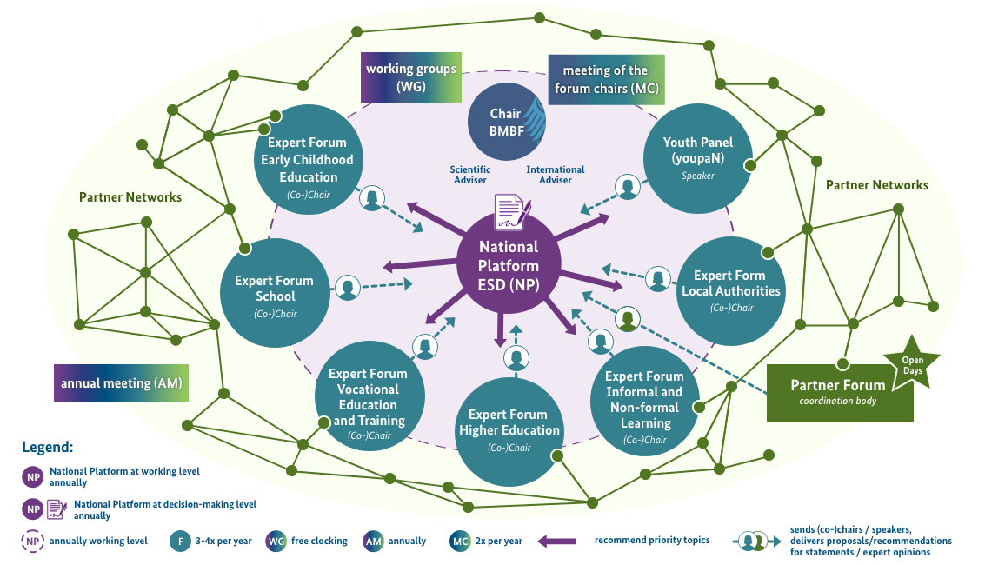
Context: ESD 2030-Implementation Structures Germany

Slide 13
Some issues arising from stakeholder engagement examples
It takes time… especially to build trust
The reporting format has become more detailed; only introduce relevant questions or sections
Managing the numbers of stakeholders can be daunting (they want to work with you because you’re the Government!)
Break down the main forum into sub-groups to manage different sectors and phases of education.

Slide 14
The wisdom of Group 1
Start with an initial mapping exercise
Establish specific procedures with relevant ministries so that this is transparent
Relevant work may not always be labelled ‘ESD’ or ‘environmental’
Collaboration is complicated – know the background history
Research: makes ESD visible and useful for evaluation.

Slide 15
Wise words from Group 2
Groups can help with data collection
Be sure to include under-represented groups
Consider geographical coverage
Beware of ‘self-reporting’ by groups; look for external evaluations
Involve existing ESD networks to avoid duplicating efforts.

Slide 16
More intelligence from Group 3
Establish a forum with different sub-groups (e.g. Italy and Germany)
Work on inter-ministerial collaboration (e.g. expert or informal level)
Do not forget the private sector!
Be flexible: allocate work to smaller groups to get things done; make bigger groups to overcome clashes.

Slide 17
Italy: National Forum for sustainable development - Structure
Collaborations
WG
Planet
Processes
WG Prosperity
Coordination Group
Nomina
Partecipa
Convoca
WG
People
Technical Support
WG
Peace
Universities
Innovative Partnerships and co-design
WG Youth
Institutional Collaboration (at international, national regional ad local level)
Regional Fora
WG Culture for sustainability
Policy Coherence
Steering Committee
Tools
Organization and procedures
(Regulation)
Events by the Forum
Events by territorial institutions
High level Political Forum
National Conference on Sustainable Development
Information Platform

Slide 18
Forum Composition
Member organisations actively participate in the Forum and animate 6 Working Groups.
The Coordination Group is composed of the coordinators of the Working Groups, as well as of representatives of main network organisations (for widest representativeness)
34
WG Prosperity
The Forum is composed of wide-ranging and heterogeneous voices representing the different realities of the Country – i.e., networks and associations from the voluntary and environmental sectors, youth, academia, as well as organisations from the world of labour, social economy, and small and medium- sized enterprises.
64
WG Planet
WG Culture for sustainability
68
29
WG Peace
17
WG People
Youth Representatives from other groups
WG Youth

Slide 19
And finally…
There is no perfect way to complete the reporting format but there is a wrong way… which is to not complete it.
Involving stakeholders can look like hard work – but they can help with the reporting task – and they will make your report brilliant!
Good luck!

Slide 20
Questions?
Thank you!

Slide 21
Agenda Item 5:
The UNECE ESD Reporting Format &
Guidelines document
Paul Vare Academic Advisor to UNECE Steering Committee on ESD
Chair of National Association for Environmental Education, UK
UNECE Steering Committee on Education for Sustainable Development
Nineteenth meeting
Geneva, 29, 30 and 31 May 2024

Slide 22
About the reporting format
This is not a competition
The aim is to learn from each other (Share your challenges too! If we report perfection, we have nothing to learn)
The reporting format is a questionnaire in 3 parts:
Part 1: The same format (with some changes) – we need your newest information
Part 2: The four priority strands
Part 3: A summary checklist of tick-boxes

