Slide 1
GRPE Workshop
24th May 2024, Session No.1
Power Determination Regulation of Korea
24th May. 2024

Slide 2
Current States on Power Determination Regulation of Korea
KMVSS No. 106
Scope and Application
- All Passenger vehicles, Buses and Trucks
- All ICE(Internal Combustion Engine), Electric drive train and REESS(rechargeable energy storage system)
Requirement
- ICE
- Electric drive train
-
Items | Tolerance (Initial Registratio) | Reference (UN R85) |  | Market Survailence | Reference (UN R85, CoP)
Max. Power | ±2 % | ±2 % |  | ±5 % | ±5 %
Torque | ±4 % | ±4 % |  | ±5 % | ±5 %
RPM | ±1.5 % | ±2 % |  | ±5 % | ±5 %
Items | Tolerance (Initial Registratio) | Reference (UN R85) |  | Market Survailence | Reference (UN R85, CoP)
Max. Power | ±5.0 % | ±2 % |  | -5 % | ±5 %
30 Min. Power | ±5.0 % | ±2 % |  | -5 % | ±5 %
Torque | ±5.0 % | ±4 % |  | -5 % | ±5 %
RPM | ±2.0 % | ±2 % |  | -5 % | ±5 %

Slide 3
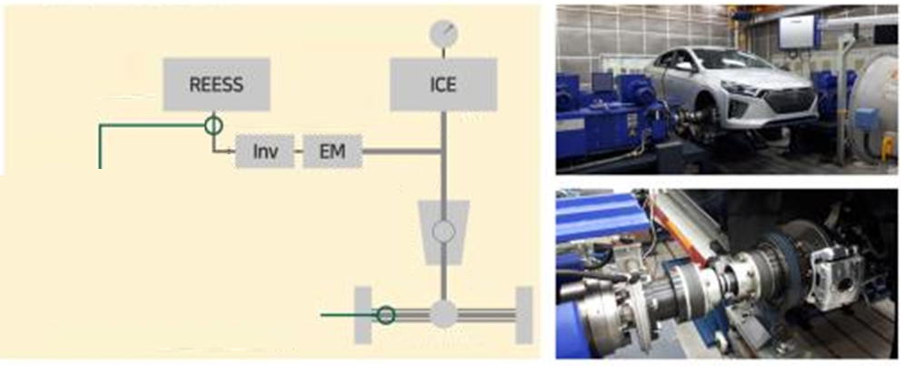
Stance for Applying System Power Determination of Korea
Draft Rules on the System Power Determination (UN GTR No.21)
- Scope (draft) : (3.5 tons or less) Hybrid vehicles and Pure electric vehicles(more than one propulsion energy converter)
Test facilities
Current States
- Prepared draft rules and facilities for introduction / Monitoring changes for harmonization
Measurement Point #1
Study Results (for reference)
KMVSS No.106 |  | Draft Rules
ICE | Motor | System Power
77kW | 32kW | 99kW
Measurement Point #2

