Slide 1
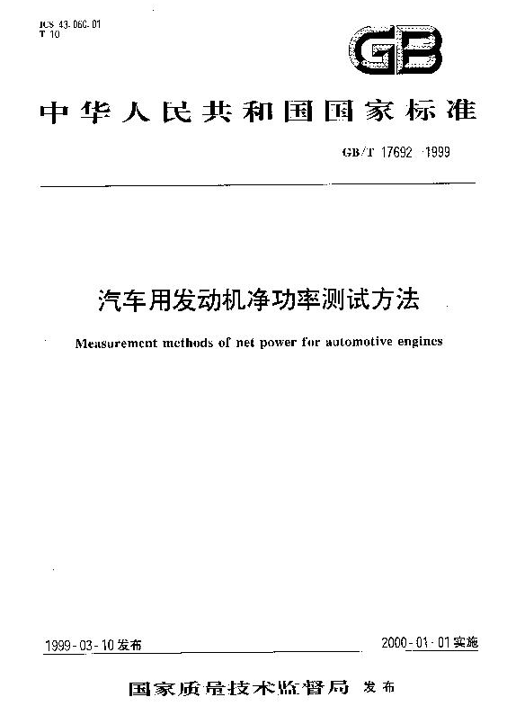
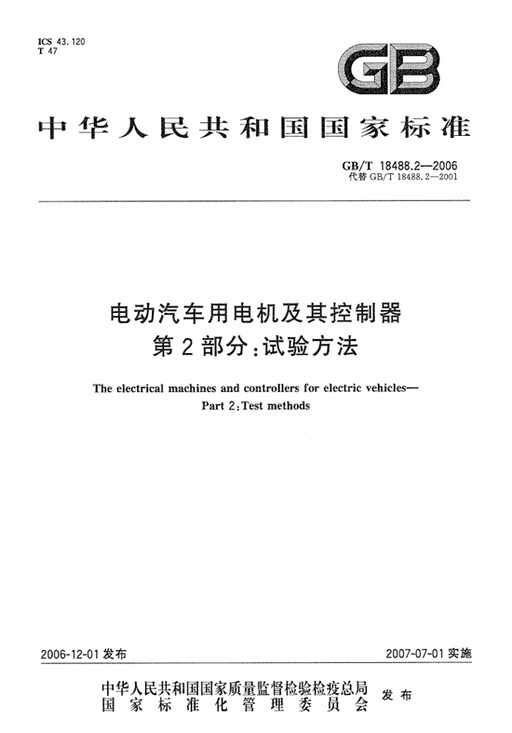
There are two GB/T standards corresponding to the internaional standard UN R 85.
GB/T 17692 Measurement methods of net power
for automotive enginge
UN R85
GB/T 18488 The electrical machines and controllers
for electric vehicles—Part 2：Test methods
（motor power）

Slide 2
UN R85 and GB/T 18488
 | ECE R85 | GB/T 18488 | GB/T 17692
Test item | 1）maximum net power in 30 minutes 2）maximum net power | 1、general item 2、The input and output characteristics 3、enviroment adaptation 4、safty 5、EMC | 1、 The input and output characteristics
Judgment | The maximum net power and maximum net power in 30 minutes are allowed to differ from the declared value by ±5% | The input and output characteristics must be greater than the values specified in the product technical documents | The output characteristics must be greater than the values specified in the product technical documents
Application | EU Product certification and type approval | China motor certification and type approval | China engine certification and type approval

Slide 3
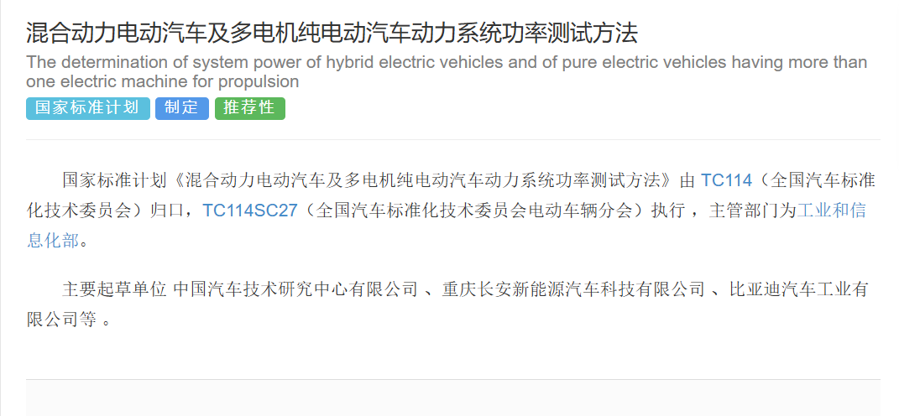
The Chinese GB/T corresponding to GTR21 has been setted on 2023 12.25th.
The name of GB/T: The determination of system power of hybrid electric vehicles and of pure electric vehicles having more than one electric machine for propulsion-Test method.
We will consider the Chinese product characteristics and formulate chinese standards

Slide 4
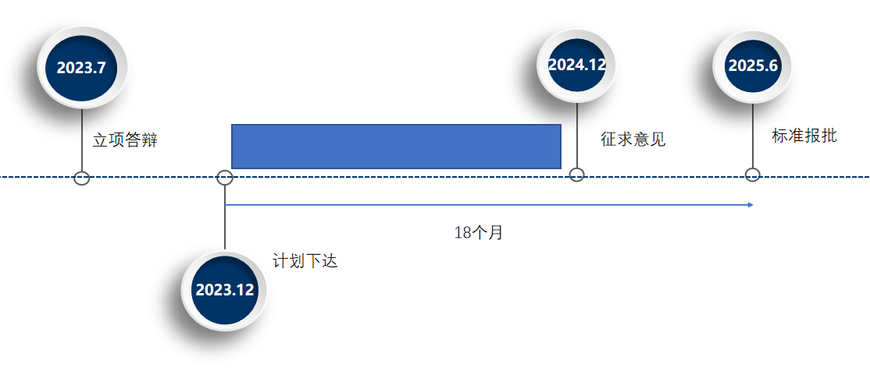
As the standard plan, the standard “The determination of system power of hybrid electric vehicles and of pure
electric vehicles having more than one electric machine for propulsion-Test method” will be finished in June 2025.

