Slide 1
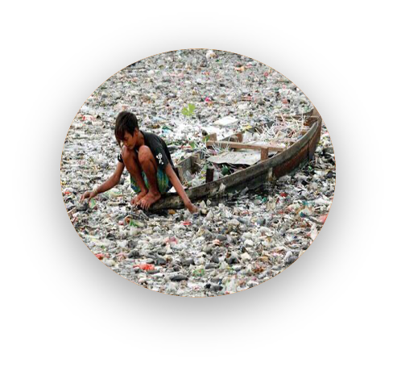
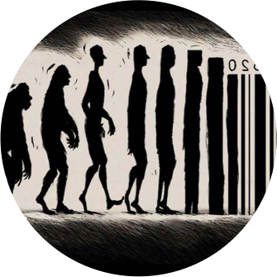
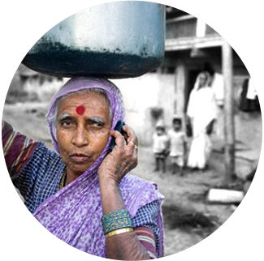
Strand 2: “Whole institution approach and education for sustainable development” - Framework and Toolkit Arjen Wals (1) & Hak van Nispen (2) (1)Wageningen University/UNESCO Chair/Norwegian Life Science University (2) SME Advies

Slide 2
Programme
3.00 Introduction: Welcome and overview of workshop
3.10 Framing Policy-Frameworks for advancing the WIA to sustainability – what do we mean? What do we need?
Brief intermezzo by Vítězslav Slíva – Tools for Walking the Talk
3.45 The WIA Toolkit: A conversation about the architecture and design principles – using the WIA Cards
4.20 Synthesis: Key messages from the workshop for future development and implementation with Simon Herteleer and Members of the UNECE ESD Youth Platform
4.30 Close

Slide 3
The Tasks at Hand
A comprehensive framework for the development, implementation and evaluation of the WIA will be designed to address a diverse array of contexts, particularly targeting educational policymakers, leadership and governance bodies.
A compilation of best practices derived from an extensive review of WSA practices across ECE member States, , along with exemplary practices on each component of the WIA.
Guidelines to assist various stakeholders including policymakers at national, regional and local levels, school leaders, educational institutions, NGOs, civil society organizations, coordinators, HRM officers and teachers.
A Toolkit on WIA (WSA) in relation to ESD

Slide 4
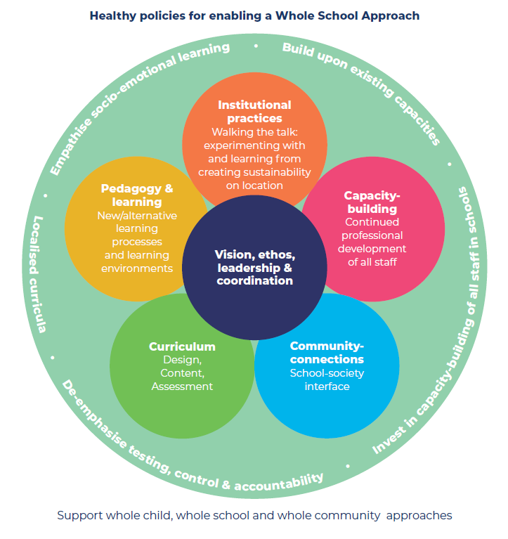
Healthy policies for enabling a Whole School Approach, adapted from Wals & Mathie (2022)
Notes:
Will you summarise each strand of the WSA flower using this slide? I’ll leave it up t you Arjen to do this bit but I haven’t added any more slides as think this one could be used

Slide 5
Some questions to ponder
What constitutes a policy-framework? (key elements) What levels to include? Who and where do we find these policy-makers? Does it mean the same in different countries?
What might be key differences when considering the WSA-flower between Early Childhood and Care, Primary and Secondary Education, Vocational Education and Training and Higher Education? Does the flower need adaptation?
How to engage stakeholders in the development of both the framework and the toolkit, especially children and youth?
What kind of ´consultative´ process might work best to increase actual use of the framework within the UNECE member states? (who to involve? how? what to ask?)

Slide 6
Quick chat In small groups pick one of the questions and try to find some common ground or areas of contention (or both) - be prepared to share a very short reflection

