Slide 1
Hybrid GRPE workshop on the global harmonization of Heavy Duty fuel economy, energy consumption and range determination
Session 2 : First elements to be considered for global harmonization
- Component testing as part of HDV FE regulatory frameworks -
Yoshihide Takenaka
OICA
HD-FE TF

Slide 2
ITEMS
Engine measurement
Aero drag measurement
Tire rolling resistance measurement
Others (Gear, AT parts)

Slide 3

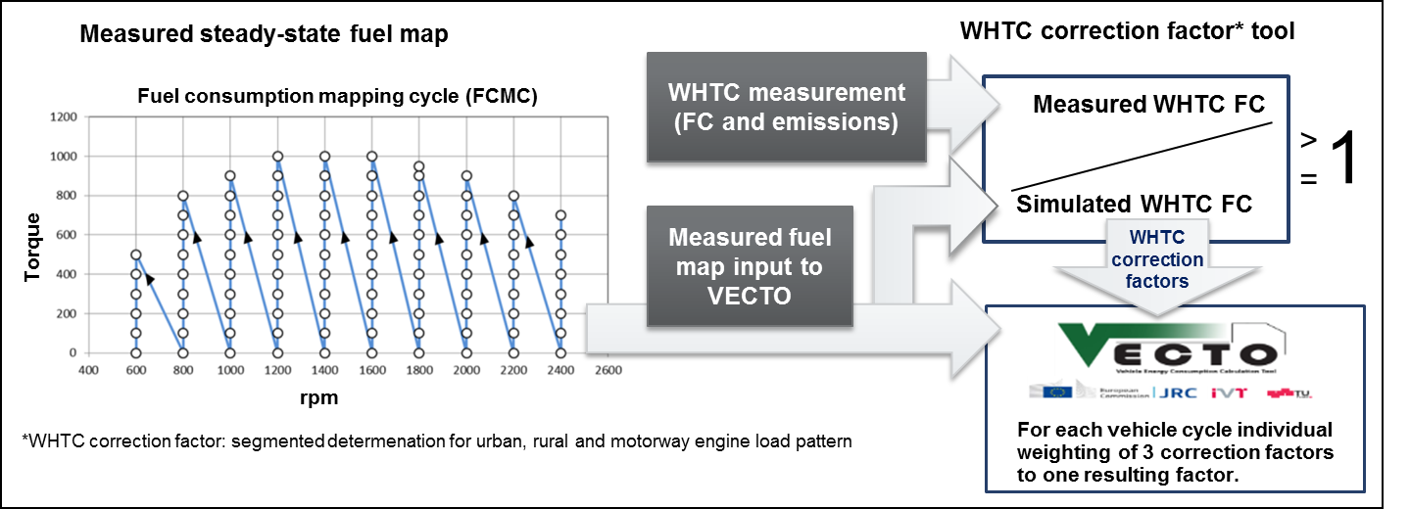
Measurement : Engine
Steady state engine map
A steady-state fuel map covers the whole engine load/speed range which is needed to provide realistic CO2 simulation results. Approximately 100 test points are needed. A defined fuel consumption mapping cycle (FCMC) should be added to the emission certification test cycles.
For representative consideration of transient engine behavior in the VECTO simulation and to secure consistency with criteria emissions a correction procedure is proposed. This procedure is based on the transient emission test cycle WHTC.
Number of points, measuring order, and measuring process like sweep time and measuring time, etc.

Slide 4

Cycle Average Method
Cycle Average Method is based on the map from transient mode experiment result with engine and T/M or HV parts.

Slide 5
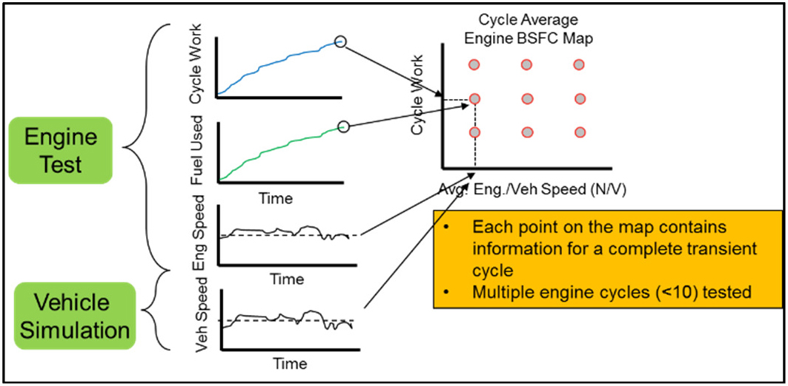
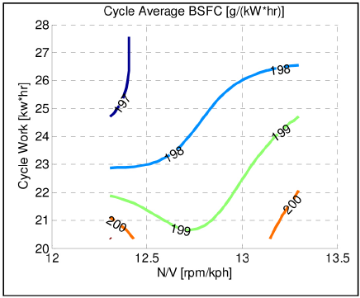
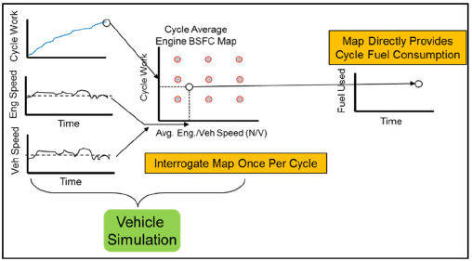
Cycle Average Generation and Usage
Process to generate
cycle average map
Example of
CA map
Usage of CA map in simulation

Slide 6
Cycle Average Map Input Data
Defined Class 2b through Class 7 vocational vehicle configurations for GEM engine duty cycle generation, engine testing and GEM interpolation

Slide 7
Map and Mode Combination in Phase 2
Vehicle type | 55, 65 mph | ARB | Comment
Conventional vehicle w/MT | Steady state fuel map ( 70 points) | Cycle average map
 | Cycle average
Conventional vehicle w/AT, AMT | Steady state fuel map ( 70 points) | Cycle average map | Default AT and AMT logic in GEM is applied
 | Cycle average map | Cycle average map | Unique AT and AMT logic is available but Power train test is required
Hybrid vehicle | Cycle average map | Cycle average map

Slide 8

Measurement : Engine
Only steady state engine map is used in FE simulation. In the test of engine map, it is necessary to select at least 81 data points to measure the fuel consumption in the range of the normal speed of the engine, from 10% to 100% of the maximum torque.
The motored torque of engine is needed in the simulation of FE
The resistance information in FE simulation comes from coast down testing.

Slide 9

Measurement : Engine
1) Steady state engine map
Number of points, measuring order, and measuring process like sweep time and measuring time, etc.
Current FES
Next FES
Engine speed 6 ×Torque 5
+ Idling = 31points
Engine speed 10 ×Torque 5
+ Idling = 51points

Slide 10
Summary: Engine Measurement
Steady state fuel map is used in EU, Japan, China and part of US.
Number of points, measuring order, transitional condition are different but seems available to be harmonized as it will be determined by technical reason.
Cycle averaged map is based on transient mode operation and totally different policy. This may be a option for each government.
Transient co-efficient for the steady state map is introduced in EU and Japan.
Steady state map and cycle average map has quite different concept and may remain as option.

Slide 11
ITEMS
Engine measurement
Aero drag measurement
Tire rolling resistance measurement
Others(Gear, AT parts)

Slide 12
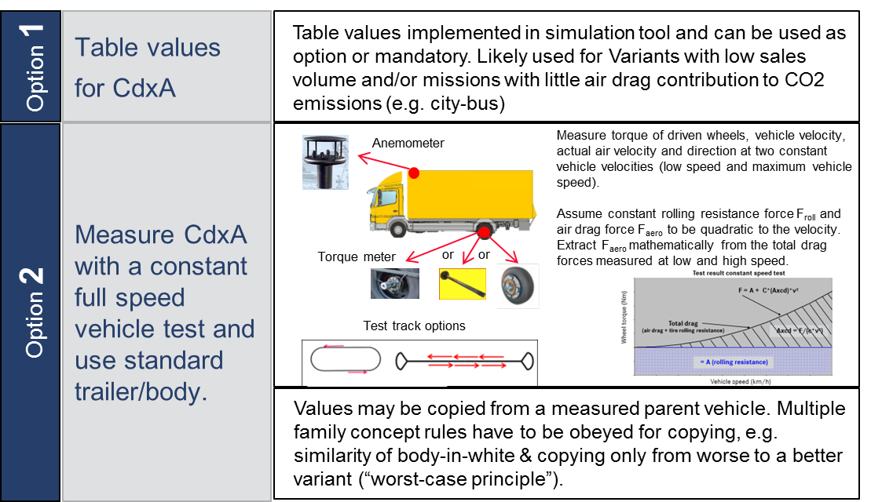
Measurement : Aero drag
The constant speed vehicle test was decided to be used for trucks and coaches. As the air drag is a full vehicle characteristic, a full vehicle test incl. body/trailer is needed.
Likely used for Variants with low sales volume and/or missions with little air drag contribution to CO2 emissions (e.g. city-bus)

Slide 13
Measurement : Aero drag
Coast down is major measurement method for aero drag.
Simulation and wind tunnel are available.
Bin is adopted for Cd value.

Slide 14
Measurement : Aero drag
Provided by manufacture with reasonable report, otherwise use the recommended CD value as following.
It is available for manufacture to use coast down or wind tunnel for aero drag measuremet.
Category | C_{D}
Truck | 0.8
Dumper | 0.8
Bus | 0.8
Coach | 0.65
Tractor | 0.65

Slide 15
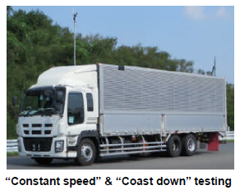
Measurement : Aero drag
Aero drag measurement method
  How to measure Cd coefficient like coast down, etc with correction using wind flow meter.
→ “Constant speed (with wheel torque meter)” and “Coast down “
“Anemometer” is Option
CFD and wind tunnel is also included. → N/A

Slide 16
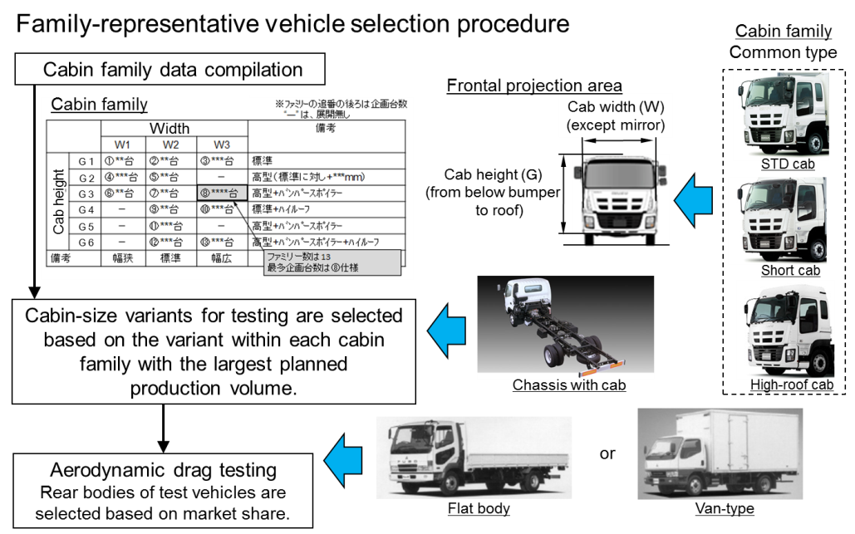
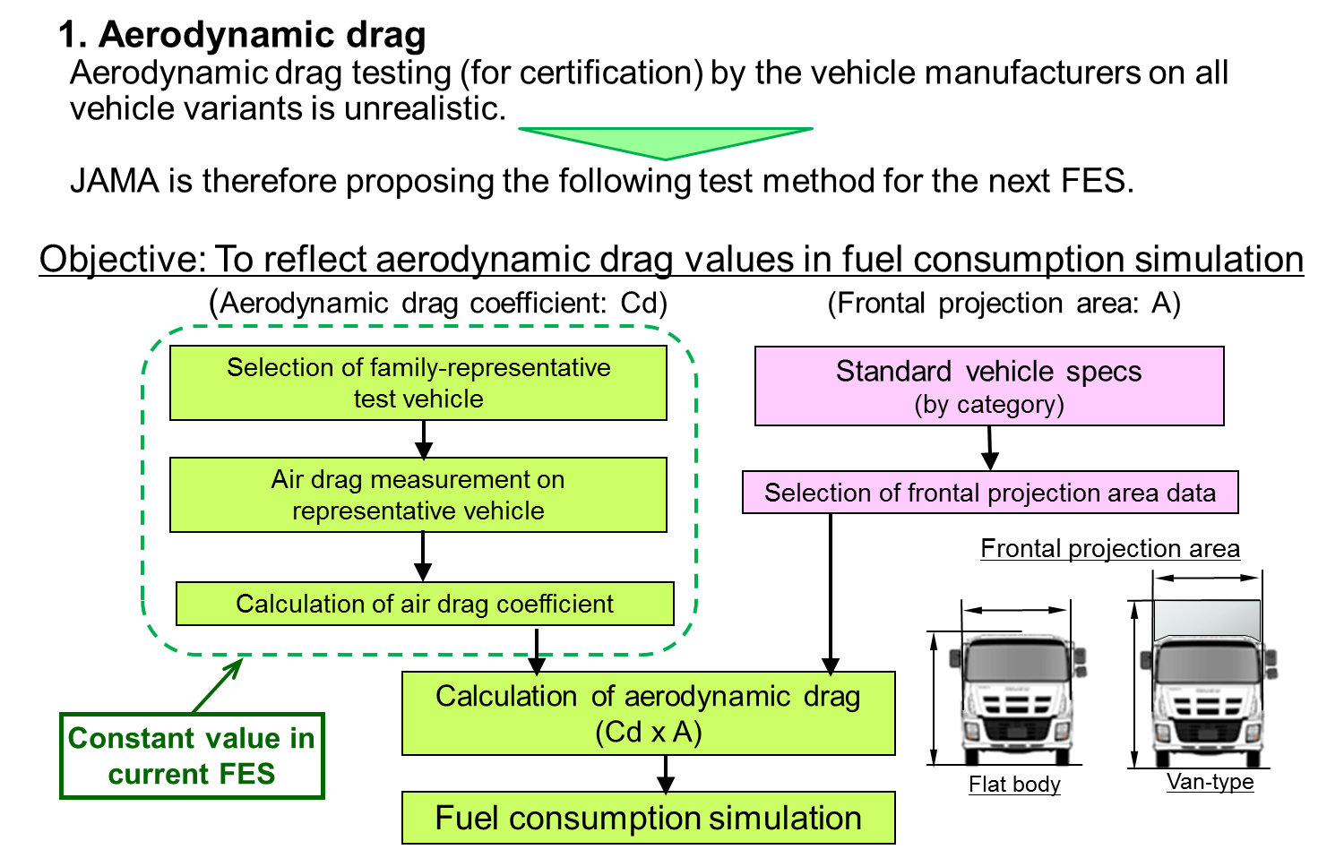
Measurement : Aero drag
Select method of cab and vehicle
  How to select or specify cabin and rear body should be included.

Slide 17
Summary of Aero Drag Measurement
EU adopted torque meter method mainly and CFD simulation as option.
Coast down, wind tunnel and CFD is adopted in US.
Coast down and wind tunnel are adopted in China.
Coast down and torque meter are adopted in Japan.
It will be possible to harmonize the aero drag measurement as common method is used in each area.

Slide 18
ITEMS
Engine measurement
Aero drag measurement
Tire rolling resistance measurement
Others(Gear, AT parts)

Slide 19
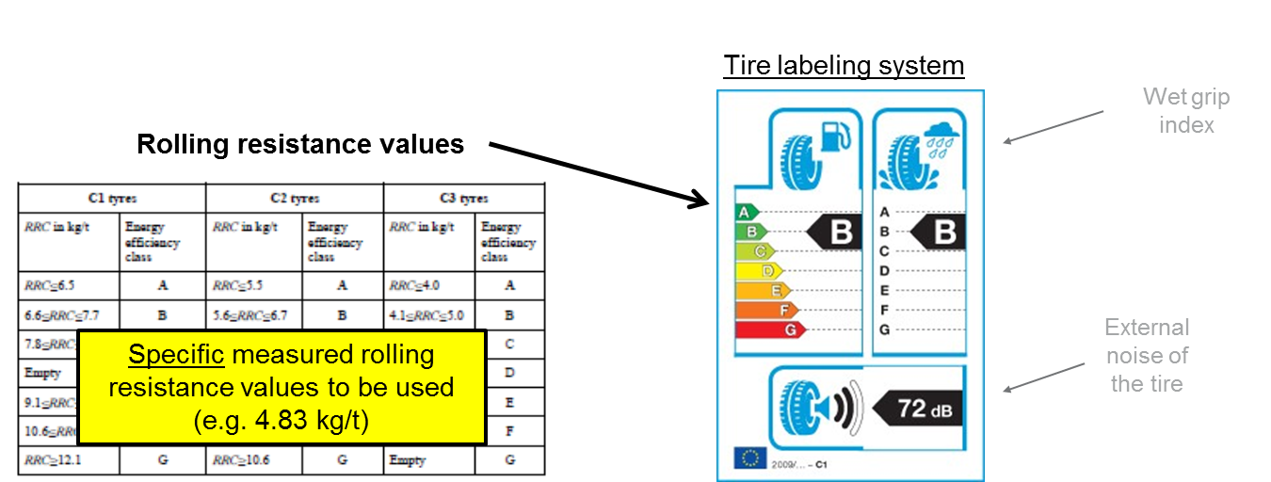
Measurement: Tire rolling resistance
The rolling resistance values from the tire labeling regulation shall be taken directly as input for the simulation.
How to measure → (EC) 1222/2009 = ISO28580

Slide 20
Measurement : Tire rolling resistance
Harmonized tire measurement method ISO28580 is adopted.
Direct value of measurement is used for simulation.

Slide 21

Measurement : Tire rolling resistance
Tire rolling resistance is determined according to:
Where V is vehicle speed in km/h

Slide 22
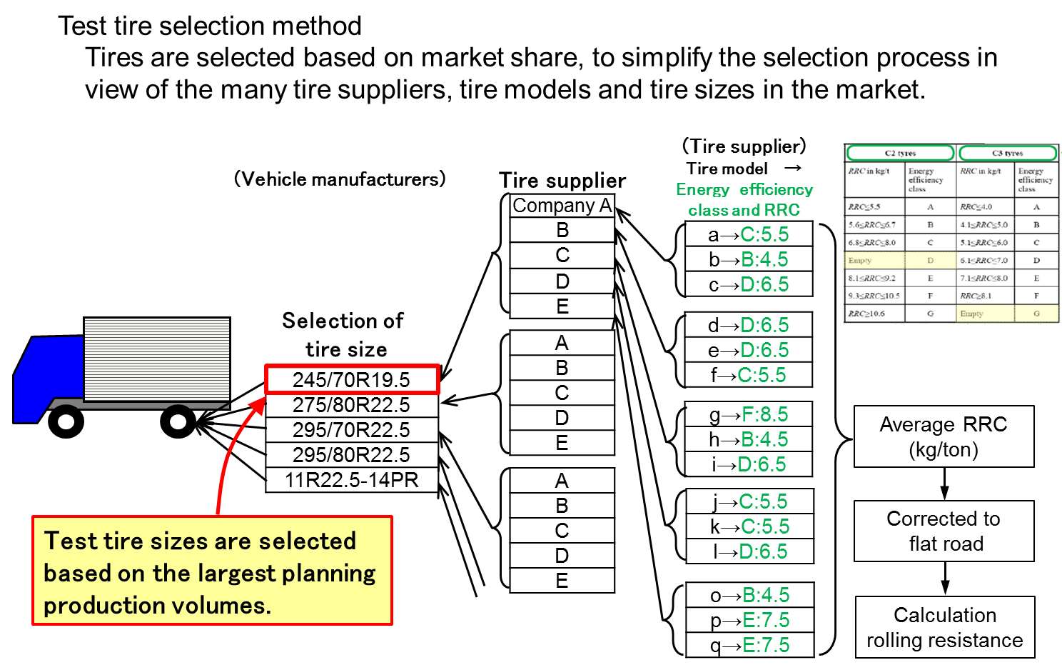
Measurement : Tire rolling resistance
Tire rolling resistance
  How to measure tire rolling resistance. → ISO28580
Resistance select method
  How to select the rolling resistance.
  Unique value of tire or value using ranking of tire.

Slide 23
Summary of Tire Rolling Resistance
Tire rolling resistance measurement method is already harmonized and provided by tire maker.
Remaining part to be harmonize is how to treat resistance value.
Direct value or value base on ranking is the point of harmonization.

Slide 24
ITEMS
Engine measurement
Aero drag measurement
Tire rolling resistance measurement
Others(Gear, AT parts)

Slide 25
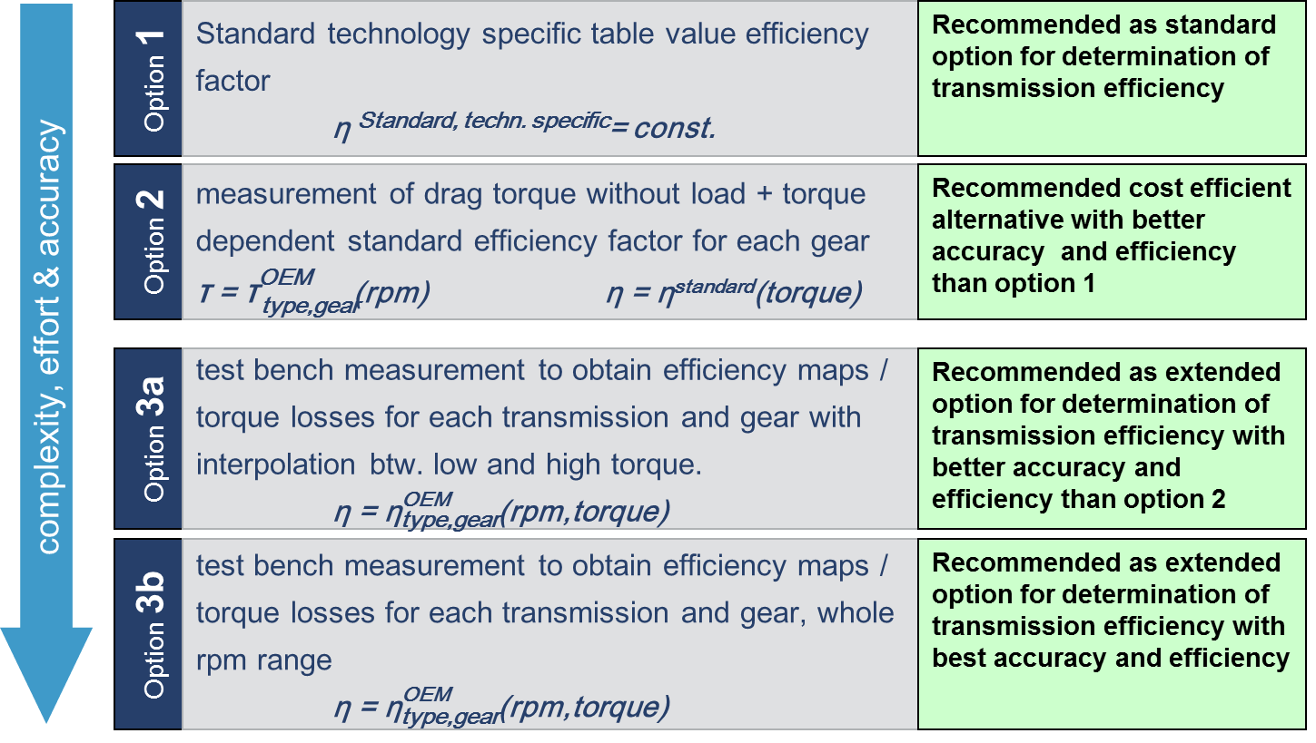
Measurement : Gear
1. Method to determine transmission losses
The vehicle manufacturer can choose from the following four options.

Slide 26
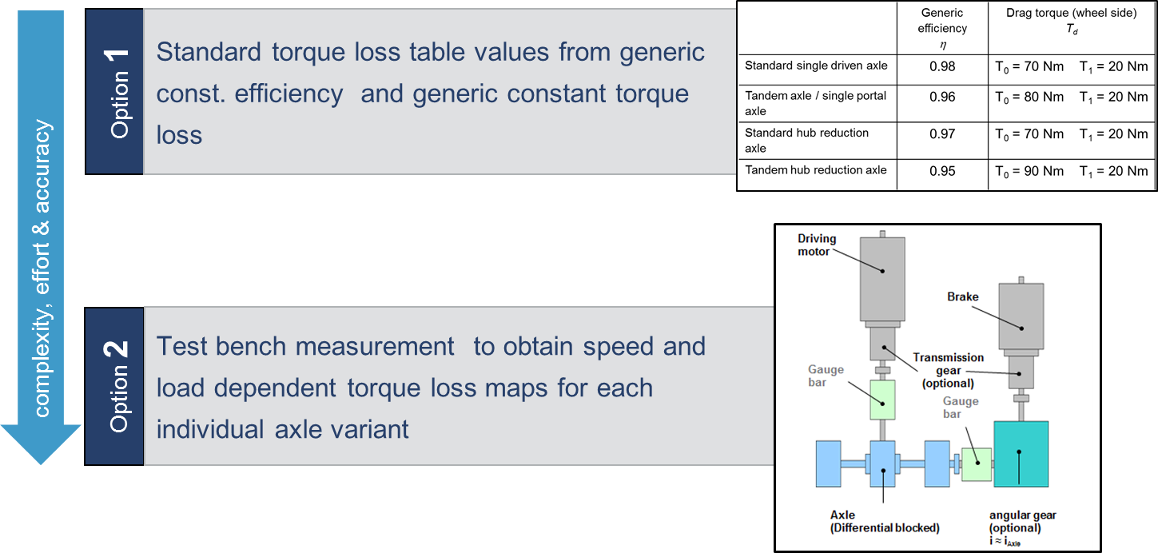
Measurement : Gear
2. Method to determine losses in driven axles
The vehicle manufacturer can choose from the following two options.

Slide 27
Conclusions

Slide 28
What to focus on as a first step for global harmonization
The driving force for global harmonization is to minimize the resources needed for certifying vehicles, resources in terms of:
Cost for performing tests.
Cost for certification administration.
Investments in test rigs.
Knowledge and competence building for test personal.
As a first step in harmonization, we should focus on harmonizing the component testing and/or simulations used for certifying the component input data.
If so, when methodology is harmonized, we could (in order of preference):
Use one certificate, approved in one market, for all markets.
Measurement data derived during one certification test in one market could be used for all markets but the component certificate to be issued on respective market.
If test data is not able to use outside the market where the test has been certified, at least use the same testing procedure but redo measurement for each market.

Slide 29
Components testing procedures to be consider for harmonization:
Engine efficiency
Air drag performance
  Physical testing procedure
  CFD simulation
Gear box efficiency and ratio
Rear axle efficiency and ratio
Tire RR
Wheel bearing
Auxiliaries
………
We also have component testing for ZEV vehicles that are subject for harmonization, such as:
Electric drive systems power and efficiency
Battery system capacity and efficiency
Fuel cell systems
……….

Slide 30
Possible next steps
Bring the topic at GRPE proper session to take official decisions
Verify the level of interest of GRPE Contracting Parties to create an Informal Working Group on FE Harmonization
Identify a Contracting Party available to take the leadership of the harmonization activities
Define the ToR of the IWG, decide the preferable solution for harmonization (UNR? GTR? Mutual Resolution? Other?)

Slide 31
Thank You for the attention!

