Slide 1
Energy consumption test methods for heavy-duty commercial vehicles in China
CATARC, 23.May 2024

Slide 2
Related standards
China has released energy consumption testing methods covering various types of fuel vehicles, including traditional fuel vehicles, hybrid electric vehicles, battery electric vehicles, fuel cell vehicles, natural gas vehicles and methanol vehicles.
1
Traditional fuel vehicles
4
Fuel cell vehicles
GB/T 27840-2021 Fuel consumption test methods for heavy-duty commercial vehicles
(First version issued in 2008)
GB/T 43252-2023 Test methods for energy consumption and range of fuel cell electric vehicles
(First version)
2
Hybrid electric vehicles
5
Natural gas vehicles
GB/T 19754-2021 Test methods for energy consumption of heavy-duty hybrid electric vehicles
(First version issued in 2005)
GB/T 29125-2012 Test methods for fuel consumption of CNG vehicles
(First version)
3
Battery electric vehicles
6
Methanol vehicles
GB/T 18386.2-2022 Test methods for energy consumption and range of electric vehicles - Part 2: Heavy-duty commercial vehicles
(First version issued in 2005)
QC/T 1130-2021 Measurement methods for fuel consumption of methanol vehicles
(First version)

Slide 3
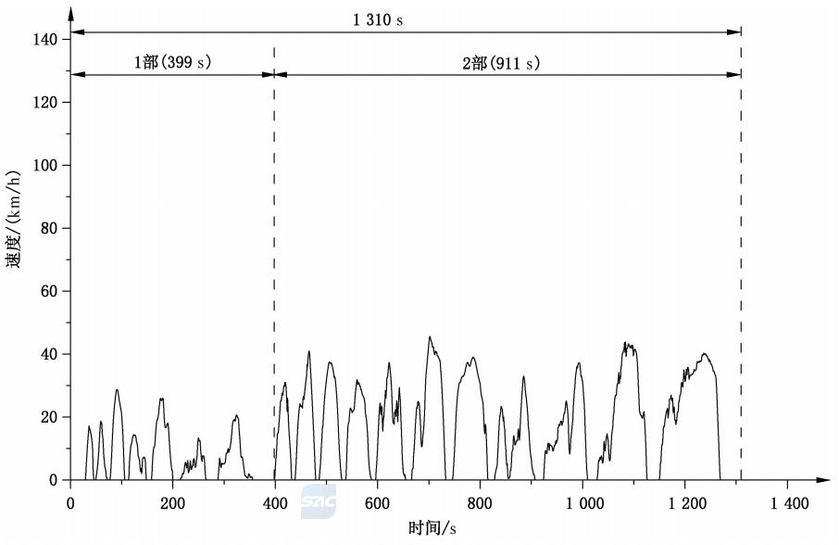
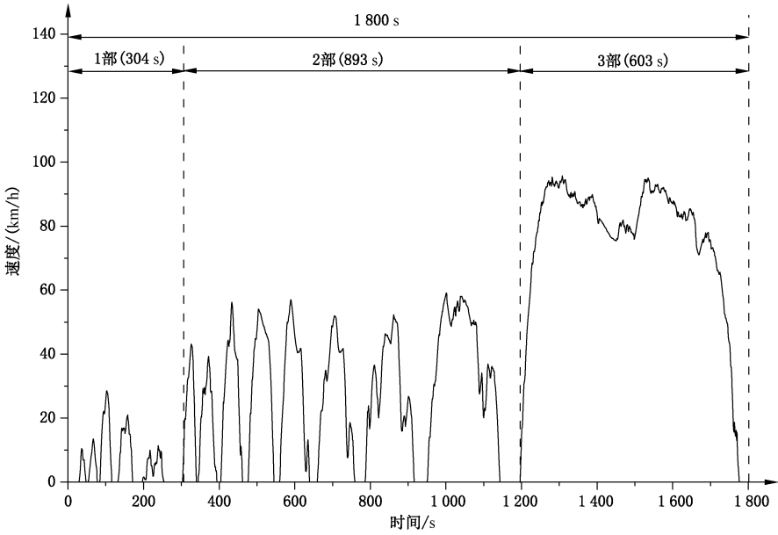
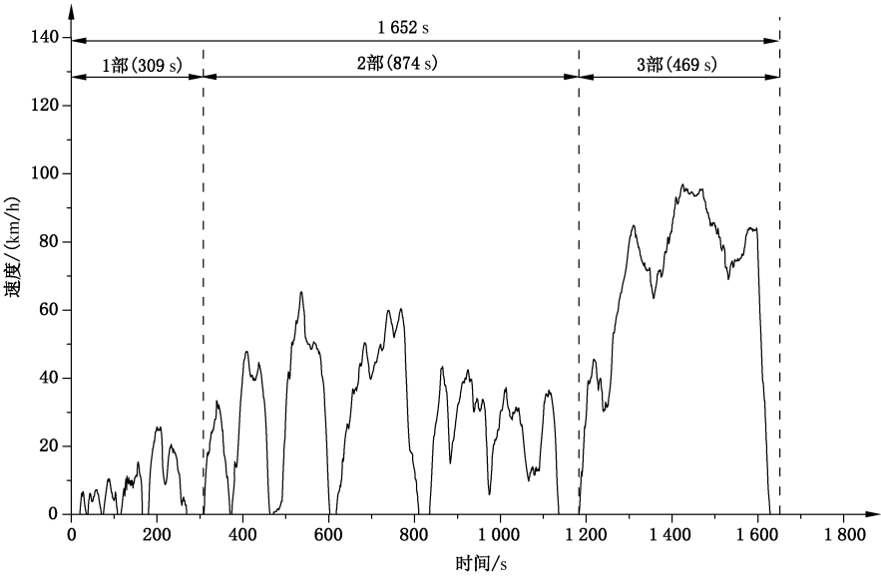
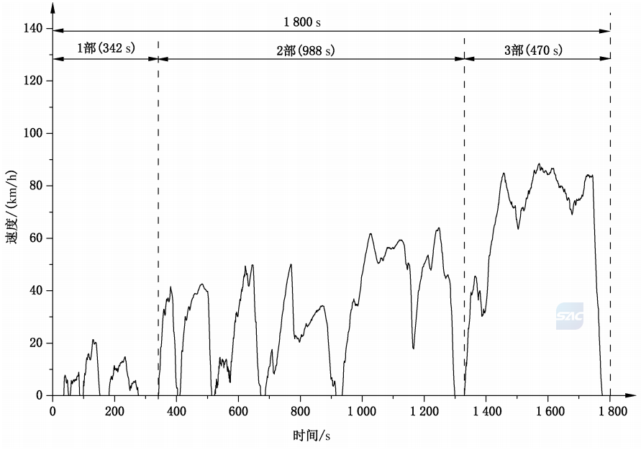
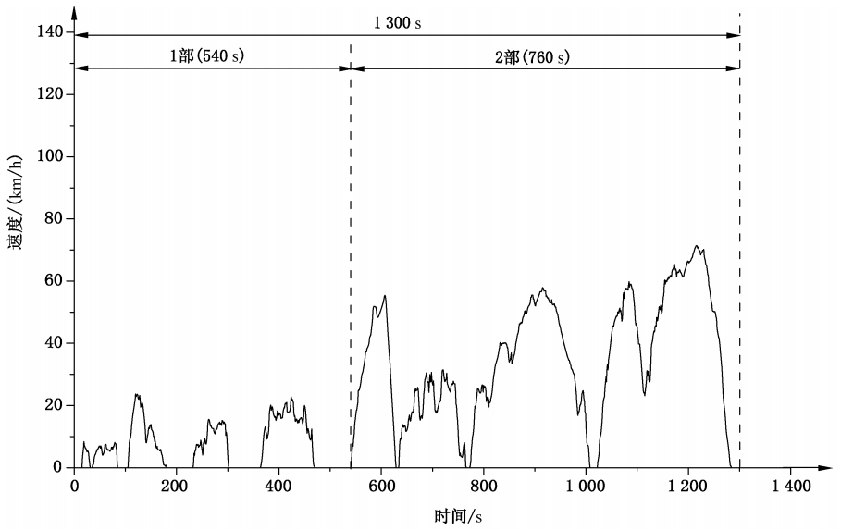
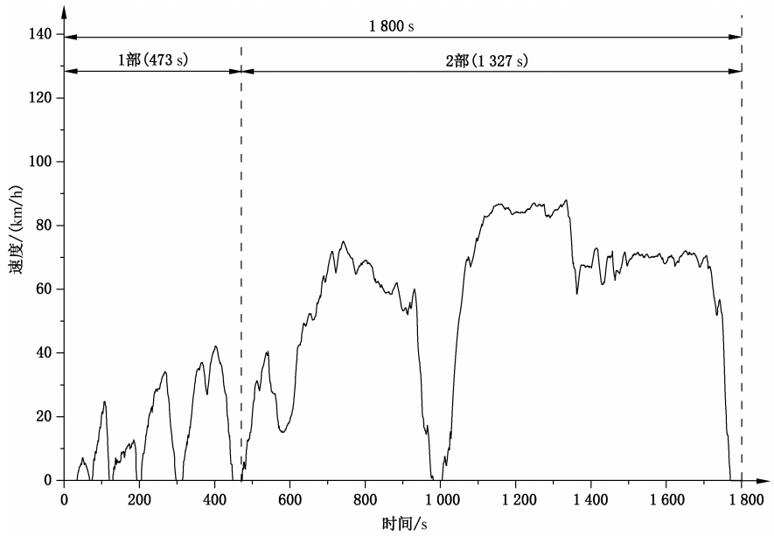
1. Traditional fuel vehicles
GB/T 27840 applies to vehicles fueled with gasoline or diesel with a technically permissible maximum laden mass exceeding 3,500 kg, including trucks, tractor-trailers, coaches, dumpers, and city buses
The tests should be conducted according to China Automotive Test Cycles, and vary for different vehicle types.
City buses
Coaches
Trucks (GVW≤5500kg）
Trucks (GVW>5500kg）
Dumpers
Tractor-trailers

Slide 4
1. Traditional fuel vehicles
Test requirements and procedure
Test methods
01
05
Gear shift
Basic vehicles should use chassis dynamometer method; Variant vehicles should have the option to use chassis dynamometer method or simulation method
Vehicles with energy-saving driving instructions can shift gears according to the corresponding instructions.
Road load
02
06
Test procedure
Coastdown method, torque meter method, lookup table method
The vehicle test should run 3 complete test cycles
Atmospheric temperature
03
07
Speed requirements
The recommended atmospheric temperature is 23 ℃± 5 ℃
The speed deviation is ± 3km/h. The single time exceeding the speed deviation should not exceed 2s, and the cumulative time should not exceed 15s
Preconditioning
04
08
Special treatment
It is advisable to conduct 1-2 complete test cycles or use other methods to fully preheat the test vehicle and chassis dynamometer
When the test vehicle cannot reach the acceleration or test speed required by the test cycles, the accelerator pedal should be fully pressed to the bottom, and this operation is not counted as a single or cumulative time exceeding the speed deviation

Slide 5
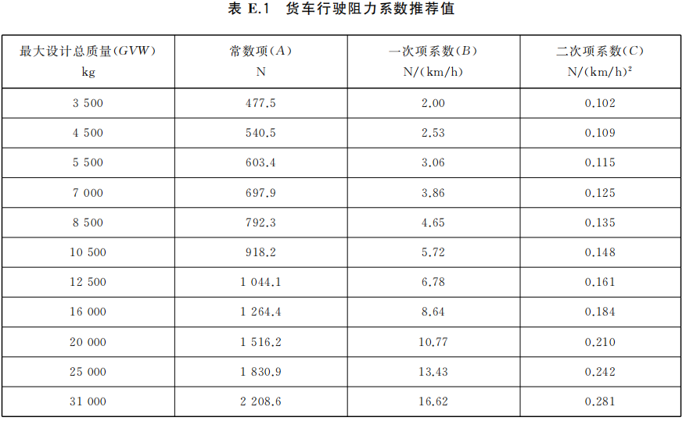
1. Traditional fuel vehicles
The road load
The determination of the road load of a test vehicle and the transfer of that road load to a chassis dynamometer:
Coastdown method
Torque meter method
Lookup table method
For vehicles with other gross vehicle weight, the interpolation method should be used.

Slide 6
1. Traditional fuel vehicles
Test results
Use one of the following three method：
01
It should be noted that, the National VI emission standard released in 2018 added vehicle emission testing. To achieve simultaneous test of fuel consumption and emissions, currently, the carbon balance method is commonly used
Carbon balance method
02
Weighing method
03
Volumetric method

Slide 7
2. Hybrid electric vehicles
The test cycles, road load setting, etc. are consistent with traditional fuel vehicles. For vehicles with a maximum speed lower than the base test cycle, the base cycle shall be modified in order to achieve the same cycle distance for the capped speed cycle as for the base cycle.
Example: City buses

Slide 8
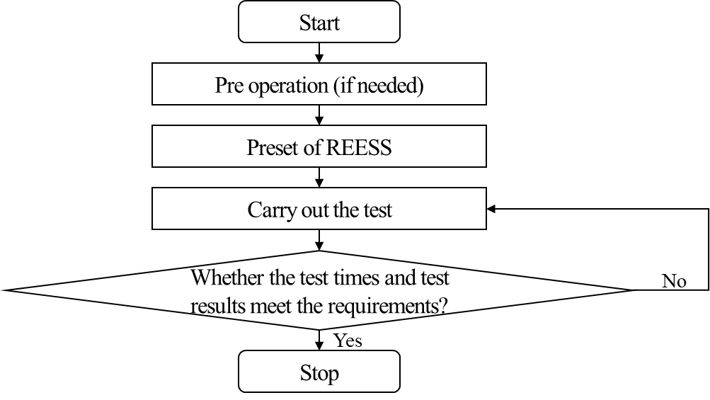
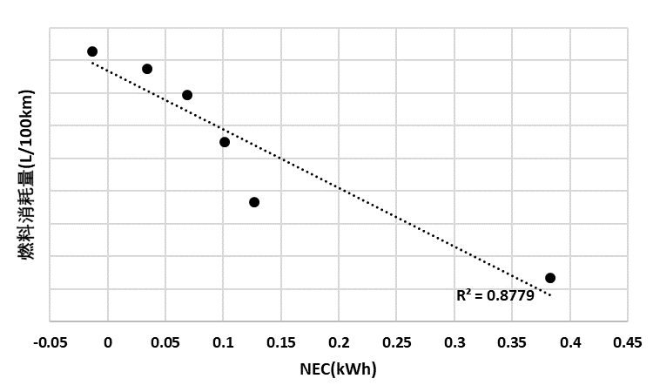
2. Hybrid electric vehicles
Test procedure and test results for NOVC-HEV
The test should be conducted at least 3 times. For the vehicles that can achieve charge sustaining, the test results only include fuel consumption, which is obtained through linear regression
Fuel consumption (L/100km)
For the vehicles that cannot achieve charge sustaining, a maximum number of test cycles has been set, and the test results shall include fuel consumption and energy consumption.

Slide 9
2. Hybrid electric vehicles
Test results for NOVC-HEV
Calculate the experimental results based on the energy changes of REESS
*E_{cycle} is cycle energy demand, same with UN R154 and GTR 15
IF |NEC_{re}|≤1%, take the average of three test results as the fuel consumption;
IF 1%<|NEC_{re}|≤5%, using linear regression to calculate fuel consumption;
IF |NEC_{re}|>5%, additional tests are required.
For the battery:
For the supercapacitor:

Slide 10
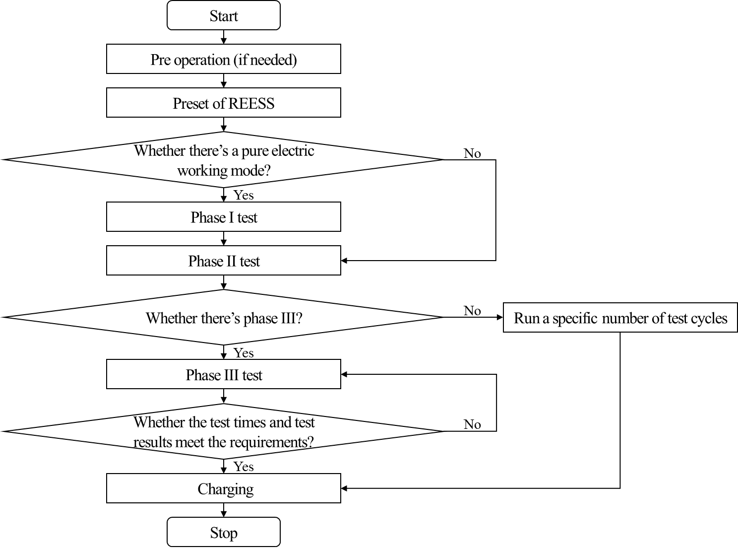
2. Hybrid electric vehicles
Test procedure for OVC-HEV
Before the test, the vehicle shall be fully charged, and then the three-phase test shall be carried out.
Each of the three-phase test involves multiple test cycles. From the beginning to the engine start, the pure electric phase (phase I*) test ends; then, when the energy balance occurs for the first time, the rechargeable electrical energy storage system (REESS) energy adjustment phase (phase II) test ends; finally, when there are two more energy balance tests occur, the charge sustaining phase (phase III) test ends.
After the test, the vehicle shall be fully charged again and the charging electricity shall be measured.
Some special vehicle types don’t include pure electric operation mode or phase III. In this case, special treatment is required.
*It should be note that, during phase I test, the engine start caused by air injection is not considered as the end of the test. The OEMs need to provide corresponding materials to prove that the engine did not participate in the vehicle driving and did not charge the REESS during the air injection process

Slide 11
2. Hybrid electric vehicles
Test results for OVC-HEV
Fuel consumption
Energy consumption
1. Phase I (including fuel consumption generated by inflation)
2. Phase II
3. Phase III
4. Fuel consumption of OVC-HEV
1. Phase I
2. Phase II
3. Phase III, equal to 0
4. Energy consumption of OVC-HEV
Range

Slide 12
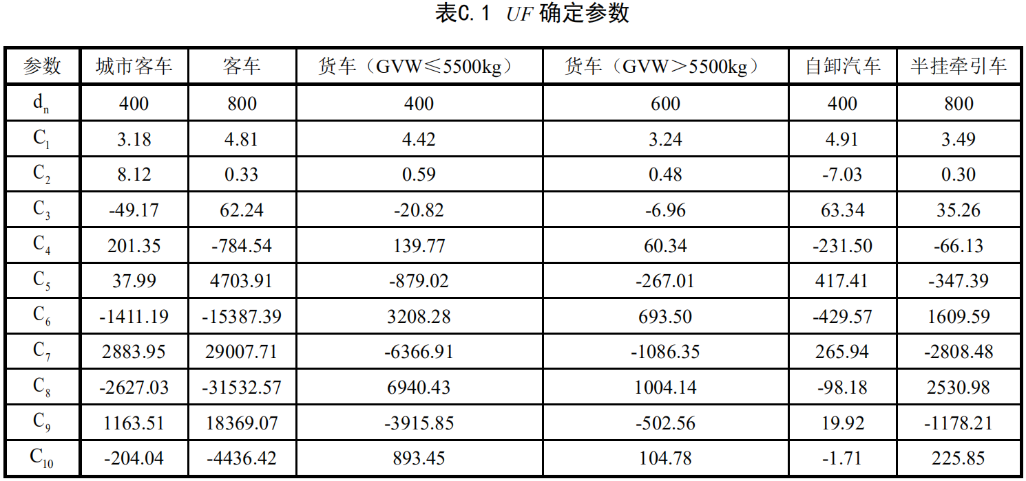
2. Hybrid electric vehicles
Utilization factor (UF)
Utilization factor (UF) is fitted according to the actual one-day travel characteristics in China. It is gradually tends to 1 with the increase of driving range, giving different weight coefficients per cycle. Based on UF, the comprehensive energy consumption of PHEV can be obtained.

Slide 13
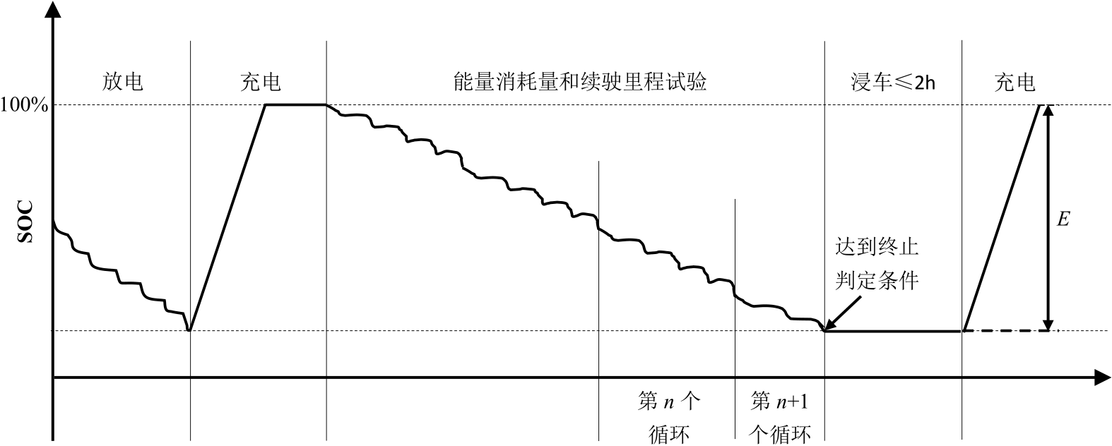
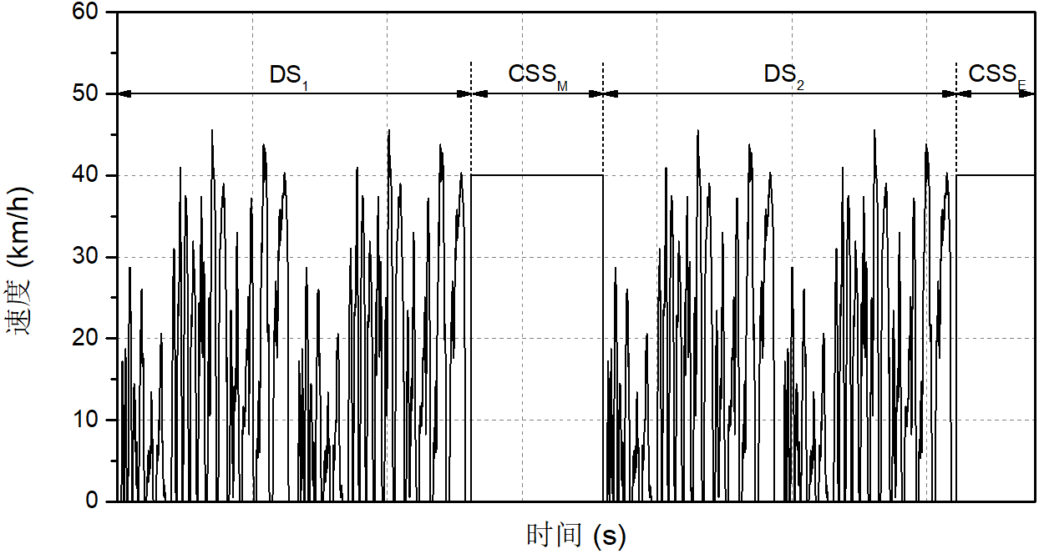
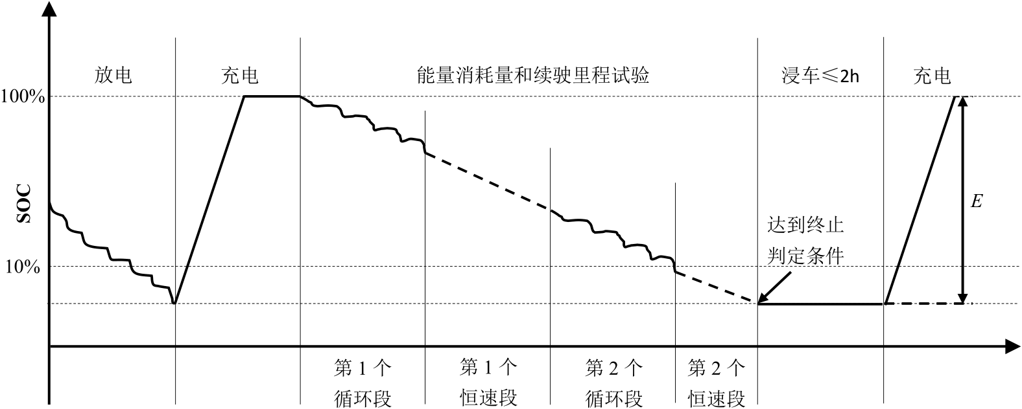
3. Battery electric vehicles
The test cycles, road load setting, test cycles, etc. are consistent with HEV.
The GB/T standard specifies two methods: consecutive cycle test procedure and shortened test procedure
Consecutive cycle test procedure
Shortened test procedure
DS₁ and DS₂ each contain 2 test cycles

Slide 14
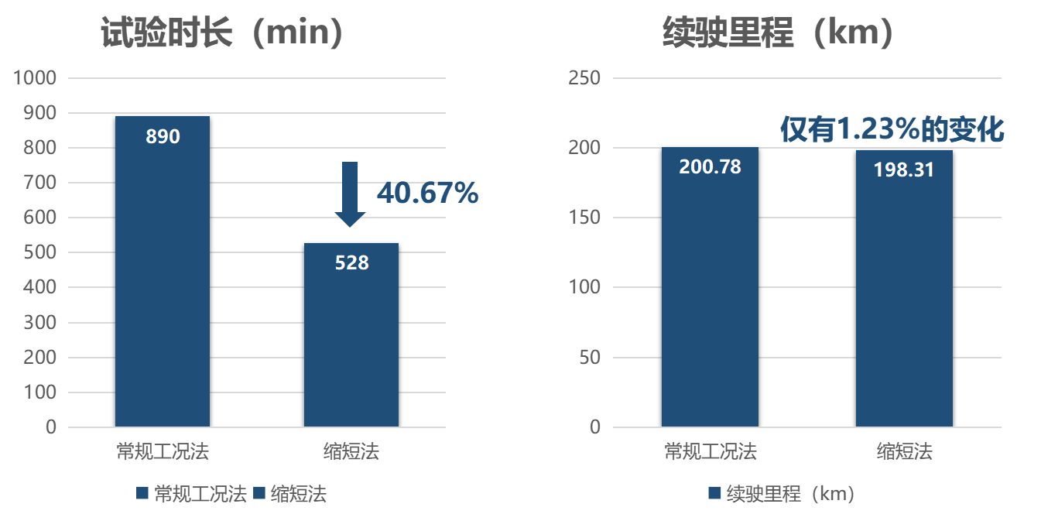
3. Battery electric vehicles
The calculation method for range varies under different methods, but for energy consumption is the same
Range
Consecutive cycle test procedure
1. Distinguish the energy consumption between the first two test cycles and the subsequent test cycles;
2. N is the complete number of test cycles, excluding the last incomplete test cycle.
Shortened test procedure
1. The first two test cycles only represent that cycle, while the last two test cycles represent the energy consumption of all cycles after the first two test cycles with the same weight.
Energy consumption
Calculate energy consumption based on driving range and external charging

