Slide 1
Automated Vehicles Act 2024
Submitted by the expert from the United Kingdom
of Great Britian and Northern Ireland
Informal document GRVA-19-58 19th GRVA,25 June 2024 (For review at the Troy meeting 20-24 May 2024 Agenda item 11
Introduction and overview

Slide 2
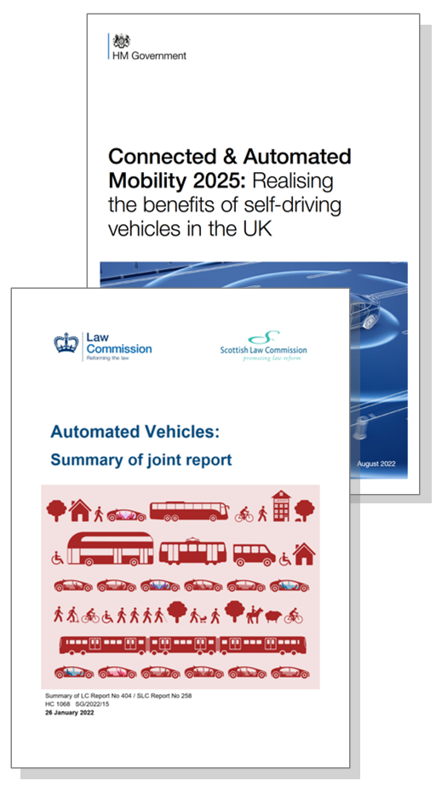
Foundations
Law Commissions’ joint report published 2022, recommending new legislation
Brought together four years of legal review, three consultations, and hundreds of responses from the public and organisations
75 recommendations setting out shape of new legal framework for safe deployment of self-driving vehicles
Government’s CAM2025 report accepted and committed to future legislation
Legislation called for by industry, stakeholder groups, and Transport Select Committee

Slide 3
The Bill has several key elements
Liability
Safety
Marketing
Licencing of passenger services

Slide 4
Liability

Slide 5
New concepts: Authorised Self-Driving Entity (ASDE) and User-In-Charge
4
Responsibilities
Responsibilities
Control vehicle
ASDE
Control vehicle
Driver
Maintain attention
Maintain attention
ASDE
Driver
Respond to road conditions
Respond to road conditions
ASDE
Driver
Follow traffic rules
Follow traffic rules
Self-driving feature activated
ASDE
Driver
Keep vehicle roadworthy
User-In-Charge
Keep vehicle roadworthy
Driver
Respond to transition demand
User-In-Charge
Feature off
Feature on
Notes:
ASDE assumes responsibility for behaviour of the vehicle when self-driving
Early self-driving features will not work in all contexts – eg some may be motorway only and need to be able to ‘hand back’ to a human.
User-In-Charge is immune from most driving offences – but must retake control if instructed

Slide 6
New concept: No-User-In-Charge (NUIC) and No-User-In-Charge Operator (NUICO)
5
No self-driving features activated
Driver is responsible for all elements as normal
NUIC feature activated - vehicle owned and operated as part of a fleet
NUICO responsible for upkeep and responding to incidents
NUIC feature activated - vehicle privately owned
Owner may retain some responsibilities eg upkeep
Responsibilities
Responsibilities
Responsibilities
Control vehicle
Driver
Control vehicle
ASDE
Control vehicle
ASDE
Maintain attention
Maintain attention
ASDE
Maintain attention
ASDE
Driver
Respond to road conditions
Respond to road conditions
ASDE
Respond to road conditions
ASDE
Driver
Follow traffic rules
Follow traffic rules
ASDE
Follow traffic rules
ASDE
Driver
Keep vehicle roadworthy
Keep vehicle roadworthy
NUICO
Keep vehicle roadworthy
Owner
Driver
Manage breakdowns & incidents
Manage breakdowns & incidents
Manage breakdowns & incidents
Driver
NUICO
NUICO
Feature off
Feature on
Feature on

Slide 7
Safety

Slide 8
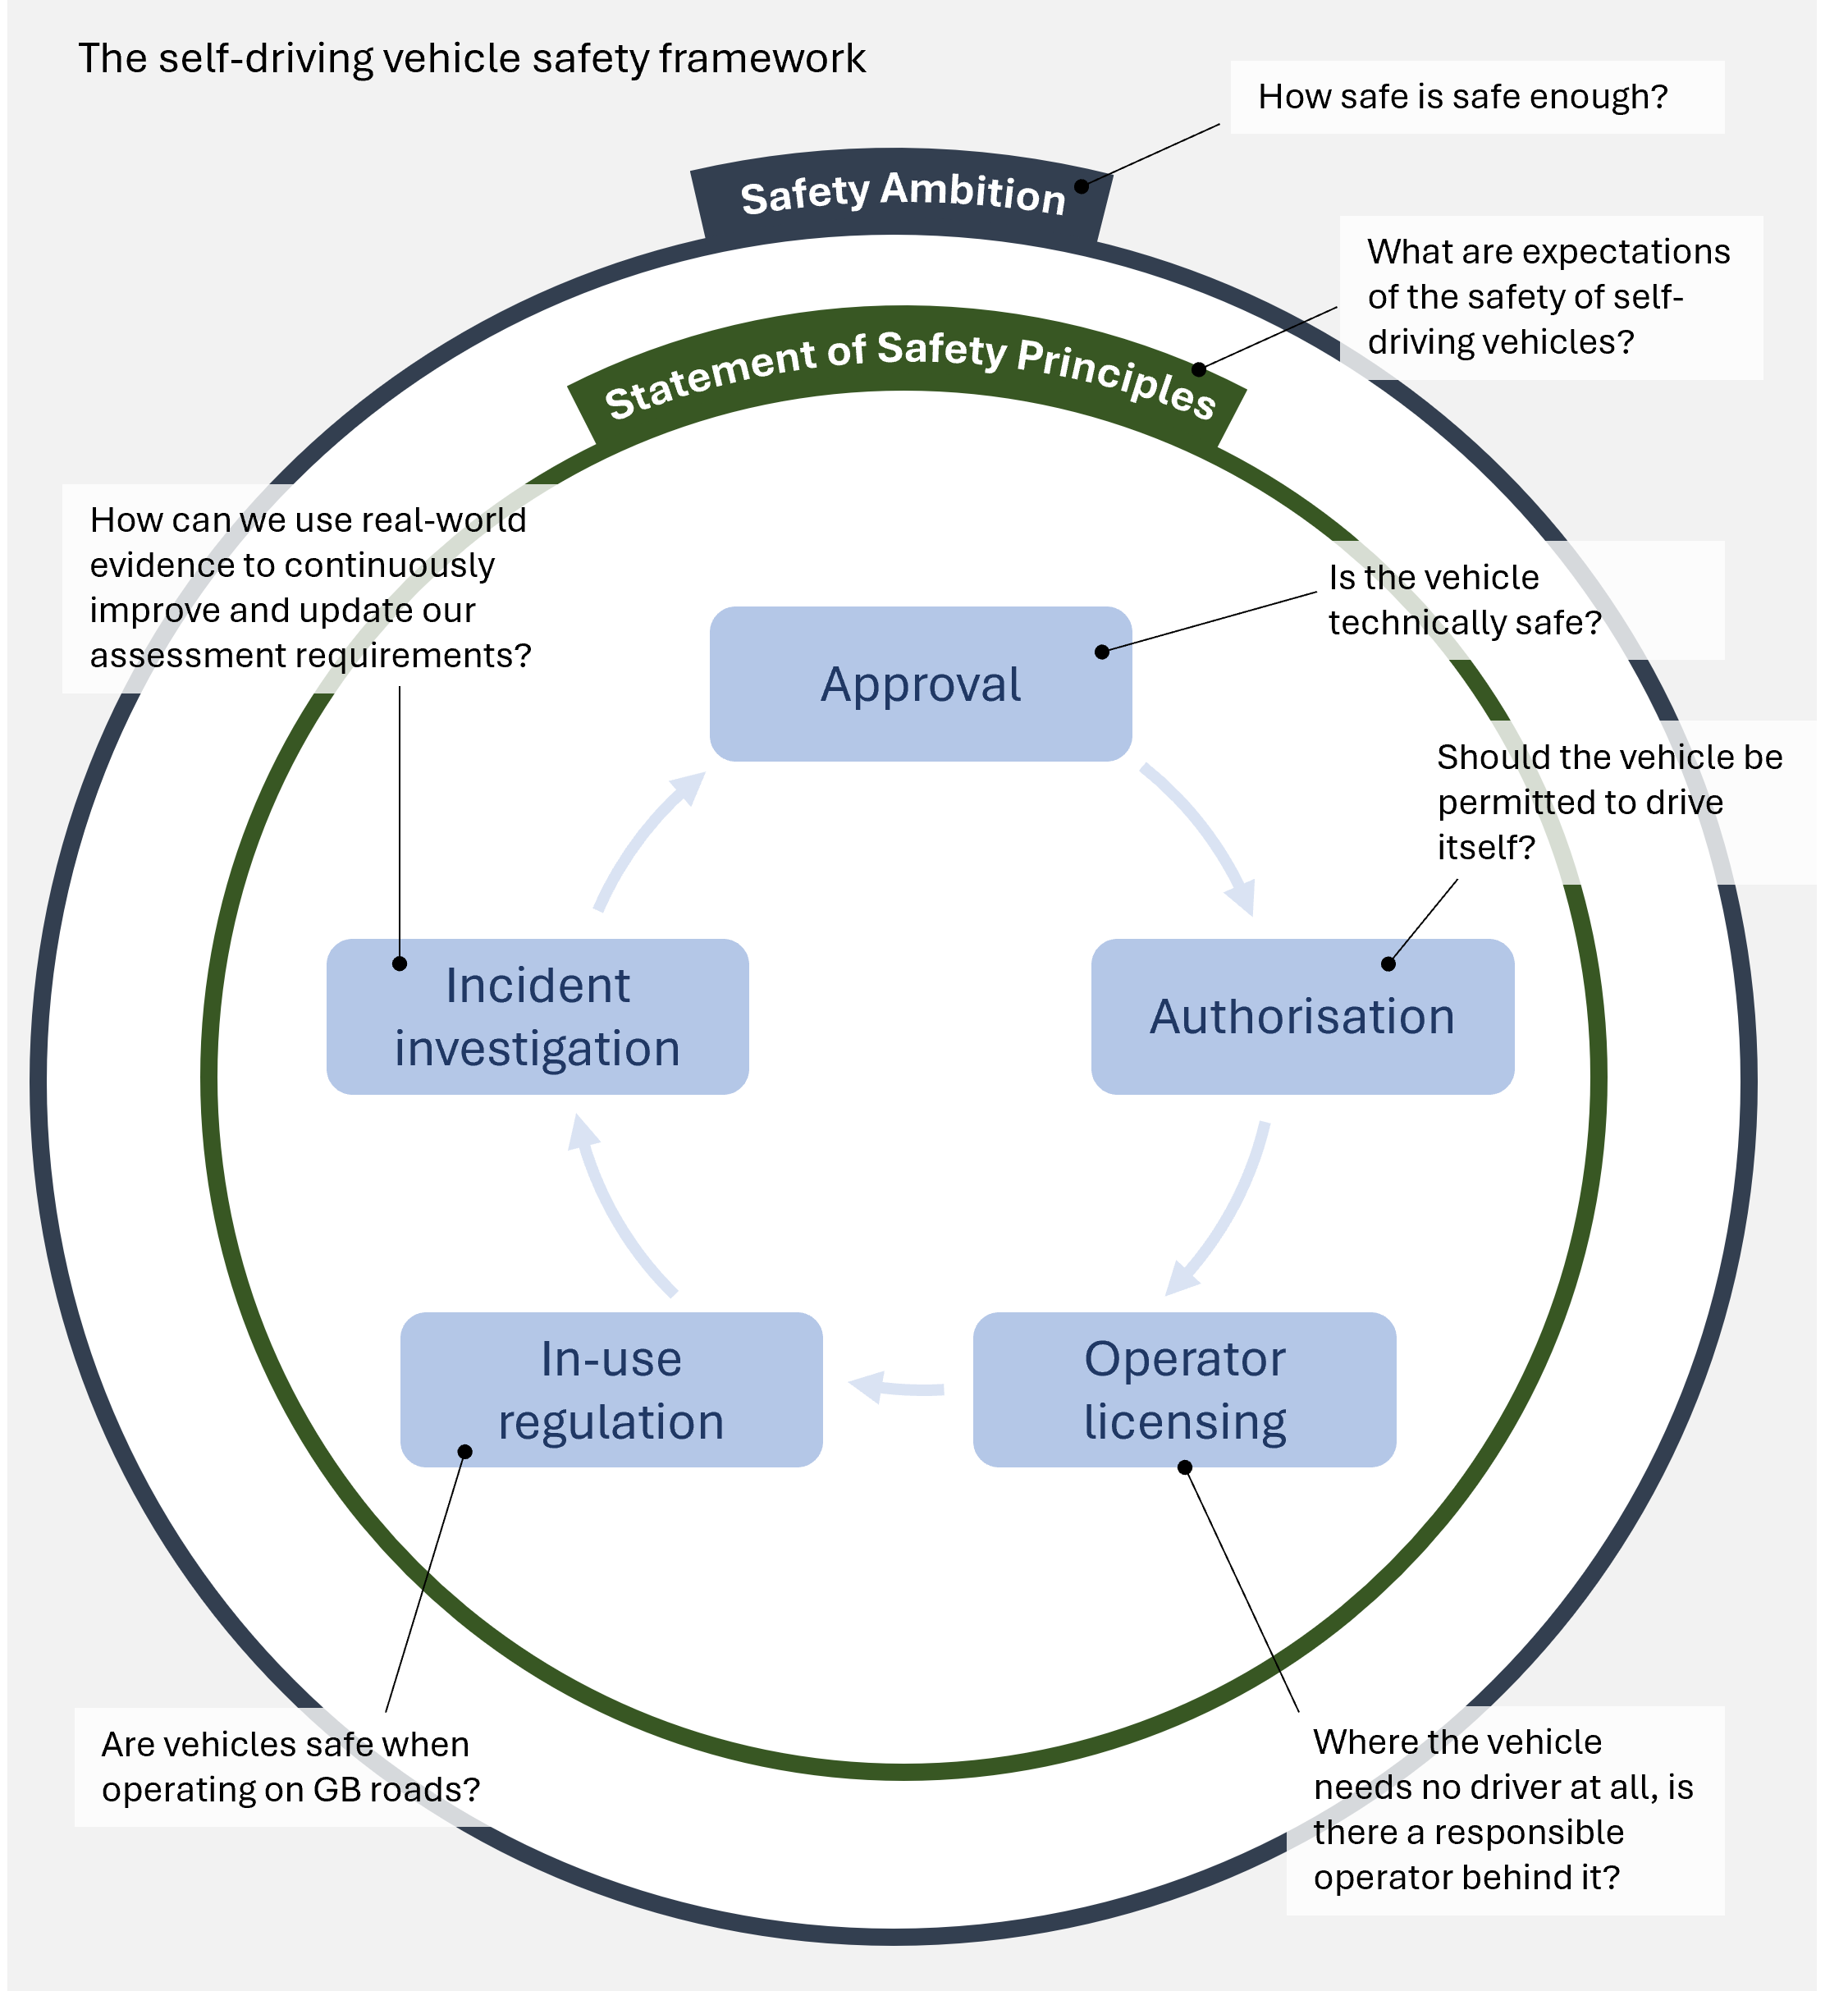
A new safety framework
3
Notes:
Ambition
Principles – defining safety expectations of self-driving vehicles – informed by Safety Ambition
In-use regulation and incident investigation → focus on learning and improving

Slide 9
Marketing

Slide 10
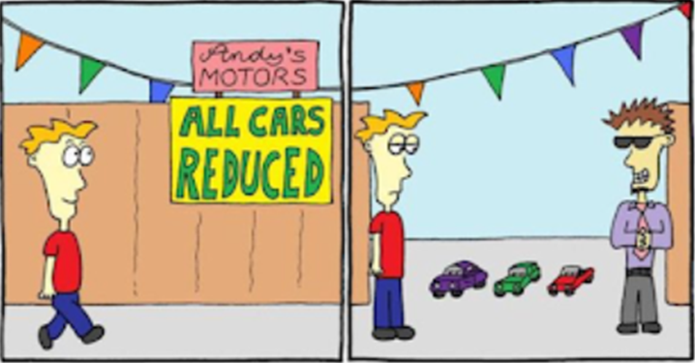
Misleading Marketing
Only vehicles authorised for self-driving can be marketed as such.
Clear distinction between self-driving and advanced assistance
Notes:
Stipulate terms in regulation

Slide 11
Permits for self-driving passenger vehicles

Slide 12
Passenger Vehicles
Alternative route to existing licencing for taxi, private hire, bus
Accessibility panel
Local authorities
Notes:
Acknowledging different considerations and doesn’t necessarily sit well within existing schemes
Accessibility panel
LA involvement

