Slide 1
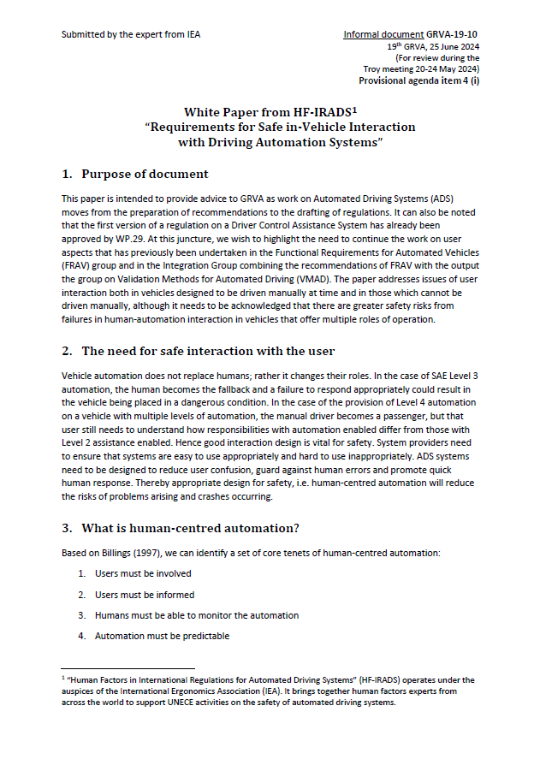
Requirements for Safe in-Vehicle Interaction with Driving Automation Systems (Informal paper GRVA-19-10)
Submitted by the expert from IEA (For review during the Troy meeting, 20-24 May 2024)
Informal document GRVA-19-39 19th GRVA, 25 June 2024 Agenda item 4(i)
Oliver Carsten
HF-IRADS

Slide 2
“Human Factors in International Regulations for Automated Driving Systems” (HF-IRADS) operates under the auspices of the International Ergonomics Association (IEA). It brings together human factors experts from across the world to support UNECE activities on the safety of automated driving systems.

Slide 3
The need for safe interaction with the user
Vehicle automation does not replace humans; rather it changes their roles
ADS systems need to be designed to reduce user confusion, guard against human errors and promote quick human response
Appropriate design for safety, i.e. human-centred automation, will reduce the risks of problems arising and crashes occurring

Slide 4
What is human-centred automation?
Based on Billings (1997), we can identify a set of core tenets:
Users must be involved
Users must be informed
Humans must be able to monitor the automation
Automation must be predictable
Automation must monitor the human (input/state)
Intent must be dually communicated between automation and human

Slide 5
How do we ensure safe interaction between vehicle and user?
Both intended use of systems and anticipated intentional and unintentional misuse must be considered. Therefore, there is a need to support user understanding for intended uses and perform a detailed safety analysis to address anticipatable misuse.
Interaction design needs to address user understanding of changeable user roles, mode structure and interactions in, for example, enabling the Automated Driving System (ADS) and responding to requests to intervene.
System limitations must be clearly communicated to drivers
Robust mechanisms for monitoring and engaging drivers are necessary to mitigate foreseeable risks of complacency and inattentiveness.

Slide 6
Human-Centred Design
ISO 9241-210:2019 describes 6 principles to be followed to ensure the design is Human-Centred:
The design is based upon an explicit understanding of users, tasks and environments
Users are involved throughout the design and development process
The design is driven and refined by user-centred evaluation
The process is iterative
The design addresses the whole user experience, including emotional aspects
The design team includes multidisciplinary skills and perspectives, including expertise in human factors

Slide 7
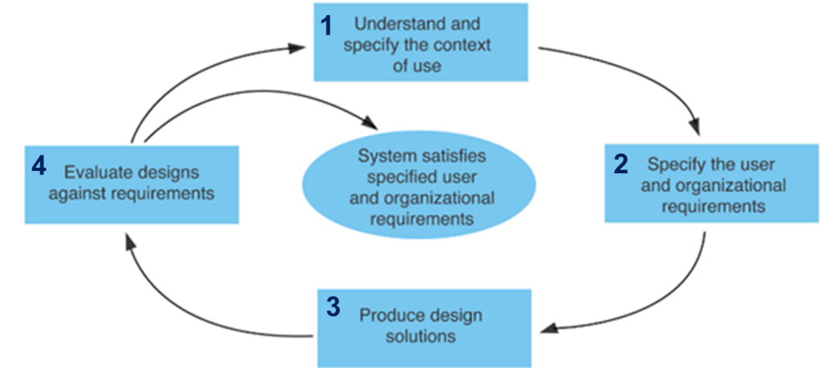
Iterative process of Human Centred Design

Slide 8
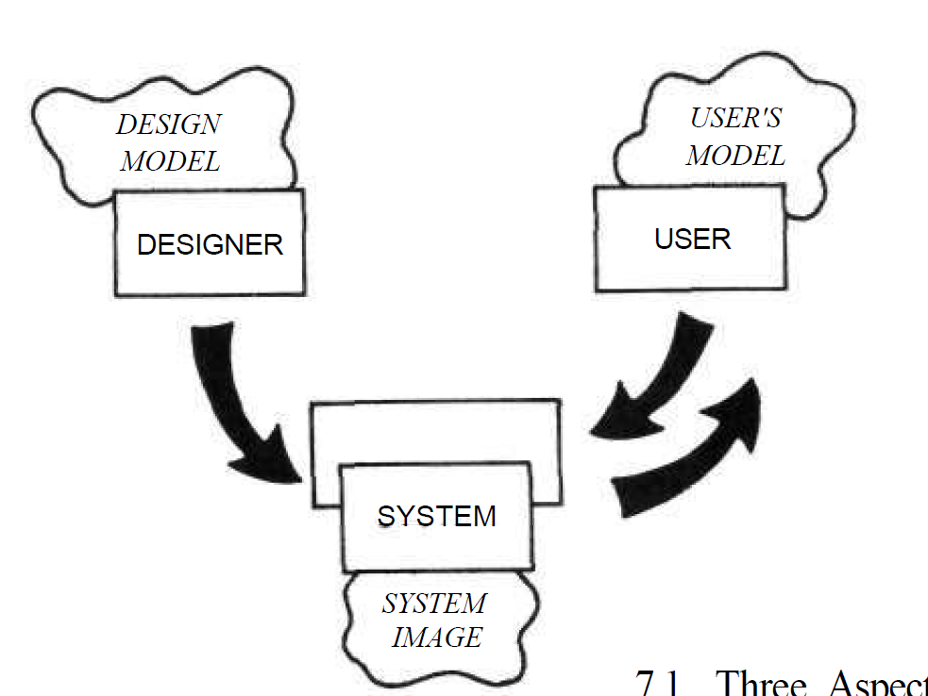
Also
Support role awareness
Mitigate against mode confusion
Enhance easy acquisition of appropriate mental models, i.e. ones where the mental models of designers and users coincide
Test with diverse users
Mental models (Norman, 1988)

Slide 9
Recommendations to GRVA
Interaction safety must be set as an objective and integrated in the safety case for a DAS since it is mission-critical.
The use of the Human-Centred Design process with the involvement of the expected range of users in the different stages of the development of driving automation systems must be verified.
There is a need to develop verifiable requirements on interaction, including on driver monitoring.
The Human-Centred Design process and established HMI principles be applied to create a high-level commonality of interaction design across vehicles and levels of automation. This will assist users in easy adaption to new vehicles and in switching from one vehicle to another in their daily use.

Slide 10
Recommendations to GRVA (2)
The consequent design recommendations could then be applied in feature development and be used in checklists at the verification or approval stage, which would substantially reduce development costs.
It will be Important to draw lessons from post-production In-Service Monitoring and Reporting to inform recalls and the refinement of driving automation system safety. Any substantive changes to interaction with driving automation systems, such as through over-the-air updates, require verification and notification of the changes to drivers.
Above all, we need an integrated approach that spans automation across the different SAE levels of automation in order to accommodate safe user interaction with these levels on a single vehicle.

Slide 11
Thank you for your attention! o.m.j.carsten@its.leeds.ac.uk

