Slide 1
Submitted by the Co-Chairs of the IWG on EDR/DSSAD
Informal document GRVA-19-21
19th GRVA, 25 June 2024 (For review during the Troy meeting 20-24 May 2024)
Provisional agenda item 4(f)
Activities/Deliverables of IWG on EDR/DSSAD
May/June 2024
Notes:
1

Slide 2
Mission of the EDR/DSSAD IWG ToR of the IWG (ECE/TRANS/WP.29/1147 Annex VII) (adopted in the 178th WP.29 in June 2019)
The IWG shall develop draft proposals for Event Data Recorder (EDR) for conventional vehicles and automated/autonomous vehicles and for Data Storage System for Automated Driving (DSSAD) for automated/autonomous vehicles. These categories shall be understood as systems collecting and storing a determined range of vehicle data, including:
Information related to collisions valuable for accident reconstruction (EDR);
The status of the automated/autonomous driving system and the status of the driver (DSSAD).
To this effect, the IWG shall address the following issues:
Define the scope and specific objectives of and differences between EDR and DSSAD,
Define EDR and DSSAD requirements.
In particular, the IWG will consider defining the categories of data recorded, the events triggering recording, as well as technical specifications in terms of performances of such systems, such as the required endurance, accessibility, storage capacity or the specific security requirements, as well as the required privacy and data protection by design features.

Slide 3
Overview of the IWG activities
 | Projects Completed | Current Work | Future Work
Comparison between EDR and DSSAD | Comparison between EDR and DSSAD (WP29-179-19, Nov. 2019) | DSSAD performance elements guidance document (June 2024 March 2025)
DSSAD | DSSAD requirements (ALKS (UNR157)) (181st WP.29, June 2020) (189th WP.29, March 2023) Updating consolidated document of domestic activities on DSSAD (188th WP.29, Nov. 2022) Primary purposes of DSSAD, Prioritization of discussion topics
EDR | EDR requirements (UNR 160 00/01 series) (183rd WP.29, Mar. 2021), and amendments (186th WP.29, Mar. 2022) Acceleration Data Accuracy Verification Procedures (125th GRSG, 2023/11&15 etc.) EDR for HDV (UNR 169, 191st WP.29, Nov.2023) | EDR performance elements for ADS (Nov. 2024 March 2026) Supplement for 8-12t (Nov.2024 March 2025) | EDR Step 2 (March 2025 2026) EDR Step3 (March 2027)

Slide 4
Activities of EDR/DSSAD IWG since GRVA #18
SG-DSSAD #18 January 30
SG-EDR #39 February 26
SG-DSSAD #19 February 27
EDR/DSSAD IWG #24 (hybrid in Tokyo, Japan) April 9-11

Slide 5
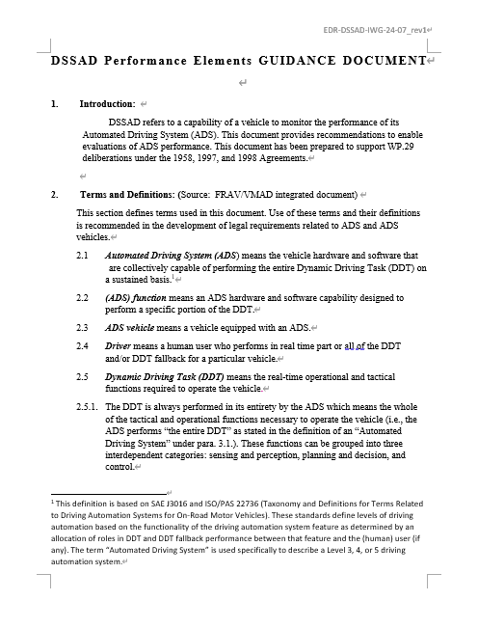
Summary of Recent Activities on DSSAD
Group is focusing on discussion of DSSAD Performance Elements Guidance Document to submit to WP.29 March 2025.
The guidance document consists of the following chapters:
Introduction
Terms and Definitions
Data Storage and Security
Data Format
Data Retrievability/Availability
Performance Elements
Misc. Specifications
Notes:
SG-EDR-28 Oct 4
SG-EDR-29 Oct 6
SG-EDR-30 Oct 31
SG-EDR-31 Nov 7
SG-EDR-32 Dec 1
SG-EDR-33 Jan 11

Slide 6
Progress Chart on DSSAD Guidance Document

Slide 7
Current Schedule for EDR/DSSAD IWG
SG-DSSAD #20 May 28,29 (13:00-15:00CET)
SG-EDR #40 May 29 (15:00-16:00CET)
SG-EDR #41 June 18
SG-DSSAD #21 June 19
EDR/DSSAD IWG #25 (hybrid in Europe) Sep. 17-19

Slide 8
Thank you!
Notes:
8

