Slide 1
OICA and CLEPA joint position on ECE-TRANS-WP.29-GRE-2023-27e-Rev.1

Slide 2
OICA – CLEPA joint position
IWG-EMC, under the leadership of by Zissis Tsakiridis, with input from the industry experts (OICA, CLEPA) and Contracting Parties has produced an excellent proposal (ECE-TRANS-WP.29-GRE-2023-27e-Rev.1) containing 100+ changes to R10.06
Updates regulation to address the latest developments in the industry
Aligns with progress made in many international standards
Enhances uniform interpretation and application
OICA and CLEPA support the proposal with two exceptions and recommend two changes are implemented which are detailed in GRE-90-23
Notes:
Update regulation to the state of the art
: Incorporates ADAS, AECS, AVAS (acoustic veicle audible system
: increases radiated immunity tests where we check the vehicles robustness to external radio frequency signals from 2 to 6 GHz to account for increased use of the radio spectrum
Dual Qualifications are relevant to the admissibility of IEC test reports which must be produced from a labs which are both certified to ISO17025 AND recognised by a Technical Service. This dual requirements will put some countries to economic disadvantage and reduce competition.
Modulation requirements: We had initially aligned the modulation used in annexes 6 and 9 with the then latest draft of Iso standards which have since changed. If we do not make this alignment, R10 will not be aligned with any standards.

Slide 3
OICA and CLEPA position 1 of 2
Decision flowcharts have been introduced to some annexes to achieve uniform implementation of test selection with mode 2 charge cords
Footnote 1 included in the flowchart
¹ IEC 61851-21-2 tests shall be performed by an ISO17025 accredited laboratory recognised by any Technical Service designated by the type approval Authority. The test report shall be provided by the vehicle manufacturer as evidence for the vehicle type approval.
This note introduces dual qualification requirements for test laboratories, (text highlighted above)
We request the highlighted text to be removed.

Slide 4
OICA and CLEPA position 2 of 2
Modulations used in Annexes 6 and 9 have been updated to reflect changes to the radio spectrum
Current draft (GRE-2023-27e-Rev.1) is aligned with interim drafts of ISO 11451-1 and ISO11452-1 which were available after October 2022.
In Feb 2024, International Standardisation bodies have revised the applicable frequency ranges of specific modulations based on a comprehensive research.
OICA & CLEPA experts recommend alignment with the Final Draft of ISO 11451-1 and ISO11452-1

Slide 5
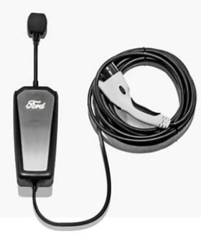
1- Dual qualification requirements (in relation to Mode 2 charge cords)
In-Cable Control and Protection Devices (ICCPDs) may be supplied with the vehicle or purchased aftermarket
Vast choice available to consumers
All ICCPDs must meet relevant IEC standards as part of national legislation (e.g. CE, UKCA etc).
R10 vehicle tests include ICCPDs
Copyright 2024, A Gunsaya, All rights reserved for reproduction permission and all other issues please contact agunsaya@ford.com
Notes:
This picture is from a UK device

Slide 6
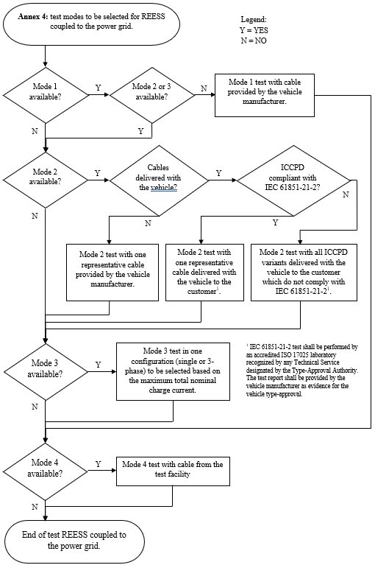
Dual qualification requirements:
Mode 2 test applicability is based on
delivery of mode 2 cable with the vehicle and
compliance status with IEC 61851-21-2
IEC 61851-21-2 tests shall be performed by an accredited ISO17025 laboratory recognised by any Technical Service designated by the type approval Authority. The test report shall be provided by the vehicle manufacturer as evidence for the vehicle type approval.
Notes:
A company in Japan develops a vehicle and
sources its mode 2 cables from a company in the Republic of Korea
conducts R10 witnessed tests in The UK.
If the technical service in the UK has not recognised the laboratory used in Korea for the IEC tests, then the UK TS will not be able to accept the IEC compliance from the Lab in Korea, which is already qualified to ISO17025. This report is acceptable for CE marking and the part can be sold as aftermarket device. However it but would be inadmissible for R10 test.
VM has to perform multiple tests

Slide 7
Dual qualification requirements:
Mode 2 test applicability is based on
delivery of mode 2 cable with the vehicle and
compliance status with IEC 61851-21-2
(1) IEC 61851-21-2 tests shall be performed by an accredited ISO17025 laboratory recognised by any Technical Service designated by the type approval Authority. The test report shall be provided by the vehicle manufacturer as evidence for the vehicle type approval.
Notes:
A company in Japan develops a vehicle and
sources its mode 2 cables from a company in the Republic of Korea
conducts R10 witnessed tests in The UK.
If the technical service in the UK has not recognised the laboratory used in Korea for the IEC tests, then the UK TS will not be able to accept the IEC compliance from the Lab in Korea, which is already qualified to ISO17025. This report is acceptable for CE marking and the part can be sold as aftermarket device. However it but would be inadmissible for R10 test.
VM has to perform multiple tests

Slide 8
Justification for objections
Eligibility criteria requires dual qualifications to ISO 17025 AND to be recognised by any Technical Service designated by the type approval Authority
Economic disadvantage to some countries:
Some (~ 8 countries) that have signed the 1958 agreement lack both a technical service and a lab recognised by a technical service.
Restriction of competition:
In Germany for example, there are 336 test laboratories accredited to ISO/IEC 17025, but only 72 labs are recognized by a Technical Service. This will restrict the number of available laboratories and reduce competition.
Lack of clear benefits
The effort for testing Mode 2 cables is not justified: There is neither a technical benefit nor a benefit related to better compliant results. Instead, it restricts free competition among labs and puts countries without any qualifying labs at an economic disadvantage.
Use of laboratories accredited to ISO/IEC 17025 is sufficient and addition of the requirement of recognition by the technical service will not improve compliance results but instead will restrict competition and disadvantage some signatories to the 1958 agreement.
Recommendation: Remove “recognised by any Technical Service designated by the Type Approval Authority”.
Notes:
Global supply chain – parts certified in countries where their ISO 17025 certified labs can no gain recognition from every country in which the vehicle manufacturer may need to obtain R10 approval. In some countries, there are multiple Type approval authorities and not all labs will be recognised by all type approval authorities.

Slide 9
2. Revise frequency ranges of modulations used in Annexes 6 & 9
Tests in Annexes 6 and 9 verify that vehicles can operate safely in the presence of external radio frequency signals from intentional radio transmitters.
Radio transmitters use carrier signals which are modulated by the intended information.
AM Modulation changes the amplitude of the carrier. Used by analogue device, e.g. MW radio broadcast, analogue 2-way radio.
Pulse modulation pulses the transmitted signal. Used by digital devices such as cellular communications, Wi-Fi
Industry experts recommend the applicable frequency ranges of modulations used during radiated immunity tests are aligned with the latest versions (DIS) of ISO 11451-1 and ISO11452-1
Specific changes we request are to extend the use of PM3 to start from 380 MHz instead of 800, and to limit the use of AM modulation to 20-400 MHz instead of 20-800MHz.

Slide 10
Justification for the request
Previous agreement in IWG was to align with ISO standards 11451-1 and 11452-1
GRE/2023/27e-Rev.1 is aligned with previous interim drafts (Draft International Standards) which have since been updated based on technical research and are scheduled for publication in March 2025 (before the applicability date of ECE R10.07.)
Modulation schemes and frequency ranges have been carefully selected to replicate actual threats from radio transmitters (cellular phones, WiFi)
We recommend to extend the applicability of certain Pulse Modulation scheme (PM3) for robustness.
Modulation details are embedded in the regulation and hence it is not needed to reference Draft International Standards.
Failure to change: R10 will not align with ISO standards (Current or future).
Recommendation: Align applicability of AM and PM3 modulation with ISO draft standards (2025)

Slide 11
Summary
OICA and CLEPA experts recommend the adoption of draft ECE R10.07 with the adoption of 2 changes
Revise footnote 1 in flowcharts as follows:
IEC 61851-21-2 tests shall be performed by an accredited ISO/IEC 17025 laboratory recognised by any Technical Service designated by the type approval Authority. The test report shall be provided by the vehicle manufacturer as evidence for the vehicle type approval.
Revise modulation section in Annexes 6 & 9 as follows:
AM (amplitude modulation), with 1 kHz modulation and 80 per cent modulation depth in the 20 to 800 400 MHz frequency range; and
PM2 (pulse modulation type 2), Ton 3 µs, period 3,333 µs in the 2,700 to 3,100 MHz frequency range; and
PM3 (pulse modulation type 3), Ton 500 µs, period 1,000 µs in the 800 380 to 2,700 MHz and the 3,100 to 6,000 MHz frequency ranges.

Slide 12
Thank You

Slide 13
Backup information

Slide 14
Details of the change
The test signal modulation shall be:
AM (amplitude modulation), with 1 kHz modulation and 80 per cent modulation depth in the 20 to 800 400 MHz frequency range; and
PM2 (pulse modulation type 2), Ton 3 µs, period 3,333 µs in the 2,700 to 3,100 MHz frequency range; and
PM3 (pulse modulation type 3), Ton 500 µs, period 1,000 µs in the 800 380 to 2,700 MHz and the 3,100 to 6,000 MHz frequency ranges.
Summary: Extend the use of PM3 to start from 380 MHz instead of 800. Limit use of AM to 400 MHz

Slide 15
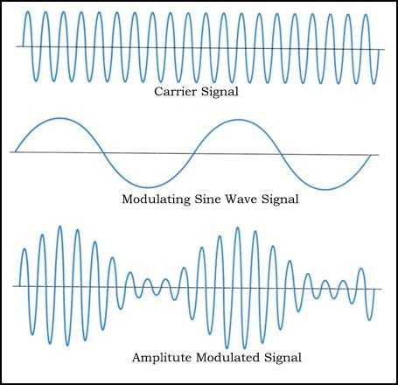
What is modulation?
Carrier Signal
Carrier Signal
Modulating with Sine wave
Modulating with digital pulse
Amplitude modulated signal
Pulse modulated signal
Used by analogue devices – e.g. MW radio, analogue 2-way-radio
Used by digital devices – e.g. cellular phone, WiFi, etc.

