Slide 2
Well-being and SDG national reporting platform
Bo Hoogerwerf
21-03-2024

Slide 3
Our products
National SDG report
Regional monitoring
Provinces and municipalities (Dutch only)
Caribbean Netherlands
Factsheets for ministries (Dutch only)
International SDG monitoring
According to official UN framework and indicators

Slide 4
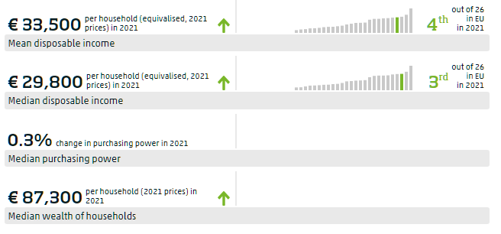
What do we communicate about indicators

Slide 5
Monitor of Well-being and SDGs Caribbean Netherlands
3 Islands: Bonaire, Saba and St. Eustatius
Dashboard
Focus on data
Summary
Interactive
Publishing and developing simultaneously
Keeping in mind the local context

Slide 6
Factsheets
Criticism on the usability of the national report
Too much information
Focus on data
Align with policy areas of the ministries
Concise and focus on core indicators
Used for political debate
Budgetday
‘General political deliberations’

