Slide 1
Transmitted by the Co-Chairs of the IWG on EDR/DSSAD
Informal document GRSG-127-32 GRSG 127th session, 15-19 April 2024 Agenda Item 17
IWG on EDR/DSSAD
Status Report April 2024
Notes:
1

Slide 2
Background IWG on EDR/DSSAD
In accordance with the ‘Framework Document on automated/ autonomous Vehicles’ (WP.29-178 June 2019): “The IWG shall develop draft proposals for Event Data Recorder (EDR) for conventional and automated/autonomous vehicles and for Data Storage System for Automated Driving (DSSAD)”.
Chairpersons: The Netherlands, Mr. Tim Guiting Japan, Mr. Hisao Matsukawa USA, Mrs. Jane Doherty Secretariat: OICA, currently new secretary being identified
Activities since GRSG-126: 1 2.5-day hybrid session, Tokyo 7 virtual sessions, incl. Sub Groups on DSSAD, EDR and Task Force on ‘8-12t’.
GRSG
GRVA
IWG on EDR/DSSAD

Slide 3
Activities
EDR | DSSAD
Completed:
UN R160 on light duty vehicle EDR incl. Amendments and Supplements. | DSSAD requirements within UN R157 on ALKS, incl. Amendments.
UN R169 on heavy duty vehicle EDR.
Current:
Clarification on demonstration of compliance of vehicles with a max. mass up to 8/12t within UN R169. | DSSAD performance elements for ADS: guidance document.
EDR Step 2, future and advanced requirements.
EDR performance elements for ADS.
Future:
EDR Step 3, future requirements.

Slide 4
State of play - DSSAD
DSSAD performance elements for ADS: guidance document.
Working document EDR-DSSAD-IWG-24-07_rev1.
Will provide input for the EDR workstream ‘EDR performance elements for ADS’.
More consideration by the IWG on this document is necessary.

Slide 5
State of play - EDR for HDVs 8-12t (1/2)
UN R169 on HDV EDR, paragraph 4.1.: - Approval for UNR169 may be based on UNR160 for a vehicle type with GVW up to 12t, if the vehicle type meets UN R160.01. - For vehicle types with GVW between 8-12t: the manufacturer must demonstrate, to the satisfaction of the approval authority, that the triggering performance is equally effective.
At the IWG and during GRSG-126, some delegates challenged: - the rationale for the additional requirement for 8-12t M2/N2 vehicles derived from M1/N1 (“lack of supporting data”), - the potential unclear requirement for, and subjective assessment of, the additional demonstration to the approval authority.

Slide 6
State of play - EDR for HDVs 8-12t (2/2)
The IWG on EDR/DSSAD was tasked to work on clarifying the additional demonstration requirement.
The IWG on EDR/DSSAD discussed the 8-12t issue during various meetings. Supporting data was submitted to, and reviewed during, the hybrid session on 10 April. The IWG concluded that:
the positions on the rationale for the additional requirements for 8-12t vehicles remained unchanged,
the IWG would continue to work on clarifying the provision on the additional demonstration to the approval authority → official document expected for GRSG-128 Oct. 2024.

Slide 7
State of play - EDR Step 2
The IWG received presentations by delegations concerning potential improvements, additions and amendments to UN R160 and 169, including: - new data elements and increased format requirements, - new triggering criteria (vehicle-to-vehicle and vehicle-to-VRU), - increased recording frequency, - increased durability requirements incl. data survivability during post-crash fires, - introduction of a number of bench tests, etc., etc.
The IWG updated the inventory of all items under consideration for EDR Step 2, document EDR-DSSAD-IWG-24-05_rev1.
The IWG considered the support, feasibility and urgency of the proposed items and agreed to introduce them in multiple steps.
The IWG will continue to work on the inventory and already start working on text proposals for the first Step 2 items.

Slide 8
State of play - EDR for ADS
Data collection for ADS is discussed in a broader perspective as part of the ‘DSSAD performance elements for ADS’ discussions.
It need to be identified what elements are to be associated with DSSAD and with EDR.
Then the data format requirements need to be developed and the EDR performance elements updated for ADS vehicles.

Slide 9
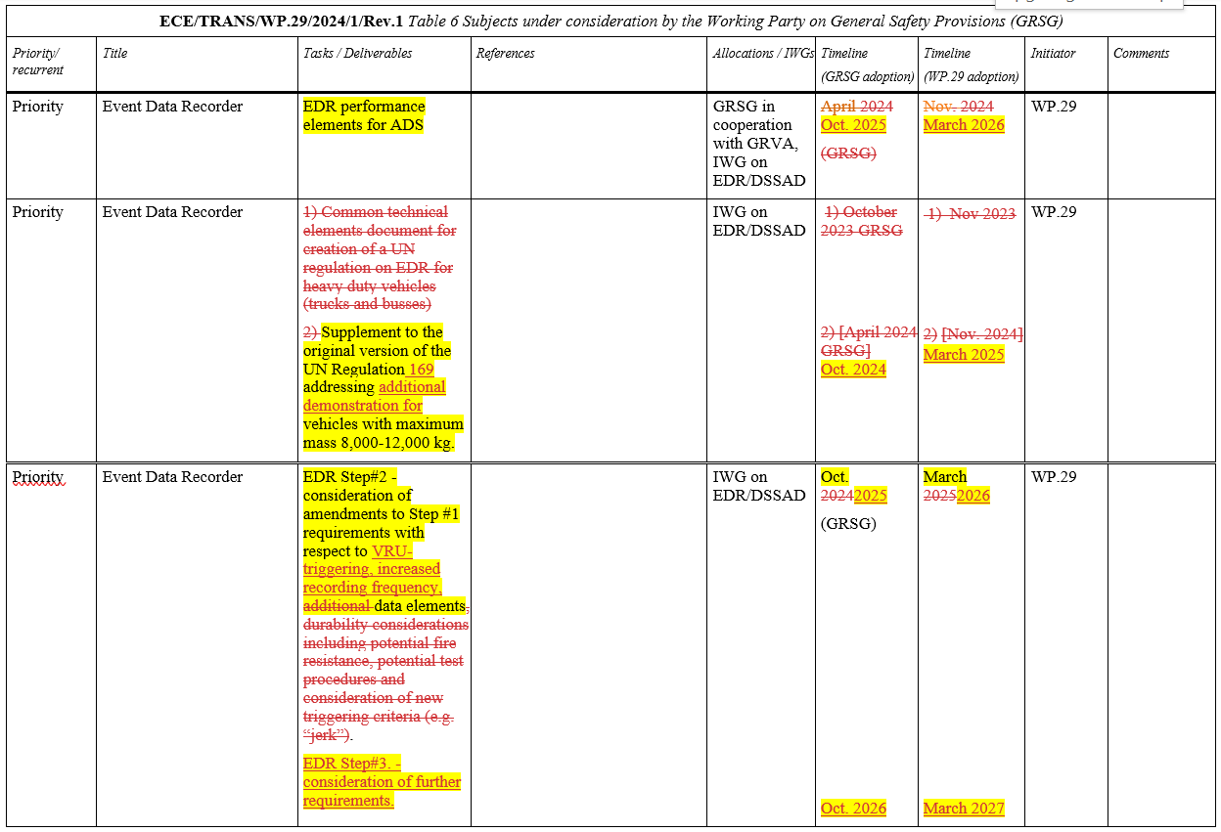
IWG on EDR/DDSAD deliverables/timelines

Slide 10
For GRSG
GRSG is invited to consider:
The proposed PoW as regards EDR deliverables/timelines.
The subjects to be considered as part of the workstream ‘Step 2’, in its first phase (GRSG-130, Oct. 2025): - VRU triggering, - increased recording frequency, - data elements, - minor corrections/improvements.
Extending the mandate of the IWG on EDR/DSSAD: - current mandate expires June 2024, - DSSAD concludes in 2025, EDR activities proceed beyond 2025.

Slide 11
Thank you for your attention!

