Slide 1
Submitted by the expert from China
Informal document GRE-90-29
90th GRE, 29 Apri-3 May 2024
agenda item 7(b)
Questions regarding the interpretation of UN R149

Slide 2
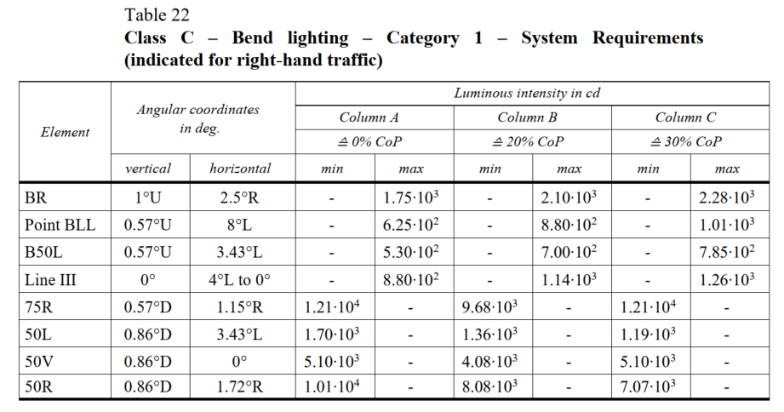
ECE R149-01
12100*(1-30%)=8470
8.47•10³
3.57•10³
5100*(1-30%)=3570

Slide 3
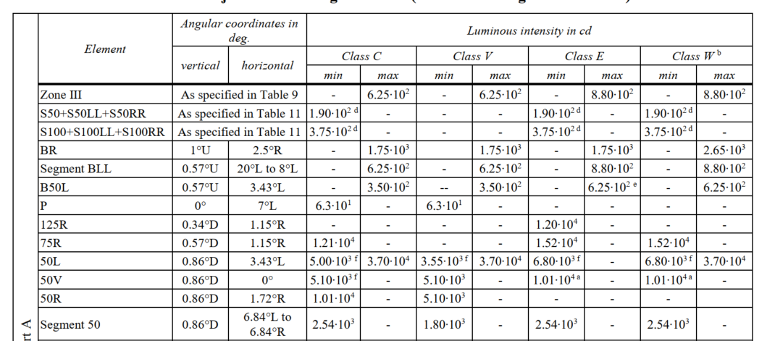
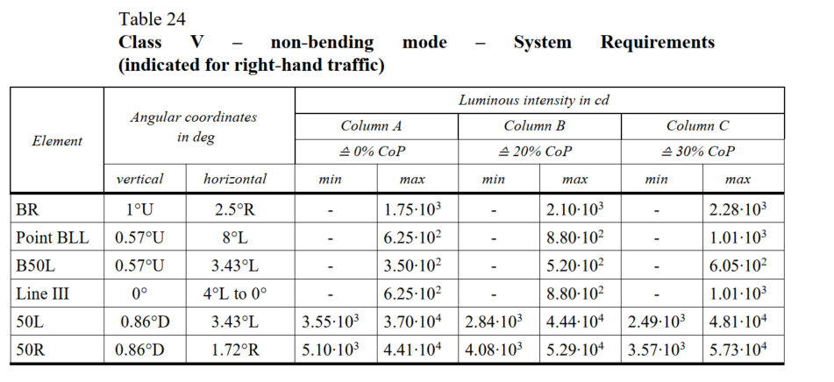
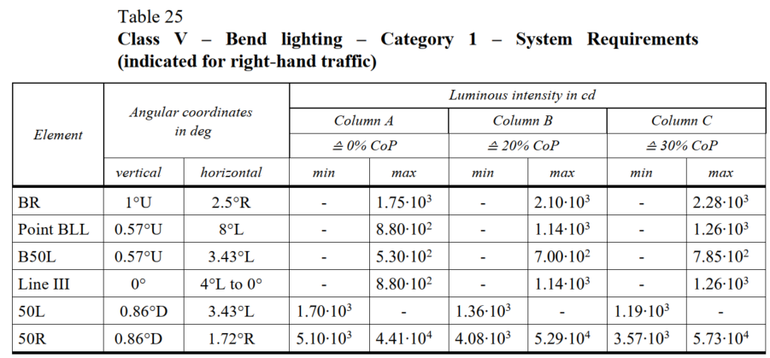
ECE R149-01
There is no maximum value requirement for the 50R point of V class in low beam light distribution table 7, but there is a maximum value requirement for V class in production consistency.
It is recommended to cancel the maximum value requirement for V class production consistency in Table 24 and Table 25.

Slide 4
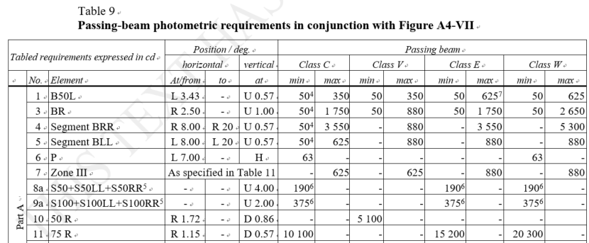
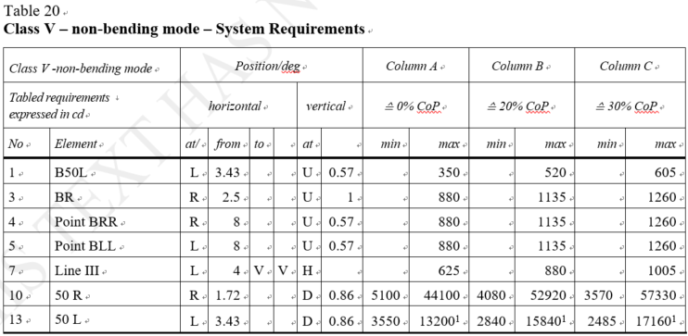
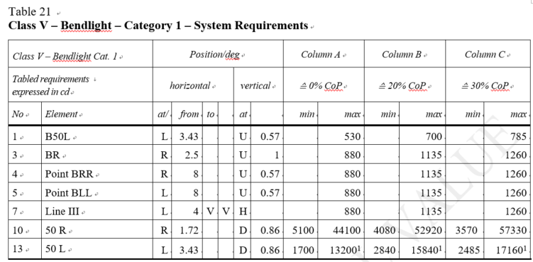
ECE R149-00
There is no maximum value requirement for the 50R point of V class in the adaptive low-beam light distribution table 9, but there is a maximum value requirement for V class in production consistency.
It is recommended to cancel the maximum value requirement for V class production consistency in Table 20 and Table 21.

Slide 5
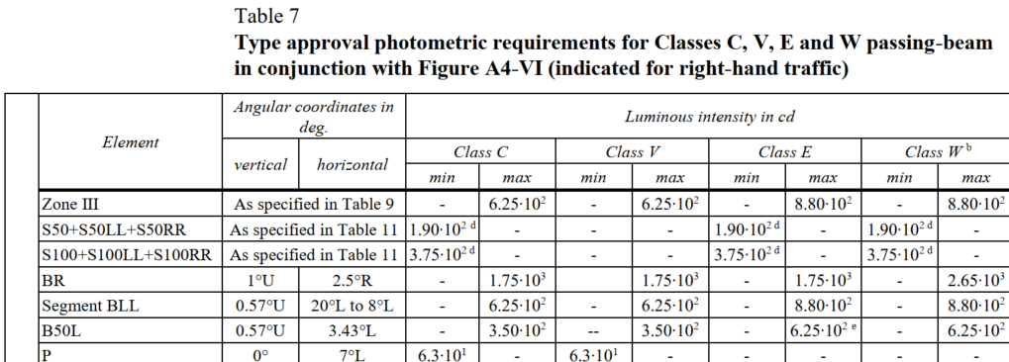
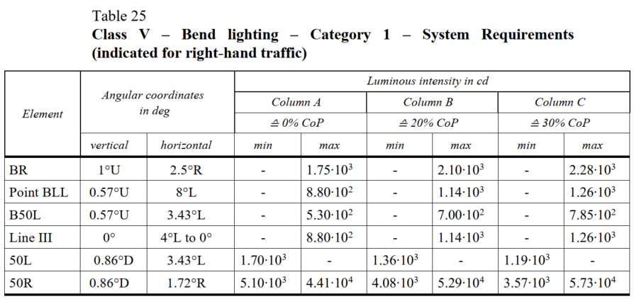
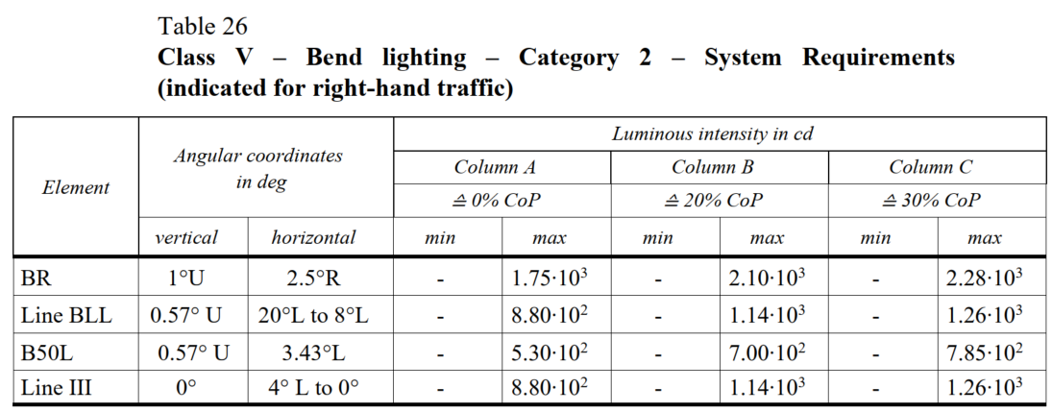
ECE R149-01
The maximum Segment BLL requirement for class V in the adaptive low-beam light distribution table 7 is 6.25·10², but the maximum requirement for 0%CoP of class V in the production consistency tables 25 and 26 is 8.80·10².
It is recommended to update Tables 25 and 26 The maximum value requirement for class V production consistency in Table 26 is 6.25·10², and its corresponding 20%CoP and 30%CoP values.

