Slide 1
Parking Lamp discussion document
Submitted by the experts of OICA
Informal document GRE-90-22
90th GRE, 29 April-3 May 2024
agenda item 6 (a)
Use of single sided parking lamp illumination when parking vehicles over 2 m in width
GRE-90 – April 2024

Slide 2
Problem Statement
Consumer demand and increased safety standards have increased the size of today’s vehicles
UN R48 paragraph 6.12.1. currently prohibits the installation of parking lamps on vehicles exceeding 2 m in width:
6.12.1. Presence
On motor vehicles not exceeding 6 m in length and not exceeding 2 m in width, optional.
On all other vehicles, prohibited.

Slide 3
Background Information
A position lamp can act as a parking lamp:
6.12.9. Other requirements
The functioning of this lamp may also be performed by simultaneously switching ON the front and rear position lamps on the same side of the vehicle. In this case, lamps that meet the requirements of front or rear position lamps are deemed to meet the requirements of parking lamps.
If a position lamp is used as a parking lamp the requirements of 5.11. do not apply:
5.11.1. This requirement does not apply while one or more of the following conditions exist:
(a) Front and rear position lamps, as well as side-marker lamps when combined or reciprocally incorporated with said lamps are switched ON as parking lamps;

Slide 4
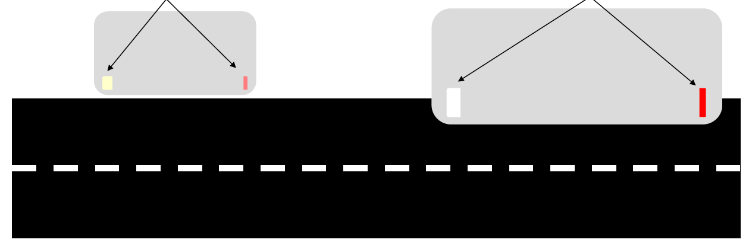
Background Information
Parking lamp (low intensity) or position lamp (higher intensity)
Allowed Condition
Parking lamp (low intensity) or position lamp (higher intensity)
Not allowed
<2 m
>2 m

Slide 5
Proposed Solution
Proposed amendment to allow single side illumination of the parking lamp when a vehicle is parked in a built-up area:
Parking Lamp
6.12.1. Presence
On motor vehicles not exceeding 6 m in length and not exceeding 2 m in width, optional.
On all other vehicles, prohibited.

Slide 6
Justification
Modern M1/N1 vehicles have increased in width due to safety systems and for the comfort of occupants. As a result, there are now M1/N1 vehicles in the market which exceed a width of 2 m.
UN R48 paragraph 6.12. does not allow parking lamps to be fitted to these vehicles.
To increase the safety of road users this proposal would extend the fitment of parking lamps to vehicles which exceed 2 m in width.

