Slide 1

Agreement concerning the adoption of uniform conditions for periodical technical inspections of wheeled vehicles and the reciprocal of such inspections
Informal document WP.29-192-19
Slide 1
А notification, sent by the Republic of Belarus
(Technical Inspection Certificates which are in use in the Contracting Parties as an alternative to the model of Appendix 2 of the Agreement (para. 4 Appendix 2))
Speaker: Brechka Pavel
the Deputy Head of the Department of Scientific and Technical Policy and Informatization of the Ministry of Transport and Communications of the Republic of Belarus
192st WP.29, 5-8 March 2024
Agenda item 7.1
Genevа, 2024

Slide 2

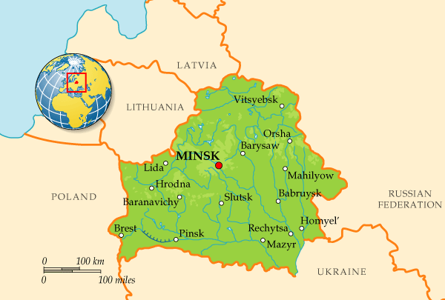
Slide 2
The Republic of Belarus - is one of the Contracting Parties
of the Agreement

Slide 3
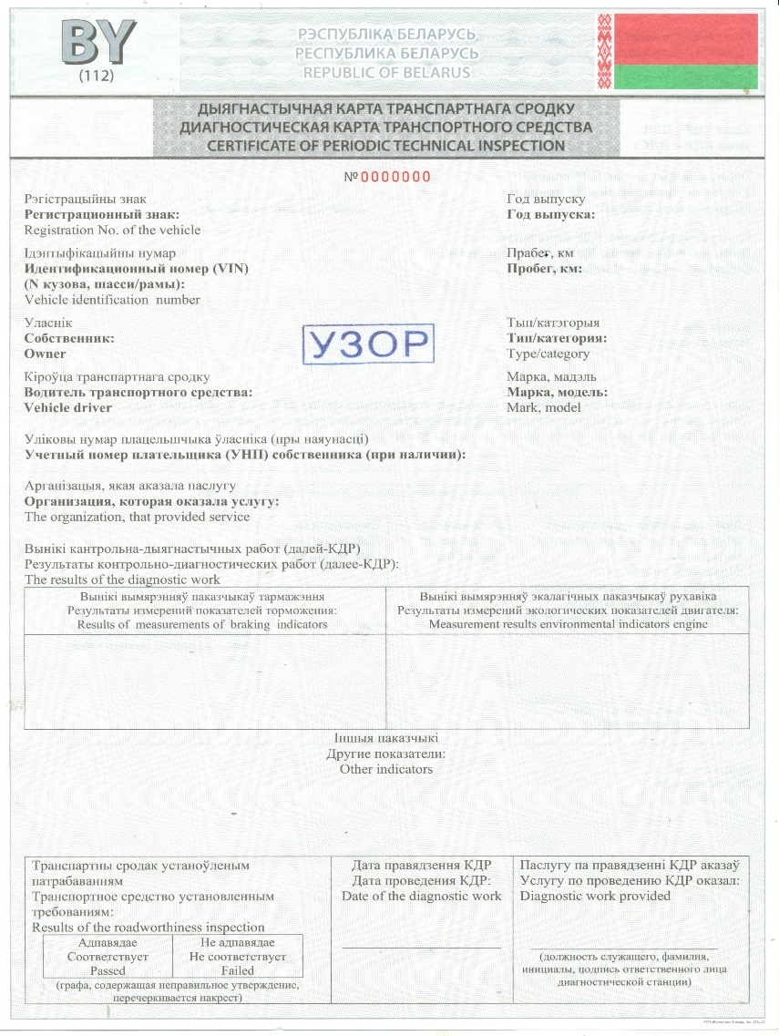

Slide 3
The Technical Inspection Certificates

Slide 4
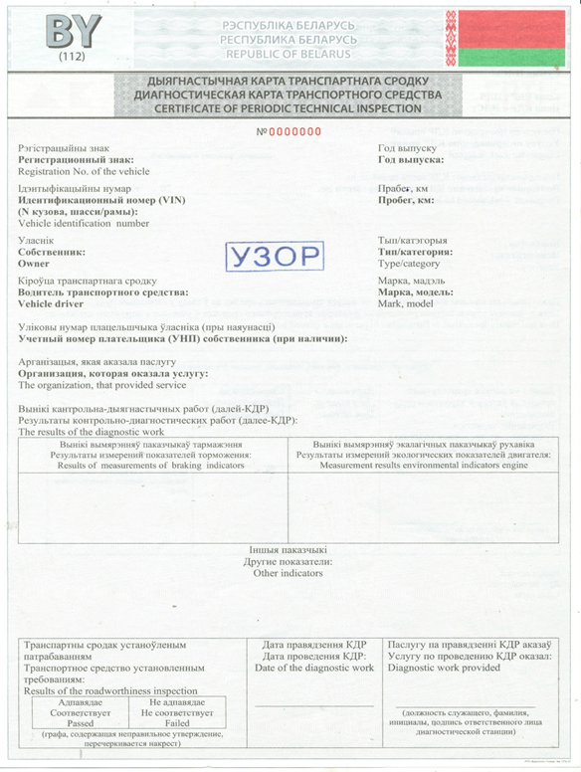
Determination of the country in which the document was issued
Slide 4

Slide 5

Slide 5
Basic information in three languages

Slide 6




Slide 6
Results of the roadworthiness inspection

Slide 7

Reduction of documents that the driver must carry
Slide 7

Slide 8
Slide 8
Thank you for your attention!

