Slide 1



Informal Document WP.29-192-06
192nd session of WP.29, 5 – 8 March 2024
Agenda item 2.4
TAKING AMBITIOUS CLIMATE ACTION
Decarbonising inland transport by 2050
ITC Strategy on Reducing Greenhouse Gas Emissions from Inland Transport
ECE/TRANS/2024/3
INLAND TRANSPORT COMMITTEE

Slide 2

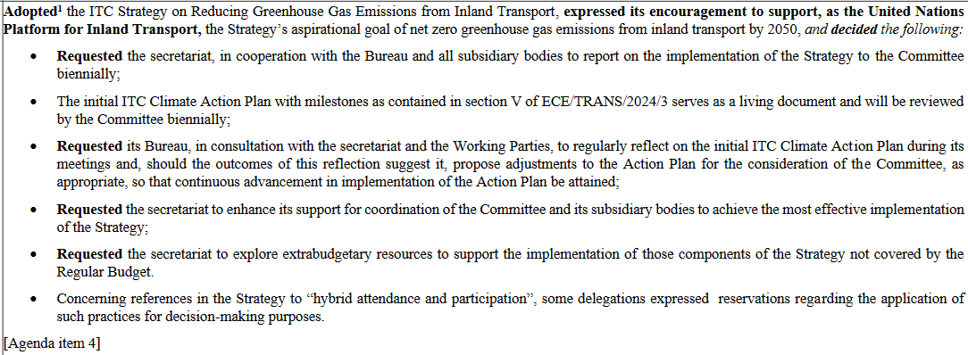
Decision from ITC at its 86th session
ITC adopted the ITC strategy on reducing GHG emissions from inland transport
Decision 4
ITC Bureau | November 2023 | Geneva

Slide 3

Climate strategy outline
Inland transport and climate
ITC vision and mission for climate action
Strategic objectives
ITC-administered instruments to assist in mitigating climate change
Initial ITC Climate Action Plan with milestones– ITC to help deliver on climate goals and priorities
Resource mobilization for the delivery of this Strategy
Partnerships
Periodic review
ITC Bureau | November 2023 | Geneva

Slide 4
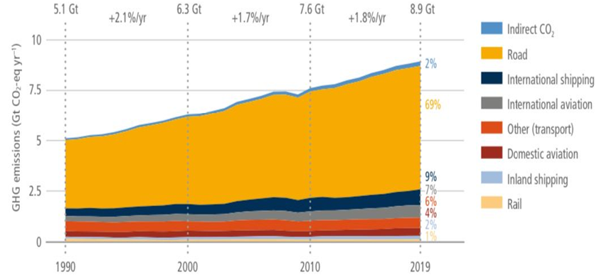
I. Inland Transport and Climate
Transport global GHG emissions trends 1990-2019
Back on past trend following COVID dip
Future Demand: Passenger demand set to rise by 79% by 2050 compared to 2019, while Freight demand will double (ITF, 2023).
Meeting the goal of the Paris Agreement to UNFCCC: Need to limit temperature rise to 1.5°C. This will require GHG emissions to peak before 2025 and reduce by 43% by 2030 (6th IPCC Report, 2022).
UN’s stance: "Decarbonize all means of transport to achieve net-zero emissions by 2050." - UN Secretary-General (Beijing, 14 to 16 October 2021).
Strategic Overview: Urgent action to support inland transport. Builds upon prior strategies by IMO, ICAO, ITC strategy until 2030(ECE/TRANS/288/Add.2) and Committee’s revised Terms of Reference endorsed by ECOSOC (E/RES72022/2).
Source: 6th IPCC report 2022, “Climate Change 2022 - Mitigation of Climate Change”, Sixth Assessment Report of the Intergovernmental Panel on Climate Change, Working Group III.
ITC Bureau | November 2023 | Geneva

Slide 5
II. ITC Vision & Mission for Climate Action
Vision
The Inland Transport Committee and its subsidiary bodies take urgent action to assist its member States and Contracting Parties to United Nations legal instruments under its purview in achieving the aspirational goal of net zero GHG emissions from inland transport by 2050.
Mission
ITC’s mission is to contribute to decarbonization of inland transport by its member States and Contracting Parties to United Nations legal instruments under ITC’s purview through enhanced regulatory support, intergovernmental policy dialogue, and increased coordination and partnership among all relevant stakeholders.
In doing so, the ITC draws from a broad decarbonization framework that draws on avoid-shift-improve measures which Member States may implement in any of or across the following areas:
Avoid unnecessary vehicle kilometres through compact development, increasing accessibility to services, and reducing the need to travel as much as we do today
Shift to low carbon, sustainable transport modes and/or operations; and
Improve vehicles, infrastructure and operations.
ITC Bureau | November 2023 | Geneva

Slide 6
III A. Strategic objectives for the ITC and
its subsidiary bodies
1. Increased Inter & Intra-regional Governance
Strengthen & elaborate inland transport regulatory framework.
2. Enhanced and more coordinated climate actions by and among ITC Subsidiary Bodies
ITC provides enhanced guidance to their members on climate change abatement.
3. Increased intergovernmental Support for Climate Change mitigation and adaptation
Foster regular policy dialogue for cooperation among member States and contracting parties to the United Nations inland transport legal instruments;
Monitor progress on decarbonization of inland transport globally;
Provide technical assistance advisory services, including awareness-raising, technical support, workshops, training and projects in support of climate change abatement;
Provide analytical support.
ITC Bureau | November 2023 | Geneva

Slide 7

III B. Strategic objectives for the implementation of the strategy by inland transport sector
(a) Develop and enhance policies, legislation and measures
Assess the feasibility and potential benefits to develop inland transport decarbonization action plans to the ITC & align, if applicable, with UNFCC NDCs & LTS
Fully implement UN inland transport legal instruments
Deploy carbon-neutral technologies & harmonize standards across border
Facilitate modal shifts from road to rail/inland waterways & multimodal mobility
Promote public transport and shared mobility options
Ease the adoption of zero to low-carbon modes of transport
Promote data collection on active mobility and Encouraging the use of globally harmonized indicators to monitor progress of inland transport decarbonization
(b) Foster the efficient use of energy
(c) Promote research and development in cooperation with academia and non-governmental bodies
(d) Support circular economy related practices
ITC Bureau | November 2023 | Geneva

Slide 8






III C. Horizontal objectives
Key role of the ITC:
Through its unique intergovernmental framework, ITC provides comprehensive support to its members and contracting parties to the UN legal instruments in ensuring actions aimed at decreasing GHG emissions:
Prioritizing Transport Affordability, Safety & Security
Avoiding Negative Environmental and Health Externalities
Fostering Inclusive Transport
Making Transport Infrastructure and Operations resilient to climate change.
Implementation of SDGs:
Reduced traffic crashes, impact on air pollution and climate (SDGs 3 & 13)
Improved urban mobility (SDG 3)
Industry innovation & efficient infrastructure (SDG 9)
Affordable and clean energy (SDG 7)
Multi-stakeholder partnerships for 2030 Agenda (SDG 17)
Source: UNECE
ITC Bureau | November 2023 | Geneva

Slide 9

IV. ITC-administered instruments to assist in mitigating climate change
Under ITC purview:
60 UN inland transport legal instruments, 49 in force; 152 UN Member States are parties to at least one legal instrument, increased accessions from outside ECE region
Key areas in the avoid-shift-improve framework:
AVOID: Develop tools and resource materials on increasing urban mobility efficiency (toolkit, publications, guidelines); promote transport-oriented urban development.
SHIFT: UN inland transport infrastructure agreements support shift to low carbon, sustainable transport modes and operations: AGC, AGN for inland waterways and rail; AGTC for multimodal transport. Road traffic, transport of dangerous goods and vehicle conventions ensure road safety in decarbonization policies.
IMPROVE: The globally-harmonized UN Vehicle Regulations improve vehicles and their operations; infrastructure agreements under the ITC purview improve inland transport infrastructure. Their climate change mitigation relevance could be enhanced with additional parameters on the availability (e.g., EV charging infrastructure, hydrogen refilling stations).
ITC Bureau | November 2023 | Geneva

Slide 10
IV. ITC-administered instruments to assist in mitigating climate Change
WAY AHEAD IN CLIMATE CHANGE MITIGATION
ITC subsidiary bodies should
Request contracting parties to apply climate considerations for amendments to the legal instruments.
For example by:
- including a standing agenda item for subjective climate impact assessment of WPs’ decisions.
- Each WP is fit for remote/hybrid decision taking
Legal instruments can be updated by WPs
By adding clauses and/or Protocols.
Develop additional legal instruments for the inland transport sector’s decarbonization.
Accelerated accessions beyond the ECE region
Open legal instruments for all UN Member States' accession/ratification for carrying further their contribution to climate change abatement.
Support and implementation
Provide capacity development and policy advice under ITC’s framework.
Develop analytical and technical guidance materials.
ITC Bureau | November 2023 | Geneva

Slide 11
V. Initial ITC Climate Action Plan with milestones– ITC to help deliver on climate goals and priorities
Initial actions for ITC and its subsidiary bodies to drive the change towards achieving the vision, mission and strategic objectives for curbing GHG emissions from inland transport.
It comprises actions for specific ITC bodies, including joint and coordinated action among them. Indicative target years for implementation of each action are provided, which ITC can adjust depending on progress achieved.
The action plan should serve as a living document. ITC will adjust and/or include therein additional actions during the plan’s biennial review based on proposals made by its subsidiary bodies while completed actions will no longer be reflected in it.
Actions targeting feasibility assessments will be considered by ITC or its subsidiary bodies based on the results stemming from these assessments so that follow-up actions are either implemented or terminated. In this way, ITC will manage this action plan.
ITC Bureau | November 2023 | Geneva

Slide 12
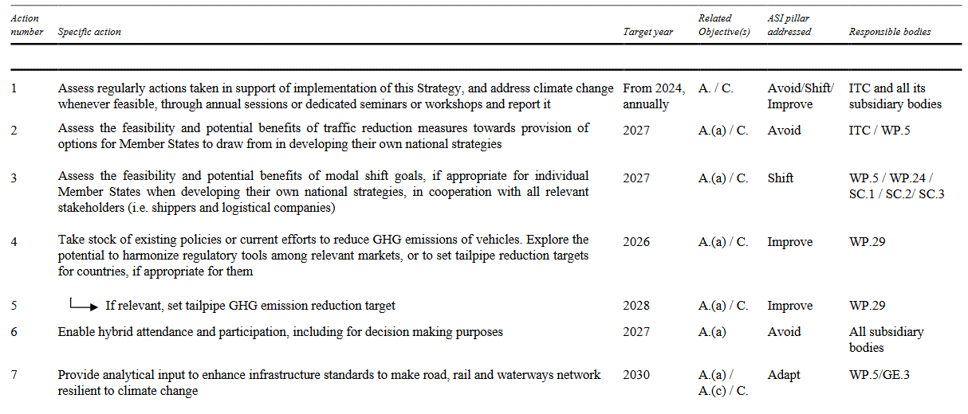
V. ITC Climate Action Plan with milestones– ITC to help deliver on climate goals and priorities
Similar topic already in GRPE list of emission topics
ITC Bureau | November 2023 | Geneva

Slide 13
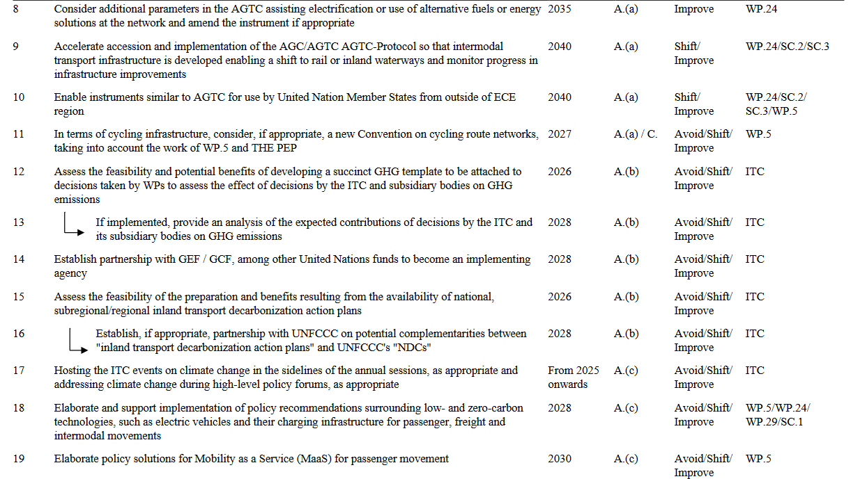
ToRs for WP.5 informal TF on e-mobility adopted, as introduced Nov 2023 WP.29

Slide 14
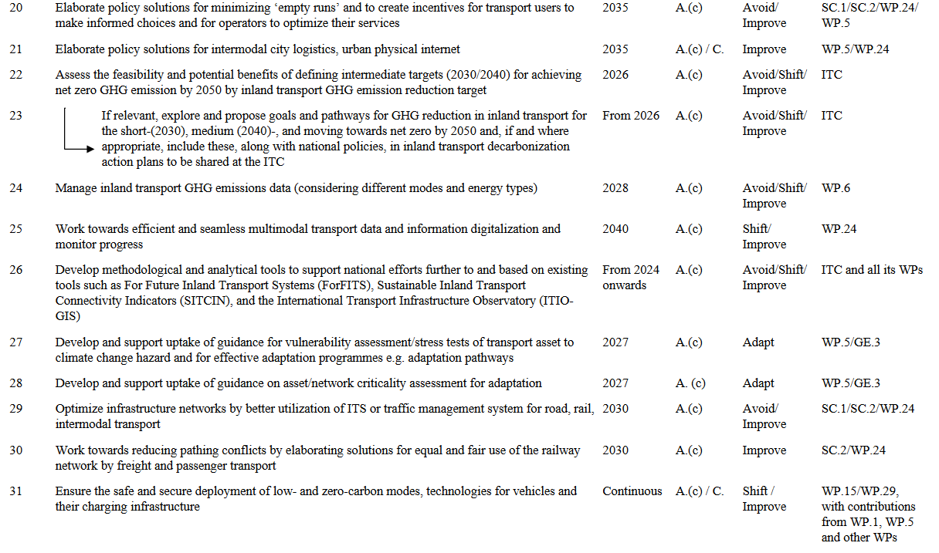
All GRs to contribute

Slide 15
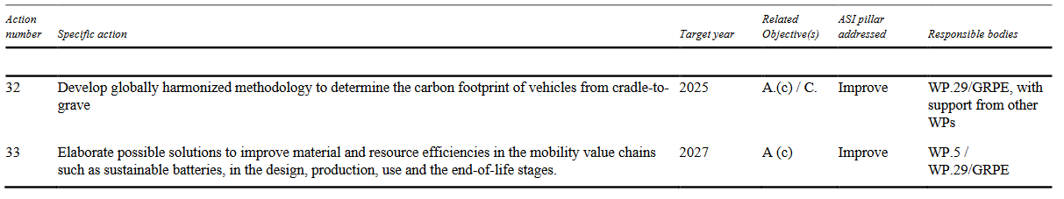
V. ITC Climate Action Plan with milestones– ITC to help deliver on climate goals and priorities
IWG on A-LCA
ITC Bureau | November 2023 | Geneva

Slide 16
VI. Resource mobilization for the delivery of this Strategy
Regular budget resources provided by member States to the ECE Transport subprogramme will continue to fund staff to service and update the existing legal instruments under the ITC’s purview and develop new ones.
The Working Parties and the secretariat will schedule their activities to evenly distribute the workload according to the initial ITC Climate Action Plan as well as resources available.
…implementation action, in particular relevant research activities, could be accelerated through additional extrabudgetary resources to be raised, among others, from developed countries.
ITC Bureau | November 2023 | Geneva

Slide 17
VII. Partnerships
ITC: A CENTRAL PLATFORM FOR KEY STAKEHOLDER COLLABORATIONS
Global partnerships: UN organizations (UNFCCC, UNEP, WHO, the PEP, WMO, ITU), inter-sectoral (ICAO, IMO).
UNFCCC & ITC: information exchange, transport decarbonization, UN GHG guidance, align ITC & UNFCCC discussions.
UN Secretariat: partnerships with DESA, UN regional commissions; ITC & ECE Committees collaboration (e.g., GHG reduction via UNECE Forum of Mayors) & energy experts (WP.5).
Cooperation: ICAO & IMO.
Partnerships: financial institutions (GEF, GCF, World Bank Group), regional organizations (EU, EAEU).
ITC: collaboration with transport organizations (ITF, IRU, OTIF, UIC) & NGOs/civil societies.
Collaborate: decarbonization initiatives (Breakthrough Agenda, Net Zero Coalition), transport & EV manufacturers, academic researchers for climate innovations.
ITC Bureau | November 2023 | Geneva

Slide 18

VIII. Periodic review
Review Cycle
Every 5 years (First in 2029) / Action plan reviewed biennally
ITC's Responsibilities:
Central coordination & defining review scope and terms of reference.
Assess progress of strategic objectives and action plan & set new actions and targets.
Knowledge Update: Incorporate latest knowledge on the decarbonization of the inland transport sector (e.g., latest reports from Intergovernmental Panel on Climate Change.
Monitoring & Reporting:
Regular monitoring Strategy implementation by ITC's subsidiary bodies.
Biennial action reports & annual initiatives at ITC Forum on Climate change.
Source: UNECE
ITC Bureau | November 2023 | Geneva

Slide 19
TAKING AMBITIOUS CLIMATE ACTION
Decarbonising inland transport by 2050
INLAND TRANSPORT COMMITTEE
Thank you!

