Slide 1
UNECE Task Force
on the Role of NSOs in Achieving National Climate Objectives
Malgorzata Cwiek
Statistical Division
United Nations Economic Commission for Europe
9th Joint OECD/UNECE Seminar on the Implementation of SEEA
20 March 2024

Slide 2
Background UNECE work on climate change-related statistics
UNSC programme review on CC and official statistics
2009
2011
2012
2013
2014
2015
2016
2017
2018
2019
2020
2021
2022
CES Task Force on climate change related-statistics
CES recommendations on CCRS
UNECE Expert Fora for Producers and Users of Climate Change-Related Statistics
CES initial indicator set
CES refined set of indicators and an in-depth review
New Task Force on the Role of NSOs

Slide 3
Background Members, objective and timeline of the Task Force
Objective
Develop guidance on how NSOs can contribute to achieving national climate objectives – identify concrete ways in which NSOs can be involved and showcase what the statistical system already offers to support climate action. The Guidance is meant to inspire and support people working in NSOs who want to start working on climate change-related statistics or want to do more.
Active Members (± 30)
NSOs: Netherlands (Chair), Armenia, Azerbaijan, Belarus, Canada, Costa Rica, Denmark, Ireland, Italy, Poland, Serbia, Spain, Türkiye, United Kingdom, Ukraine…
Ministry of Environment / GHG inventory: Armenia, Belarus, Poland, Costa Rica …
IOs: ECLAC, ESCAP, ECA, ECB, EEA, Eurostat, IMF, IEA, PARIS21, UNFCCC, UNSD, UNEP…
Timeline
February 2022 – start of the work
August 2022 and 2023 – progress review by the Expert Forum
February 2024 – approval of the draft report by the CES Bureau
April 2024 – broad consultation with all CES member countries and international organizations
3

Slide 4
Background
Guiding principles for the work
Target audience
Primary audience: NSOs who start or develop their work in this area
Document may also be useful to data users to inform about what NSOs can offer and international organizations
The Guidance is meant to…
Showcase how NSOs can contribute through, e.g.: producing data and indicators, helping standardize data produced by others, building up data inventories, coordinating within the statistical office and with other agencies and ministries, knowledge sharing, and improving the accessibility and use of data for informing the public
Build on existing resources and materials
Define the main questions about the role of NSOs, identify differences and similarities between countries, and the main challenges
Provide a portfolio of real country examples, including statistical activities and products, collaborations, institutional arrangements etc.
Not: Reinvent the wheel, develop new indicators, classifications or frameworks
…

Slide 5
Guidance on the Role of NSOs in Achieving National Climate Objectives
Introduction
Institutional landscape and the role of NSOs
Reporting under the Paris Agreement
Statistics for climate change mitigation policymaking
Statistics for climate change adaptation policymaking
Statistics for just transition policymaking
Informing the public
Climate finance and financial aspects of climate action
Guidance on cross-cutting issues
Conclusions/recommendations and future work
Each chapter from 3 to 8 examines policy context, definitions and data needs and identifies how NSOs can contribute

Slide 6
Chapter 1: Institutional landscape and role of NSOs Role of NSOs, statistical frameworks and indicator sets
NSOs…
Frameworks
Are the main part of national statistical systems and produce official statistics on key topics for the economy and society
Have the mandate for and expertise on data collection, safeguarding, processing and dissemination
Are professionally independent providers of data for public good in line with the Fundamental Principles of Official Statistics
Framework for Development of Environment Statistics
System of Environmental-Economic Accounting
International Recommendations for Energy Statistics
Disaster-Related Statistics Framework
And: IPCC Guidelines for National GHG Inventories
Indicator sets
CES Set of Core Climate Change-Related Statistics and Indicators
Global Set of Climate Change Statistics and Indicators
CES Set of Core Disaster-Risk-Related Indicators
Sendai Framework indicators
SDG Global Indicator Framework

Slide 7
Chapter 1: Institutional landscape and role of NSOs Roles in producing statistics and data

Slide 8
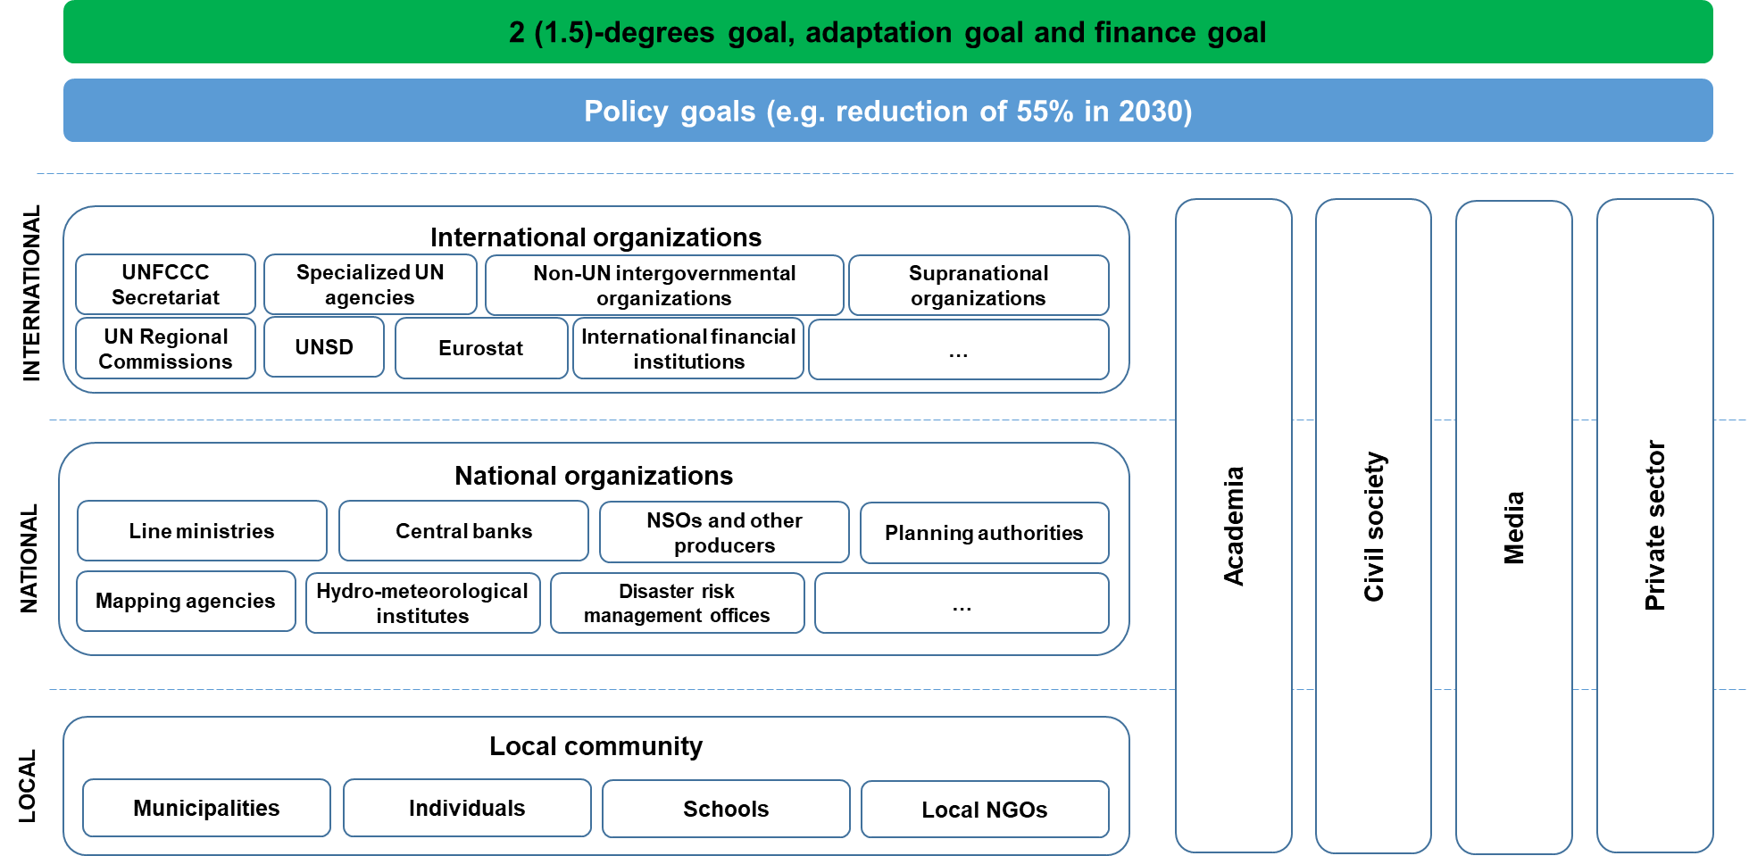
Chapter 1: Institutional landscape and role of NSOs Examples of actors by main stakeholder group

Slide 9
Chapter 5: Statistics for climate change adaptation policymaking Concepts and definitions related to CC adaptation
Understanding the key terms
Adaptation: “in human systems, (…) the process of adjustment to actual or expected climate and its effects, in order to moderate harm or exploit beneficial opportunities”, where the potential for adverse consequences (risk) results from “interaction between climate-related hazards with the exposure and vulnerability of the affected human or ecological system” (IPCC AR6) + successful adaptation vs. maladaptation
Hazard: “The potential occurrence of a natural or human-induced physical event or trend that may cause loss of life, injury or other health impacts, as well as damage and loss to property, infrastructure, livelihoods, service provision, ecosystems and environmental resources.”
Exposure: “The presence of people; livelihoods; species or ecosystems; environmental functions, services, and resources; infrastructure; or economic, social, or cultural assets in places and settings that could be adversely affected.”
Vulnerability: “The propensity or predisposition to be adversely affected. Vulnerability encompasses a variety of concepts and elements, including sensitivity or susceptibility to harm and lack of capacity to cope and adapt.”
And relationships between them

Slide 10
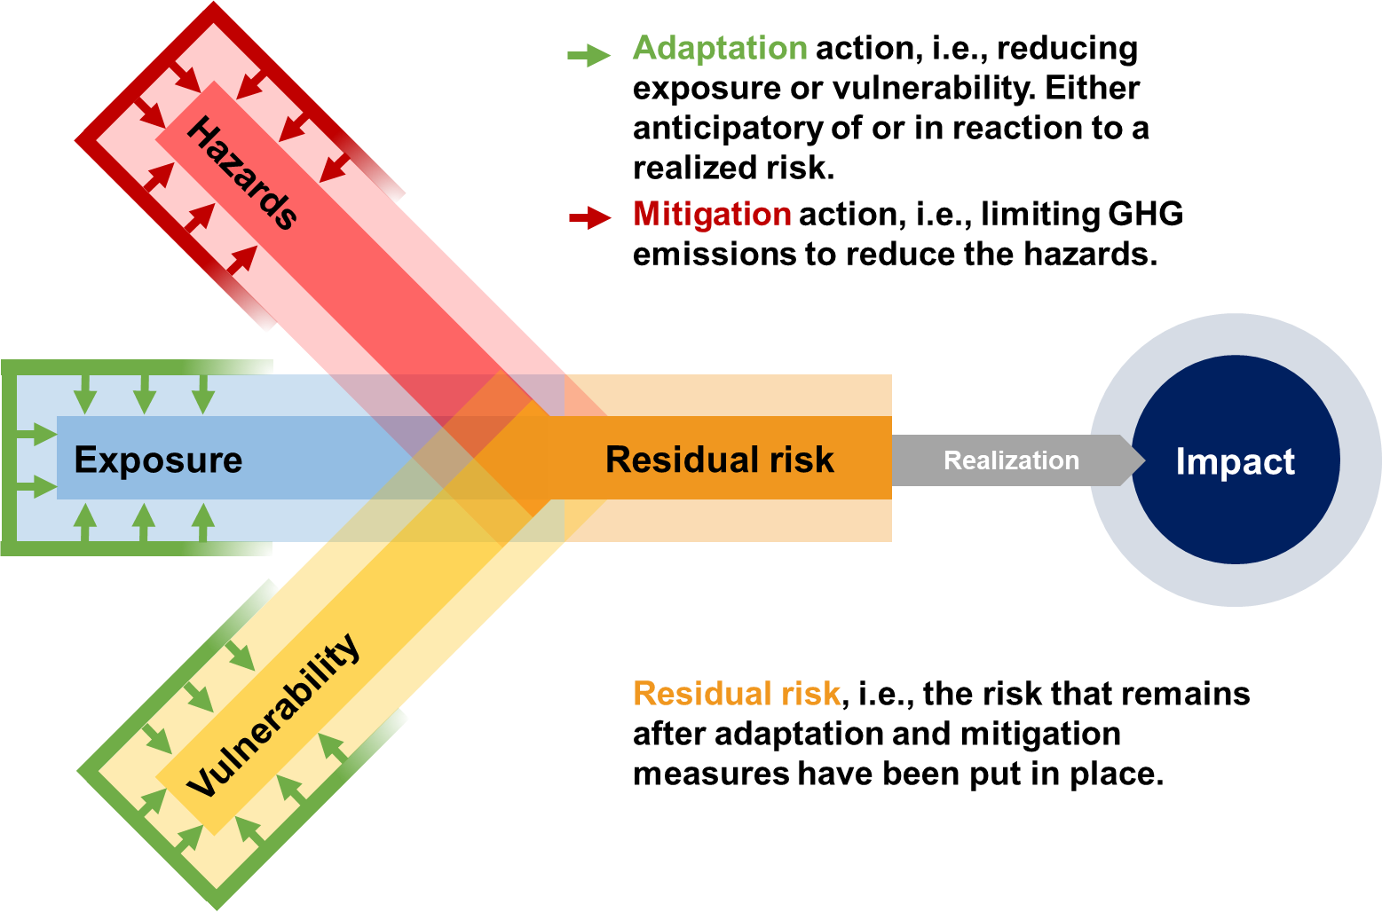
Chapter 5: Statistics for climate change adaptation policymaking Concepts and definitions related to CC adaptation

Slide 11
Chapter 5: Statistics for climate change adaptation policymaking Policy context
National Adaptation Planning (NAP) and Implementation Process
NAP process enables countries to ‘assess vulnerabilities, mainstream CC risks and address adaptation’ and can be used to understand the scope of information needed for effective adaptation policymaking
Explaining the Adaptation Policy Cycle:
Assessing impacts, vulnerability, risks and resilience
Planning for adaptation
Implementing adaptation measures
Monitoring & evaluation
Did you know?
Technical guidelines for the national adaptation plan process (2012) highlight that a data plan for the NAP M&E should be developed and supported with adequate resources and data should be collected and stored in a systematic manner. The responsibility for compilation and aggregation of data collected from multiple agencies should be clearly assigned to one agency, which could be the NSO.

Slide 12
Chapter 5: Statistics for climate change adaptation policymaking Policy context
Challenges in implementing and assessing adaptation
Insufficient institutional arrangements, lack of knowledge and capacity, unreliable and outdated data and information, lack of existing policy, lack of resources
Did you know?
The UNFCCC Adaptation Committee’s 2022 Synthesis report for the technical assessment component of the first global stocktake specifically mentions gaps in socioeconomic data, especially collocated with climate observations as one of challenges in adaptation, which could inhibit a more accurate identification of climate risks and the attribution of observed changes to either climate impacts or socioeconomic developments.
It also notes the following potential opportunities for enhanced action, support and international cooperation:
Enhancing open access to existing climate and socioeconomic data,
Exploiting the potential of, among others, national statistical systems, and
Establishing international arrangements for the coordination of socioeconomic data collection and management, e.g. new adaptation-relevant official statistics

Slide 13
Chapter 5: Statistics for climate change adaptation policymaking How NSOs can contribute?
Roles
Identifying the current role and coordinating with other organizations
Identifying and producing relevant statistics and indicators – by statistical domain:
Demographic and social statistics, health statistics, economic statistics, agriculture statistics, energy statistics, environment statistics, hazardous events and disasters, System of Environmental-Economic Accounting
Linking data from different sources or domains
Subnational focus and geospatially enabled statistical data
Sharing data and microdata for research and risk analyses
Playing a role in adaptation monitoring and evaluation
Promoting harmonization and international comparability through use of existing classifications and indicators
Linking work already done by NSOs (based on collected examples) with policy questions in the context of meeting information needs related to climate change adaptation

Slide 14
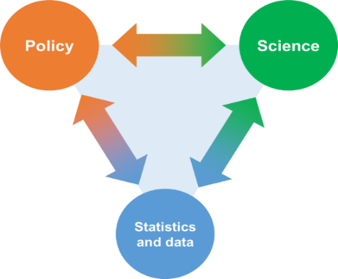
Data is integral to the implementation of the Paris Agreement
How can the statistical community contribute to climate action?
Enhanced Transparency Framework and Global Stocktake
Enabling new research
Possible involvement in GHG inventories, NDC tracking reporting on adaptation – from providing source data to active collaboration
Improving availability of internationally comparable data to facilitate both ETF and Global Stocktake
GLOBALLY
Mitigation
Adaptation
Just transition
Monitoring energy transition and other activities
Monitoring enablers for transition like infrastructure, green jobs and perceptions
Data on populations, infrastructure and ecosystems which are vulnerable or exposed to risk
Localized, granular data
Impact of policies by populations groups, gender, regions, e.g. energy poverty
Linking environmental with social and economic data
NATIONALLY AND LOCALLY

Slide 15
Data is integral to the implementation of the Paris Agreement
How can the statistical community contribute to climate action?
Informing the public
Making statistics and data easy to access and use – dedicated portals, explanations for users with various levels of expertise, various dissemination formats, e.g. for analysts, journalists, students, bloggers
Building trust and public awareness through transparent, reliable and relevant data
Financial aspects of climate action
NATIONALLY AND LOCALLY
Coordination, cooperation and standardization
Government expenditures, subsidies and transfers
Supporting national climate finance reporting
Climate impacts of economic/financial activities
Data for assessing physical and transition risks
Measuring climate investment

Slide 16
Role of national statistical offices in achieving national climate objectives
Cross-cutting issues
Governance and coordination
Engagement with policymakers
Strengthening data collection
Local and geospatially enabled data
Collaboration with researchers and academia
Perceptions, attitudes and behaviours
Conclusions, recommendations and further work
Conclusions
Recommendations
Climate change is a big societal issue
NSOs have a strong basis for supporting work and already a lot to contribute
Statistical system needs to catch up with the climate community
Establishing collaborations, sharing the work, leveraging the expertise
Get engaged with the climate community
Start with existing statistics and data
Cooperation and capacity building
Governance and procedures
Content and development of new information
Further work: building relations, supporting new reporting, work on new topics, promotion of the Guidance

Slide 17
Key resources
Pages of the past Expert Fora 2012-2023
Climate Change-Related Statistics in Practice 2023 (August 2023)
Climate Change-Related Statistics in Practice 2022 (September 2022)
Climate Change-Related Statistics in Practice 2021 (August 2021)
CES Set of Core Climate Change-Related Indicators and Statistics Using SEEA (August 2021)
Reporting on climate data and information under the Paris Agreement: A potential opportunity for national statistical offices to get involved (UNFCCC, June 2021)
In-depth review on the role of the statistical community in climate action (February 2020)
Road maps to improve climate change-related statistics Word Russian (March 2017)
Leaflet summarizing the CES Recommendations also in Russian (October 2016)
CES Recommendations on Climate Change-related Statistics (December 2014)
All the resources available on the web

Slide 18
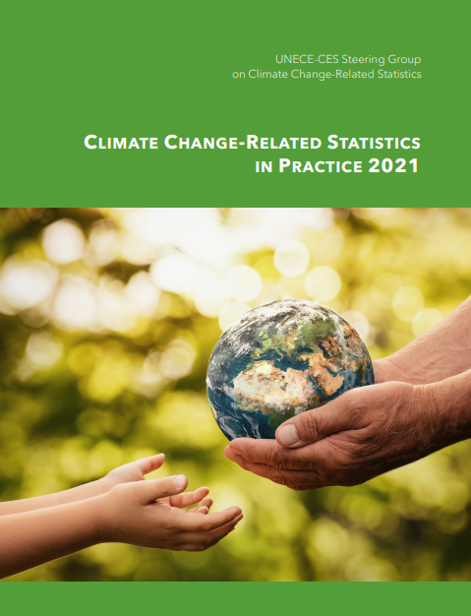
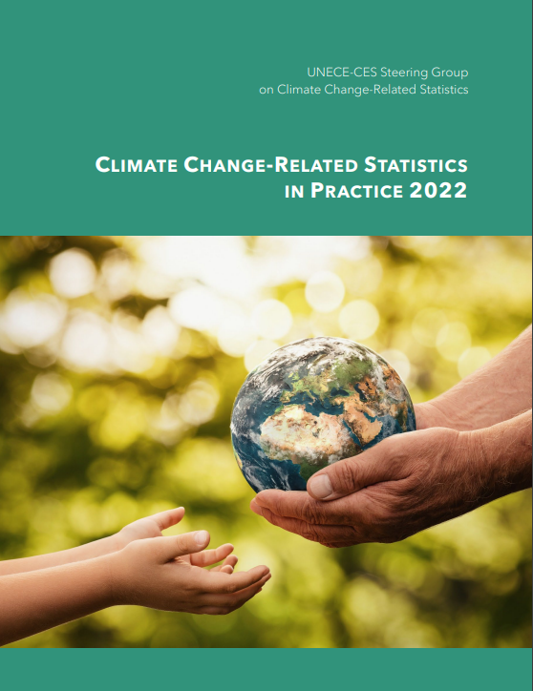
Collecting good practices Climate Change-Related Statistics in Practice 2021-2023
Link to the document
Link to the document
Link to the document

Slide 19
Thank you!
Malgorzata Cwiek
cwiek@un.org
20 March 2024

