Slide 1
Status report to the 79th session of GRBP (February 2024)
Transmitted by the chair of the TF-SL (Sound Limits)/VS (Vehicles’ Sound)
Informal Document GRBP-79-40
79th GRBP, 6-9 February 2024
Agenda item 13
Task Force Vehicles’ Sound
(TF-VS)
NB: previous name of this TF was TF-SL for Sound Limits

Slide 2
TF Vehicles‘ Sound: Key Points
Reminder
“The experts from EC, ETRTO and OICA reported on their studies on sound level limits (GRBP-73-23, GRBP-73-11 and GRBP-73-25, respectively). To coordinate such initiatives, GRBP decided to establish a taskforce (TF) and sought a volunteer among the experts from Contracting Parties to take the leadership of TF, while OICA agreed to act as secretary. GRBP considered that TF should address the sound level limits of UN Regulation No. 51 and, at a later stage, No. 41. To kick-off the TF activities without delay, the Chair pointed out that he could take the lead of TF on a temporary basis, if needed.”
Roles
Chair: France
Secretariat: OICA
TF-VS homepage
Task Force on Sound Limits (TF SL) - Transport - Vehicle Regulations - UNECE Wiki

Slide 3
TF Sound Limits / Vehicles‘ Sound: Facts and Figures
Meetings were held in hybrid or virtual depending on the pandemic situation at that time
14
~60-70
Number of Meetings
Participants (Contracting Parties, NGOs, Guests)
01st TF SL: March 24, 2021 (TFSL-01-07)
02nd TF SL: May 26, 2021 (TFSL-02-12)
03rd TF SL: July 12-13, 2021 (TFSL-03-08)
04th TF VS: September 13-14, 2021 (TFVS-04-16)
05th TF VS: October 26-27, 2021 (TFVS-05-07)
06th TF VS: December 17, 2021 (TFVS-06-04)
07th TF VS: February 07, 2022 (TFVS-07-15)
08th TF VS: April 04, 2022 (TFVS-08-10)
09th TF VS: May 24, 2022 (TFVS-09-08)
10th TF VS: July 12, 2022 (TFVS-10-08 )
11th TF VS: September 09, 2022 (TFVS-11-09)
12th TF VS: July 10, 2023 (TFVS-12-08)
13th TF VS: August 29, 2023 (TFVS-13-05)
14th TF VS: November 10, 2023 (TFVS-14-06)
CPs: China, European Commission, France, Germany, India, Italy, Japan, Spain, Switzerland, The Netherlands, United Kingdom
NGO‘s: CLEPA, ETRTO, EUWA, IMMA, ISO, OICA
GUESTS: Aristotle University, ATEEL, BRUITPARIF, FEDRO, FEV, HS Data analysis & Consultancy, IDIADA, JARI, TNO, Brussels Env., …

Slide 4
TF VS – MAIN WORKS DONE & ONGOING (1/3)
GUIDELINES OF THIS TASK FORCE:
During the 01st Session, a subgroup decided to draft a proposal that was approved at the 03rd Session and subsequently updated at the 04th session.
Change of the name of this TF from TF-SL (Sound limit) to TF-VS (Vehicle Sound)
During the 13th session, it was pointed out the necessity to update the Guideline to take into account the future activities of the TFVS. It will be managed during next TFVS occurrences
On going
Informal document
GRBP-74-03 Rev.1
GRBP-74-03 Rev 02 (Work in progress)
Need to identify where the noise issues lie e.g. through a cross-matrix to get a reference scenario as close as possible of real life
Identified a subgroup within the TFVS to define a Cross-matrix.
Activities still on-going due to the complexity of the topic for example difficult to gather the required input data.
TFVS-02-07
TFVS-04-14
TFVS-05-06
TFVS-07-08
TFVS-06-03
TFVS-06-05
TFVS-07-05
TFVS-07-13
TFVS-08-06
TFVS-09-06
TFVS-12-06
On going
Impact of AVAS (UN-R138) on Noise Emissions (UN-R51) at low speeds
Thoughts from some Noise experts related to UN-R138 & UN-R51 matching
Actions to be defined through the documents related to the UN-R138
→ To be followed with the new TF-QRTV (UN-R138-02)
On going with the UN TF-QRTV
TFVS-04-12
TF-QRTV (UN-R138-02)

Slide 5
TF VS – MAIN WORKS DONE & ONGOING (2/3)
EC study on sound level limits of M, N, L-cat. Veh. → Analysis & comparison between the different studies :
A lot of different points have been discussed and highlighted (for details see UNECE TF-VS Website) → work to be continued
Done
EC Report for M/N
EC Report for L
ATEEL(OICA) Report (GRBP-75-16)
GRBP-76-14 ATEEL/OICA Comparison
TFVS-11-06 ETRTO comments
(OICA) Comparison of EMISIA and ATEEL study
Done
A lot of studies about vehicles, tyres, roads, methods, enforcement … has been presented during the 12 sessions of the TF-VS (see UNECE TF-VS Website) with a potential to improve the noise in real life.
The TF agreed to the creation of a subgroup with the aim of preparing a Report in order to provide an overview and a common view of topic discussed from March 2021 to September 2022 and identify the potential for the future.
The full report has been completed, presented during the 12th session of the TF-VS and shared (see link on the right).
Volunteers: CPs with France, The Netherlands, Japan, and NGO with IMMA, OICA, ETRTO, ISO
TFVS-14-05 (Status Report TFVS-12th)
Full Report

Slide 6
TF VS – MAIN WORKS DONE & ONGOING (3/3)
TOPICS DISCUSSED DURING TFVS-14 SESSION:
(SINTEF) “Representativity of ISO test track surface based on controlled pass-by and CPX measurements.”
(NTSEL) “Illegal muffler vehicle detection system under development at NTSEL”
(ENBF) “Environmental Sustainability and Durability of Noise Barriers”
Cross matrix: status of the activities and future development
Done
TFVS-14-06 (Status report)
TOPICS STILL OPEN FOR THE NEXT SESSIONS:
Update of previous national presentations (EC, Japan, UK, China, Germany, Belgium …) and others (OICA, IMMA, ETRTO …)
Cross-matrix
Next steps to be decided
…
On going
To be continued
The NEXT 15th Session is scheduled for April 12, 2024
Hybrid – Paris OICA Offices / US-CANADA
TBD

Slide 7
Feel free for any comments / suggestions.
Feel free for contacting our subgroup to get any additional information and/or contribute to the work of our subgroup.
Thank you!

Slide 8
Backup documents

Slide 9
Work done by the sub-group Extract from the presentation done at the 12th session (TFVS-12-05)
REPORT OF THE 11 TF-VS SESSIONS

Slide 10
TF Sound Limits / Vehicles‘ Sound: Facts and Figures
Other Meetings
SUBGROUP on
the report of the 11 sessions
Volunteers
(Contracting Parties & NGOs)
01st Subgroup: October 21, 2022
02nd Subgroup: November 04, 2022
03rd Subgroup: November 29, 2022
04th Subgroup: December 14, 2022
05th Subgroup: January 16, 2023
06th Subgroup: January 26, 2023
07th Subgroup: February 15, 2023
08th Subgroup: March 02, 2023
09th Subgroup: March 10, 2023
10th Subgroup: March 29, 2023
11th Subgroup: April 11, 2023
12th Subgroup: April 26, 2023
13th Subgroup: May 16, 2023
14th Subgroup: May 30, 2023
15th Subgroup: June 20, 2023
CPs:
France: Serge FICHEUX, Romain BARBEAU,
Japan: Takehiro ITO, Yoshihiro SHIRAHASHI, Yoshihisa TSUBURAI,
The Netherlands: Jan Sybren BOERSMA,
NGO‘s:
ETRTO: Michael STEFFAN,
IMMA: Edwin BASTIAENSEN, Alex DESPLENTER,
OICA: Klaus NEUHAUS, Per-Uno STURK, Françoise SILVANI.

Slide 11
GENERAL GUIDELINES OF THE SUB-GROUP
Target: full report ready by June 2023 to be ready for next TF-VS Session
“Rules”:
Need to remain factual, objective & neutral + take care for having the same ‘level’ of information in each document:
cross-reading of the different documents between the members of our subgroup, and then
getting feedback from the authors of the various TFVS presentations

Slide 12
STRUCTURE OF THE REPORT & APPROACH
DONE
54 Documents/presentations
PART 4.
Grouping by subject/theme & distribution of the work between subgroup’s experts
General introduction
Executive summary
Analysis to identify the general findings/ statements for further consideration
Identification of the
Main messages,
Summary &
Open issues
of the 54 documents/ presentations
25 subjects/themes → 25 Individual sheets
Feedback from the authors to be get
DONE
Identification of the key points & Classification
DONE
31 Key points identified
Grouping by subject/theme & work split between the subgroup experts
DONE
PART 3.
5 main key domains identified & defined
Analysis distributed by pair between the subgroup experts
DONE
Identification of the general findings & open issues
PART 2.
Executive Summary
DONE
PART 1.
General introduction
DONE

Slide 13
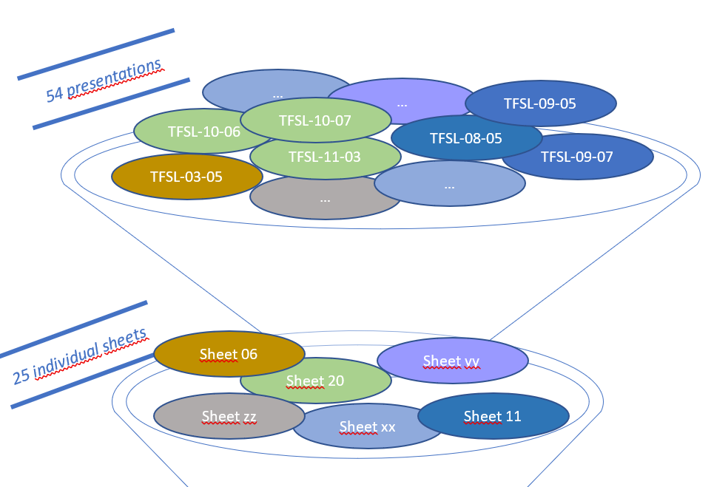
‘Individual sheets » x 25
PART 4.
During the 11 sessions of the TF-VS, there were 54 presentations on different topics such as:
Road surfaces,
Studies on noise emissions of M/N/L vehicles,
Test methods,
Noise mapping
Noise camera/sonar experimentation,
Test campaigns,
General ideas, studies & considerations,
Cross matrix to improve traffic noise scenario and test procedures.
From these 54 presentations, the subgroup decided to combine them as much as possible by subject/theme. This step led to 25 subjects/themes.

Slide 14
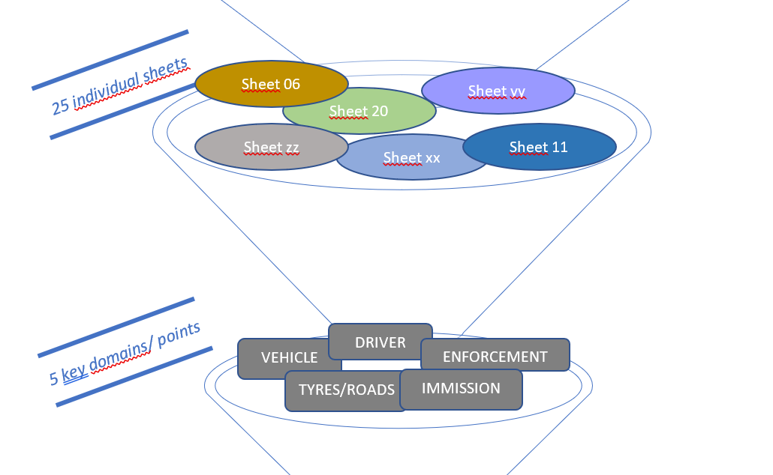
‘Individual sheets » x 25
PART 4.
2. An ‘individual sheet’ (targeted in 2 pages) was built for each of these 25 subjects/ themes to:
Identify the main messages shared during the different sessions of the TF-VS,
Make a summary of the presentation(s),
Add points discussed at the TF-VS,
Identify the references related to the concerned subject/theme.
→ The result is the Part 4. of this report.
Through this exercise, the subgroup identified several key points.
In the next step, these key points were combined and led to 5 key domains: vehicle, driver, enforcement, immission, tyres/roads.

Slide 15
Identification & Definition of the main key-domains
PART 3.
“DRIVER” means a person having the care and control of a motor vehicle on the road. He or she operates the vehicle's controls whether or not the motor vehicle is in motion. The driver is responsible for the safe, daily use of the vehicle including the after-market components in accordance with rules of the road.
“ENFORCEMENT” (in the context of sound) means the activities to ensure vehicles are and remain compliant to the regulations.
The applicable regulations are related to bringing-vehicles-into-the-market (type approval, market-surveillance) and to use of vehicles in the jurisdiction (roadworthiness, Periodic Technical Inspection, roadside inspection, sound radar, manipulation).
“IMMISSION” means the sound recorded or predicted at receiver point, caused by the road vehicle fleet in continuous traffic flow or as single vehicle events, however potentially mitigated by abatement measures of various effect and efficiency (social impact and CBA).
“TYRES_ROADS” have a recognized influence on vehicle sound emissions. Different aspects have to be considered as the road surface itself, the tyre rolling sound, the interaction between the tyre and the road, but also the different tools available to classify them (e.g., the tyre labelling) taking into account the performances and impacts of tyres/roads on health, safety and environment.
“VEHICLE” (in the context of sound) means the sound produced by any means of transport resulting from its operation in traffic, including effects from alterations over its lifetime (NB: for tyre, see the other sheet related to tyre/road component).
For each of the 5 key domains fixed, the subgroup created a sheet to:
Define/describe them
Identify the general findings/ statements explained during the presentations/ reports to the TF-VS, and
Identify the needs & questions for potential further considerations by the TF-VS.
→ The result is the Part 3 of this report.
NB: These 5 key-domains and their associated sheets have to be considered together, in parallel.

Slide 16
Five Key-domains
Traffic flow,
road type etc.
Immission
PART 3.
Enforcement
Maybe R.E.3
Market surveillance
PTI, road side check, …
Driver
 | Type approval | In use
Vehicle | R41, R51,R9, R63, R28,R138, R165
Tire | R117
Road surface | NA
Replacement parts
Driver behavior
GRBP task
Maintenance

Slide 17
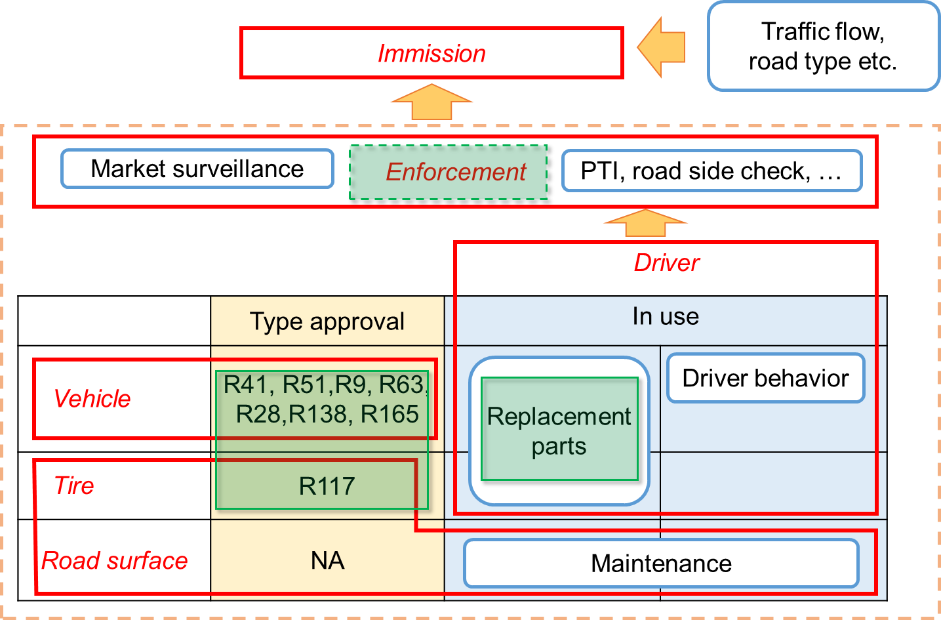
Five Key-domains
PART 3.
Maybe R.E.3
GRBP task
Global regulation
Local rule
Need balance

Slide 18
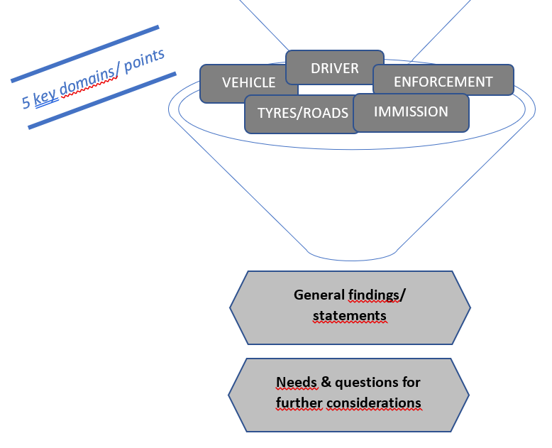
General findings from the 5 Key-domains
PART 2.
Noise issues in the (urban) environment have to be considered in a holistic way (combination of complementary measures necessary) and are mainly linked to:
the manipulation of vehicles and components
the maintenance of the vehicles
the driver behaviour and awareness
the single events
the ‘organisation’ of the vehicle fleet (traffic flow, vehicles distribution, speed, bumps, …)
the tyres contribution to the vehicle’s sound emissions and their interaction with
the road surfaces which is becoming still more important with electrified vehicles
the environmental & safety tyres performances and their inter-dependency
the road surfaces including the road maintenance to maintain their performances regarding the noise
the interaction between the environmental noise and the type-approval tests
the sound assessment modelling tools to estimate sound from road traffic
the various usages of the vehicles – private and commercial

Slide 19
Needs & questions for further consideration
PART 2.
Education of the drivers to make them aware of the impact of their driving behaviour
information’s display (roadside information, noise information inside the vehicle, …),
prevention campaigns,
roadside checks,
sanction systems supported for instance by noise sonars/cameras including vehicle license plate detection, speed, acceleration, …
Development of solutions against manipulation of vehicles
better control of aftersales component,
periodical technical inspection,
market surveillance,
detection of illegally modified vehicles, for example by noise cameras

Slide 20
Needs & questions for further consideration
PART 2.
Arrangement of traffic fleet to provide more ‘relaxed’ driving conditions and reduce noise by
optimizing traffic flow,
adding low speed areas,
avoiding speed bumps,
traffic flow distribution especially for the future with growing electrified vehicle part …
Improvement of the knowledge of vehicles impacts on noise including
Future worldwide automotive electrification including AVAS and impact on environmental noise
Data from real life for all categories of vehicles and not only for M1 & N1 categories of vehicles to be considered through test campaigns

Slide 21
Needs & questions for further consideration
PART 2.
Definition of a cross-matrix between the traffic noise situations, contributing factors and major complaints
Update and improvement of the understanding of the environmental noise in real life concerning:
CBA (Cost-Benefit-Analysis) to assess the potential health benefits of noise reduction to be improved
Noise mapping tools including single events
Traffic scenarios

Slide 22
Needs & questions for further consideration
PART 2.
Further improve knowledge of tyres for:
their performances and their inter-dependency regarding noise and other environmental aspects (as particles), and safety (as handling & braking of vehicles)
their interaction with the road surfaces
their test methods (indoor in addition to outdoor)
Further research on low-noise road surfaces with a focus on their acoustic behaviour, their maintenance with the associated costs, and their safety performances
Amend the UN Regulation no.51
after assessment of previous steps and measures
to expand the various potential uses of the vehicles (RD-ASEP and its assessment in real life in the future)

Slide 23
SUMMARY of potential for the future
Topics for potential future works of GRBP:
Education of the drivers and their awareness
Development of solutions against manipulation of vehicles
Arrangement of traffic fleet
Improvement of the knowledge of vehicles’ impacts on noise
Cross-matrix
Improvement & update of the understanding of the environmental noise in real life
Improvement of the knowledge of tyres
Further research on low-noise road surfaces and their maintenance
Future for UN-R51-03.
Main messages
Limited possibilities in further sound reduction on TA
Improve relevance of TA test for in use (RD-ASEP) for both vehicles & tyres
Tyre/road noise and technology challenge
Other measures to reduce immission (speed reduction, road surface, …)
Driver awareness
Contribution of enforcement

Slide 24
Next steps for the TF-VS ?
Work on the cross matrix,
Follow-up of the different studies in progress everywhere
Potential actions/opportunities and prioritization:
Experience (forum) to be continued to share various information linked to noise topics for as much as possible promote worldwide harmonization,
Consider the needs and questions highlighted in the report for potential future work of the TF-VS.
Agreed for consideration? How to consider them?
Full report to be made as “GRBP Document for Ref.”?

