Slide 1


The National Monitoring on ESD in Germany – brief insights
Dr. Antje Brock and Jorrit Holst
on behalf of the monitoring team (Prof. Gerhard de Haan (Lead), Julius Grund, Ann-Kathrin Schlieszus, Christoph Schönherr, Marcus Schneider, Dr. Mandy Singer-Brodowski, Susanne Waldow-Meier, Dr. Sarah Widany)
23.01.2024
Notes:
AB: Folie 1-5, ab F 13 (Punkte: 1,4 (2.Hälfte), 5)
JG: 2,3, 4 (1. Hälfte)

Slide 2
Overview
Context and Structure ESD-Monitoring
Some focal areas of action
Instruments
Notes:
Dazusagen: Stand der Studie?!

Slide 3
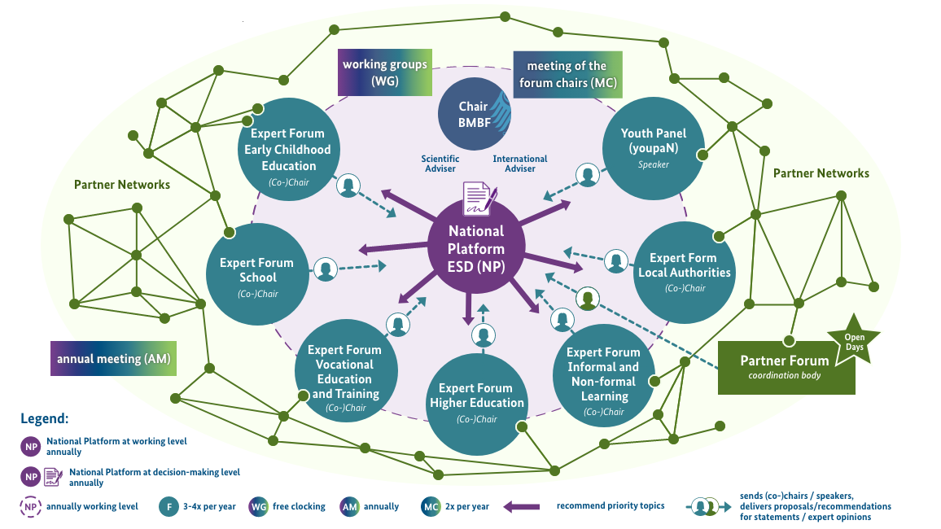
Context: ESD 2030-Implementation Structures Germany
Notes:
Dazusagen: Stand der Studie?!

Slide 4
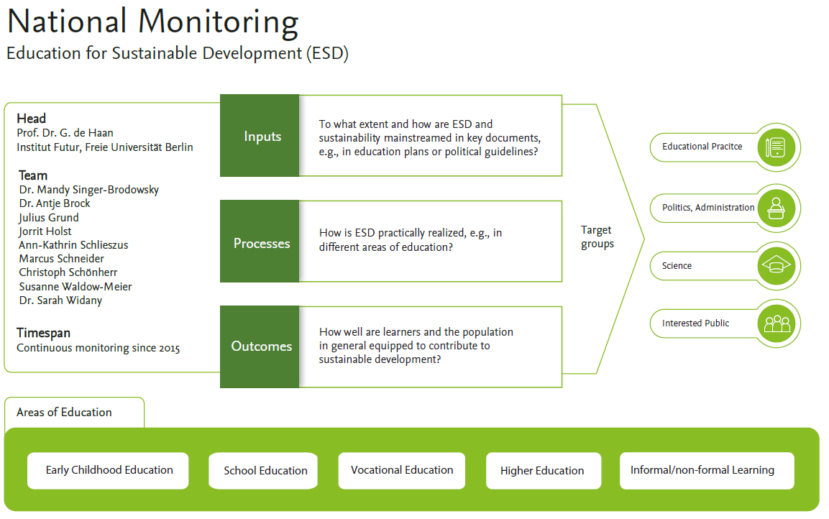

Slide 5
Aims and conception of the ESD-Monitoring
Capturing quantity & quality of ESD in Germany (formal & non-formal learning settings)
→ Supportive-facilitative monitoring: aiming to increase both dimensions
Independent monitoring at the science-policy interface
Offering instruments for (self-)evaluation
Empirically based contributing to conception of ESD: What is good and effective ESD?
Transdisciplinarity: exchange with researchers, practitioners, administrative level (e.g. Document Analysis, Reflexive Monitoring in Action (RMA), Expert Study on Competencies for SDG 4.7)

Slide 6
Some focal areas of action
„Bottlenecks“ for good ESD:
Qualification of multiplicators
Agency of learners (misfit: problem size and available solutions → hopelessness, negative emotions)
→ Importance of socio-emotional dimension of ESD
Importance of material setting/ context of learning → Whole Institution Approach
Type of structural anchoring: Integration / Redesign instead of „Add-on“

Slide 7
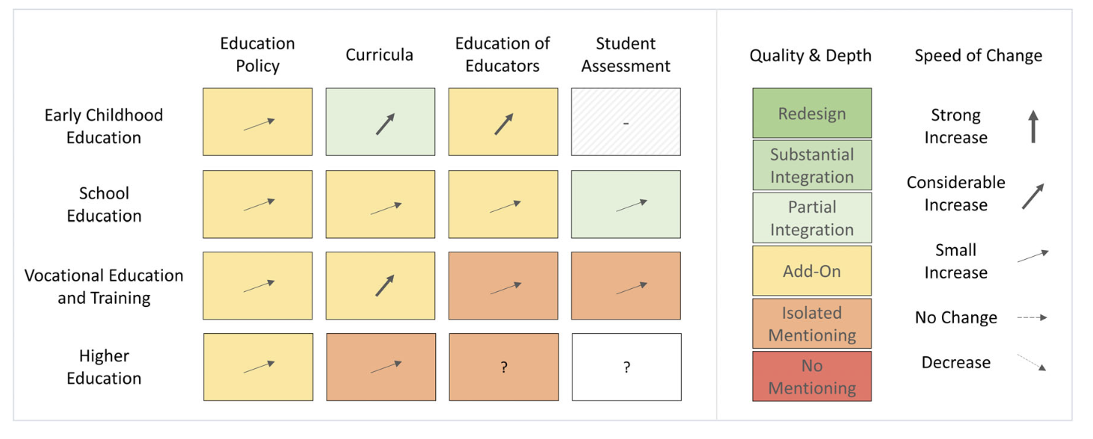
Instruments for (self-)assessments - structural anchorage of ESD (input-level)
Monitoring SDG 4.7.1 at the input-level: Assessing structural anchorage of ESD (documents) in different educational areas, based on > 11.000 documents
(Holst, Singer-Brodowski, Brock, de Haan 2024)

Slide 8
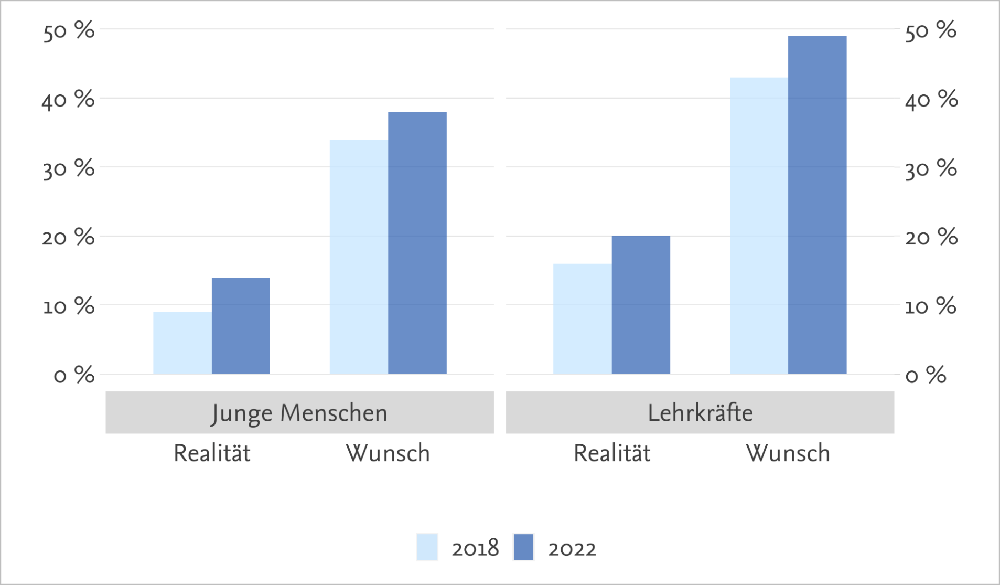
Status quo vs. desired ESD-quantity
Learners
Multiplicators
Status Quo
Wish
Status Quo
Wish
(Grund & Brock, 2022)
Status Quo: What percentage of the total teaching time at your [educational institution: school, university) currently makes clear reference to the topic of sustainable development?
Wish: In an ideal educational institution that fully meets your expectations: In what percentage of your total teaching/studies are there clear references to the topic of sustainable development?"“
(0% = no references, 100% = clear references everywhere)
Notes:
Achtung: Häufigkeit der Begegnung mit NE hat in formaler Bildung nicht zugenommen (s. Ergebnisfolie zuvor), wenn NE jedoch in der formalen Bildung thematisiert wird, dann wird dem mehr Zeit eingeräumt (nach Angabe junger Menschen statt 9% in 2018 nun 14%.
Zentrales Ergebnis: Sowohl bei Lernenden, als auch bei Lehrenden besteht ein starker Wunsch nach wesentlich mehr BNE und demnach eine hohe intrinsische Motivation, was zu sinnstiftenden Bildungserfahrungen bei stärkerer Implementierung führen kann.

Slide 9
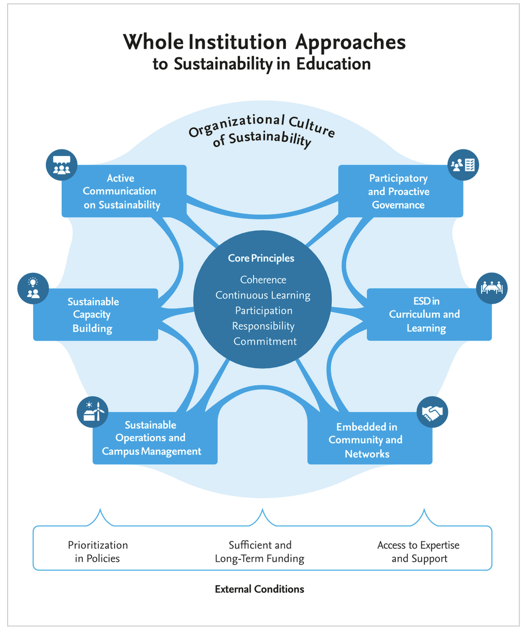
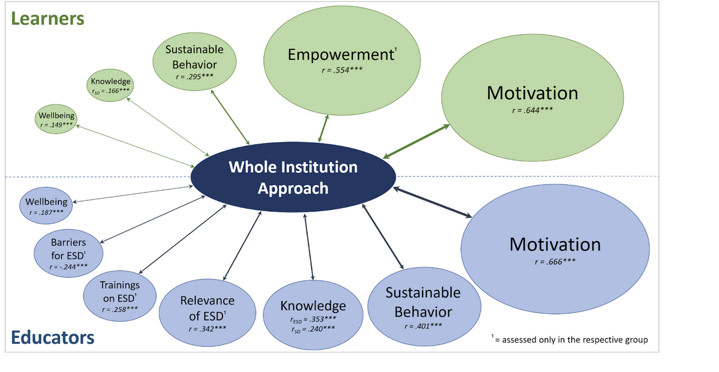
Instruments for (self-)assessments – Whole Institution Approach
Development and application of WIA-Scale;
assessment with> 2.500 learners and > 500 educators
(Holst, Grund & Brock, in review)

Slide 10
References:
Grund, J. & Brock, A. (2022): Formale Bildung in Zeiten von Krisen – die Rolle von Nachhaltigkeit in Schule, Ausbildung und Hochschule. Institut Futur, Freie Universität Berlin.
Holst, J., Grund, J. & Brock, A (in review): Whole Institution Approach: Measurable and highly effective in empowering learners and educators for sustainability.
Holst, J., Singer-Brodowski, M., Brock, A., & de Haan, G. (2024). Monitoring SDG 4.7: Assessing Education for Sustainable Development in policies, curricula, training of educators and student assessment (input-indicator). Sustainable Development, 1–16.

