Slide 1
Informal Document GRVA-18-54
18th GRVA 22-26 January 2024
Electrical Braking Special Interest Group
(Electro Mechanical Braking)
Chairman’s Status Report
GRVA 18 (22-26 January 2024)
Electrical Braking Special Interest Group

Slide 2
GRVA documents, GRVA/2024/13 and GRVA 2024/14
These two papers reflect the status of the Special Interest Group on electrical braking systems following their meeting
in November 2023. The content is developed from informal document GRVA/15/17 (CLEPA).
GRVA/2024/13 is concerned with Regulation 13 (heavy vehicles) and is intended to be considered together with
GRVA/2023/10 (Special requirements to be applied to the safety aspects of electronic control systems).
GRVA/2024/14 is concerned with Regulation 13H (M₁ and N₁ vehicles). The detail of GRVA/2023/10 is included in this
proposal.
The Special Interest Group would welcome comments on those proposals.
Electrical Braking Special Interest Group

Slide 3
Activities of the Special Interest Group
Since receiving its mandate from GRVA at its 17th session (22-26 May 2023 ), the Special Interest Group has met 6 times.
12/13 July 2023 (CLEPA Brussels)
22/24 August 2023 (OICA Paris)
10/12 October 2023 (CLEPA Brussels)
7 – 9 November 2023 (OICA Paris)
12 – 14 December 2023 (OICA Paris)
9-11 January 2024 VDA (Berlin)
A further meeting is scheduled at the VDA in Berlin for February 6-8.
Electrical Braking Special Interest Group

Slide 4
Terms of Reference
A. Energy supply and brake transmission architectures.
1. Identify design principles for the energy supply.
2. Identify the brake transmission arrangements that may be recognised by UN Regulations Nos. 13 and 13-H.
3. Develop recommendations for the methodology of measuring/monitoring the value of energy available in a reserve of energy suitable for use in identifying critical energy thresholds.
4. Identify the safety critical elements of electromechanical braking systems that will require monitoring for fault/failure and the generation of warning signals.
Based upon understanding from the above, and building upon the content of the
GRVA Informal Document GRVA-15-17:
1. Develop proposals to amend UN Regulation No. 13,
2. Develop proposals to amend UN Regulation No. 13-H, and
3. Make recommendations regarding the application of the electrical system safety principles with respect
to other UN Regulations, esp. UN Regulation No. 79.
Objectives A and B will be developed concurrently.
Electrical Braking Special Interest Group

Slide 5
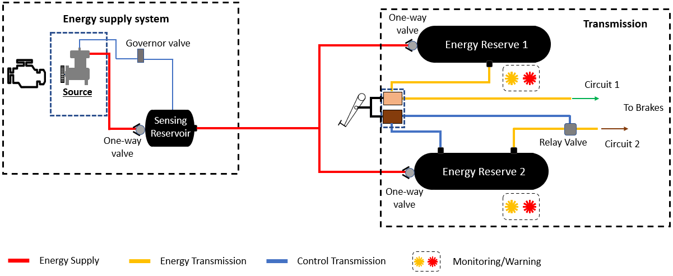
System Arrangement: Pneumatic (GRVA-16-07)
Electrical Braking Special Interest Group

Slide 6
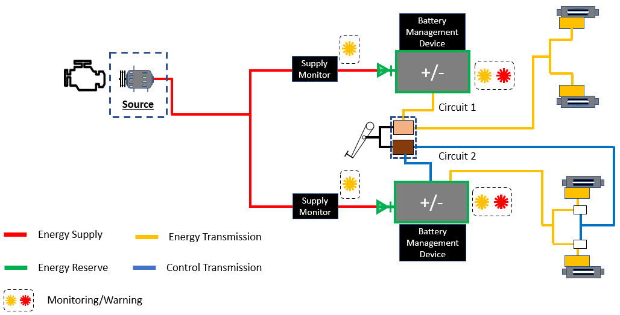
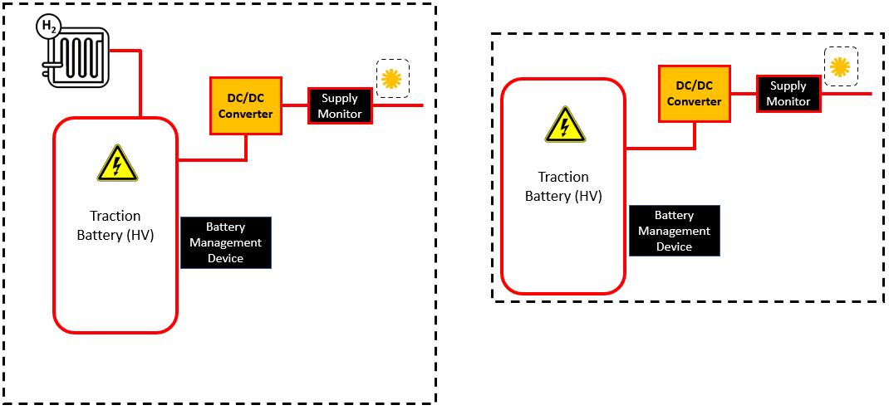
Possible System Arrangement: Electric (GRVA-16-07)
Source
No Source
Electrical Braking Special Interest Group

Slide 7
Possible System Arrangement: Electric (GRVA-16-07)
No Source
Electrical Braking Special Interest Group

Slide 8
Electrical Storage Device (ESD)
The absolute ability of the electrical storage device (e.g. battery) to provide power to the braking system is not constant.
1. The capacity of the ESD gradually reduces with time and use. This change is irreversible.
Conclusion: It is necessary to monitor the change in capacity to ensure it remains sufficient to satisfy the Regulation.
2. The internal resistance of the ESD changes with temperature. The ability to provide power to the braking system changes even when the internal energy remains the same. This change is reversible and could be quite dynamic.
Temp. Down
Resistance up.
Output down.
Internal Energy
Constant
Conclusion: It is necessary to monitor continuously the ESD output capability, rather than its internal energy.
Electrical Braking Special Interest Group

Slide 9
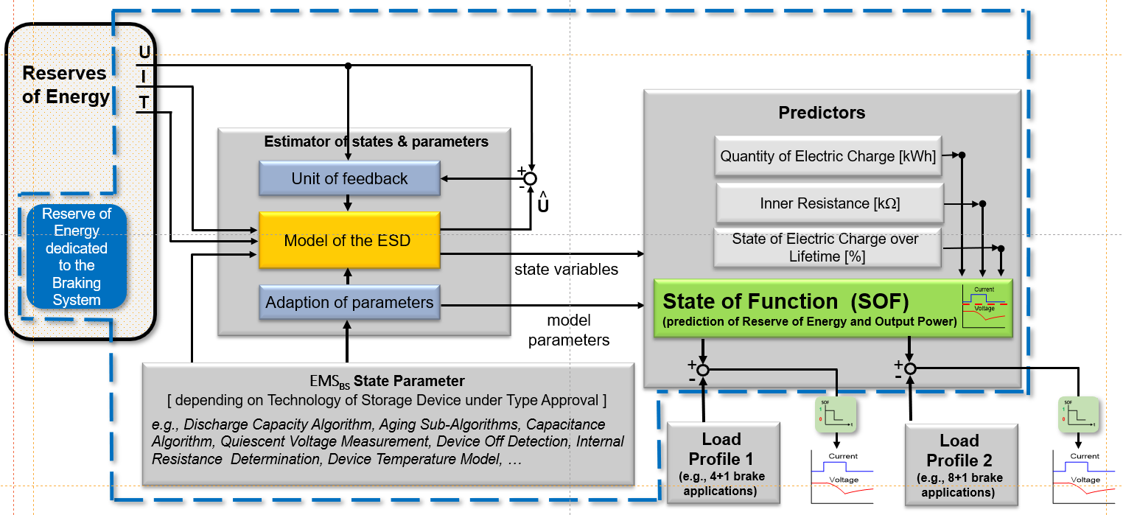
Energy Management System (EMS) (GRVA-1-7-19)
The energy management system deduces the availability of power to the braking system by monitoring multiple variables
Electrical Braking Special Interest Group

Slide 10
Energy Management System (EMS) - Assessment
The energy management system must be capable of recognising when the condition of an electrical storage device is such
that an action, required by the Regulation, is fulfilled (e.g. warning signal).
The ability to provide power to the braking system is not directly proportional to the internal energy and therefore the
EMS must deduce when the capability to provide power (Watts and Watt hours) reaches defined limits.
Because of the effect of age, use, temperature, etc. on the ESD, the EMS cannot be thoroughly assessed at the time
of type-approval.
Conclusion:
It is proposed that a Technical Service may evaluate the EMS in advance of the type-approval test, perhaps as part
of the product development programme.
The manufacturer will be required to provide detail of the variables assessed by the EMS and the methodology of deduction.
The Technical Service will be required to ensure that the EMS can correctly identify the critical conditions taking account of
ageing and environmental effects.
At type-approval, further validation will be required, and the revised Annex 18 (R13) Annex 8 (R13H) will be employed.
Electrical Braking Special Interest Group

Slide 11
Capacity of Storage Devices
Annex 7 (R.13) is specifically related to braking systems that rely on stored energy to deliver braking performance.
The group has devoted much time to adapting this Annex for electrical transmission braking systems.
Section 1 of the requirements is concerned with the capacity of the storage device.
Section 2 is concerned with the ability of the supply to maintain the reserve of energy in the storage device.
Points of consideration:
Capacity – the Group considers that capacity is not the correct term for an electrical storage device.
2. The procedures for hydraulic/pneumatic/vacuum systems do not read across for electrical – new approach required.
The performance of the electrical energy storage device will reduce over time – ageing. The Annex 7 procedure has
to specify the Performance of the storage device for the test.
4. Full-Stroke application of the brake is used here (and throughout the Regulation) – it is not easily understood for
electrical braking.
Electrical Braking Special Interest Group

Slide 12
Capacity Performance of Electrical Storage Devices - 1
Capacity
The Group proposes to refer to the “performance” of an electrical storage device rather than its capacity.
Performance being defined as:
“Its ability, when fully charged, to provide power (W) and quantity of energy (Wh)“
Electrical Braking Special Interest Group

Slide 13
Capacity Performance of Electrical Storage Devices - 2
Full-stroke.
It is argued that the relationship between the position of the brake pedal and the energy delivered to the brake is
not the same with an electrical brake as for, say, a pneumatic brake.
It is also argued that a brake control may not have a “stroke” as is understood today – it may, for example, be a
pressure pad.
The Group is considering whether, rather than refer to a full-stroke actuation, instead to refer to “Actuation” and to
define that as the condition at which, in response to the movement of the control, the brake transmission receives the
power necessary to provide a certain level of deceleration.
Electrical Braking Special Interest Group

Slide 14
Capacity Performance of Electrical Storage Devices – 3A
Section 1: Ageing
With a pneumatic system the capacity of the air reservoir remains constant over time and it is sufficient for the
Annex 7 test that the pressure in the reservoir is specified.
As the Performance of the electrical storage device will reduce over time the test has to be sure that, it can provide
the necessary energy to the braking system at all times.
It is propose to require a warning signal when the Energy Management System detects that the electrical storage device
has reached useful life limit. The Annex 7 test will be conducted when the amount of energy available is equal to that of
The electrical storage devices at the end of their useful life, i.e. when the warning signal is activated.
Electrical Braking Special Interest Group

Slide 15
Capacity Performance of Electrical Storage Devices - 4
Section 2: Supply?
Section 2 requires the energy supply to be able maintain the energy in the storage device at a functional level.
This ensures that when the vehicle is driven, the braking system, when free of faults, has suficient energy to
function correctly.
Electric vehicles will not be maintaining the energy in the electrical storage device – they have no source of energy
and the energy reserve is, by definition, intended to deplete as the vehicle is used.
The question of a depleting reserve is relevant within the body of the regulation, not just Annex 7. There is a proposal
that there should be an automatic braking action when the energy has reached a certain level. This and the test of
Section 2 remains under discussion by the Group.
Electrical Braking Special Interest Group

Slide 16
Use of Electrical Storage Device by “other systems”
Regulation 13 requires that each braking circuit has its own dedicated energy storage device. However, the Regulation
also permits the use of that device by auxiliary equipment, provided that the braking system is protected.
The informal group is continuing to discuss principles that will permit other electrical systems to be supplied with energy
from the same reserve as the braking system.
There is discussion regarding whether to consider essential systems (steering, lights, etc.) as being different to auxiliary
equipment (climate control, in-car entertainment, etc.) within these provisions.
The informal group recognises that the transition to electric vehicles will cause multiple vehicle systems to demand energy
from common energy reserves. It is argued by some, that the energy reserve is not part of the braking system.
There is potential for conflict with Regulation 79 which requires that steering has priority over braking for energy supply.
Comment
Developing an understanding of the status of an energy reserve within the core architecture of a vehicle seems necessary
if regulatory conflicts are to be avoided.
Electrical Braking Special Interest Group

Slide 17
Next Steps
The Special Interest Group will meet next month in Berlin for its 7th session. It has the objective to resolve
the outstanding discussion points:
Complete Annex 7.
Finalise the requirements for shared electrical storage devices.
Address the issue of providing information on the status of the energy reserve.
The group has the ambition to have proposals presented to WP.29 at their November 2024 session.
It will provide two revised papers for consideration by GRVA at its 19th Session (May 2024).
The views of GRVA, particularly Contracting Parties, would be welcome.
Electrical Braking Special Interest Group

