Slide 1
UN Regulations No. 78 Limitations and Improvements for S-EPAC
Submitted by the expert from WBIA | Informal document GRVA-18-39 18th GRVA, Geneva, 22-26 January 2024 Provisional agenda item 9(b)

Slide 2
Limitations and Improvements for S-EPAC
Definition:
EPAC is the acronym for Electrically Power Assisted Cycle, which are non-type approved e-bikes in EU.
S-EPAC is considered a pedal-driven vehicle of category L1 with auxiliary electric propulsion, which is a type-approved e-bike in EU
Specifically, it is a vehicle of subcategory L1e-B according to (EU) 168/2013)
Background:
In certain conditions, ABS can offer benefit in terms of cycling safety as it optimizes the trade-off between bicycle stability and deceleration
ABS can work only within the physical limits of the bicycle (friction of tire & road, center of gravity of rider & bicycle, etc.)
ABS has, as all technical systems, a level of efficiency compared to rider’s best performance (pro rider who knows when & how to brake)
Applicable standards:
ABS is available for both EPAC and S-EPAC,. hence UNECE R78 is mandatory for S-EPAC
Current design of the UNECE R78 targets ABS technology on powered two wheelers (PTWs) such as mopeds and motorcycles which have different physical limits (cf. slide 2)
Issue:
The center of gravity (CoG) of S-EPACs combined with the level of efficiency of every ABS does not fit to the braking test “Stops on high friction surface” (chapter 9.3) which includes a vehicle independent deceleration threshold of 6.17m/s² (cf. slide 2)
Proposal:
Changing the deceleration threshold definition from a vehicle independent one to a vehicle dependent one as in braking test “Stops on low friction surface” (chapter 9.4) enables a better fit of UNECE R78 to S-EPACs (cf. slide 3)

Slide 3
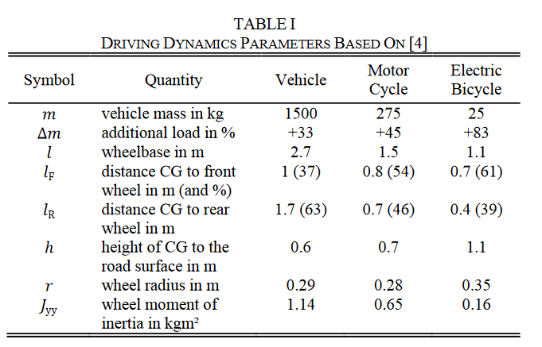
A Standard made for Motorcycles and Mopeds
Discussion points:
The deceleration threshold of 6.17m/s² on high friction surface in UN R78 does not fit for bicycles physics (geometry, center of gravity, etc.)
A brake efficiency of 100% is impossible in comparison to the rider’s best values due to the working principle of ABS
An ABS efficiency of 80-90% can be rated as very good and leads to a significant increase of stability and hence safety of the bike
Source: O. Maier, M. Pfeiffer, S. Scharpf and J. Wrede, "Conditions for nose-over and front wheel lockup of electric bicycles,“ doi: 10.1109/MECATRONICS.2016.7547145.

Slide 4
Needed Change Points for S-EPAC
Chapter
9.3. Stops on a high friction surface:
9.3.2. Performance requirements
Current version
The stopping distance (S) shall be ≤ 0.0063V² (where V is the specified test speed in km/h and S is the required stopping distance in metres) or the MFDD shall be ≥ 6.17 m/s²; and
There shall be no wheel lock and the vehicle wheels shall stay within the test lane.
Proposal
The stopping distance (S) shall be…
a.1 in general, ≤ 0.0063V² (where V is the specified test speed in km/h and S is the required stopping distance in metres) or the MFDD shall be ≥ 6.17 m/s²; or
a.2 in case of pedal-driven vehicles of category L1 with auxiliary electric propulsion, ≤ 0.0056V²/P (where V is the specified test speed in km/h, P is the peak braking coefficient and S is the required stopping distance in metres) or the MFDD shall be ≥ 6.87 x P, in m/s²; and
There shall be no wheel lock and the vehicle wheels shall stay within the test lane.
Current phrasing in UN R78
New additions to UN R78
Source: UNECE R78

Slide 5
Exemplary Calculation for 9.3 and 9.4
Current version of UNECE R78: 9.4.2 Performance requirements (Stops on low friction surface)
The stopping distance (S) shall be ≤ 0.0056V²/P (where V is the specified test speed in km/h, P is the peak braking coefficient* and S is the required stopping distance in metres) or the MFDD shall be ≥ 6.87 x P, in m/s²;
Proposal: 9.3.2 Performance requirements (Stops on high friction surface)
The stopping distance (S) shall be…
a.2 in case of pedal-driven vehicles of category L1 with auxiliary electric propulsion, ≤ 0.0056V²/P (where V is the specified test speed in km/h, P is the peak braking coefficient and S is the required stopping distance in metres) or the MFDD shall be ≥ 6.87 x P, in m/s²;
Calculation example:
Calculation of PBC (from arbitrary measurement):
t = 0.76 s P = 0.566/0.76 = 0.75
MFDD criteria = 6.87 x 0.75 = 5.15 m/s² Comparison with rider’s best deceleration**: rider’s best value from same arbitrary measurement: 7.1 m/s² MFDD criteria / rider’s best = 5.15 m/s² / 7.1 m/s² = 73%
→ The pass criteria for ABS is 73% of rider’s best value
Calculation example:
Calculation of PBC (from another arbitrary measurement):
t = 1.3 s P = 0.566/1.3 = 0.43
MFDD criteria = 6.87 x 0.43 = 2.95 m/s² Comparison with rider’s best deceleration**: rider’s best value from same exemplary measurement: 4.0 m/s² MFDD criteria / rider’s best = 2.95 m/s² / 4.0 m/s² = 74%
→ The pass criteria for ABS is 74% of rider’s best value
* Calculation of PBC: The Peak Braking Coefficient (PBC) is calculated from the test stop that generates the maximum vehicle deceleration rate, as follows: PBC = 0.566/t, where t = time taken, in seconds, for the speed of the vehicle to reduce from 0.8 Vmax to (0.8 Vmax – 20), where Vmax is measured in km/h
Source: UNECE R78
** rider’s best: mean deceleration from 0,8 Vmax to 0,1 Vmax, best out of 10 measurements without ABS to define a criteria close to the physical limit
Notes:
5.3.1. MFDD (Mean Fully Developed Deceleration) calculation…
relative performance criteria instead of a fixed performance criteria should be kept.

