Slide 1



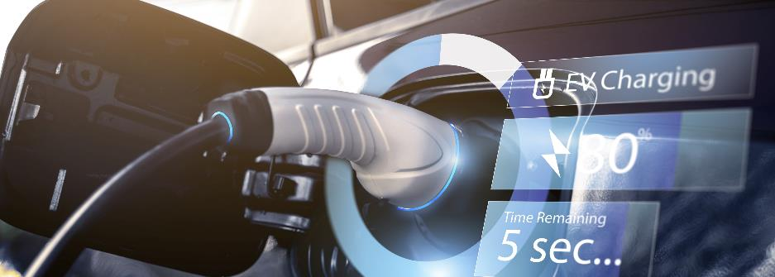
Virtual testing for AEBS – UN R152
Submitted by the experts of France (leader of the workshops group on UN-R 152) on behalf of the workshops group on UN-R 152
Informal document GRVA-18-22
18th GRVA, 22-26 January 2024
Provisional agenda item 7

Slide 2


Previous GRVA (15th to 17th)
During GRVA 16th session : discussions on documents GRVA-15-19 & GRVA-15-20 aiming to propose the opportunity for a virtual testing assessment for AEBS under regulation UN R152.
Presentation of document GRVA-16-22 from OICA supporting the principle with a way forward harmonizing the process of validation, based on credibility assessment developed by VMAD.
Proposal to switch the document under an official one (ECE/TRANS/WP.29/GRVA/2023/22) with request to the concerned contributors to bring inputs.
Based on the feedbacks received, France proposed to manage a dedicated workshop to complete the proposal, with concrete amendment proposals.

Slide 3
Workshops sessions
3 workshops have been managed since GRVA 17th session : 1 in-person and 2 remotely
Between 10 & 15 participants for each session distributed around : 3-5 TAA, 2-4 TS, industry representatives
Full revision of the initial proposal (ECE/TRANS/WP.29/GRVA/2023/22) have been completed with the following intentions :
  Take under consideration feedbacks received from GRVA stakeholders
  Combine the 2 proposals already tabled : France & industry
  Ensure consistency with credibility assessment initially developed by VMAD and integrated in DCAS regulation draft proposal
  3 documents submitted to the 18th GRVA:
  GRVA-18-22 as synthesis of the activities
  GRVA-18-23 as informal document amending working document ECE/TRANS/WP.29/GRVA/2023/22
  GRVA-18-24 as cleaned version of the proposal

Slide 4
Next steps
  Guidance requested from GRVA regarding para. 6.7.3. on additional physical tests during the approval process :
  Option #1 : keep para. 6.7.3. to let the opportunity to TAA/TS to perform some physical tests in addition to the virtual testing results (coming from toolchain previously validated under pillar 1) provided by the manufacturer during the final approval process (pillar 2). The intention is to support trust in the entire validity domain of the virtual testing toolchain used in a context of mutual recognition.
  Option #2 : remove para. 6.7.3. because it is redundant with the validation of the virtual testing toolchain validated under pillar 1. If the toolchain has been evaluated and validated, there is no need to double check results with physical evaluations (limitation of the added value brought by virtual testing in terms of volume reduction of physical tests).
  Request from some workshop stakeholders to finalize activities including a restructuration of the proposal to ensure consistency and robustness in the application ➔ coming inputs
  Proposal to GRVA, either to :
  Adopt the current proposal ECE/TRANS/WP.29/GRVA/2023/22 as amended by GRVA-18-23 OR
  Endorse the « cleaned version » GRVA-18-24 as a new working document for the next session, replacing working document ECE/TRANS/WP.29/GRVA/2023/22, if coming inputs are expected in between.

