Slide 1
Electric Vehicles and the Environment (EVE IWG)
Submitted by the EVE informal working group
Informal document GRPE-90-36
90th GRPE, January 9-12, 2024
Agenda item 9.(b)
Report to 90th GRPE Session

Slide 2
Recent EVE Meetings
Virtual meetings
63rd EVE IWG – July 18-19, 2023
64th EVE IWG – September 19-20, 2023
66th EVE IWG – December 6-7, 2023
In –person meetings
65th EVE IWG – October 11-12, 2023, in Ottawa, Canada
67th EVE IWG – January 9, 2024, concurrent with GRPE in Geneva, Switzerland

Slide 3
Current Work
Hybrid power determination (GTR-21)
Continuing to develop the GTR based on the experiences of stakeholders
In-vehicle battery durability (GTR-22) – Light-duty
Considering further development and refinement of GTR 22
New GTR for in-vehicle battery durability – Heavy-duty
Building from GTR-22, shaping around unique circumstances of heavy-duty vehicles.

Slide 4
GTR-21 Amendments: Determination of Electrified Vehicle Power
Efforts on GTR-21 were focused refining the text and test procedures
Consideration of CAN signals in place of direct measurement
Data analysis conducted
Appropriate accuracy requirements
Reviewed technical necessity of current values
Measurement alternatives for highly integrated systems
Considered the use of vehicle CAN signals in lieu of instrumented values
Considered alternative for system bench testing
Developed family concept
Continued considering need for Candidate Method
Continued considering need for power determination of heavy-duty and fuel-cell vehicles

Slide 5
GTR-21 Amendments: Determination of Electrified Vehicle Power
Revisions to GTR-21:
Family concept added (section 7)
Additional TP1 method 6.1.3.1.2 (d) to accommodate highly integrated powertrain
Uses a power distribution ratio between two powertrain branches based on CAN signal
Use of a system bench is allowed in the case of vehicles that are too powerful to be tested on a chassis dynamometer (3.6 and 6.1)
Revisions to accuracy requirements
Soak area temperature revised to specify a tolerance around a set point and to accommodate Type 1 soak area target temperature (5.1.4)
Engine speed, fuel flow rate, atmospheric pressure allowed from onboard signal (5.2.1/6.1.2)
Accuracy of intake manifold pressure, dynamometer speed, time, accelerator pedal (5.2.1)
TP1 calculation revised to 5% tolerance for fuel flow rate and manifold pressure to align with COP requirement (6.9.2.1)
Deleted placeholder Annex 3 for candidate/equivalency method

Slide 6
GTR-22 Amendments: LDV Battery Durability
GTR-22 amendments finalized in 2023
Amendments of GTR-22
Battery durability requirements for electrified vehicles of category 2
Accounting for energy consumption not related to mobility in the calculation of Virtual Mileage, with focus on category-2 vehicles that may have ancillary, non-propulsion electrical loads
Part C Verification of reported virtual distance: V2X and/or non-traction purposes, if applicable
Update in the specific metrics and requirements of the Annex 2: Values to be read from vehicles
Minor revisions of Annex 3 Determination of Performance Parameter during Part A Test Procedure
Continue gaining experience with the GTR
Included in the implementation of Euro 7
Included in the US EPA’s LMDV Multipollutant Standards for 2027+ MY proposed rulemaking

Slide 7
Heavy-duty Durability GTR
Heavy-duty in-vehicle battery durability is currently the most significant work being performed by the EVE IWG
While the overall framework of GTR-22 is helpful, there is limited technical similarity
Light-duty test procedures with respect to electrified vehicles are more mature
Light-duty vehicle activity is relatively homogenous
Heavy-duty vehicle activity and energy demands can vary significantly between applications (e.g. PTO, non-traction loading)
Potential common elements: SoH monitor, test procedure for verifying the monitor, initial battery condition, in-use assessments and minimum performance requirements
The EVE IWG would like to request an approximate 6-month delay to our initial timelines
Submission of draft text at the 91st GRPE session as an informal document, for group feedback
May 2024 GRPE solution
Submission of draft text in the 91st GRPE session as a working document
October 2024 GRPE solution

Slide 8
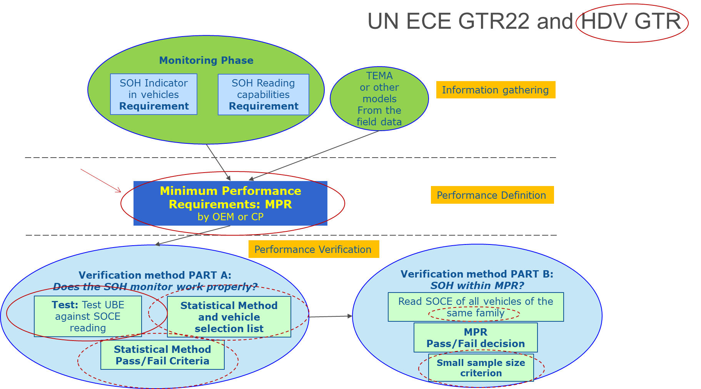
Heavy-duty Durability GTR

Slide 9
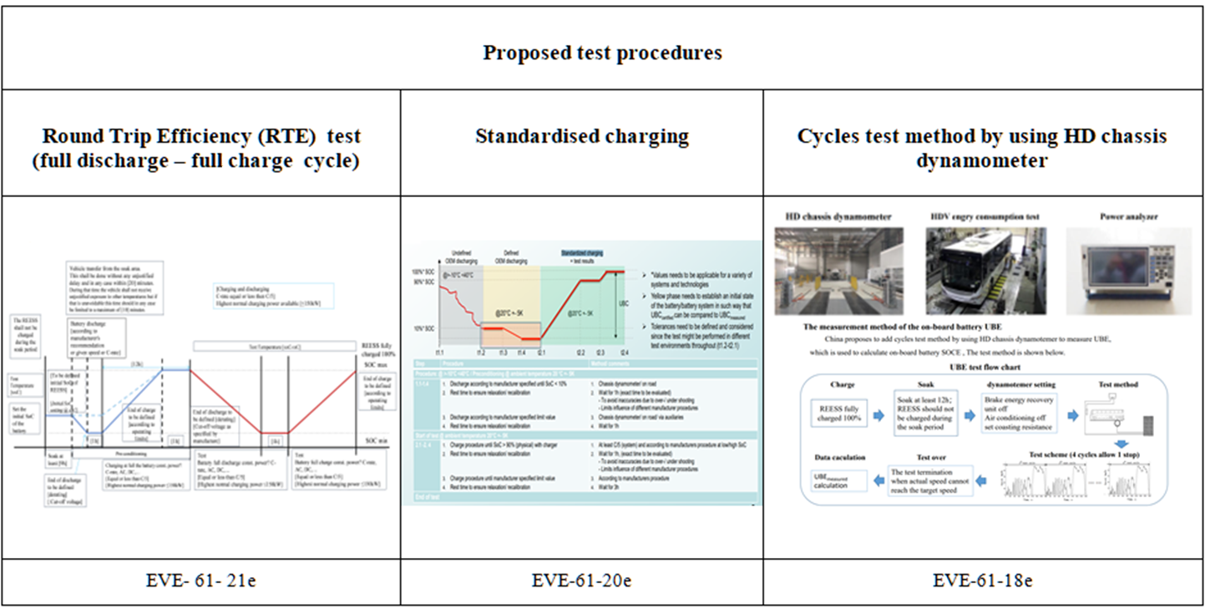
Heavy-duty Durability GTR
Test procedures under discussion

Slide 10
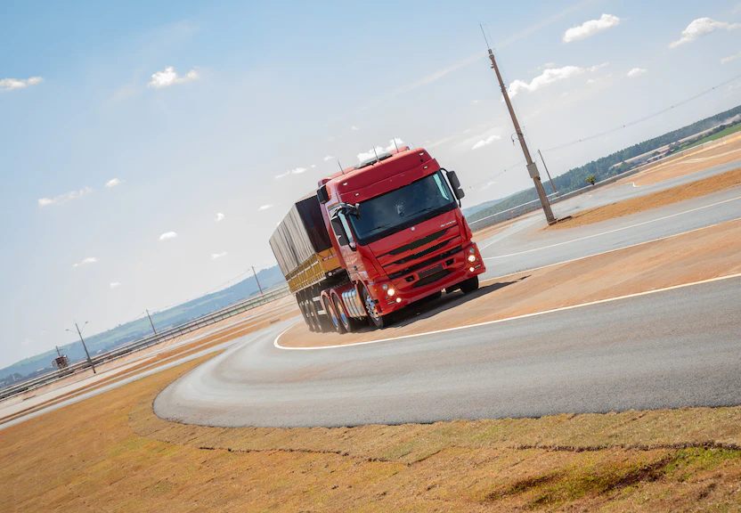
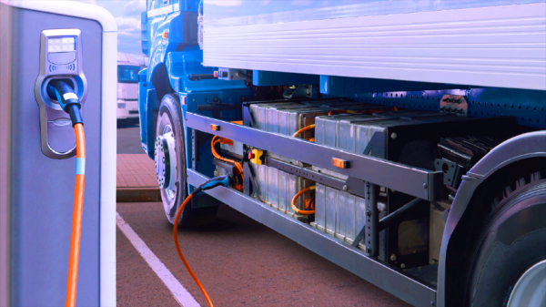
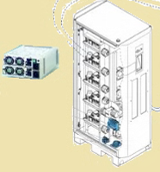
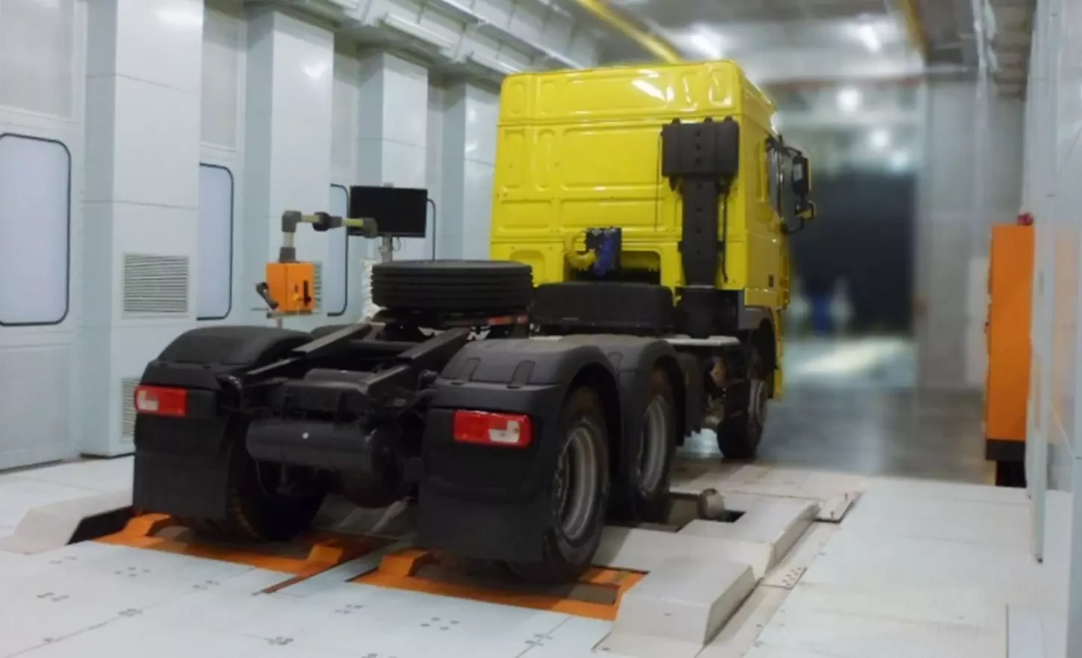
Heavy-duty Durability GTR
Test procedures under discussion
Methods for Checking Battery Durability Monitor for HDV
Test Methods | HDV with no bidirectional charging system |  | HDV with bidirectional charging system
 | Method 1a | Method 1b | Method 2
Description | Discharge by standard average speed with tolerances on test track And charge | Discharge by driving on the road with average speed with higher tolerances And charge | Virtual Round Trip Efficiency (VRTE) test Discharging and charging in a column or by a bidirectional power supply
Alternative Method | HDV Dyno testing with similar driving characteristics constant speed test or transient condition test

Slide 11
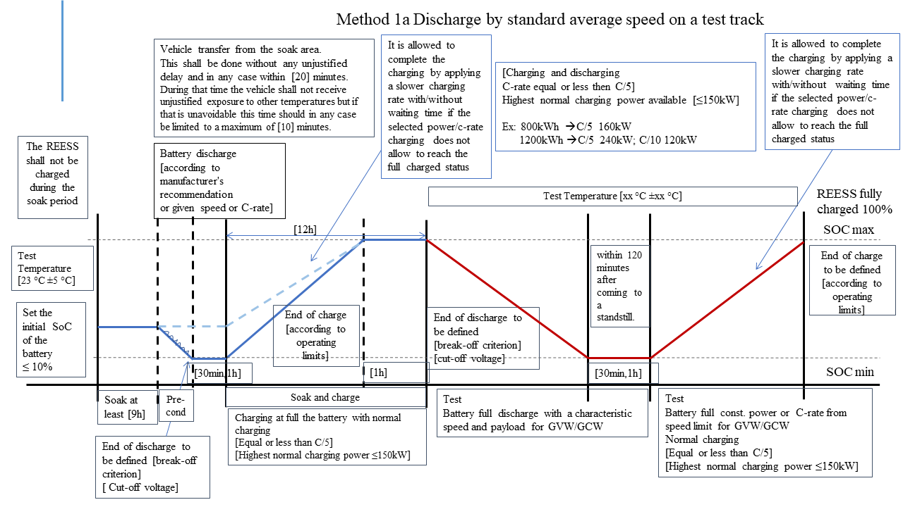
Heavy-duty Durability GTR
Boundary conditions of the test procedures under discussion
Test in Method 1a and 1b driving on test track or on-road with characteristic constant speeds (regional speed)
different speed around regions
but same methodology and test procedure
Regional specific speeds and payload in agreement with authorities (GVW, GCW)
With a C-rate in the range of [C/6 or less, C/2], as check, not to have unwanted battery behaviour
Guideline for the harmonisation of the characteristic speed:
Range of speed per category per region
To leave open the speed for the test and prescribe only the target speed in the last part of the test for which a speed tolerance will be applied
The last part of the test starts when the SOC < [10%]
Speed tolerance in last test segment [± 5km/h;± 7km/h]
The acceleration/deceleration during vehicle speed change shall be smooth and accomplished within the range ±[0.5-1] km/h/sec
End of discharge: break-off criterion
Temperature not prescribed

Slide 12
Terms of Reference Renewal
Requesting renewal for January 2024 – June 2027
Leadership group
Chairmanship shared by European Commission and the United States
Vice-chairmanship shared by China and Japan
Secretary responsibilities by Canada
Proposed future work includes
eHDV GTR development
Amendments to UN GTR No. 21
Amendments to UN GTR No. 22
Ongoing review of literature, policies and developing technologies
Investigating lessons learned from the adoption of UN GTRs
Coordination of environmental performance and technology considerations in the context of existing mandates of other IWGs

Slide 13
Current Timeline
January 2024:
Renewal of the EVE IWG Terms of Reference
Submit working document to GRPE for UN GTR 21 amendments, for consideration
Submit working document to GRPE for UN GTR 22 amendments, for consideration
Offer status update of new eHDV battery durability GTR as an informal document, for further discussion.
June 2024:
Submit working document amendments for UN GTR 21 to WP.29 AC.3 for vote, if authorized
Submit working document amendments for UN GTR 22 to WP.29 AC.3 for vote, if authorized
October 2024:
Submit working document of UN GTR on eHDV battery durability to GRPE for consideration
March 2025:
Submit working document of UN GTR on eHDV battery durability to WP.29 AC.3 for vote, if authorized

Slide 14
Proposed Future EVE Meetings
68th EVE IWG – February 28-29, 2024 (virtual)
69th EVE IWG – April 16-17, 2024 (in-person – Seoul, South Korea)
70th EVE IWG – Fall 2024 (in-person – Tokyo, Japan)

Slide 15
Thank you!
Michael Olechiw
EVE C0-chair
olechiw.michael@epa.gov
Elena Paffumi
EVE C0-chair
elena.paffumi@ec.europa.eu

