Slide 1
Status report to 90th GRPE
(January 2024)
Transmitted by the co-chairs
of TF for Tyre Abrasion
Informal document GRPE-90-29-Rev.2
(90th GRPE, January 9-12, 2024,
agenda item 7.(c)
Task Force on Tyre Abrasion
On behalf of GRBP and GRPE

Slide 2
Task Force on Tyre Abrasion
Targets | Develop a robust procedure for measuring the abrasion of tyres: Test conditions and methods; Define the acceptable uncertainty for the tyre abrasion test method(s) and assess the uncertainty of the tyre abrasion test method; Based on the abrasion test method, define a characterisation of relative mileage potential index; Evaluate the abrasion performance and tread depth reduction of a wide range of tyres available in the market; Define abrasion limits for tyres in order to limit the emission of microplastics to the environment; Develop a proposal of amendment to UN Regulation No 117 for the type approval of tyres in respect to their abrasion.
Roles | Co-chairs: France (Elodie.COLLOT@utac.com) and European Commission (Theodoros.GRIGORATOS@ec.europa.eu) Secretariat: ETRTO (European Tyre and Rim Technical Organisation)
Reporting | To both working parties: GRPE and GRBP Adoption: GRBP
Web page | Task Force on Tyre Abrasion (TF TA) - Transport - Vehicle Regulations - UNECE Wiki ToRs (under revision): TF TA Terms of Reference

Slide 3


Task Force on Tyre Abrasion: facts and figures
Meetings
  13th web-meeting: 11th May 2023
  14th web-meeting: 5th June 2023
  15th hybrid-meeting: 20th July 2023
  16th web-meeting: 26th Sept 2023
  17th web-meeting: 26th Oct 2023
  18th web-meeting: 13th Nov 2023
  19th web-meeting: 13th Dec 2023
Attendees ~80
  CPs:
  European Commission, France, China, Germany, India, Japan, Norway, Netherlands, South Korea, Spain, Switzerland, UK, USA, Canada
  NGOs:
  ADAC, AVL, ETRMA, ETRTO, HORIBA, IDIADA, ITMA, JAMA, JATMA, LINK, OICA, SMMT, TRAC, TÜV Nord, UniBW., USTMA, UTAC, VTI

Slide 4
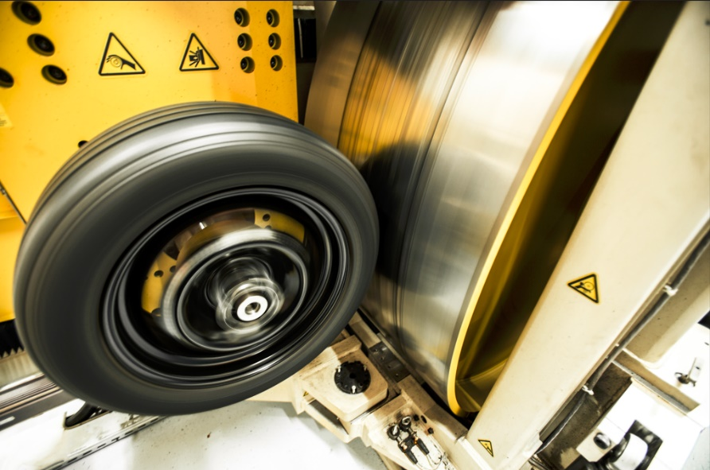
Testing methods developed by TFTA
©UTAC
©ADAC / Test und Technik
LABORATORY
(Indoor drum method)
IN-VEHICLE REAL LIFE
(On-road method)

Slide 5
Task Force on Tyre Abrasion: work progress
Work on the 2023 test campaign | Validation and correlation test campaign for 2023: ongoing for C1 Tyres selections (candidate and “reference” tyres) for correlation: done ☑ Tyres selections for alignment: done ☑ Validation test campaign on 3 on-road test centres and 4 drum test centres: done ☑ Alignment test campaign on 7 on-road test centres and 4 drum test centres: ongoing ◻ Post processing: done ☑ (for the correlation) Market assessment
Working document | Test conditions and methods*: submitted ☑ for C1 tyres GRBP/2024/10 new supplement to UNR117.04 → to complete by informal document Revision of the ToRs (ongoing)
Market assessment for 2024 | For C1: preparation and first discussions on the number of tyres (~200 TBC), sizes and characteristics to be tested for 2024
*detailed description of the methods: GRBP-78-26

Slide 6
Task Force on Tyre Abrasion: next
Next steps | Final proposal of methods Feedback expected of the GRPE (January 24) → comments expected by end of January 2024 Adoption expected at GRBP (February 24)
C1 tyres | Perform the market review (2024 and 1H 2025 (multi circuit assessment) Define and introduce reference tyre(s) for abrasion test in ASTM standard Set the limits for abrasion [2025] Work on the feasibility of rating and definition of the mileage of tyres [2025]
C2 tyres | Propose abrasion method(s) [2026] Set the limits for abrasion [2027] Anticipation of 1 year will be evaluated depending on the C1 method(s)’ suitability for C2 tyres C2 clustering (and timeline) TBC
C3 tyres | Propose abrasion method(s) [2028] Set the limits for abrasion [2029]
Under revision in the ToRs

Slide 7
Back up

Slide 8
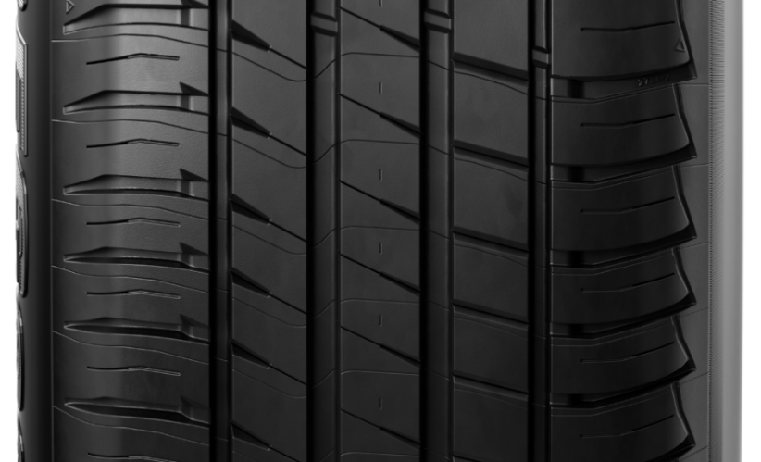
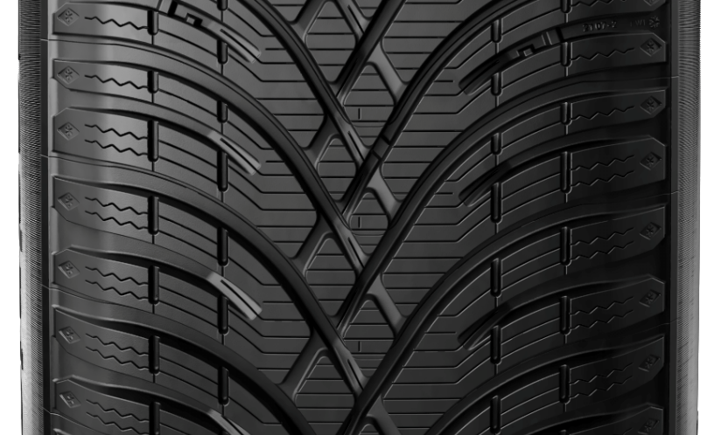
Scope
Applicable to C1 tyres as defined in R117, excluded:
  Ice grip tyres and tyres having a nominal rim diameter code ≤ 13.
Reference tyres
Reference tyres shall be stored in condition recommended by ASTM.
Normal: 225/45R17 94 XL 3PMSF: 225/45R17 94 XL
 |  | Reference tyre
Candidate tyre |  | SRTT17S | SRTT17W
Normal tyre |  | X
Snow tyre |  |  | X
 | Snow tyre that is classified as tyre for use in severe snow conditions |  | X
Special use tyre |  | [X]
 | "M+S" or "M.S" or "M&S" |  | X
 | Special use tyre that is classified as tyre for use in severe snow conditions |  | X
Red: under discussion

Slide 9
On-Road method - Circuit
Test distance: 8 000 km (±300 km) driven by repeating circuits on open public roads
Circuit consists of one or more loops, with cars returning to the departure point without being transported.
Circuit min distance 300 km of different roads.
Loop: section of circuit having the same start and end point. Loop driven opposite way is considered different loop. The loops of a circuit can be run in any order.
Red: under discussion

Slide 10
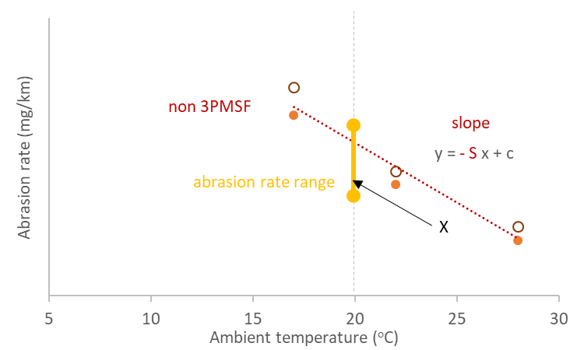
On-Road method - Circuit
The circuit abrasion rate shall be determined:
  Convoy of at least 2 vehicles having the reference tyres (Normal or 3PMSF)
  At three ambient temperatures: one at least 15-25°C (Normal) or 5-15°C (3PMSF)
The circuit abrasion rate shall be (one needs to be checked)
  @20°C (Normal reference tyres) needs to be in the range [range] mg/km/ton
  @10°C (3PMSF reference tyres) needs to be in the range [range] mg/km/ton
If the circuit is modified by ≤10 km, or 10-30 km for ≤8 shifts or <100 km (or 20% of circuit, whichever is smaller), it is still valid
Red: under discussion

Slide 11
On-Road method - Preparation
Example
Convoy
  Up to 4 vehicles. One is fitted with reference tyres
  Convoy composition. Homogeneous for:
    Number and position of driven wheels
    FWD or RWD or AWD only in the convoy
    Propulsion energy converters (e.g. ICE, or NOVC-HEV etc.)
    F2 vehicle ref. tyres ≤1.2*F2 vehicle candidate tyres (if available)
  Vehicles and drivers’ rotation
    Each tyre shall be exposed to the same distance (±10%) to all drivers and positions in convoy
Red: under discussion

Slide 12
On-Road method - Preparation
Tyres preparation
  Tyre mass measurement (without rim)
  Tyre fitment on rim (and vehicle)
  Tyre and wheel assembly mass measurement (optional)
  Tyre inflation pressure: Ref. tyres: 290 kPa, candidate tyres: 250 kPa for standard load tyres or 290 kPa for reinforced load and high load capacity tyres (XL, HL)
Vehicles preparation
  Vehicle balasting]
    Tyre load 67% (±7%) of tyre load capacity (and not exceeding 85% vehicle max payload)
    Load distribution: FWD: 56% (±7%) to 44% (±7%); RWD/AWD: 50% (±7%) to 50% (±7%);
  Vehicle tuning (alignment)
  Vehicle mass measurement and load at each wheel
Red: under discussion

Slide 13
On-Road method – Acceleration and Speed
Circuit approval
End of test
 | Urban | Regional | Highway | Global
Share (% distance) | >25 | >25 | >35 | -
Long. acc. stdev (m/s²) | 0.40-0.90 | 0.20-0.75 | 0.15-0.55 | 0.35-0.55
Lat. acc. stdev (m/s²) | 0.40-1.20 | 0.70-1.80 | 0.15-0.80 | 0.83-1.03
Instrumentation
Circuit
  Total distance 8000 km (±300 km) along selected circuit
  Circuit of at least 300 km consisting of one or more loops
  Driving style distribution (see table)
  Abrasion level for reference tyres at 20°C (normal) and/or 10°C (severe snow) [range] mg/km/t
  To be checked at the end of the test (monitored continuously):
  Global (test) acceleration levels
  Speed requirements (<140 km/h)
Red: under discussion

Slide 14
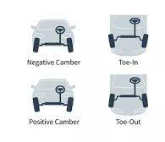
On-Road method - Measurements
Before and after test
Tyre mass
Load on each tyre
Vehicle alignments
  (unloaded and loaded vehicle)
Tyre pressure
  Before test and after tyre fitment
  After test and before dismounting
Red: under discussion

Slide 15
On-Road method - Measurements
During test
Long. and lat. acc. of each vehicle with frequency ≥10 Hz (e.g. constant monitoring)
Speed of each vehicle (constant monitoring)
Tyre pressure each day (cold condition)
Average of five temperatures of at least start, end, at lower and higher altitude points
Wet distance measurement, ice on road measurement
At intermediate stops
Vehicle alignment of reference vehicle every 2 000 km
Tyre and wheel assembly mass (optional but compulsory during the test campaign)
Vehicle alignment of test vehicles (optional at half distance but compulsory during the test campaign)
Red: under discussion

Slide 16
On-Road method - Troubleshooting
Vehicle:
  Repair is possible: The repaired vehicle shall run the distance lost (without other vehicles of the convoy)
  Major failure or accident: The replacement vehicle equipped with the same (new) tyres shall run the distance lost (without other vehicles of the convoy)
  If failure happens to a test vehicle and not reference vehicle, the failed vehicle (and tyres) can be withdrawn.
Tyres:
  Tyre is destroyed: Spare part with same size and pattern is used. The mass loss of the other tyre is multiplied by two for the calculations
  Tyre is reparable: The added repair mass is taken into account in the calculations. Spare tyre can be used for max one loop. Distance will be considered in the calculations
Red: under discussion

Slide 17
On-Road method - Validation
 | Normal | 3PMSF
Average T (°C) | 7 to 35 | -3 to 20
Min/max for 90% of dist. (°C) | 2 / 40 | -7 / 25
Wet mileage | <20% | <20%
Ice or snow mileage | 0% | <5%
Weather and Climate
Accelerations
  see table beside
  Long. and lat. acc. stdev
  within 5% of ref. vehicle values
Vehicle alignments
  End-Start: ±0.15° toe, ±0.3° camber
Visual inspection
  Sidewall marking readable
  Tyre loss <1cm² of tread chunking area (for Ref tyre: all results invalid)
Ref. tyres abrasion rate value @20°C or @10°C within abrasion rate range
 | Global
Max speed (km/h) | 140
Long. acc. stdev (m/s²) | 0.35-0.55
Max long. acc. (m/s²) | ±5 (for ≥99.8% distance)
Lat. acc. stdev (m/s²) | 0.83-1.03
Max lat. acc. (m/s²) | ±5 (for ≥99.6% distance)
Red: under discussion

Slide 18
On-Road method - Test report
Calibration
Instrument | Interval | Criterion
Scale for tyres | Yearly and at major maintenance | ±2 g
Instrument for toe and camber | Yearly | +/- 0.033º
Acceleration/Speed sensor | Yearly
Scale for vehicle | Yearly and at major maintenance | +/- 0.1%
Temperature sensor | Yearly | ±1°C
Tyre pressure sensor | Yearly | ±3 kPa
Scale for tyre and wheel assembly | Yearly and at major maintenance | ±2 g
Red: under discussion

Slide 19
Indoor drum method - Drum specification
Tyre Wear Test Equipment
  A drum, a tyre mounting device, a loading device and an adhesion prevention system
Drum diameter
  The test dynamometer shall have a cylindrical flywheel (drum) with a diameter of at least [1,7] m.
  The roller diameter shall be defined and reported considering the thickness of test surface, to compute test speed and running distance correctly.
Width
The width of the test surface shall always exceed the width of the test tyre contact patch throughout entire test duration.
Red: under discussion

Slide 20
Indoor drum method - Drum specification
Surface
The test surface shall be applied to external surface of the cylindrical drum.
The test surface of drum shall:
(a) have MPD measured at the start and the end of the drum test,
according to ISO 13473-1 except for low pass filter, applied from 0,22 mm to 2,10 mm.
(b) low pass filter cut-off shall be 0,1mm for MPD data processing procedure.
(c) be textured with sands, stone or an alternative material, e.g., aluminium oxide resin
(d) The drum surface shall be built with rigid and not deformable material.
  Check surface by reference tyre abrasion rate.
    The abrasion rate of the reference tyre for all surface shall be in the range
      50 mg/km/t to 190 mg/km/t for SRTT17S
      35 mg/km/t to 165 mg/km/t for SRTT17W
Red: under discussion

Slide 21
Indoor drum method - Tyre carriage and drive system
The tyre carriage and drive system shall be able to provide dynamic control of:
(a) tyre lateral force developed by the drag force produced by tyre slip angle during running
(b) Longitudinal tyre force or torque developed by tractive force by the tyre during braking and accelerating
Adhesion prevention system
  Tread wear test equipment shall be equipped with the powder delivery system to spray a controlled volume of such material (e.g., talc) on the test surface near the test tyre contact patch so that a test tyre does not adhere to and change the test surface.
Red: under discussion

Slide 22
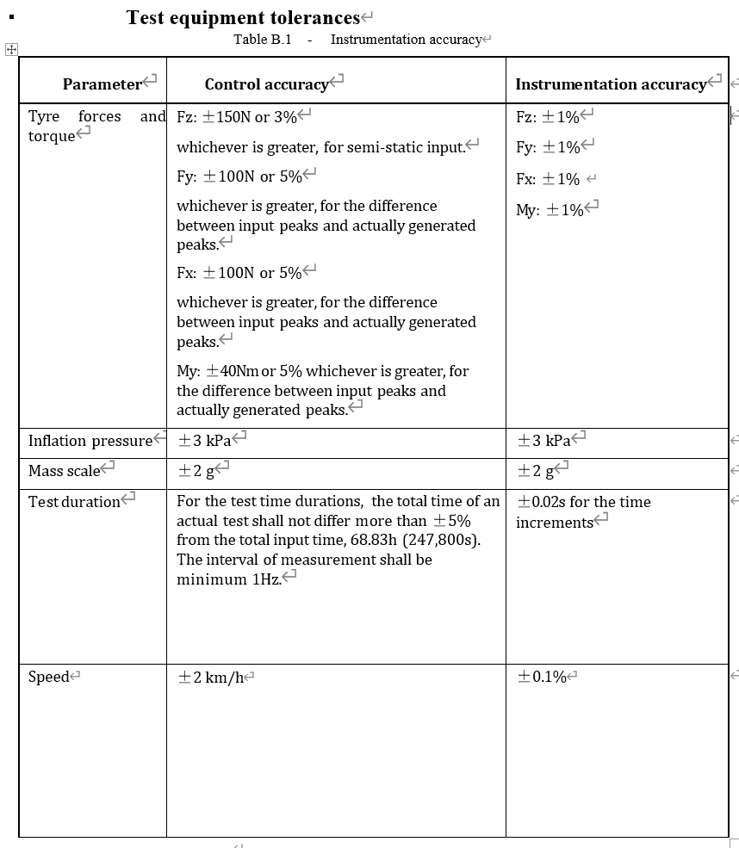
Indoor drum method - Test Conditions
Test load
  Test load Fz is 80% of maximum load capacity
Tyre inflation pressure
  Standard load : 210 kPa
  Extra load : 250 kPa
Testing condition
  Longitudinal force, lateral force and speed
  Running distance is 5 000km.
  Running velocity , constant speed
    100km/h for flat road ,
    60km/h for curve/slope
Red: under discussion

Slide 23
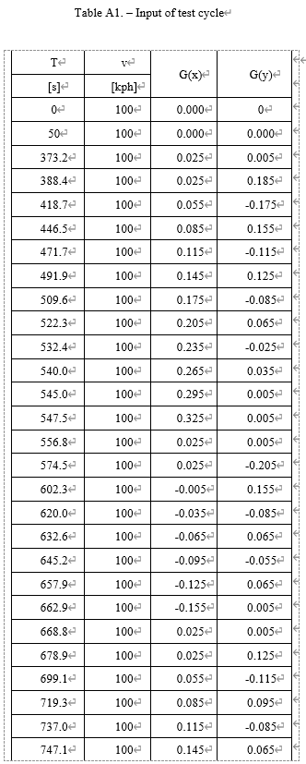
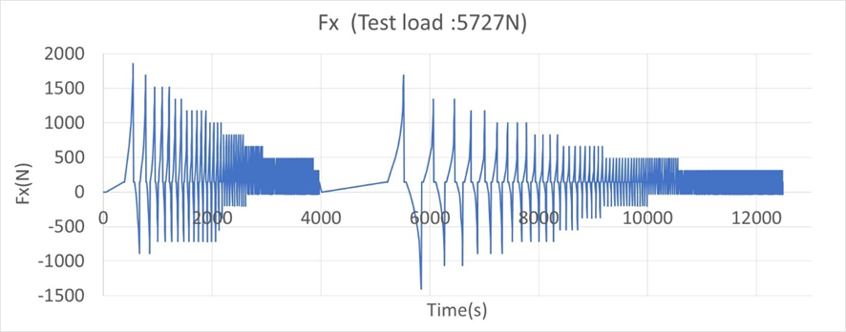
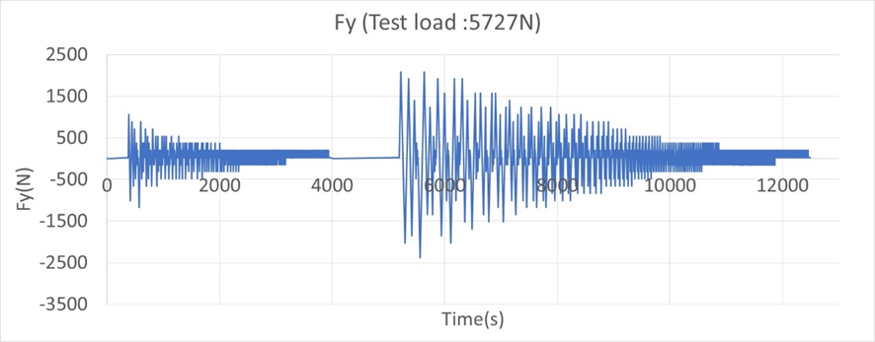
Indoor drum method - Input of test cycle
1 cycle : 250 km
Fx (or My) and Fy calculation
  Longitudinal force : Fx = Test load Fz × Longitudinal acceleration G(x)
or Tyre torque : My = Fz × G(x) × Loaded Radius RL
  Lateral force : Fy = Fz × Lateral acceleration G(y)
At a point of test duration T, the values of G(x) and G(y) shall be equal to those listed in Table A1;
G(x) and G(y) shall change linearly between two adjacent points.
Therefore, the values of Fx and Fy will also change linearly from one point to another.
The following graphs show samples of linear change for Fx or Fy with respect to T.
Red: under discussion
T represents the total test duration from the beginning of the test
G(x) and G(y) represent the index compared to the standard acceleration due to earth gravity

Slide 24
Indoor drum method - Test procedure
Thermal conditioning
Place the inflated tyre in the thermal environment of the test location for a minimum of 3 h.
Pressure adjustment
After thermal conditioning, the inflation pressure shall be adjusted to the test pressure.
Thermal environment
During the test, the ambient temperature, at a distance of not less than 0,15m and not more than 1 m from the tyre, shall be 25 °C ± 5 °C
Average temperature for reference and candidate tyre during test within 2 degrees
Mass measurement
The mass of tyre shall be measured before and after 5 000km of run set out in paragraph 5.6 for both reference and candidate tyres.
Red: under discussion

Slide 25
Indoor drum method - Test cycle
Input condition
  Both reference tyre and candidate tyre shall be tested according to input condition of Appendix 1.
  The Appendix 1 test condition of 250 km is set as one set, and the test cycle shall be repeated 20 times until 5 000 km is reached.
Red: under discussion

Slide 26
Indoor drum method - Test cycle
Basic test cycle (2 positions)
  Both reference tyre and candidate tyre shall be mounted different position of one drum. Test of both reference tyre and candidate tyre shall be conducted at the same time.
  Tyre positions shall be exchanged once after the completion of 2 500km.
  Direction of rotation shall remain constant throughout the test.
Alternative test cycle (1 position)
  In case test of reference tyre and candidate tyre is not possible at the same time,
  the alternative test cycle is available. As Reference tyre (R) and Candidate tyre (T),
  test order is following:
  R(1000km) - T(2000km) - R(2000km) - T(2000km) - R(2000km) - T(1000km)
  Repeat a set of Appendix 1 input conditions 4 times for 1 000 km and 8 times for 2 000 km.
Red: under discussion

Slide 27
Indoor drum method - Measurement and recording
The following shall be measured and recorded:
(a) Test speed;
(b) Load on the tyre normal to the drum surface, Fz;
(c) Test inflation pressure: initial and middle of the test;
(d) Ambient temperature measured in degree °C;
(e) Force or torque applied to the test tyre and testing duration, with a maximum time interval of 1s;
(f) Test rim size;
(g) Mass of tyre; at the beginning and the end of the test
(h) MPD of the test surface; at the beginning and the end of the test
(i) Photograph of tyre after test run;
Red: under discussion

Slide 28
Indoor drum method - Validation
Test operate undergo with NO…
Permanent deformation
Loss of air
Visual inspection to check there are NO…
Visual evidence of tread, sidewall, ply, cord, inner liner, belt
Bead separation
Chunking
Open splices
Cracking
Broken cords
Rubber adhesion
Red: under discussion

Slide 29
Thank you

