Slide 1
90th UNECE GRPE session
PMP IWG Progress Report
Informal document GRPE-90-28
90th GRPE, 9 - 12 Jan 2024
Agenda item 7.(b)
B. Giechaskiel, T. Grigoratos
Geneva, 10th Jan 2024
UNITED NATIONS

Slide 2
PMP MEETINGS IN 2023
Before GRPE 90th session
2023-01-09: PMP hybrid (exhaust and non-exhaust)
2023-01-11: Presentation to GRPE
2023-04-27: PMP Webconference (exhaust and non-exhaust)
2023-05-24: PMP Webconference (non-exhaust)
2023-06-29: PMP Webconference (non-exhaust)
2023-09-28: PMP Webconference (non-exhaust)
2023-11-22: PMP Webconference (non-exhaust)
2024-01-09: PMP hybrid (exhaust and non-exhaust)

Slide 3
PMP ToR (FILE GRPE_89_27)
ToR renewed until June 2025
Non-exhaust emissions:
Tyres/road: Continue monitoring on-going projects
Brakes LDV: (i) Development of vehicle-specific friction share coefficients; (ii) Development of 1st amendment (e.g. light-wear discs); (iii) Round-robin with GTR compliant labs
Brakes HDV: (i) Feasibility of existing setup for measurement (ii); Feasibility of existing HD cycles; (iii) Assessment of engine and non-friction braking
Exhaust emissions:
Continue monitoring current measurement and calibration* procedures
*Calibration procedures for brakes might need assessment, too

Slide 4
EXHAUST TOPICS
Calibration procedures of CPCs
A round Robin started at the end of 2023 with the aim to determine one material for calibration or correlation curves.
10 labs expressed interest. Three CPCs and a silver generator will be circulated. Each lab will also test with CAST, PAO and other generators
 | Lab | CPC23a | CPC23b | CPC10* | PAO | CAST | Silver | Other
Dec 2023 | #1 | Y | Y | Y | Y | Y | Y
Feb 2024 | #2
summer 2024 | end
* The CPC can change between 10 nm and 23 nm

Slide 5
OVERVIEW OF GTR-24 ON BRAKE EMISSIONS
The current version of the UN GTR No. 24. adopted by the WP 29 on 17.07.2023 is available at:
https://unece.org/transport/documents/2023/07/standards/un-gtr-no24-laboratory-measurement-brake-emissions-light-duty
Proposal for the 1st Amendment to UN GTR No. 24 (GRPE-2024-4e_track, clean ECE/TRANS/WP.29/GRPE/2024/4) submitted as working document in October 2023 at:
https://unece.org/transport/documents/2023/12/working-documents/track-iwg-pmp-proposal-new-amendment-un-gtr-no-24
https://unece.org/transport/documents/2023/10/working-documents/iwg-particle-measurement-programme-pmp-proposal-new

Slide 6
OVERVIEW OF GTR-24 ON BRAKE EMISSIONS
Proposal for amending the working document of the 1st Amendment to UN GTR No. 24 (GRPE-90-25e) submitted as informal document in January 2024 is available at:
https://unece.org/transport/documents/2024/01/informal-documents/pmp-proposal-amend-ecetranswp29grpe20244
Overview of main changes (GRPE-90-06 and GRPE-90-26)
https://unece.org/transport/documents/2023/12/informal-documents/pmp-main-modifications-and-justifications
https://unece.org/transport/documents/2024/01/informal-documents/pmp-additions-grpe-90-06
Amendment to Final Report (GRPE-90-25)
https://unece.org/transport/documents/2024/01/informal-documents/pmp-proposal-final-status-report-amendment-1-un-gtr

Slide 7
1ST AMENDMENT TO GTR-24 – OVERVIEW
Definition of original and replacement parts and definition of brake families for non-original replacement parts (i.e. aftermarket parts);
Refinement and adjustment of fixed friction braking share coefficients representing the worst-case scenario in each vehicle category;
Addition of Annex C with a procedure for the determination of the vehicle- specific friction braking share coefficient on a chassis dynamometer;
Definition of different temperature parameters for the cooling air adjustment of carbon-ceramic disc brakes;
Definition of active and passive filtration systems – Introduction of a requirement for active filters and agreement on the need for further specs

Slide 8
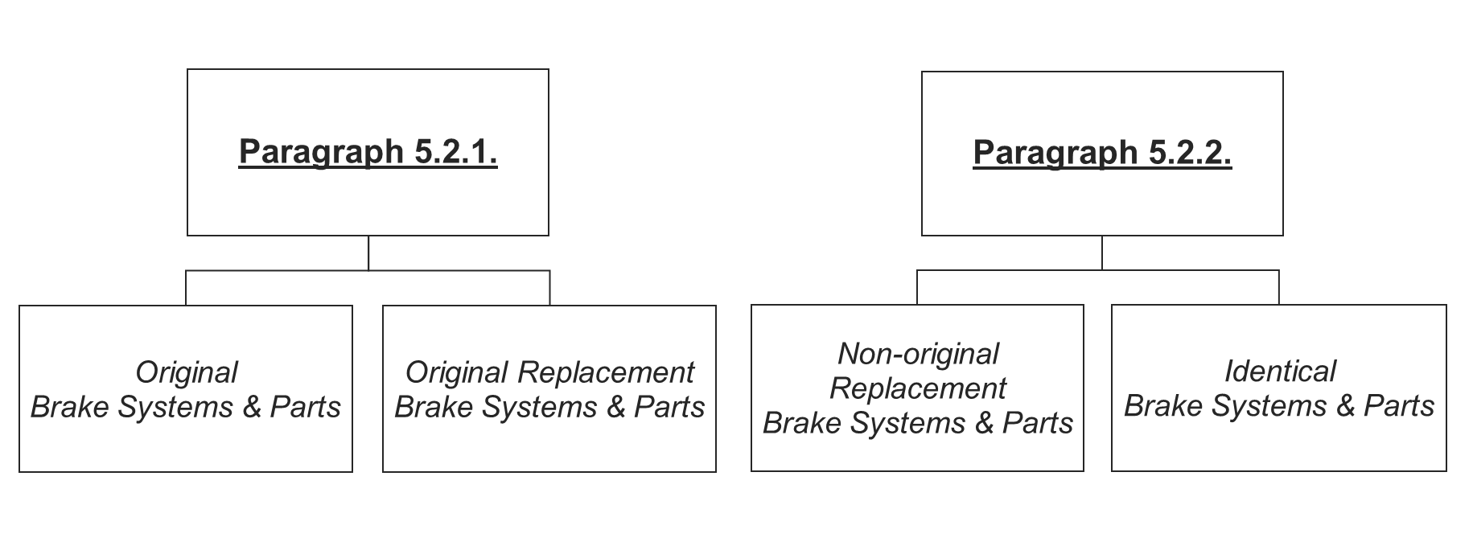
1ST AMENDMENT TO GTR-24
MAIN POINTS
1. Definition of original and replacement parts and definition of brake families for non-original replacement parts (i.e. aftermarket parts)

Slide 9
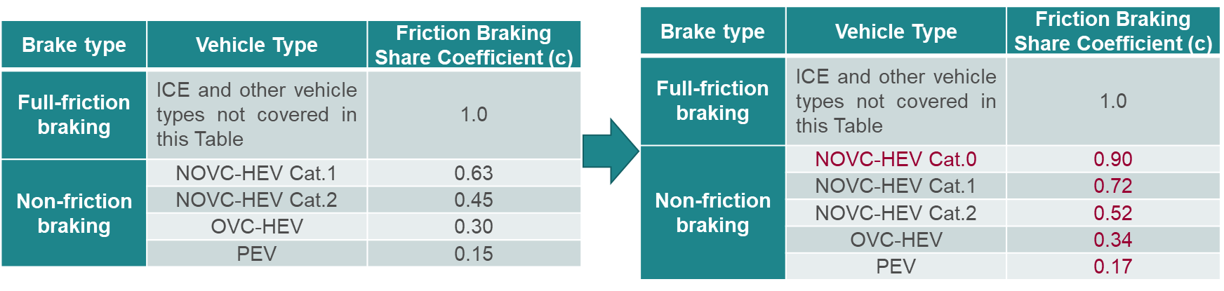
1ST AMENDMENT TO GTR-24
MAIN POINTS
2. Refinement and adjustment of fixed friction share coefficients representing the worst-case scenario in each vehicle category
The c factors in Table 5.3 of the GTR-24 (ex-Table 5.1) were recalculated using a correction (1/0.87=1.15) for aligning the c definition in the two cycles as it is defined in the newly introduced Annex C. A new category was added to cover mild-hybrids with smaller batteries.

Slide 10
1ST AMENDMENT TO GTR-24
MAIN POINTS
3. Addition of Annex C with a procedure for the determination of the vehicle- specific friction braking share coefficient on a chassis dynamometer. The contents are:
Purpose of Annex C (A paragraph describing why Annex C was developed);
Scope and Application (A paragraph providing details about the scope of Annex C and how this shall be applied in the context of the GTR-24);
Reference Method and Calculation (Details about the reference and the alternative methods along with the subsequent calculations are provided);
Testing Setup and Specifications (Details about the vehicle selection, test preparation, data recording, chassis dynamometer settings, and test sequence are provided);
Equivalency of Methods (Specifications regarding the selection of vehicle, testing of the alternative method, and equivalency criterion are given);
Equivalency of Test Cycles (Discusses what alternative cycles shall be used).
Test Output (Discusses what provisions shall be followed when declaring the test results).

Slide 11
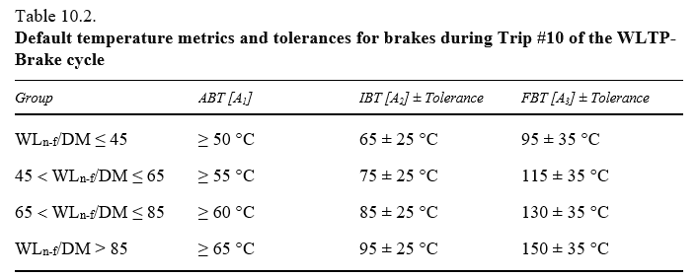
1ST AMENDMENT TO GTR-24
MAIN POINTS
4. Definition of different temperature parameters for the cooling adjustment of carbon-ceramic disc brakes
The group classification in Table 10.2 may be unrealistic for non grey cast iron discs as they show different temperature behavior. For example, if a middle-class vehicle with a GCI disc system is classified in WL/DM group 45 < X ≤ 65, the same vehicle with a CC disc would be in WL/DM > 85.
10.1.2 Verification of Parameters and Tolerances for Brake Temperature
(a) ... For carbon-ceramic disc brakes, the default temperature metrics apply; however, the ABT [A1] temperature metrics are lowered by 15 °C and the tolerances to the low end of the temperature regime for the IBT [A2] and FBT [A3] are further relaxed by 15 °C;

Slide 12
1ST AMENDMENT TO GTR-24
MAIN POINTS
5. Definition of active and passive filtration systems – Introduction of a requirement for active filters and agreement on the need for further definition of specifications
Requirements need to be defined to account for the activation of the blower in active filtering devices when testing on the brake dyno;
For the time being, these systems are allowed to be tested according to the GTR-24 for their emissions as long as all specifications defined in the GTR are met (e.g. temperatures, dimensions, cooling airflow, etc.);
Following the PMP discussions, the proposal for the 1st amendment is to define the activation of the filtering devices through dedicated dyno signals and allow for some time for the pump to run AFTER the end of the braking event. This time has been set to 5 sec after the end of the brake event;
Following the PMP discussions, it was decided that a more elaborated analysis on the specifications of the active filters will be introduced in the next amendment to the GTR-24.

Slide 13
OTHER BRAKE RELATED TOPICS
The PMP ToR require the execution of a Round-robin with GTR compliant labs (ILS-3 Interlaboratory Study 3)
Task Force 3 has resumed meetings in December 2023 to support the task. The purpose of TF3 is to organize the upcoming ILS-3. Biweekly meetings will follow and a face-to-face workshop will take place in February 2024 in Munich to finetune the exercise;
The PMP ToR require the investigation of the feasibility of the defined method for measuring brake emissions for HDV brakes
Task Force 5 has been created in December 2023 to follow up on this task. The TF5 will be co-chaired by OICA and JRC. OICA provided a first presentation with its views during the PMP IWG meeting in November. TF5 will kick-off in January;

Slide 14

Thank you
© European Union 2024
Unless otherwise noted the reuse of this presentation is authorised under the CC BY 4.0 license. For any use or reproduction of elements that are not owned by the EU, permission may need to be sought directly from the respective right holders.
Notes:
Update/add/delete parts of the copy right notice where appropriate.
More information: https://myintracomm.ec.europa.eu/corp/intellectual-property/Documents/2019_Reuse-guidelines%28CC-BY%29.pdf

Slide 15
EXHAUST CALIBRATION TOPIC
Due to the impact of the material on the efficiencies of 23 nm PNCs, and in order not to have impact on the current market situation, which is mainly based on PAO calibrations, it is recommend to adjust soot-like (or other materials, e.g. silver) efficiencies to PAO or vice versa.
Option 1: adjust PAO efficiencies to soot-like
For 23 nm PNCs, setting “soot” as reference material will result in increase of counting efficiencies of most PNCs in the market (which are calibrated with PAO) during re-calibration. This will result in a 5-10% difference of measured concentrations of a PN system before and after recalibration of the PNC (depending on the size distribution).
Another solution would be to change the PNC efficiencies in the regulation from 50% (±12%) to e.g. 40% (±12%) (values to be defined, but least preferable option)

Slide 16
CONCLUSIONS
Option2: adjust soot-like efficiencies to PAO
There was no unique correlation of PAO and soot-like particles, but for simplification reasons a correlation factor could be used
The correlations should be done independently at the respective calibration facility. As examples:
  Calibrating a few CPCs with both emery oil and soot-like materials and determining a “correction” factor for 23 nm, and 41 nm.
  Having a 23 nm “transfer” PNC calibrated with emery oil and adjusting (or comparing the rest) with the specific PNCs using soot-like particles
Preferred option is third bullet (already in 10 nm PNC procedures).
A round robin could investigate this topics; a calibration guidance could further address the topic.

