Slide 1
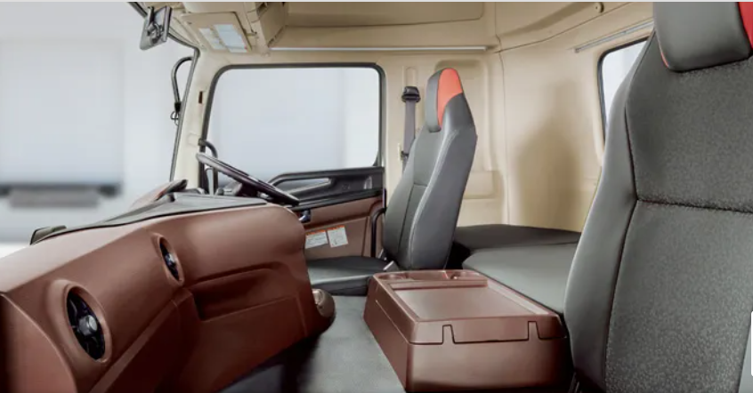
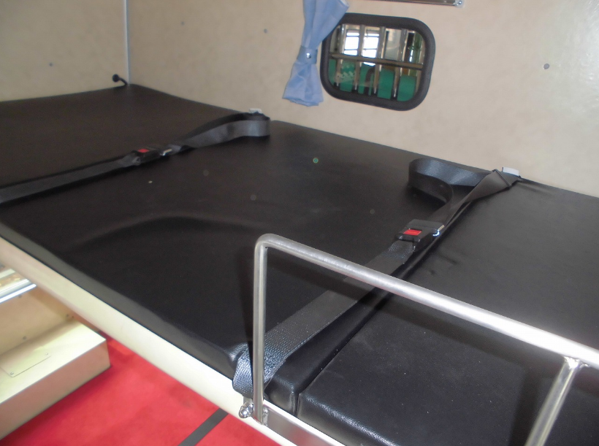
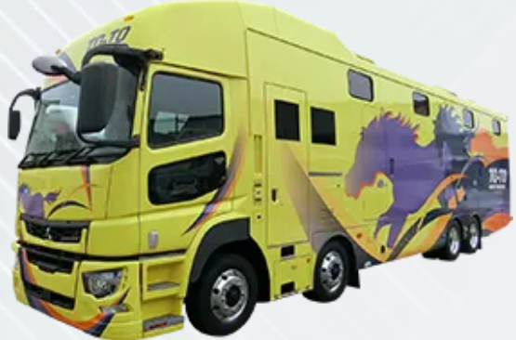
Use of a Bed in Trucks While Running
Submitted by Japan
Informal document GRSP-74-18
(74th GRSP, 04 - 08 December,
agenda item 23 (a)
- Japanese heavy-duty trucks have a sleeping berth in the cabin. This is originally designed for the driver to take a nap at truck stops or parking lots at their destinations.
- Recently in Japan, the reduction of working hours of truck drivers has become an issue, and there has been discussion for improving their working environment by requiring trucking operators to, if it is a long-distance ride, assign two co-drivers so that they can take turns to take a nap or break in a bed while the other is at the wheel, thereby helping to reduce their burden on the road.
- There has been, however, no safety regulations in Japan for a sleeping berth in the cabin used while running, so we would like to listen to your comments on the matter to learn what it is like in other countries, as a basis for our study and discussion about the requirements in Japan for such a bed used while running. We would also like to consider the development of international standards and would like to hear opinions from other countries.
Sleeping berth
Example of a trucker’s sleeping berth
Specifically, we would like you to answer the questions such as:
(i) Do you allow a co-driver to use a bed in the cabin while running? Or is it forbidden? If so, please specify the law or regulation the ban is based on.
(ii) Do you have any safety regulation for a bed in trucks used while running? If so, please specify the name. If not, do you think it appropriate to establish a safety regulation for a bed in truck cabs used while running?
(iii) Do you have any accident statistics on deaths or injuries of users of beds in trucks while running? If so, we would appreciate it if you could share them with us.
(iv) A special case in Japan is horseboxes, as one shown at right, that carry racehorses, of which handling takes great care. These horseboxes have a sleeping berth in the cab to be used by a co-driver while running, considering that these boxes need to be driven over long distances without stops.
Please let us know if there are any special cases like this.
>> If you have any information or data on the matter, please let JASIC know from its website: jasic@jasic.org, watanabe@jasic.org
Examples of a special sleeping berth

