Slide 1
Transmitted by the Netherlands
Informal Document GRPE-90-15
90th GRPE, 9th of January – 12th of January, 2024,
agenda item 16
Report to 90th Session of GRPE (January 2024)
Task Force Automated Vehicles Regulation Screening
(TF-AVRS)

Slide 2
TF Automated Vehicles Regulation Screening
9
13
Number of Meetings
Participants (Contracting Parties & NGOs)
Web-meetings
1st Kick-off meeting: 13th March 2023
2nd TF-AVRS: 4th April 2023
3rd TF-AVRS: 17th April 2023
4th TF-AVRS: 9th May 2023
5th TF-AVRS: 22nd May 2023
6th TF-AVRS: 11th September 2023
7th TF-AVRS: 10th October 2023
8th TF-AVRS: 13th November 2023
9th TF-AVRS: 5th December 2023
CPs: Germany, France, United Kingdom, South Africa, Unites States, Netherlands
NGO‘s: OICA
Report TF-AVRS – GRPE-90

Slide 3
TF Automated Vehicles Regulation Screening
Targets
WP29 requests a screening of regulation for application of Automated Vehicles.
GRVA proposed a template for the screening
TF-FADS (GRVA) provides further guidance
Roles
Chair: [Netherlands]
Secretariat: […]
TF-AVRS wikipage
https://wiki.unece.org/pages/viewpage.action?pageId=198672917&src=contextnavpagetreemode
Report TF-AVRS – GRPE-90

Slide 4
Screening process: Considered items
1. Terminology
Relevant terms based on GRVA guidance (accelerator, handle-bar type steering)
2. Use cases AVs
Driverless AVs
With passenger
Without passengers (cargo)
AVs with driver
Bi-directional AV’s
3. Other considered items
Telltales & warning signals
Test modes
Report TF-AVRS – GRPE-90

Slide 5
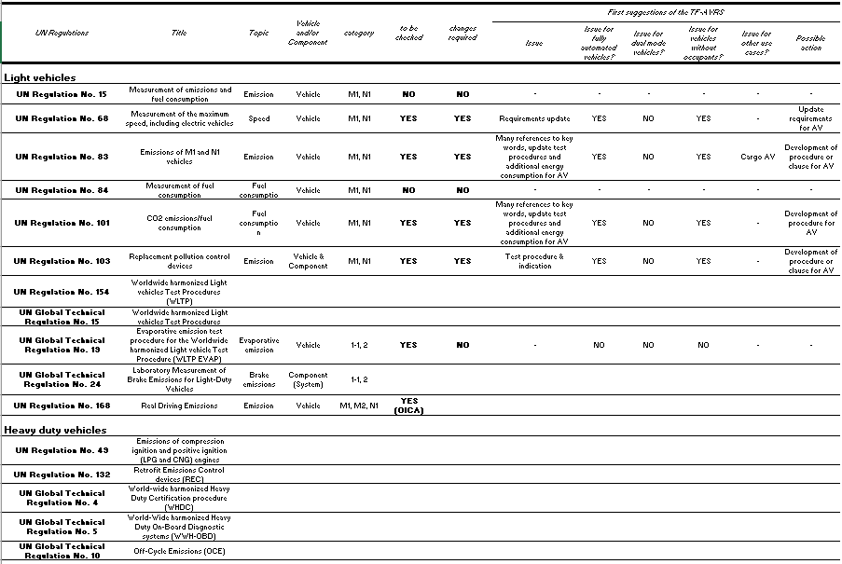
Report TF-AVRS – GRPE-90

Slide 6
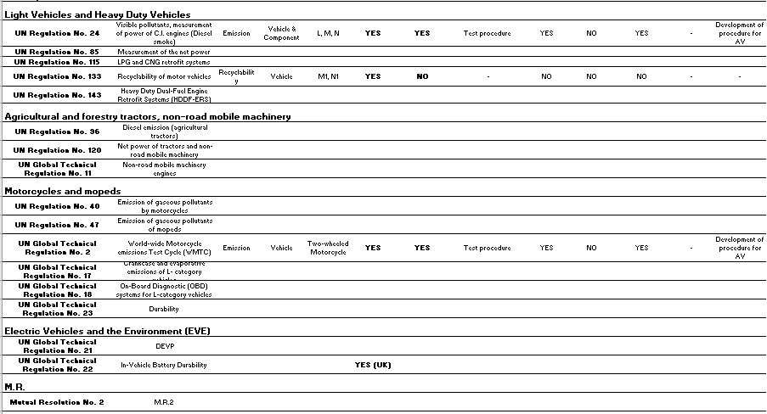
Report TF-AVRS – GRPE-90

Slide 7
TF-AVRS Results
No vehicle categories will be excluded from screening
2 Regulations are excluded from screening (old)
9 regulations are screened
1 regulation is planned to be screened
Report TF-AVRS – GRPE-90

Slide 8
Next steps
Continue with meetings once per month
Participants from CP’s and NGO’s are really needed to accelerate the screening and to continue the necessary work after the screening.
Interesting topic and good opportunity to get familiar with GRPE legislation
GRPE is really behind on other GR’s
Timeline for amendments needs to be provided in March 2024 to WP.29, which means that screening should be finished before March 2024! A final report with summary sheet of the screened legislation needs to be provided.
Who is willing to join TF-AVRS?
Report TF-AVRS – GRPE-90

Slide 9
Thank you for your attention
Report TF-AVRS – GRPE-90

