Slide 1
List of issues related to all series of amendments to UN Regulation No. 154
Informal document GRPE-90-10
90th GRPE, 10-12 January2024
Agenda item 3.(a)
GRPE 90th session

Slide 2
New topic – just editorial
Annex B7 Paragraph 6.2.– Table A8/6 refers to 6.2. (but 6.2. refers to Table A7/1 only)
Series: 00, 01, 02 and 03
 | Current/amended text based on 02 series (applicable on 00, 01, 03 series as well)
Current text
Amended text

Slide 3
New topic – just editorial
Editorial error in Table A8/5, Step 4c – „CS“ missing in index of process column
Series: 00, 01, 02 and 03
 | Current/amended text based on 02 series (applicable on 00, 01, 03 series as well)
Current text
Amended text

Slide 4
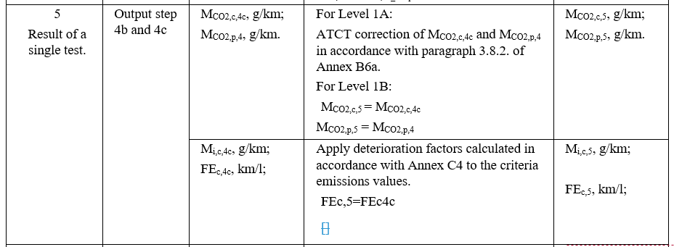
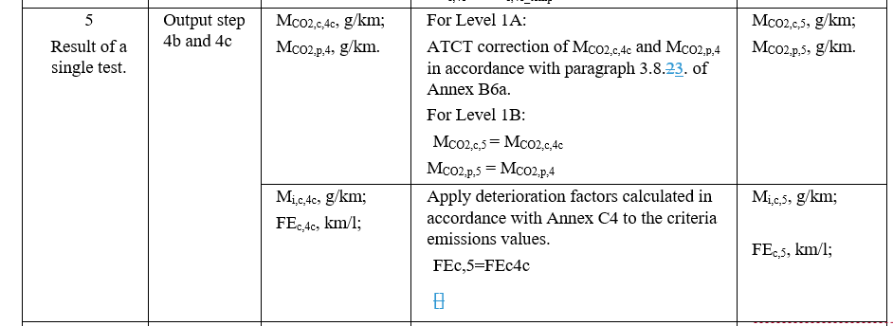
New topic – just editorial
Editorial error in Table A8/5, Step 5 – wrong reference
Series: 00, 01, 02 and 03
 | Current/amended text based on 02 series (applicable on 00, 01, 03 series as well)
Current text
Amended text

Slide 5
New topic – just editorial
Editorial error in Table A8/5, Step 7 – “according to”
Series: 00, 01, 02 and 03
 | Current/amended text based on 02 series (applicable on 00, 01, 03 series as well)
Current text
Amended text

Slide 6
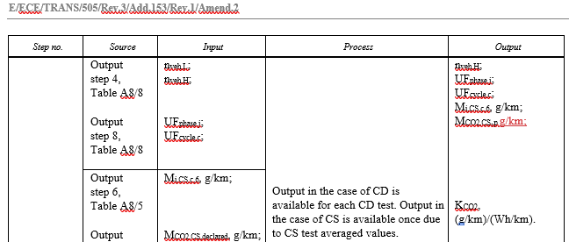
New topic – just editorial
Annex B8 – Table A8/9 “g/km” missing in Output of Step 1
Series: 00, 01, 02 and 03
 | Current/amended text based on 02 series (applicable on 00, 01, 03 series as well)
Current text
Amended text

Slide 7
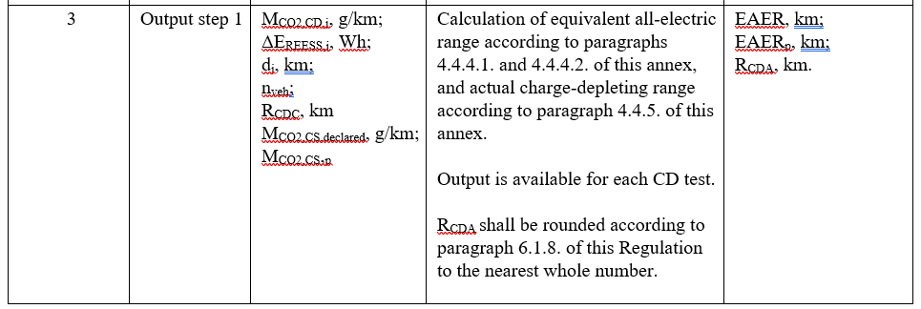
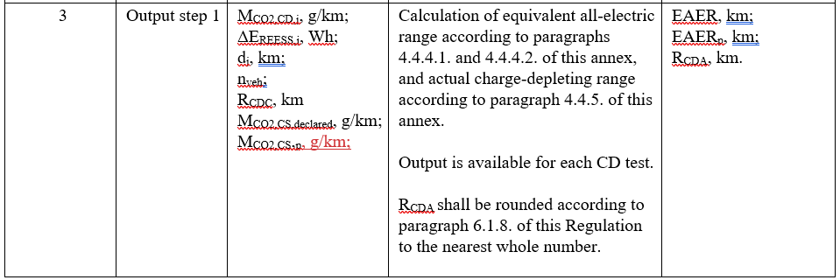
New topic – just editorial
Annex B8 – Table A8/9 “g/km” missing, Step 3
Series: 00, 01, 02 and 03
 | Current/amended text based on 02 series (applicable on 00, 01, 03 series as well)
Current text
Amended text

Slide 8
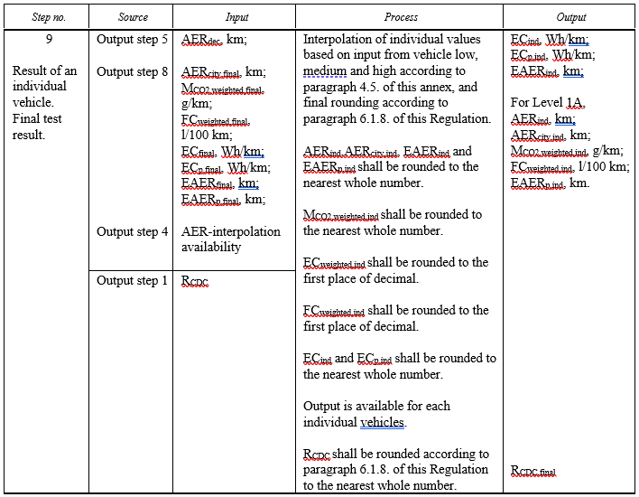
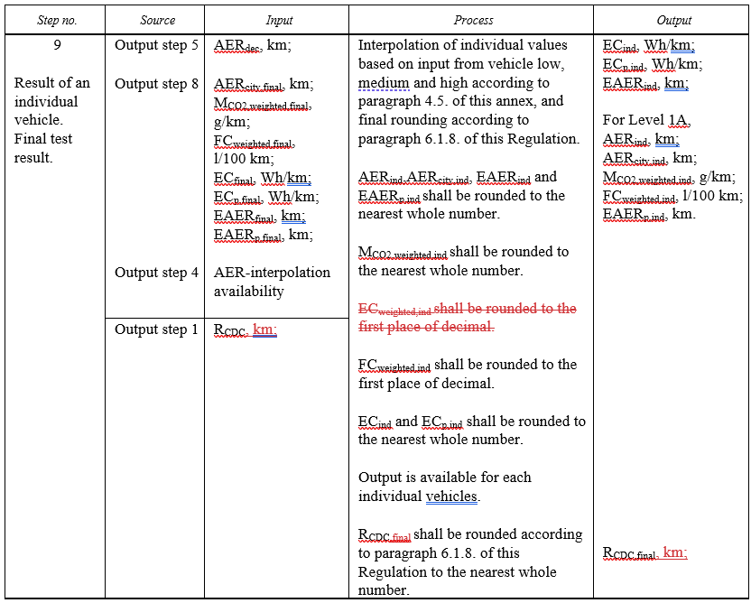
New topic – just editorial
Annex B8 – Table A8/9 “km” missing, EC_{weighted,ind} not exists, R_{CDC,final} shall be rounded (step 9)
Series: 00, 01, 02 and 03
 | Current/amended text based on 02 series (applicable on 00, 01, 03 series as well)
Current text
Amended text

Slide 9
New topic – just editorial
Table App1/1 → Paragraph number of headline to be changed: OLD 6.4. → NEW 7.
Series: 00, 01, 02 and 03
 | Current/amended text based on 02 series (applicable on 00, 01, 03 series as well)
Current text
Amended text
(…)
Justification:
Table App1/1 currently under paragraph 6.4. which is limited only to EC of OVC-HEVs
But Table App1/1 covers ALL vehicles
Paragraph number to be changed in 7.
(…)

Slide 10
New topic – error correction
Annex B8 → EAER formula in 03 series to be amended (R_{CDC,ave} changed into R_{CDC})
Series: 01, 03
 | Current/amended text based on 03 series (applicable on 01 series as well)
Current text
Amended text
Justification:
In 02 series, the formula is correct (see below)

Slide 11
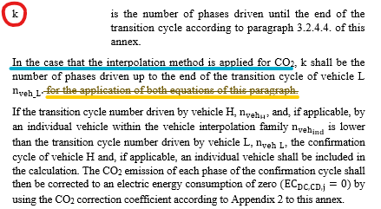
New topic – clarification
Annex B8 → Paragraph 4.1.3.1.: Clarification that VL provision not applies on crit. emiss.
Series: 00, 01, 02 and 03
 | Amended text based on 02 series (applicable on 00, 01, 03 series as well)
Amended text
Justification:
Special provision should only apply to weighted CO2 but could be read as it also applies on criteria emissions
Blue underlined text and yellow underlined text are in contradiction
Furthermore, M_{i,weighted} is not interpolated
Proposal: delete yellow underlined text

Slide 12
Annex A1: Add EAER to information document as declared value
New topic – required
Series: 00, 01, 02 and 03
 | Amended text based on 02 series (applicable on 00, 01, 03 series as well)
Amended text
Justification:
All declared values are part of information document
To test report and certificate, it has been added but in information document missed
Comment to EU-COM:
To avoid different information documents in 1151 and UN-R154, information document should be deleted from 1154, just reference to UN-R154

Slide 13
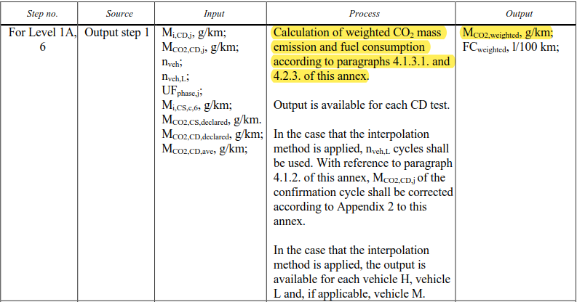
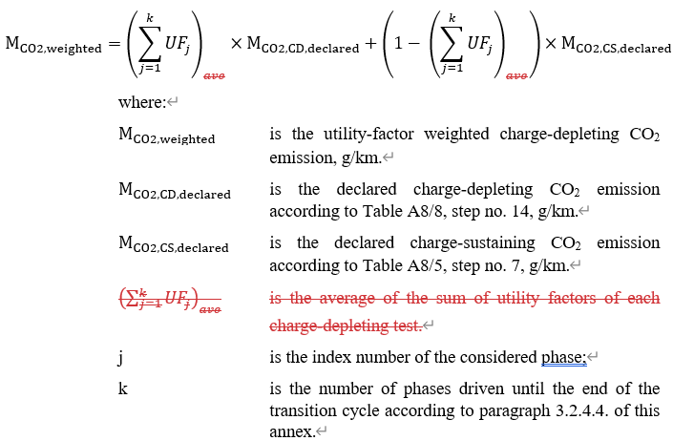
New topic – error correction
Annex B8 → M_{CO2,weighted} formula in 02 series to be amended
Series: 00, 01, 02 and 03
 | Amended text based on 02 series (applicable on 00, 01, 03 series as well)
Amended text
Justification:
Ensure consistency between tables and formulas

Slide 14
New topic – just editorial
Appendix 1 → Reference missing in paragraph 5.2. for Shortened Type 1 Test Procedure for PEVs
Series: 00, 01, 02 and 03
 | Current/amended text based on 03 series (applicable on 02 series as well)
Current text
Amended text
Justification:
Verification of CoP on electric energy consumption of PEVs can be conducted according to Consecutive cycle Type 1 Test Procedure (Table A8/10) or Shortened Type 1 Test Procedure (Table A8/11).
References for DC Electric energy consumption according to Shortened Type 1 Test Procedure (Table A8/11) should be included as well

Slide 15
Table App 1/1 → Reference missing for Shortened Type 1 Test Procedure for PEVs
New topic – just editorial
Series: 00, 01, 02 and 03
 | Current/amended text based on 03 series (applicable on 02 series as well)
Current text
Amended text
Justification:
Verification of CoP on electric energy consumption of PEVs can be conducted according to Consecutive cycle Type 1 Test Procedure (Table A8/10) or Shortened Type 1 Test Procedure (Table A8/11).
Run-in factors should be applicable also for shortened type 1 test procedure energy consumption results

Slide 16
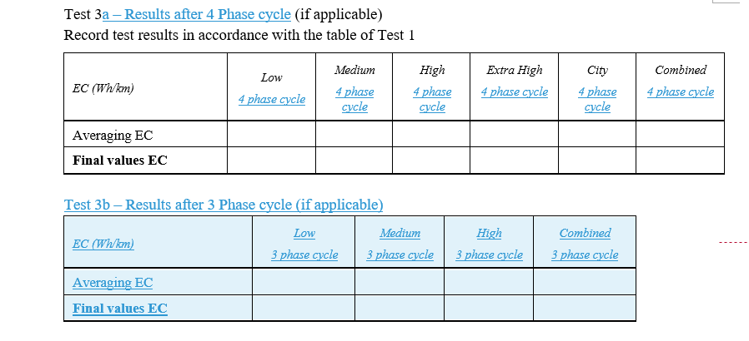
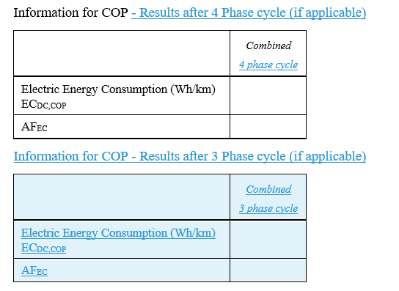
Annex A1 – Appendix 1 → extension of Test 3 table in 2.1.1.5.2.
New topic – just editorial
Series: 01 and 03
 | Current/amended text based on 01 series (applicable on 03 series as well)
Current text
Amended text
Justification:
Additional tables required as Low, Mid, High can be different for 3-phase and 4-phase because these are multiplied by the adjustment factor
Adjustment factor is calculated from “combined value measured” and “combined value declared”
Adjustment factor can be different between 3-phase and 4-phase
Note: Same rationale applies for COP values

Slide 17
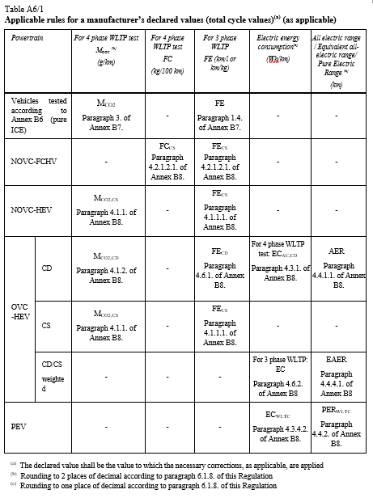
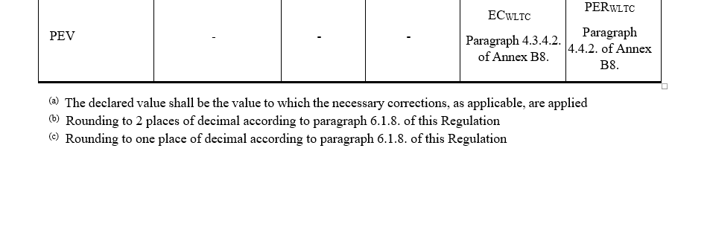
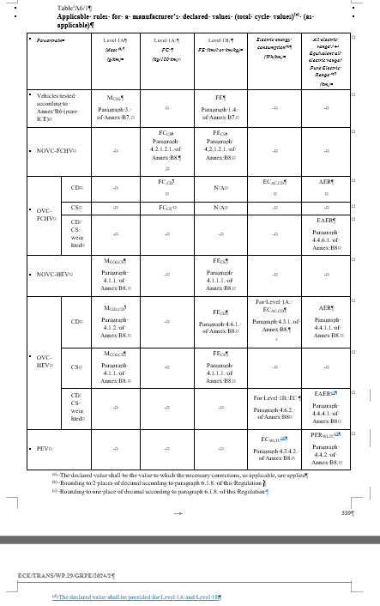
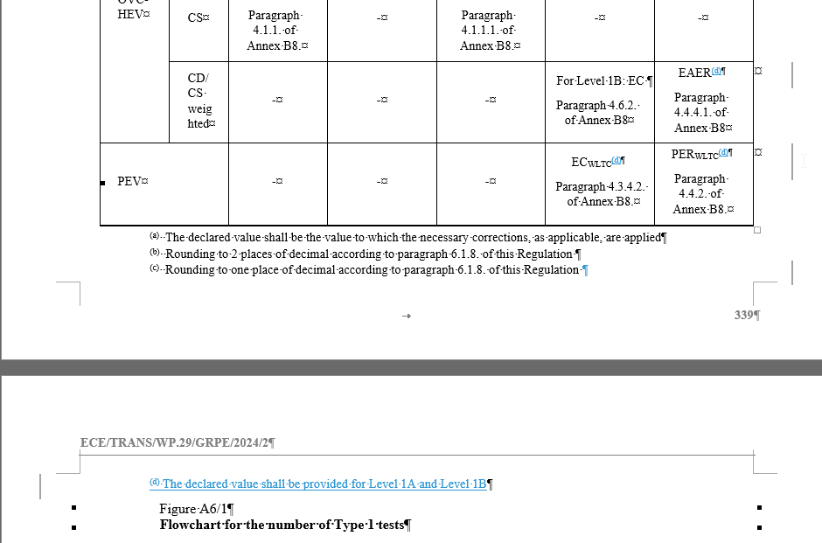
Annex B6 → Table A6/1 footnote
New topic – just editorial
Series: 00 and 02
 | Current/amended text based on 00 series (applicable on 02 series as well)
Current text
Amended text
Justification:
Separate declared values for 3 and 4 phased EC_{WLTC} and PER
MDV table does not distinguish between 3 and 4 phase here
Proposal: additional footnote
Note: slightly different wording for Series 00 & 02

Slide 18
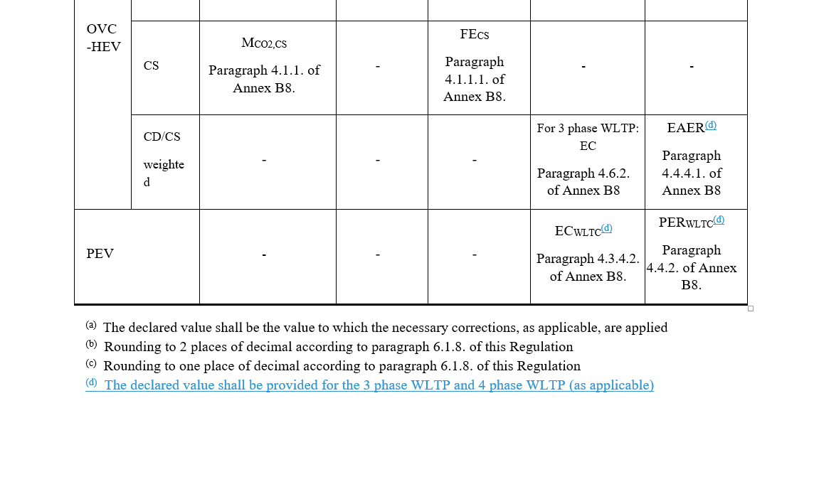
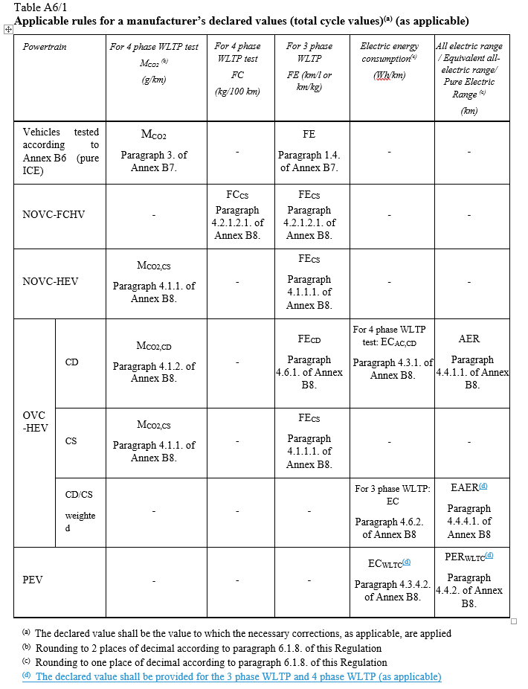
New topic – just editorial
Annex B6 → Table A6/1 footnote
Series: 01 and 03
 | Current/amended text based on 01 series (applicable on 03 series as well)
Current text
Amended text
Justification:
Separate declared values for 3 and 4 phased EC_{WLTC} and PER
MDV table does not distinguish between 3 and 4 phase here
Proposal: additional footnote

Slide 19
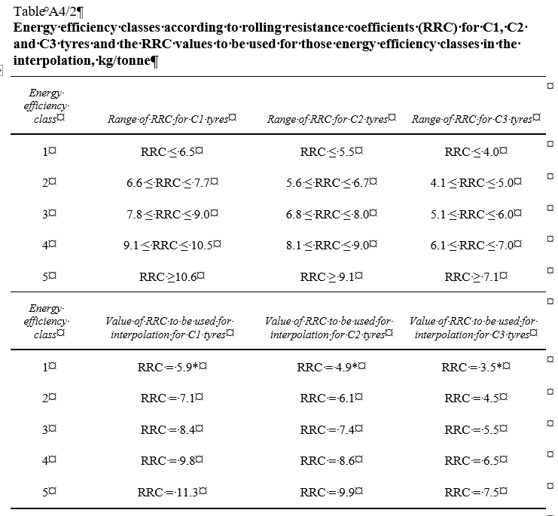
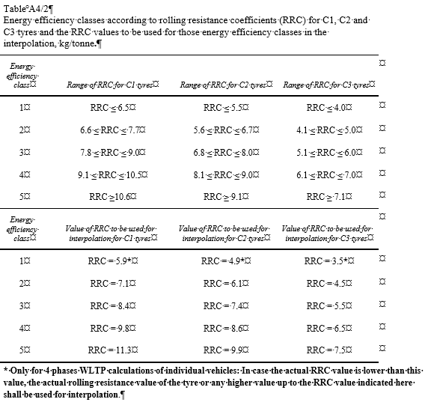
New topic
Annex B4 → Table A4/2
Series: [00] 01, [02], 03
 | Current/amended text based on 03 series (applicable on 01 series as well)
Current text
Amended text
Justification:
4 phases calculation results of individual vehicles should be identical whatever the series of amendment.
Proposal is to harmonize 01 and 03 series of amendment with provisions applicable to level 1A of 00 and 02 series when coming to Rolling Resistance of tires used for 4 phases calculation of individual vehicles.
This would apply to 4 phases calculation only. No change for 3 phases calculation.
The proposed modification results in a change for 01 and 03 series only. Retrofit in 00 and 02 series would be for harmonization of wording only.

Slide 20
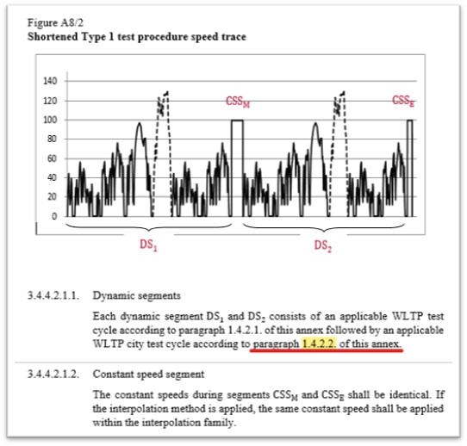
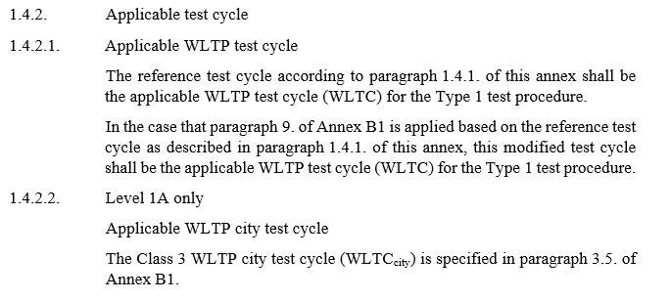
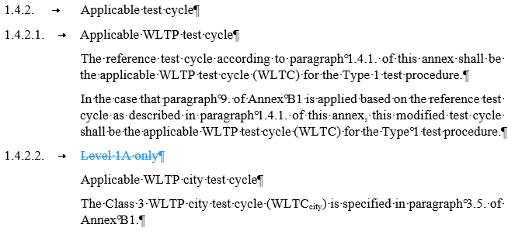
New topic – just editorial
Annex B8 → Deletion of “Level 1A only” in 1.4.2.2.
Series: 00 and 02
 | Current/amended text based on 02 series (applicable on 00 series as well)
Current text
Amended text
Justification:
“Level 1A only” makes no sense in 1.4.2.2.
It could lead to the interpretation in paragraph 3.4.2.1.1. that dynamic segment for Level 1B just consists out of applicable WLTP test cycle only as paragraph 1.4.2.2. is not applicable
Furthermore, restriction to Level 1A not required in paragraph 1.4.2.2. because anyway stated in the whole calculation chapter that city cycle not applicable for Level 1B, e.g. in front of Table A8/11
Proposal:
Delete “Level 1A only” in paragraph 1.4.2.2.

