Slide 1
Sustainability considerations for LED technology
Transmitted by the experts from IEC
Informal document GRE-89-22
89th GRE, 24–27 October 2023, agenda item 11 (c)
Philipp Plathner, Walter Schlager – IEC
25-October 2023

Slide 2
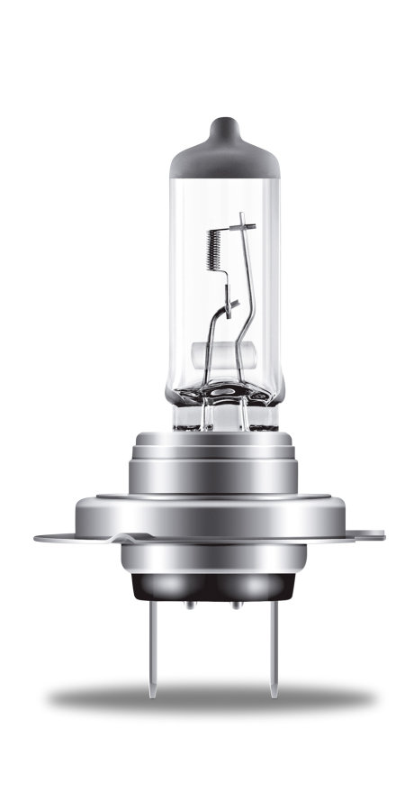
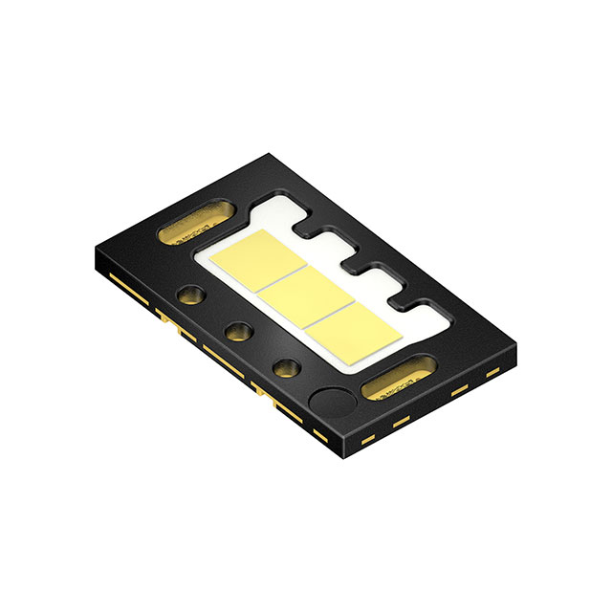

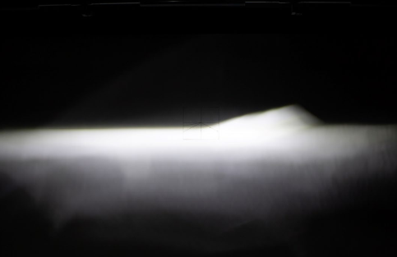
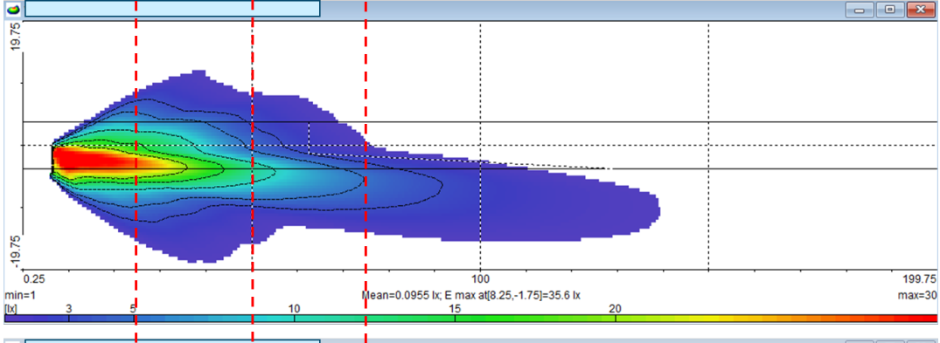
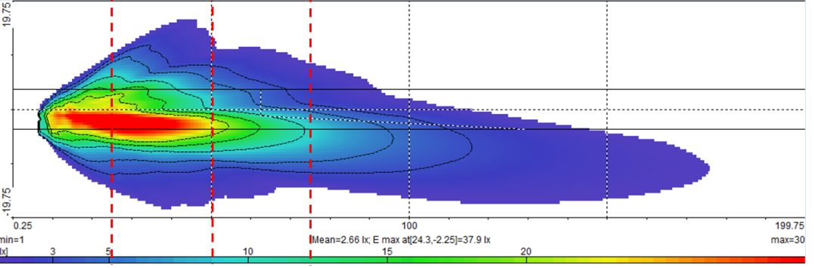
Sustainability benefits of LED technology
Technology transition
WHILE keeping / improving beam performance
~ 25 lumen / Watt
~ 500 hours lifetime
~Faktor 4
~ 100 lumen / Watt
> 2000 hours lifetime
> Faktor 4
Figures taken from GRE-89-06

Slide 3
A quantitative estimation – per vehicle
Example of low-beam
  Baseline technology (= Halogen): consumption of 137 W
  Innovative technology (= LED): consumption of 40 W**
  Usage factor of low-beam function: 33% (assumption: during night only)
  Resulting CO₂ savings: 0,85 g/km
  Based on a car life of 200.000 km this means ~170kg CO₂ (or ~68 l fuel)
** Note: the basis of the calculation uses typical OEM solutions, but the same holds for H7-LED products as currently approved in Germany or France
Source of calculation: “Technical Guidelines for the preparation of applications for the approval of innovative technologies pursuant to Regulation (EC) No 443/2009
of the European Parliament and of the Council”

Slide 4
New vehicle production –
Projection of LED transition
Figure taken from TFSR-05-07
2023
Halogen
LED
2020
2030
2040
Source: IHS global insight, LUMILEDS Business analysis dept. 2019

Slide 5
→ As a consequence … –
Projection of LED transition in the carpark
Figure taken from TFSR-05-07
2023
Halogen
LED
2020
2030
2040
But, this transition can be accelerated by LED replacement solutions for vehicles in use
Source: IHS global insight, LUMILEDS Business analysis dept. 2019

