Slide 1
UN Regulation No. 140 modification proposal
Informal document GRVA-17-47
17th GRVA, 25-29 Sep. 2023
Provisional agenda item 8(a)
Submitted by the expert from OICA
GRVA-17, September, 2023

Slide 2
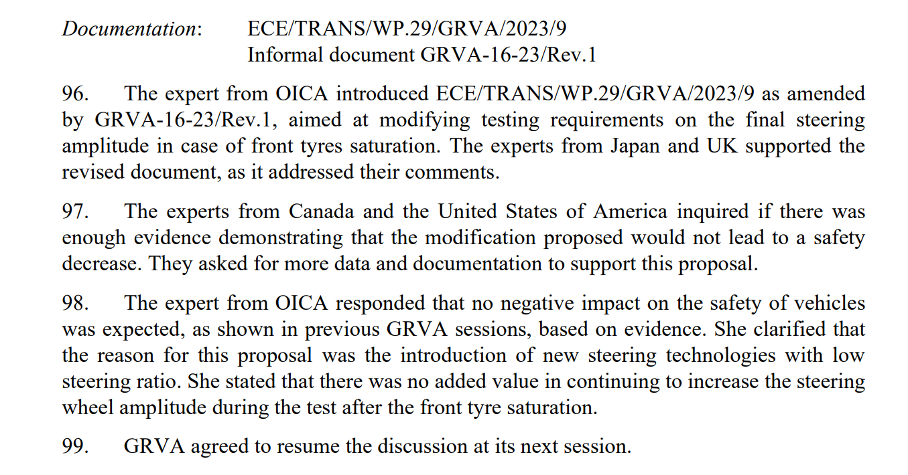
GRVA#16 Report

Slide 3
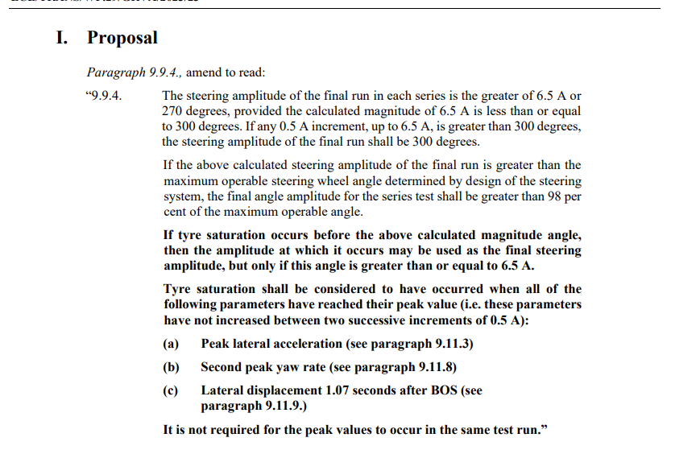
Working document GRVA/2023/23

Slide 4
Clarification of the Aim of the Amendment
Proposal for Amendment concerning Paragraph 9 (Test Procedure)
Proposed amendement keeps technical requirement and safety level unchanged.
Safety concept follows the requirements of :
  Paragraph 6 on Functional Requirement
  Paragraph 7 on Performance Requirement

Slide 5
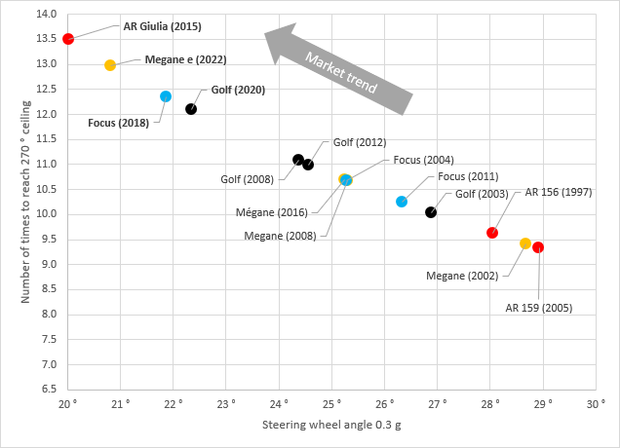

EVOLUTION OF STEERING RATIO
Chassis characteristics, especially overall steering ratio, are moving continuously
As a result, targetting fixed value of 270° steering wheel angle represents more and more severe input (now 12-13 times 0.3 g sollicitation; it was ~10 one decade before)

Slide 6
Does 270 ° amplitude give more information?
On this example, above ~7 A, front tires are saturated so more steer don’t give more force
No benefit to go over ~7 A
No modification of yaw rate and lateral acceleration after 7A run

Slide 7
Thank you

