Slide 1
Informal document GRVA-17-46 17th GRVA, 25-29 September 2023 Agenda item 12(a)
Submitted by the expert from CITA
17th GRVA
Some thoughts about the Unique Identifier
25th – 29th September 2023
Alejandro Checa | Technical Director | a.checa@citainsp.org

Slide 2
The Unique Identifier
The UI replaces traditional approval marking by making the information available on a website with the so-called Summary Document
+ It requires less surface for the engraving
- It adds additional time and resources to obtain the same information

Slide 3
Concepts to clarify
The UI does not simplify marking, it moves marking away
The UI only simplifies the engraving
DETA is working without the UI: 46.000 approvals uploaded https://unece.org/sites/default/files/2023-06/WP.29-190-13e.pdf. UI to be implemented on top of.
The Summary Document is not intended to contain any further information than today’s marking

Slide 4
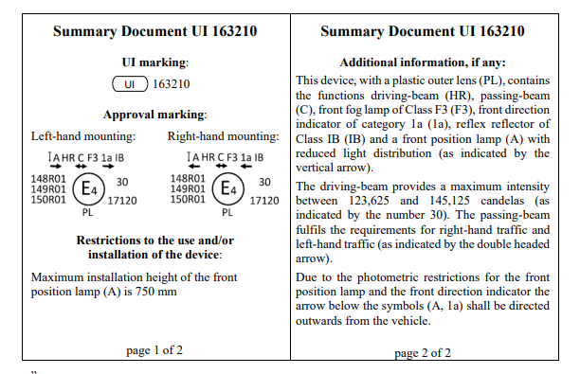
Concepts to clarify
Different markings of the device correspond to a single UI
One UI
Two traditional markings
https://unece.org/sites/default/files/2022-09/ECE-TRANS-WP29-GRE-2022-10e.pdf

Slide 5
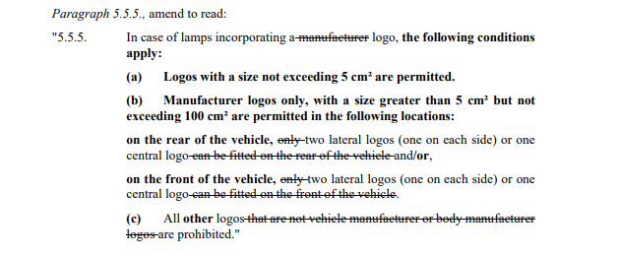
Concepts to clarify
In most lighting devices, engraving is not an issue. There is even a proposal to include brands
https://unece.org/sites/default/files/2023-05/ECE-TRANS-WP29-GRE-2023-10e.pdf

Slide 6
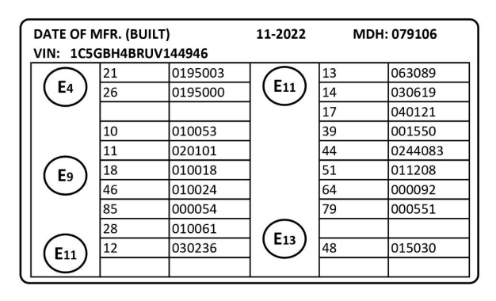
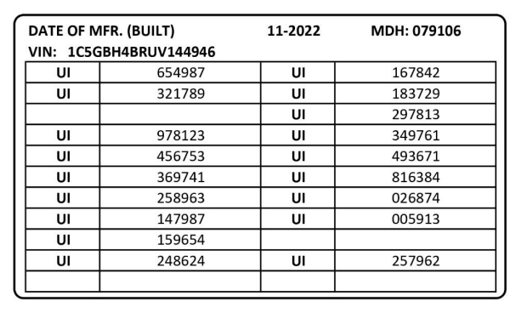
How the UI would look like
For vehicle approvals
GRVA-16-44

Slide 7
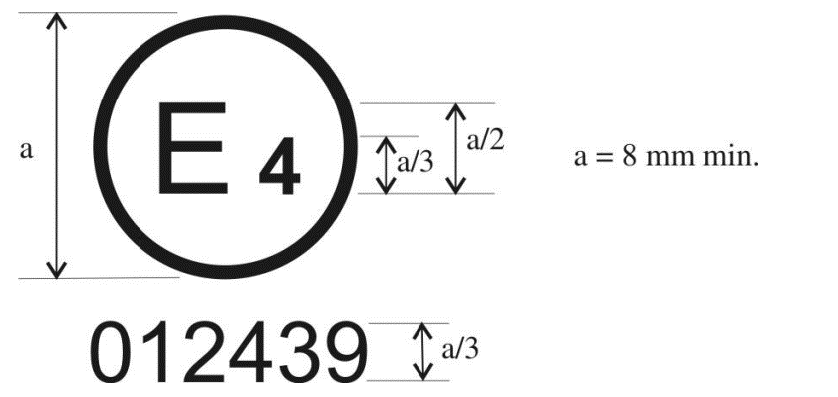
How the UI would look like
For component approvals in case there is no additional marking (example Reg 45)
Markings not at the same scale

Slide 8
Thank you for your attention!
www.citainsp.org
Rue du Commerce 123 - 1000 Brussels, Belgium
+32 (0)2 469 06 70
secretariat@citainsp.org

