Slide 1
Assessment of speed variance
Submitted by the expert of the Joint Research Centre (EC)
Informal document GRVA-17-41
17th GRVA, 25-29 September 2023
Provisional agenda item 6(a)
In Response to GRVA-17-11
(TF ADAS issues to seek guidance from GRVA)
EC JRC with the support of UTAC

Slide 2
Content
Influential factors
Statistical model
Experience from Intelligent Speed Assistance (ISA) from UTAC (FR)
Estimation of risk of perturbed traffic flow

Slide 3
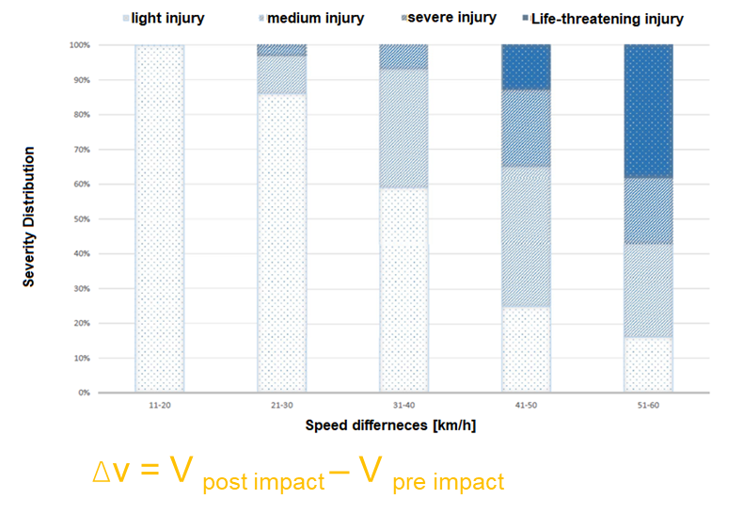
Influential factors of risk of crash
Mean speed
Mean speed, speed variation(s)
Speed difference
Risk ~ exp(α Mean(v))
Risk ~ exp(α Mean(v)+β Std(v))
Risk ~ v²
Path analysis of traffic flow
Forensic and accident reconstruction experts to describe accident severity
compare the average speed and the number of crashes before and after a speed management measure
Source: JRC - UNR157-07-09
Elvik et al, Accident Analysis and Prevention 123 (2019)
Park et al, Accident Analysis and Prevention 150 (2021)

Slide 4
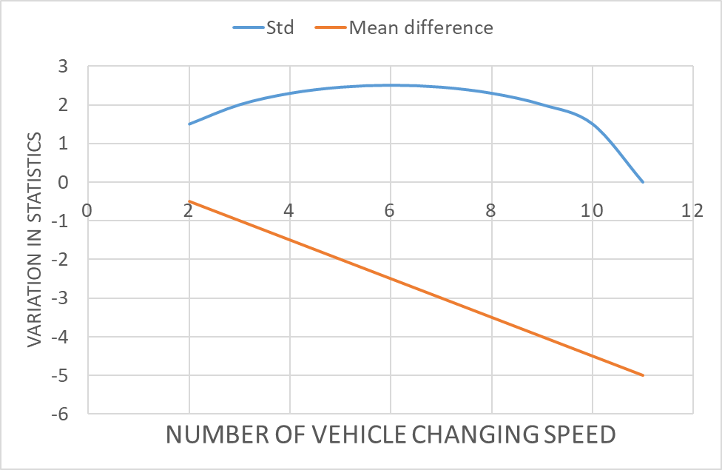
Speed variation in traffic flow
speed differences among vehicles
speed changes of individual vehicles
between lanes speed variance
Wang et al, Accident Analysis and Prevention 113 (2018)
Choudharya, Accident Analysis and Prevention 121 (2018)
Simple model:
All travelling at the same speed at the beginning
10 vehicles in the lane
5 km/h speed reduction per vehicle

Slide 5
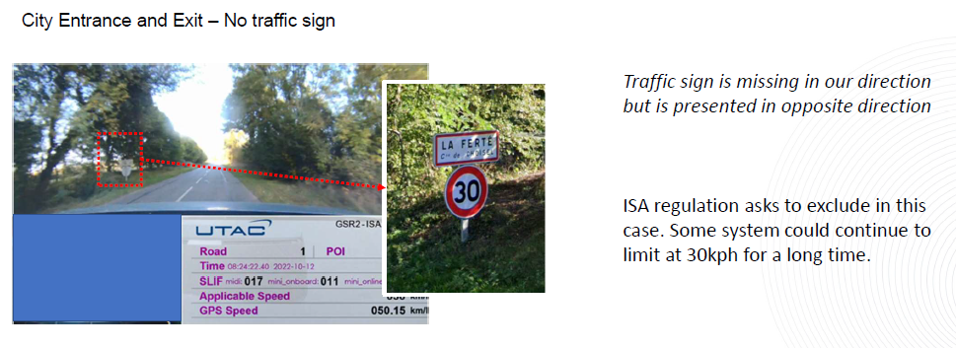
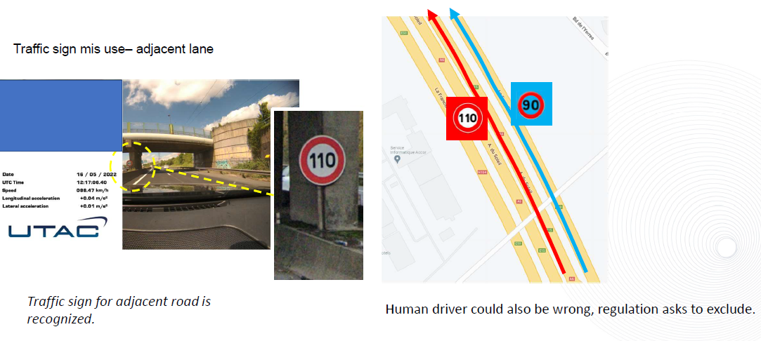
Experience from ISA
ISA
§5.3.1 – Trafic sign is partly obstructed or clearly not well positioned
§5.3.2 – Trafic sign is missing or positioned ambiguously
§5.3.3 – Ambiguous, additional, complementary or diverging informations
According to UTAC internal procedure to conduct the test:
Latest test campaign shows following rate: 40km over 400km 10% is excluded from the calculation of the system performance
Source: UTAC

Slide 6
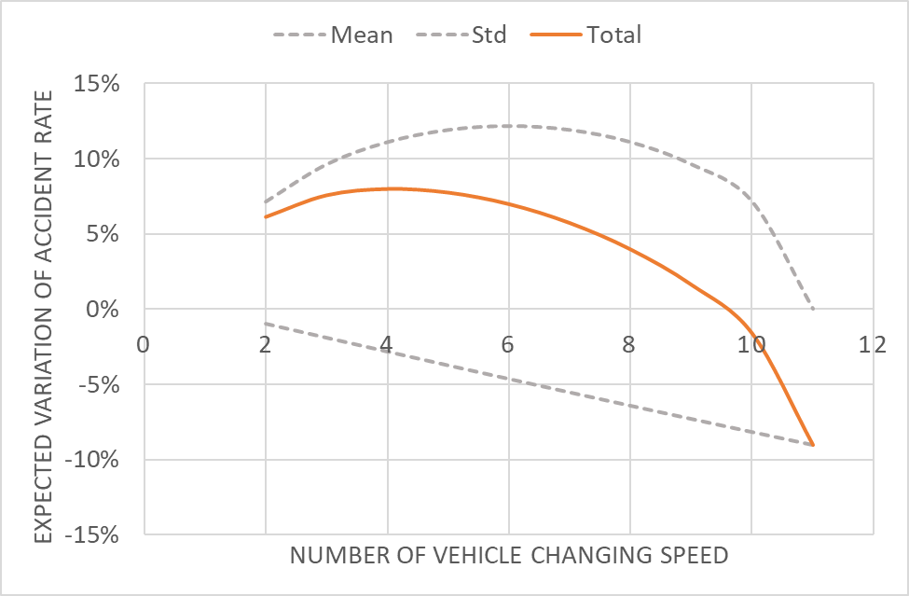
Effect of unintended speed reduction
1% increase in mean speed resulted 0.7% increase in crash frequency
1% increase in speed variation resulted in 0.74% increase in crash frequency
Wang et al, Accident Analysis and Prevention 113 (2018)
Simple model:
All vehicles travelling at the same speed at the beginning
10 vehicles in the lane
5 km/h speed reduction per vehicle

Slide 7
Summary
String (in)stability is an important factor to be considered in reduction of crashes. The chance of unintentional speed change shall be minimised
  Mattas et al., https://doi.org/10.1016/j.trb.2023.102785
  Ciuffo et al., https://doi.org/10.1016/j.trc.2021.103305
ISA field experience: 10% ambiguous cases are excluded from the performance calculation
90 % correct recognition is required (ISA)
Human supervision of speed limit detected by the system is essential before it is applied
Speed management measures shall be applied to all vehicles

Slide 8








Keep in touch
ec.europa.eu/
europeancommission
europa.eu/
@EuropeanCommission
@EU_Commission
EUTube
@EuropeanCommission
EU Spotify
European Commission
Notes:
Delete/update as appropriate

Slide 9

Thank you
© European Union 2023
Unless otherwise noted the reuse of this presentation is authorised under the CC BY 4.0 license. For any use or reproduction of elements that are not owned by the EU, permission may need to be sought directly from the respective right holders.
Notes:
Update/add/delete parts of the copy right notice where appropriate.
More information: https://myintracomm.ec.europa.eu/corp/intellectual-property/Documents/2019_Reuse-guidelines%28CC-BY%29.pdf

