Slide 1
Submitted by the Co-Chairs of the IWG on EDR/DSSAD
Informal document GRVA-17-28
17th GRVA, 25-29 September 2023 Provisional agenda item 4(c)
Activities/Deliverables of IWG on EDR/DSSAD
September 2023
Notes:
1

Slide 2
Mission of the EDR/DSSAD IWG ToR of the IWG (ECE/TRANS/WP.29/1147 Annex VII) (adopted in the 178th WP.29 in June 2019)
The IWG shall develop draft proposals for Event Data Recorder (EDR) for conventional vehicles and automated/autonomous vehicles and for Data Storage System for Automated Driving (DSSAD) for automated/autonomous vehicles. These categories shall be understood as systems collecting and storing a determined range of vehicle data, including:
Information related to collisions valuable for accident reconstruction (EDR);
The status of the automated/autonomous driving system and the status of the driver (DSSAD).
To this effect, the IWG shall address the following issues:
Define the scope and specific objectives of and differences between EDR and DSSAD,
Define EDR and DSSAD requirements.
In particular, the IWG will consider defining the categories of data recorded, the events triggering recording, as well as technical specifications in terms of performances of such systems, such as the required endurance, accessibility, storage capacity or the specific security requirements, as well as the required privacy and data protection by design features.

Slide 3
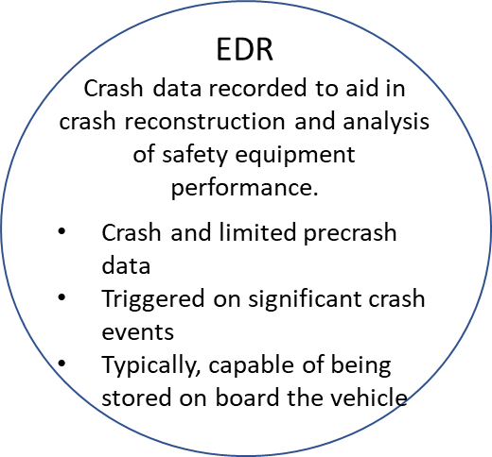
Conventional Vehicles
ADS Equipped Vehicles
DSSAD Analysis Plan:
DSSAD is active when:
ADS system/feature is activated
ADS system in transition of control
In the above cases, the following safety relevant events/circumstances should record (or trigger to record) relevant data elements:
Impact situations (EDR triggered impacts or impacts that are sensed but below EDR trigger thresholds)
Active conflict situations (e.g., incursion into “safety envelope”/”near miss”)
Execution/attempted execution of minimal risk maneuvers.
Operator emergency shutdown request
Remote operator intervention.
Positive Safety Performance events/occurrences??
DSSAD
Data recorded to evaluate/monitor overall safety performance and identify when ADS is in control of vehicles
EDR/ADS
Captures data for safety performance relevant events/situations
Volume of data may require off-board storage.
For crash events which meet the EDR triggering criteria – that event should be flagged so that the EDR data can be tied to associated DSSAD data elements
Crash data recorded to aid in crash reconstruction and analysis of safety equipment performance.
Crash and limited precrash data
Triggered on significant crash events
Typically, capable of being stored on board the vehicle
Includes ADS system state data elements
Note: there were some SG members/CP’s that suggested that the DSSAD should be continuously recording data whenever the ADS system/feature is active and that critical safety events/occurrences be data elements/flags. Others believe that the system should only record during (and sometime prior) to a safety relevant events/situation.

Slide 4
Overview of the IWG activities
 | Projects Completed | Current Work | Future Work
Comparison between EDR and DSSAD | Comparison between EDR and DSSAD (WP29-179-19, Nov. 2019) | DSSAD performance elements guidance document (June 2024)
DSSAD | DSSAD requirements (ALKS (UNR157)) (181st WP.29, June 2020) (189th WP.29, March 2023) Updating consolidated document of domestic activities on DSSAD (188th WP.29, November 2022) Primary purposes of DSSAD, Prioritization of discussion topics
EDR | EDR requirements (UNR 160 00/01 series) (183rd WP.29, Mar. 2021), and amendments (186th WP.29, Mar. 2022) Acceleration Data Accuracy Verification Procedures (125th GRSG, 2023/11&15 etc.) | EDR for HDV (Nov 2023) EDR performance elements for ADS (June 2024) | EDR Step 2 (Nov. 2024)

Slide 5
Activities of EDR/DSSAD IWG since GRVA #16
SG-EDR #36 June 6
TF Data Elements (EDR) #14 June 8
SG-DSSAD #15 June 27
SG-EDR #37 & TF Data Elements (EDR) #15 June 28
EDR/DSSAD IWG #22 (prep session for Sept. ) August 29
EDR/DSSAD IWG #23 (hybrid in D.C. the US) September 6-8

Slide 6
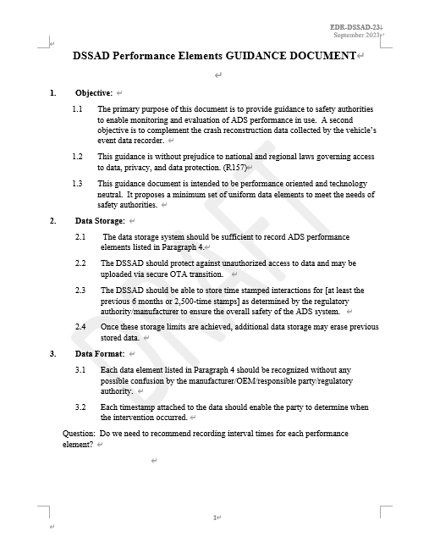
Summary of Recent Activities on DSSAD
Group is focusing on discussion of DSSAD Performance Elements Guidance Document to submit to WP.29 June 2024.
The guidance document consists of the following chapters:
Objective
Data Storage
Data Format
Performance Elements
Data Retrievability/Accessibility
Data Security
Misc.
Notes:
SG-EDR-28 Oct 4
SG-EDR-29 Oct 6
SG-EDR-30 Oct 31
SG-EDR-31 Nov 7
SG-EDR-32 Dec 1
SG-EDR-33 Jan 11

Slide 7
Current Schedule for EDR/DSSAD IWG
SG-DSSAD #16 November 20
SG-EDR #37 November 21
EDR/DSSAD IWG #24 (Virtual) February
EDR/DSSAD IWG #25 (hybrid in Tokyo, Japan) April 9-11

Slide 8
Thank you!
Notes:
8

