Slide 1
IT Security vs Access to Data Data Privacy in Connected Vehicles
Gerd Preuss, FIA Representative UNECE 17th GRVA session UNECE Geneva 25-29 September 2023
Submitted by the expert from FIA
Informal document GRVA 17-20
17th GRVA, 25-29 September 2023
Provisional agenda item 5(d)

Slide 2
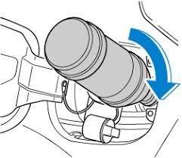
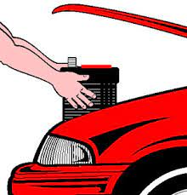
FIA IT Security vs Access to Data
More and more VMs define parts for their vehicles as security relevant and set additional conditions as a prerequisite for repairs
Problem Nr. 1: 3/4/5G-Abdeckung
Example: AdBlue-Tank
After refilling the AdBlue-Tank, the engine stop mechanism must be deactivated. => Some VMs require specific certificates and Internet Connection
Example: 12V Battery
After the Change of the 12V Battery, the Battery-Management-System must be activated. => Some VMs require specific certificates and Internet Connection

Slide 3
FIA IT-Security vs Access to Data
FIA welcomes the UNECE initiative to regulate IT Security, Data Privacy and Over The Air Updates. R155 aims to prevent the vehicle from unauthorised access to in vehicle data
As by now FIA sees, that Cyber Attacks via interfaces is declining, if vehicles are approved via R155 requirements
The authorised access to data via the standardised OBD-port is more and more controlled via individual security measures of VMs
The remote authorised access to data is completely controlled by VMs via individual APIs

Slide 4
FIA IT Security vs Access to Data
FIA proposes to look on IT-Security and Authorised Access to Data together
Problem Nr. 1: 3/4/5G-Abdeckung
Without
Loosing any level of security
Pre-empting national legislation on data access
But
Look on how an authorised access to in-vehicle-data can be ensured in a secure and more standardised way
Individual Security measures lead to disadvantages for the worldwide automotive aftermarket and in consequence to higher prices for Consumers

Slide 5
FIA Data Privacy in Connected Vehicles
IT-Security and Data Privacy are prerequisites for connected and automated vehicles
While IT-Security is regulated in WP29/GRVA/R155, Data Privacy issues were set as “out of scope for GRVA” by OICA
On 6 September 2023 “Mozilla” released a study on data privacy of connected vehicles. The results correspond largely with findings by FIA

Slide 6
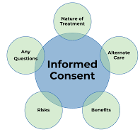
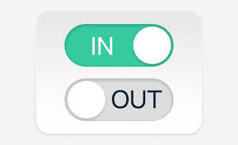
FIA Data Privacy in Connected Vehicles
IT-Security and Data Privacy are prerequisites for connected and automated vehicles
The consumer is not informed in detail what the collected data of his vehicle are used for => INFORMED CONSENT is missing!
The consumer cannot submit consent / revoke consent on single services
Problem Nr. 1: 3/4/5G-Abdeckung

Slide 7
FIA Data Privacy in Connected Vehicles
IT-Security and Data Privacy are prerequisites for connected and automated vehicles
It is not transparent for the consumers, what data is actually stored in the
backend server of the vehicle manufacturer, what is sold to other parties and for how long it is stored
Problem Nr. 1: 3/4/5G-Abdeckung
FIA proposes GRVA to look on data privacy by design architectures and methods to improve data privacy issues in vehicles on a technical level, too

Slide 8
FIA Data Privacy in Connected Vehicles
Summary
R155 is an effective measure towards secure vehicles
Currently out of scope from GRVA, FIA sees negative impacts for consumers by R155:
The aftermarket faces new burdens on authorised access to data
Data Privacy issues in Connected Vehicles are not transparent for consumers
Problem Nr. 1: 3/4/5G-Abdeckung
FIA proposes that the impact of R155 on Access to Data and Data Privacy be given greater consideration in GRVA's work

Slide 9
Thank you for your attention

