Slide 1
Submitted by the experts from France
Informal document GRBP-78-20-Rev.1
(78th GRBP, 30 August – 1st September 2023, agenda item 7 (a))
Additional justification to ECE/TRANS/WP.29/GRBP/2023/18
Proposal for Supplement 27 to UN Regulation No. 54

Slide 2
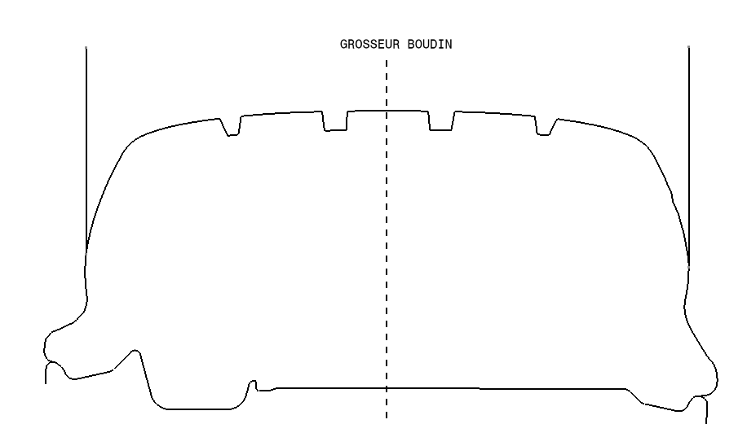
Background
Tyre concerned: tyre identified by the "tyre to rim fitment configuration" symbol "A“
2.13.1. However, in case of tyres identified by the "tyre to rim fitment configuration" (see para. 2.20.5.) symbol "A", it means the area of the tyre which is seating on the rim.
The lower sidewall is specific for symbol A tyre with a dedicated tyre to rim configuration
Specification concerned: maximum overall tyre width
6.1.4.2. It may exceed that value by 4 per cent in case of radial-ply tyres and by 8 per cent in the case of diagonal (biasply) tyres. […]
6.1.4.3. However, for tyres identified by the "tyre to rim fitment configuration" (see paragraph 2.20.5.) symbol "A", the overall width of the tyre, in the lower area of the tyre, equals the nominal width of the rim on which the tyre is mounted, as shown by the manufacturer in the descriptive note, increased by 27 mm.
Problem: not clear that the tolerance mentioned in §6.1.4.2 needs to be added on top of the 27mm referred to in §6.1.4.3 for symbol A tyre.
rim width
overall width for Symbol A tyre

Slide 3
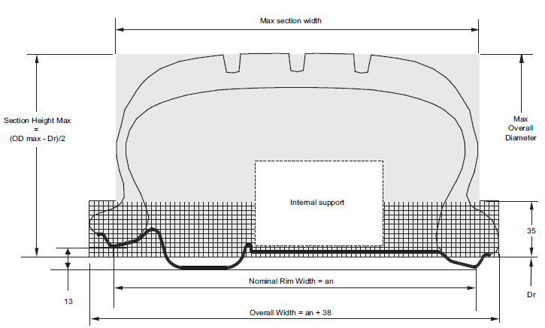
Proposal: 27mm + 4% → 38mm
Maximum overall width specification clearly includes the tolerance of 4% referred to in §6.1.4.2:
(rim width + 27mm) x 1.04 ≈ rim width + 38mm
Source: ETRTO Standards Manual C.18

Slide 4
Numbering
REG30:
6.1.4. Tyre section width specifications
6.1.4.1. The overall width of a tyre may be less than the section width determined pursuant to paragraph 6.1.1. above.
6.1.4.2. It may exceed that value by the following percentages, whereby the limits shall be rounded to the nearest mm:
[…]
6.1.4.2.4. However, for tyres identified by the "tyre to rim fitment configuration" (see para. 2.27.1.) symbol "A" or "U", the overall width of the tyre, in the lower area of the tyre, equals the nominal width of the rim on which the tyre is mounted, as shown by the manufacturer in the descriptive note, increased by 20 mm.
REG54:
6.1.4. Tyre section width specifications
6.1.4.1. The overall width of a tyre may be less than the section width or widths determined pursuant to paragraph 6.1.1. above.
6.1.4.2. It may exceed that value by 4 per cent in case of radial-ply tyres and by 8 per cent in the case of diagonal (biasply) tyres. However, for tyres intended for dual mounting (twinning) listed in column A of the following table, the overall width of the tyre may exceed the value determined pursuant to paragraph 6.1.1. above taking into account the tolerances listed in column B; different specific tolerances are listed in annex 5 Part II in footnotes of the relevant tables. The respective limits shall be rounded to the nearest millimetre (mm).
6.1.4.3. However, for tyres identified by the "tyre to rim fitment configuration" (see paragraph 2.20.5.) symbol "A", the overall width of the tyre, in the lower area of the tyre, equals the nominal width of the rim on which the tyre is mounted, as shown by the manufacturer in the descriptive note, increased by 27 mm.
Mini overall width
Maxi overall width
Mini overall width
Maxi overall width

