Slide 1
Presentation of ETRTO and STEER Analysis of Measurement Uncertainty related to UN-ECE Regulation No.117
Informal Document GRBP-78-06
78th GRBP, Geneva
30 August-1 September 2023
Agenda item 7c
Submitted by the Chair of Informal Working Group on Measurement Uncertainties

Slide 2
1. Background
In 2020, CEDR* launched the project STEER (STrengthening the Effect of quieter tyres on European Roads).
Partners: G+P Engineers (CH), BRRC (B), VTI (S), SINTEF (N), Nokian Tyres (SF)
Main objectives: To improve the EU Tyre labelling procedure for noise (EU Directive 2020/740).
As part of this work a detailed study of the measurement uncertainties related to the test method (Reg.117) was conducted as well as proposals to reduce the uncertainties. The main findings were presented to GRBP in 2022 (GRBP-76-23).
The work of STEER has also been presented to IWG MU and meetings between members of the STEER consortium and ETRTO has been arranged. The main purpose of these meetings has been to discuss any disagreements between the impact of different quantities to the overall expanded uncertainties.
The scope of this presentation is to harmonise the presentation of uncertainties as presented by the STEER project with the approach and terminology used by IWG MU and ISO.
* CEDR = Conference of European Directors of Roads

Slide 3
2. Approach and terminology used by STEER 2.1. General Approach
The STEER approach is based on the ISO GUM procedure.
The term standard uncertainty contribution, µc is used, expressed as one standard deviation, ơ.
The overall combined standard uncertainty is then calculated by the sum of the square root of each standard deviation.
To find the 95 % standard uncertainty (95 % confidence interval), this sum must be multiplied with 2.
STEER analysed in total 41 quantities which could contribute the overall uncertainties, which were grouped into 8 different groups like equipment, measurement set-up and conditions, test vehicle, test tyres, etc.
IMPORTANT: STEER evaluated the uncertainties related to the EU tyre labelling for noise, which means that the uncertainty related to the tyre chosen for labelling is included (only a few tyres within a tyre line is tested), which is not relevant for the UN Regulation No. 117 uncertainty evaluation.

Slide 4
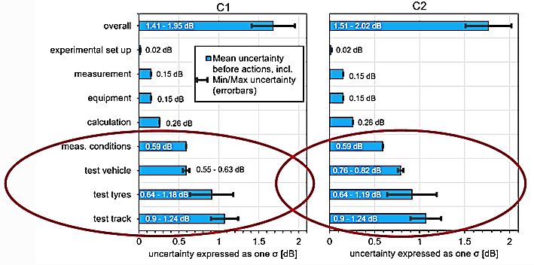
2. Approach and terminology used by STEER 2.2. Uncertainty Analysis
Note that the max/min error bars are related to the evaluation of the impact of the different quantities on the uncertainty (from literature and basic knowledge)

Slide 5
3. The ETRTO/ISO approach 3.1. General Approach
The ETRTO/OICA/ISO approach is based on establishing the peak-to-peak variation of each quantity. This variation can either be based on calculations or on known variation from experiences. Each quantity is defined as either a random error or a systematic error, with a gaussian or rectangular distribution. From this distribution, the variance and the standard uncertainty (standard deviation) is calculated.
As a final result, the 95 % Expanded uncertainty was calculated by the square sum of the combined uncertainties.

Slide 6
Uncertainty table by ETRTO/IWG MU (based on discussion with ISO WG42) – valid for Reg.117 and C1/C2/C3 tyres:
Table 1. ETRTO - Estimation of measurement uncertainties for C1 tyres measured according to Reg.117
STEER analysis with comparable terminology (highest estimation)
– excluding tyre line variations: 95 % expanded uncertainty = 3.58 dB

Slide 7
4. Agreements and Differences between STEER and ETRTO
Joint meetings have created a common agreement on most of the quantities contributing to the overall uncertainties.
Some differences in opinions still exists:
Temperature Influence Standard deviation is calculated by ETRTO to be 0.26 dB, while the estimate by STEER is 0.59 dB. Since these meetings, ETRTO has proposed a revised temperature correction procedure for C1 and C2 tyres, which makes it more likely that the proposed standard variation by ETRTO for this quantity may be more correct.
Test Track Humidity Standard deviation has been determined to be 0.32 dB by ETRTO inline with OICA, based on a peak-to-peak variation of 1.1 dB. Part of the STEER group means that this is too high and should be avoided by either waiting to the surface to dry up or use for example a leaf blower to remove any humidity or underheating of the track. However, measurement experience among members of both ETRTO and IWG MU claim that this may still be a problem and the main influence is that the humidity can influence any absorption of the test track (still below allowed maximum allowed absorption). The uncertainty contribution for this quantity should be further investigated.
Despite these points of discussion the overall measurement uncertainity would be comparable.

Slide 8
Thank you for your attention!

