Slide 1
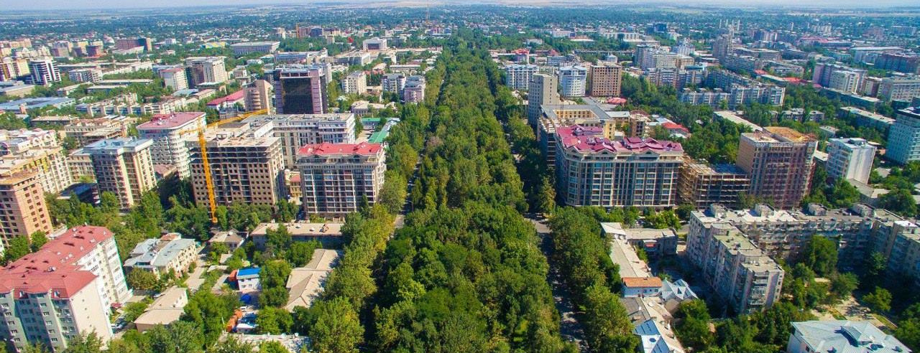
"The city of the future is a green city: why we need trees in our cities for the SDGs"
Presented by Bekkul Dzhekshenkulov
Bishkek City Hall

Slide 2
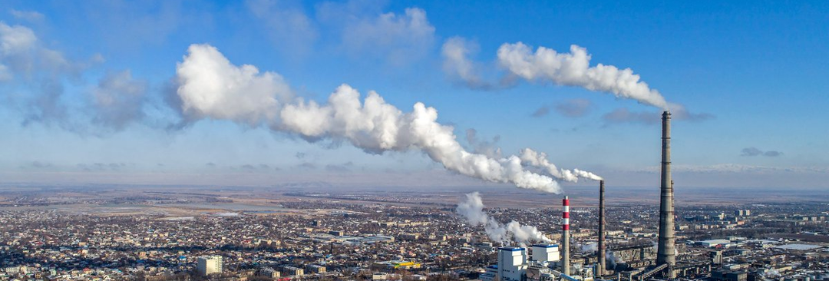
Bishkek City Hall | United Nations Economic Comission for Europe
A brief overview
Bishkek is the capital city of the Kyrgyz Republic, located in Central Asia like many urban areas around the world faces several environmental challenges that affect the health and well-being of its inhabitants. Here is an overview of some of the current environmental conditions in Bishkek:
Air Pollution
Waste Management
Loss of greening
In mid-December 2020 the reputable air quality monitoring site, IQAir.com released figures showing that the air quality in Bishkek city was “Very Unhealthy” with a US AQI reading of 234.
The city relies heavily on landfill sites to dispose of waste, but many of these sites are poorly managed, and waste is often not properly segregated before being dumped. This leads to the release of toxic chemicals and gases, which can harm the environment and human health.
In recent years, the area of green spaces in Bishkek has decreased to 3.5 square meters per inhabitant, which is six times less than the international norm (21 square meters).

Slide 3
Message from
Our Leaders
"Every person should leave a mark in this world after himself. A person should not set a goal to live only for himself, it is necessary to leave a legacy to his children, and grandchildren. It can be different: material, spiritual, or climatic. One of the most important is the natural heritage"
Sadyr Zhaparov
The President of the Kyrgyz Republic launched the national campaign "Zhashyl Muras" ("Green Heritage"), planting seedlings of coniferous trees on the territory of the Kyrgyz State Natural Park "Ala-Archa"
Bishkek City Hall | United Nations Economic Comission for Europe

Slide 4
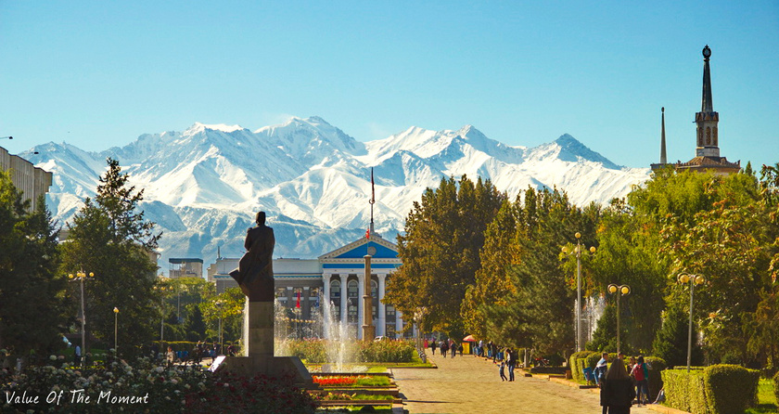
Zhashyl Muras
According to the data of the Ministry of Natural Resources, Ecology and Technical Supervision of the Kyrgyz Republic and the Forest Service under the Ministry of Agriculture of the Kyrgyz Republic, there are 6,426,010 planting materials:
The total number of planting materials that will be planted in the coming days in the regions is 580,316 pieces, of which:
- Bishkek city – 120,000 pieces;
- Jalal-Abad region - 136 500 pieces;
- Naryn region – 75,300 pieces;
- Osh region – 50,241 pieces;
- Talas region – 23,099 pieces;
- Chui region – 51,471 pieces;
- Issyk-Kul region – 89,000 pieces;
- Batken region - 34,705 pieces;
It is also planned to plant 150 thousand planting materials in the territories of State Parks and 1.5 million in the territories of forestry.
11
Bishkek City Hall | United Nations Economic Comission for Europe

Slide 5
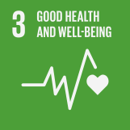
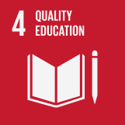
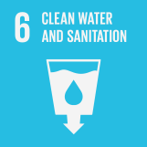
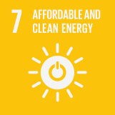
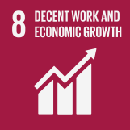
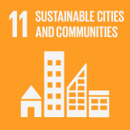
Bishkek City Hall | United Nations Economic Comission for Europe
In the context of Bishkek, the city plays a critical role in achieving several SDGs, including:
Bishkek contributes to this goal by improving access to healthcare services, promoting healthy lifestyles, and reducing air and water pollution.
Bishkek contributes to this goal by improving access to quality education for all, promoting lifelong learning opportunities, and reducing the education gap between urban and rural areas.
Bishkek contributes to this goal by improving access to clean drinking water and sanitation facilities, reducing water pollution, and promoting sustainable water use.
Bishkek contributes to this goal by promoting the use of renewable energy sources, improving energy efficiency, and reducing greenhouse gas emissions.
Bishkek contributes to this goal by promoting economic growth, creating job opportunities, and ensuring decent working conditions for all.
Bishkek contributes to this goal by promoting sustainable urbanization, improving access to affordable housing, developing efficient public transportation, and reducing the environmental impact of urbanization.

Slide 6
Contact
We thank you for your continued support in our efforts to contribute to the SDGs.
international@meria.kg
bekkul@meria.kg
www.meria.kg
Bishkek Mayor’s Office

