Slide 1
Recent activities organized in the framework of the Mediterranean Strategy on Education for Sustainable Development (MSESD) (reporting period: June 2022-May 2023)
18th Meeting of the UNECE ESD SC, 25-26 May 2023
MCESD Secretariat
Prof Michael Scoullos,
MIO-ECSDE Chairman, UNESCO Chair & Network on Sustainable Development Management and Education in the Mediterranean, (University of Athens)

Slide 2
The Mediterranean Strategy on Education for Sustainable Development (MSESD)
The Mediterranean Strategy on Education for Sustainable Development (MSESD) was unanimously endorsed on 13 May 2014 by the UfM Ministers of Environment & Climate Change and accepted as an integral part of the “Mediterranean Strategy for Sustainable Development” (2016-2025) in the Barcelona Convention’s COP19 (Athens, February 2016).
Its Action Plan was developed and endorsed in December 2016 by the Mediterranean Ministers of Education, in Cyprus. The overall aim is to encourage the countries to develop and incorporate ESD into formal, non-formal and informal education.

Slide 3
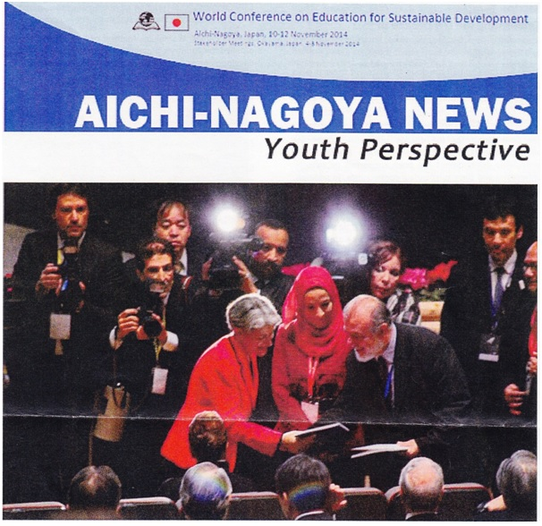
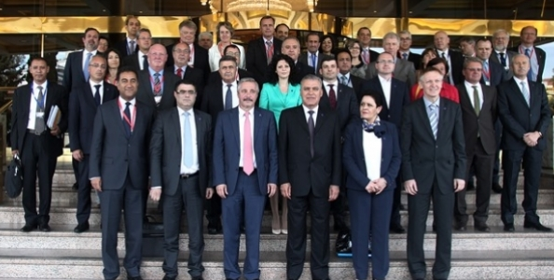
Nagoya 2014
Athens UfM Ministerial 2014

Slide 4
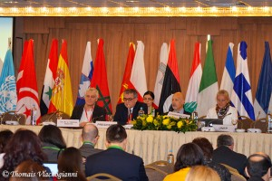
Members of MCESD Bureau:
UNESCO Venice, UNEP/MAP, UNECE, UfM, League of Arab States
Cyprus (Chair), Croatia, Greece, Jordan, Malta, Portugal
Adoption of the Action Plan of MSESD
Athens Barcelona Convention COP19 Febr. 2016
Nicosia ESD Ministerial Dec. 2016

Slide 5
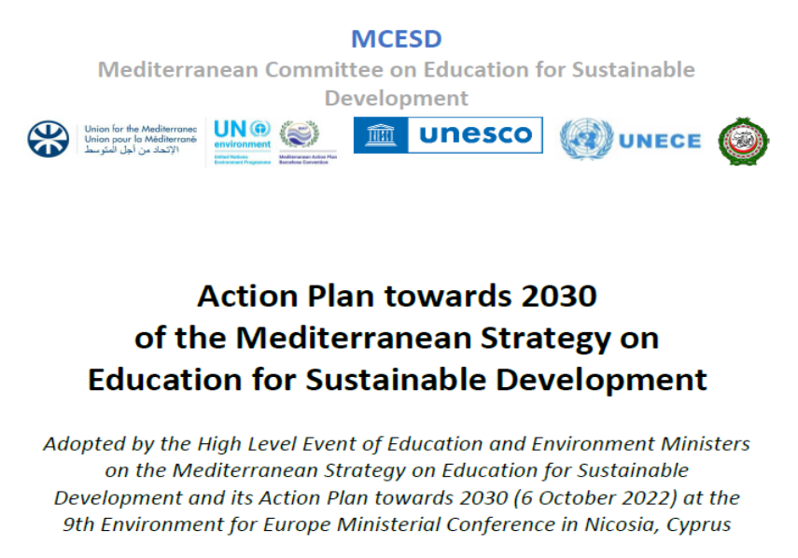
High-Level Event of Education and Environment Ministers on the Mediterranean Strategy on Education for Sustainable Development (MSESD) & its Action Plan towards 2030
On 6th of October 2022, within the 9th Environment for Europe (9EfE) Ministerial Conference Nicosia, Cyprus.
55 participants: Ministers, High-level Officials, Academia, IGOs, NGOs, shared and reflected on the implementation of the MSESD & unanimously agreed on its “Action Plan towards 2030”
The meeting approved a Statement.

Slide 6
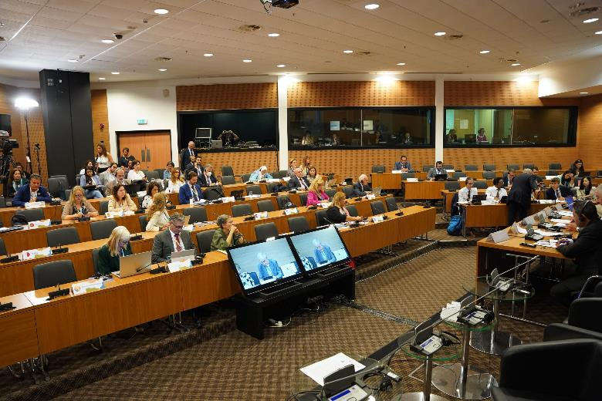
High-Level Event of Education and Environment Ministers on the Mediterranean Strategy on Education for Sustainable Development (MSESD) & its Action Plan towards 2030
Monitoring of the progress showed that most countries have already or are in the process of elaborating National Strategies or Plans on ESD in accordance to the provisions of the Action Plan of the MSESD.
The majority of the countries have integrated SD principles into their curricula or are in the process of reforming their national curricula to embed ESD and SDG topics.
Training of educators, application of whole institute approach, lack of resources highlighted as persistent challenges in the mainstreaming of ESD in the region.

Slide 7
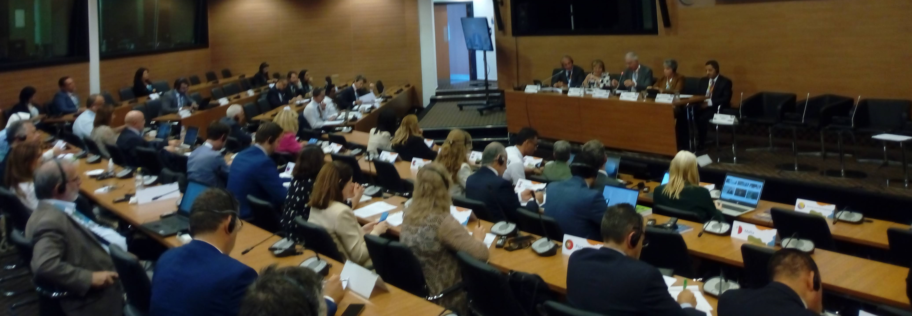
High-Level Event of the MSESD & its Action Plan towards 2030
The Mediterranean Committee on ESD is guided by a new Bureau consisting of the Ministries of Education of Cyprus (Chair), Greece, Lebanon, Morocco and Palestine and UNESCO, UNEP/MAP, UNECE, UfM and LAS.

Slide 8
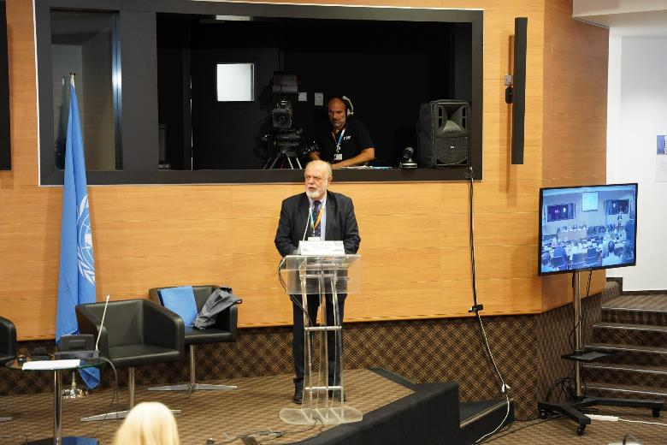
The Action Plan towards 2030 of the MSESD
Takes into consideration the key provisions and updates of the international and regional frameworks that the MSESD is closely linked to, such as: the Mediterranean Strategy for Sustainable Development (MSSD, 2016-2025) of the Barcelona Convention, the UfM GreenerMedAgenda, the UNESCO ESDfor2030, the Recommendation on learning for environmental sustainability of the European Council, and the UNECE Framework for the implementation of the Strategy for ESD (2021-2030).

Slide 9
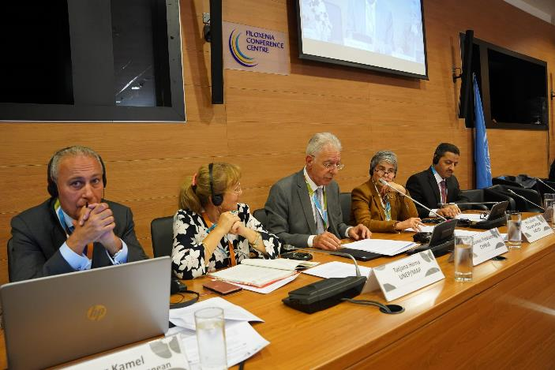
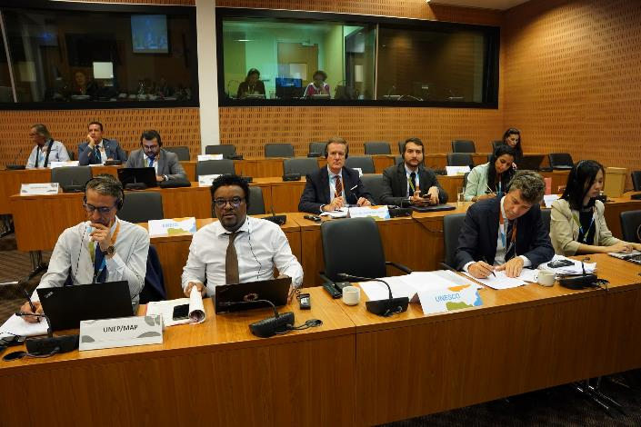
The Action Plan towards 2030 of the MSESD
Interprets the “Framework of Implementation” of the MSESD in a detailed, up-to-date and concrete way, addressing mostly the needed changes and provisions to be undertaken at the national level for the promotion of ESD, proposing regional (or sub-regional) programmes, highlighting suggested thematic priorities and, proposing progress indicators to monitor the way forward.
In this context, its implementation fulfils simultaneously the ESD related priorities and commitments of the Mediterranean countries to the UN and regional organizations and frameworks.

Slide 10
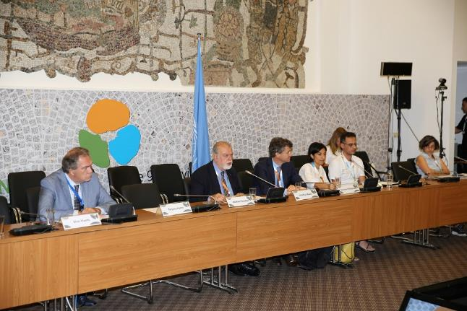
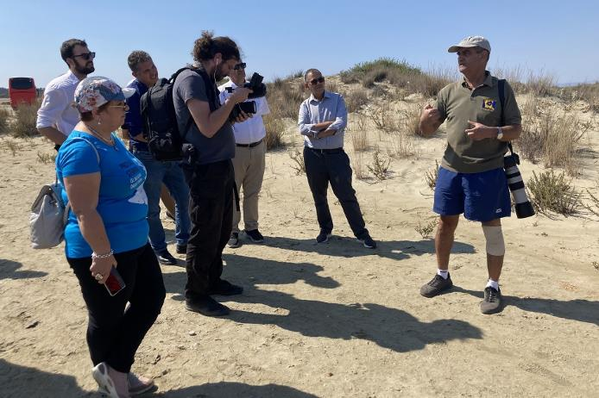
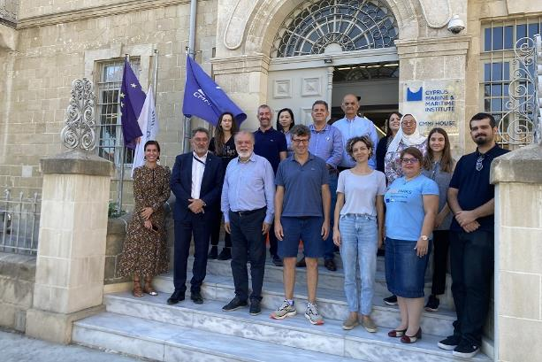
Pilot actions with potential for upscaling continued (1/4)
2022 Cyprus Hybrid University on Ocean Literacy in Biosphere Reserves
8th edition of the series of Summer Universities, the 3rd time as a hybrid one.
Phase A (live) Crete (September 2022) and Cyprus (October 2022) with 57 participants (in total).
Phase B (online) : 9 January -5 February 2023 with 97 participants from 37 countries.

Slide 11
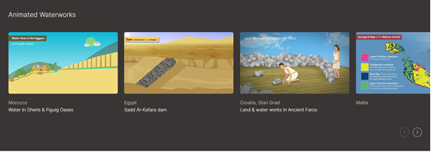
Pilot actions with potential for upscaling continued (2/4)
Revitalization of the HYDRIA Virtual museum
promoting awareness on a new “water culture” based on the Mediterranean water management heritage
a WAMUNET member,
with the support of the Ministry of Education of Cyprus & the EU Creative Europe Programme
www.hydriaproject.info

Slide 12
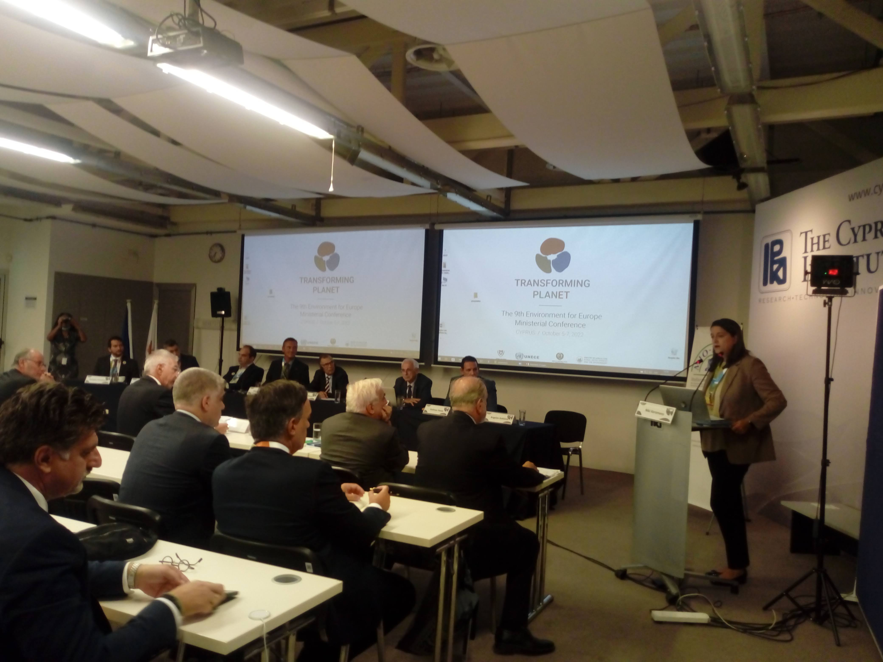
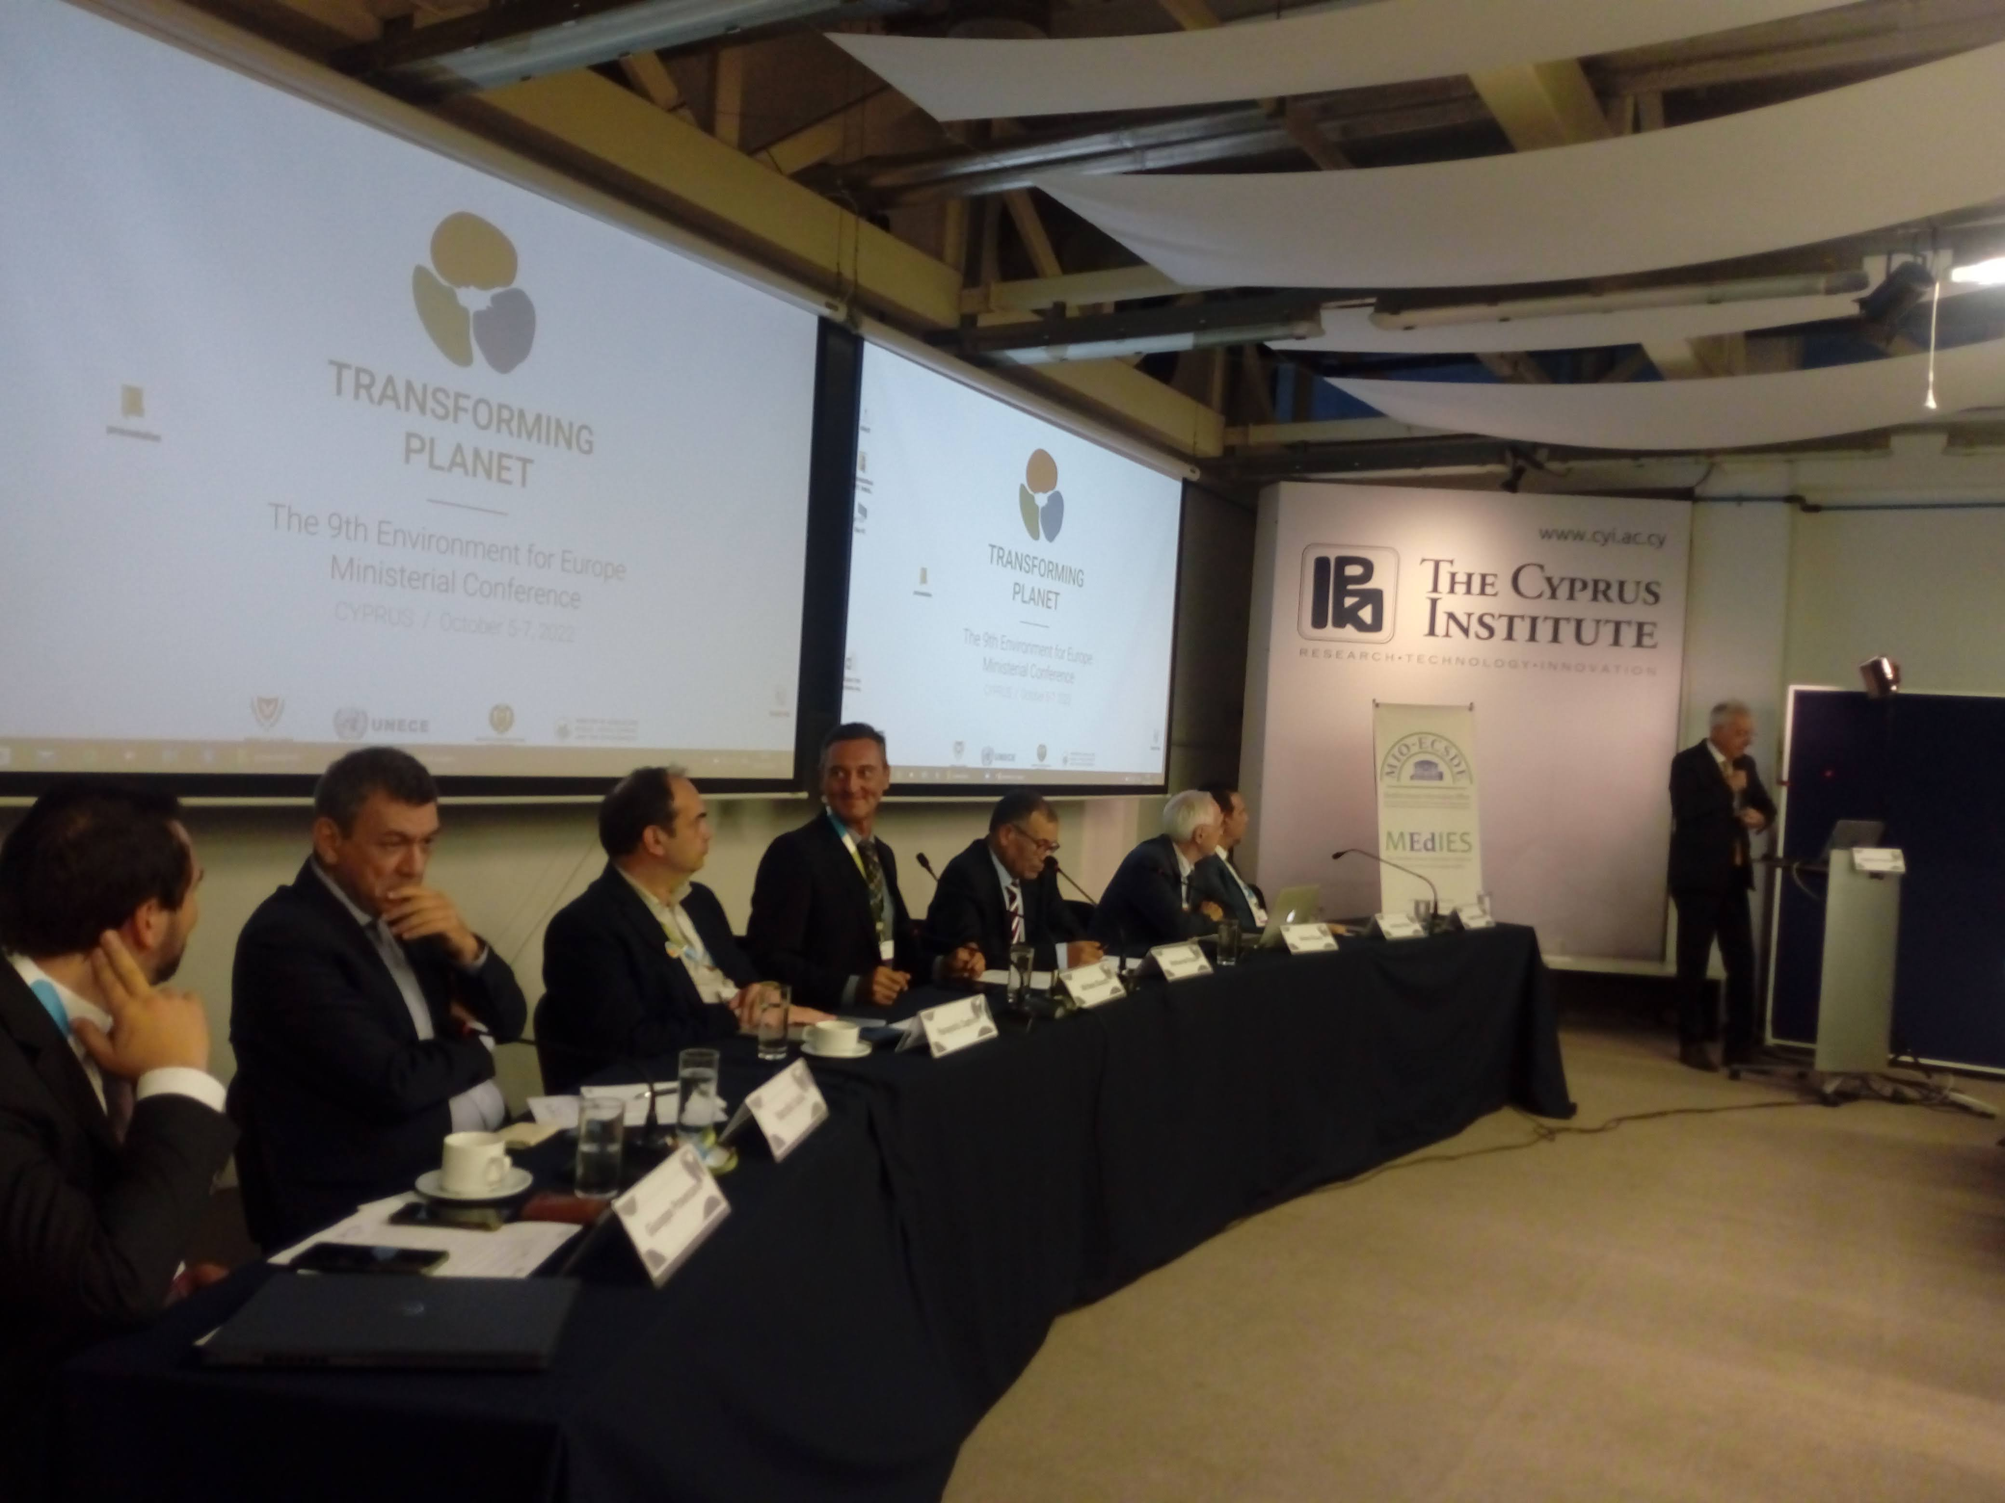
Pilot actions with potential for upscaling continued (3/4)
The Charter of Greek Universities for Sustainable Development (2022-2030).
A case study to be followed by the Academic communities of other countries.
Already, the Rectors of the Universities of Cyprus and Albania have expressed interest to adopt and implement the Charter.
Presented at the 9EfE Side Event “Higher Education towards Sustainable Development: Making Universities Lighthouses of Sustainability” (6 October 2023) co-organised by the Ministries of Education of Cyprus and Greece, MEDUNET and MIO-ECSDE

Slide 13
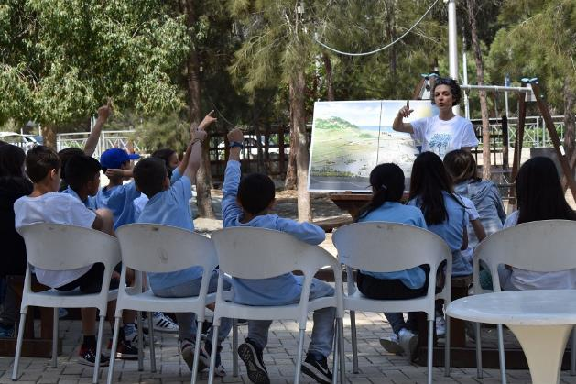
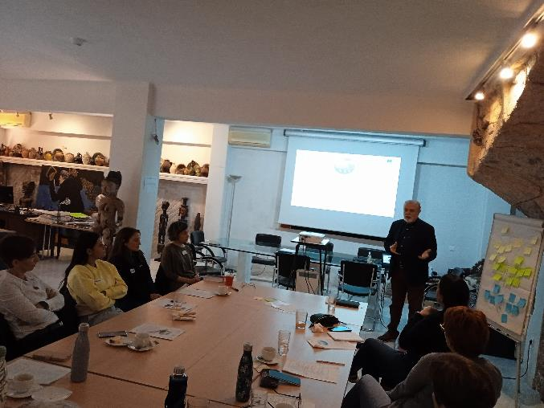
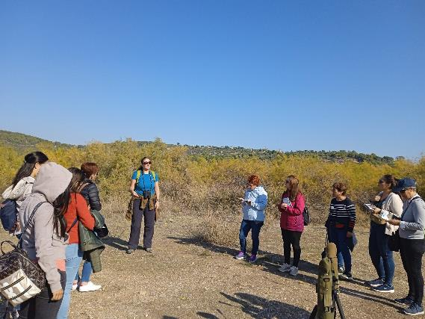
Pilot actions with potential for upscaling continued (4/4)
Schools demo projects & Teachers’ Trainings on Ocean Literacy , Nature-Based Solutions/NCWRs, etc., in Cyprus, Greece, Malta, etc. with the participation of hundredths of school students, teachers and non-formal educators .

Slide 14
Thank you for your attention

