Slide 1
Large-scale demonstration of AVs for shared mobility
Submitted by the expert from UITP
Informal document GRVA-16-32
16th GRVA, 22-26 May 2023
Provisional agenda item 4(f)
United Nations WP.29/GRVA #16 | May 2023

Slide 2
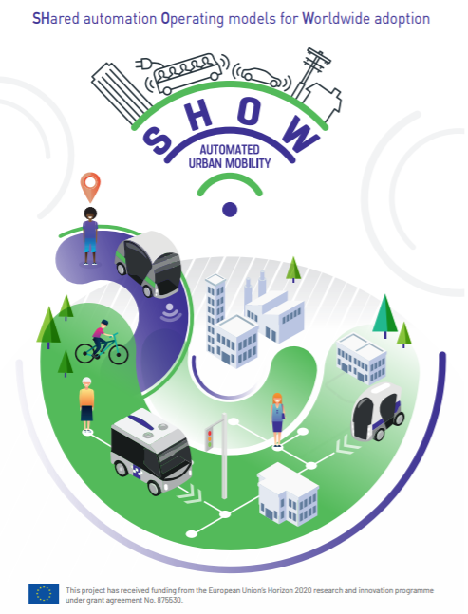
SHOW in a nutshell
Deployment of shared, connected and electrified automated vehicles to advance sustainable urban mobility
Coordinated by UITP
70 partners from 13 EU-countries
January 2020 – December 2023
30 Mio. EUR funding from European Commission (GA No. 876630)

Slide 3
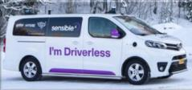
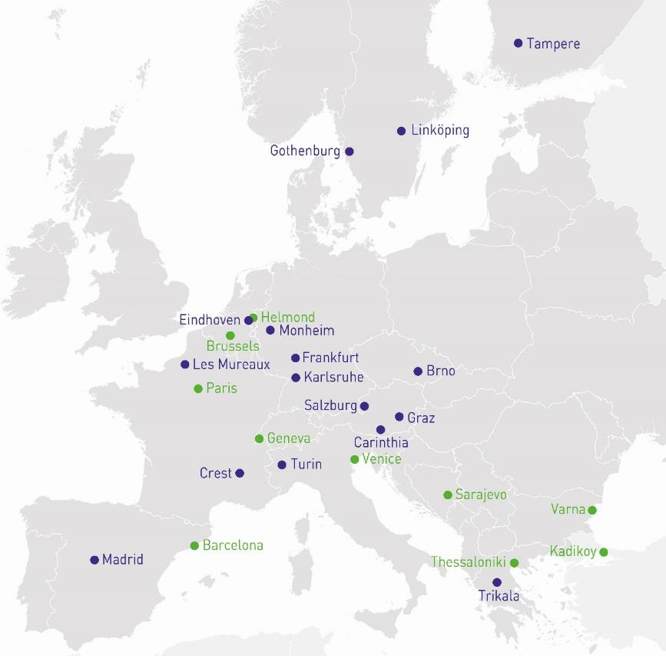
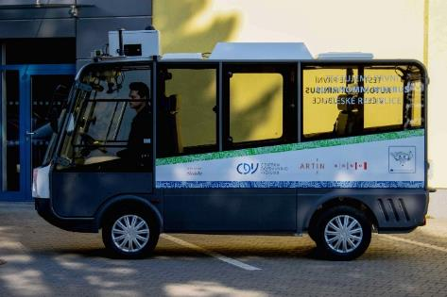
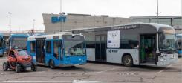
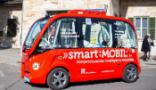
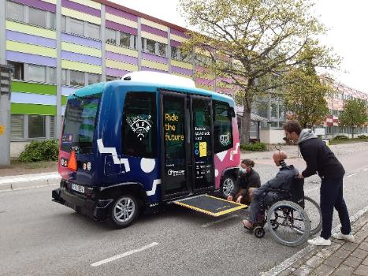
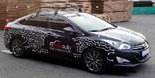
Real-life services on open roads have started and will last until end of 2023
From 12 to 30 months of operation – and beyond grant period
Covering real mobility needs and travel demand
Residents, commuters, visitors, children, elderly, students
On-demand & shared services
70 Automated Vehicles
Robotaxis, buses & shuttles
70+ AVs multi-brands in 16+ cities
50,000+ trips | 1,200+ cargo deliveries
120,000 km travelled
Notes:
Local full architectures and Physical & Digital Infrastructure in place
Project Dashboard for KPIs visualization operational (open to the public soon!)
User engagement strategy with surveys, Ideathons, focus groups
First simulation studies on-going
Work on application guidelines and policy recommendation starting

Slide 4
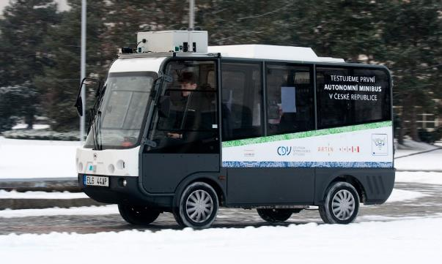
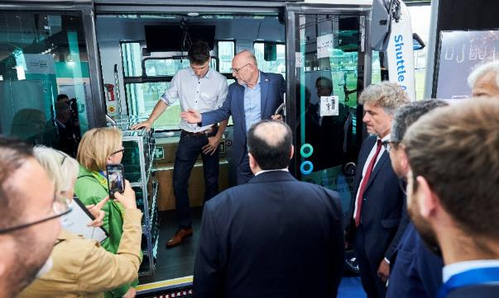
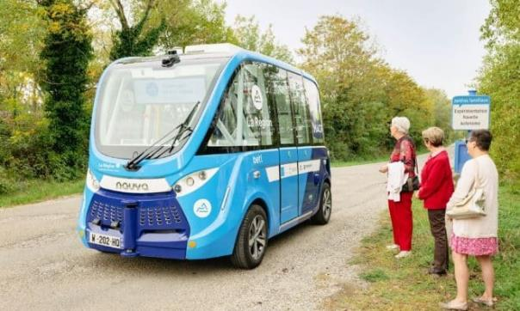
SHOW pilots cover a diversity of services and innovations for shared mobility
Brno, Czech Republic
Retrofitted Grifo shuttles
Feeder services
Harsh weather environment
Karlsruhe, Germany
Retrofitted EasyMile shuttles
Driving behaviour +
Mix cargo/passenger
Crest, France
NAVYA shuttles
Rural services

Slide 5
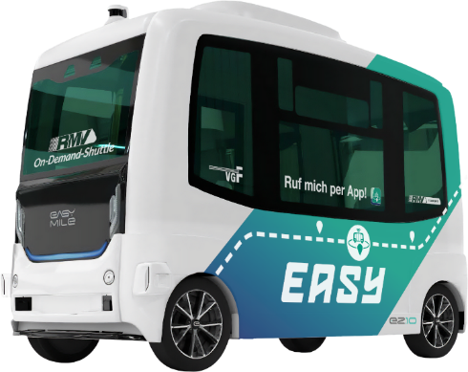
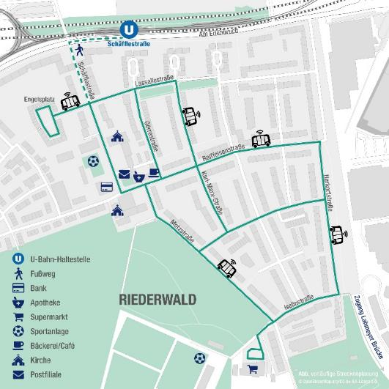
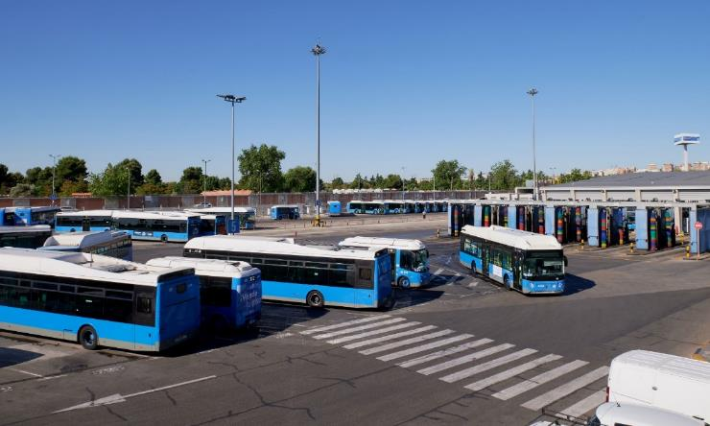
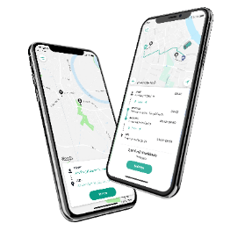
SHOW pilots cover a diversity of services and innovations for shared mobility
Madrid, Spain
Retrofitted IRIZAR buses
Depot management
Frankfurt, Germany
EasyMile shuttles fully integrated to public transit services

Slide 6
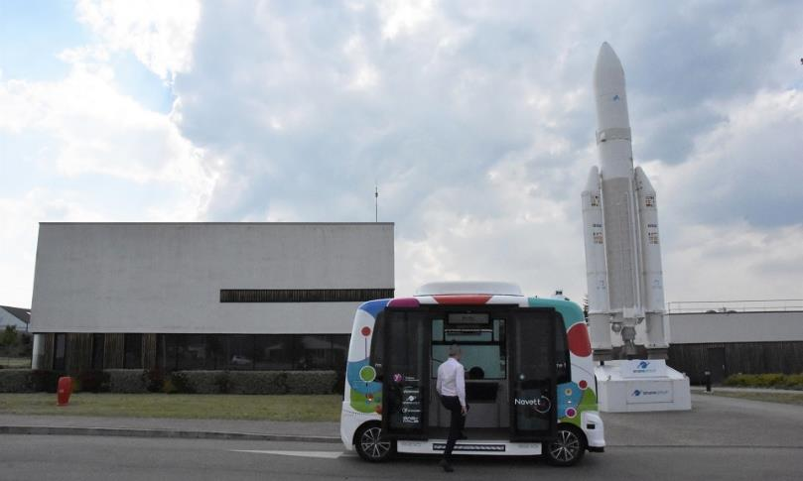
SHOW pilots cover a diversity of services and innovations for shared mobility
Graz, Austria
Retrofitted passenger car
Robotaxi
Curb management at bus terminal
Les Mureaux, France
No safety operator on-board
One remote supervisor for 3 shuttles
Trikala, Greece
Retrofitted vans
On demand Automated Mobility as a complement of Public Transport

Slide 7
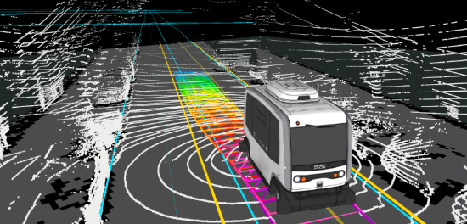
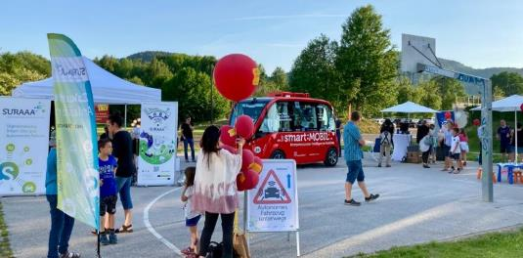
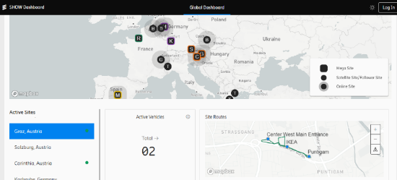
SHOW building blocks paving the way for Automated Shared Mobility
Technical development
Stakeholders’ engagement
Business models & services
Impact assessment
Guidelines & recommendations
Trainings for PTO/PTA & public
Credits: SHOW partners, www.shutterstock.com
Notes:
Impact assessment using MAMCA methodology: Multi-actor Multi Criteria Analysis

Slide 8
Pilots' validation & commissioning
Technical verification & commissioning phase, on individual technical aspects, including the typical vehicles commissioning and other standard processes required from the legislation perspective, among others. Focus on automated driving vehicle Safety, Performance, Communications and Cybersecurity.
Technical validation/commissioning on integrated service level phase, Addresses Safety, Performance and Quality of Service.
For instance:
Safety test scenario 5: Handover to driver when approaching end of ODD
Safety test scenario 6: Handover to driver due to emergency
Risk assessment towards 17 cybersecurity threats, e.g., unauthorized access, code modification, jamming
More information: https://show-project.eu/media/deliverables/ D11.1 Technical validation protocol
Notes:
1 includes: 6 safety test scenarios, 7 communication test scenarios, 8 performance test scenarios and the description of the measures adopted against 17 cybersecurity threats.
2 is conducted in exact same real-life context

Slide 9
More information: https://show-project.eu/media/deliverables/ D3.3 Recommendations for Adapting Regulatory and Operational Strategies for CCAV deployment at Local and Regional Level

Slide 10
Lessons Learned, impacts & transferability
The future of Public Transport is on-demand & shared
→ Automated operation is the next evident step
Business cases are envisioned if regulations enable operations:
without extra speed limitation for AVs
at intersections without constant interventions of safety operator
integrated in PTO fare systems
With reasonable/fair data set exchange between private/public
Middle term: with more robust & homologated / diversified vehicles
Longer term: without a mandatory safety operator on board

Slide 11
International collaborations in SHOW
US Exchanges on Accessibility of automated public transport services with US-DOT Volpe Center Cooperation on robotaxi services with the University of San Francisco / Cruise (NDA in preparation) | Australia NDA signed with George Institute of Health Sept 2020 Joint paper VTI/George Institute of Health about AV usage by elderly
Tainan (Taiwan) NDA signed with National Cheng Kung University (NCKU) July 2021 Topics identified: Comparison study of user acceptance of autonomous mobility in culturally different environments Safety aspects of teleoperation (impacts on road safety) Requirements for HD maps and relation to road infrastructure specifics of respective countries | China MoU signed with Beijing Jiaotong Technical University July 2021 Strongly supported by Prof Georgios Giannopoulos, link with CATARC Actions identified Joint event on Automated Transport in Beijing in 2023 Business models for AV operation Standardization/certification
Japan MoU signed in October 2021 Identification of topics: AV driving behavior Regulations Public perception of shuttles services Joint events (ITS WC, TRA, etc.) | Korea Workshop with International Transport Federation on Regulatory Framework for AV services | Feb 2022 Presentation to Ministry of Land, Infrastructure and Transport (MOLIT), Korea Association Automotive Mobility Industry (KAAMI) and Vehicle Safety research (KATRI) | March 2022 Presentation to Korean Automotive Technology Institute & Korean Transport Institute Research Agency | Dec 2022
Notes:
MOLIT: Ministry of Land, Infrastructure and Transport

Slide 12
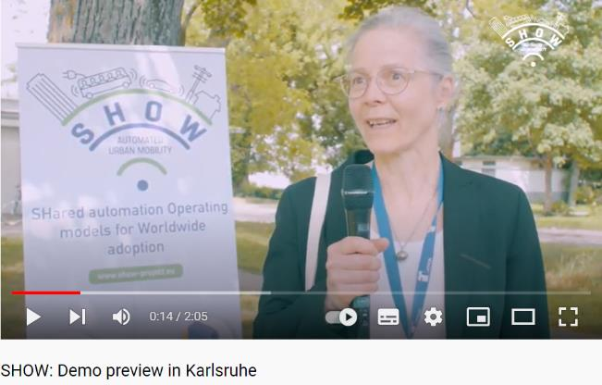
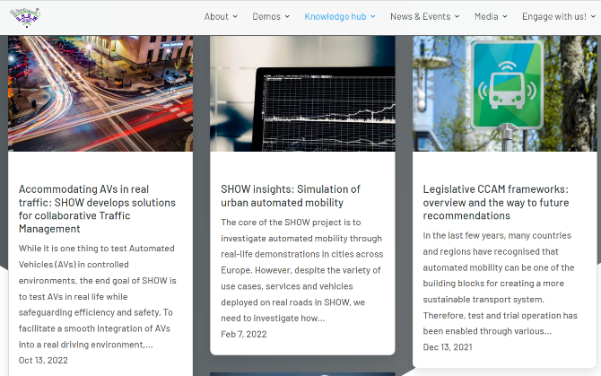
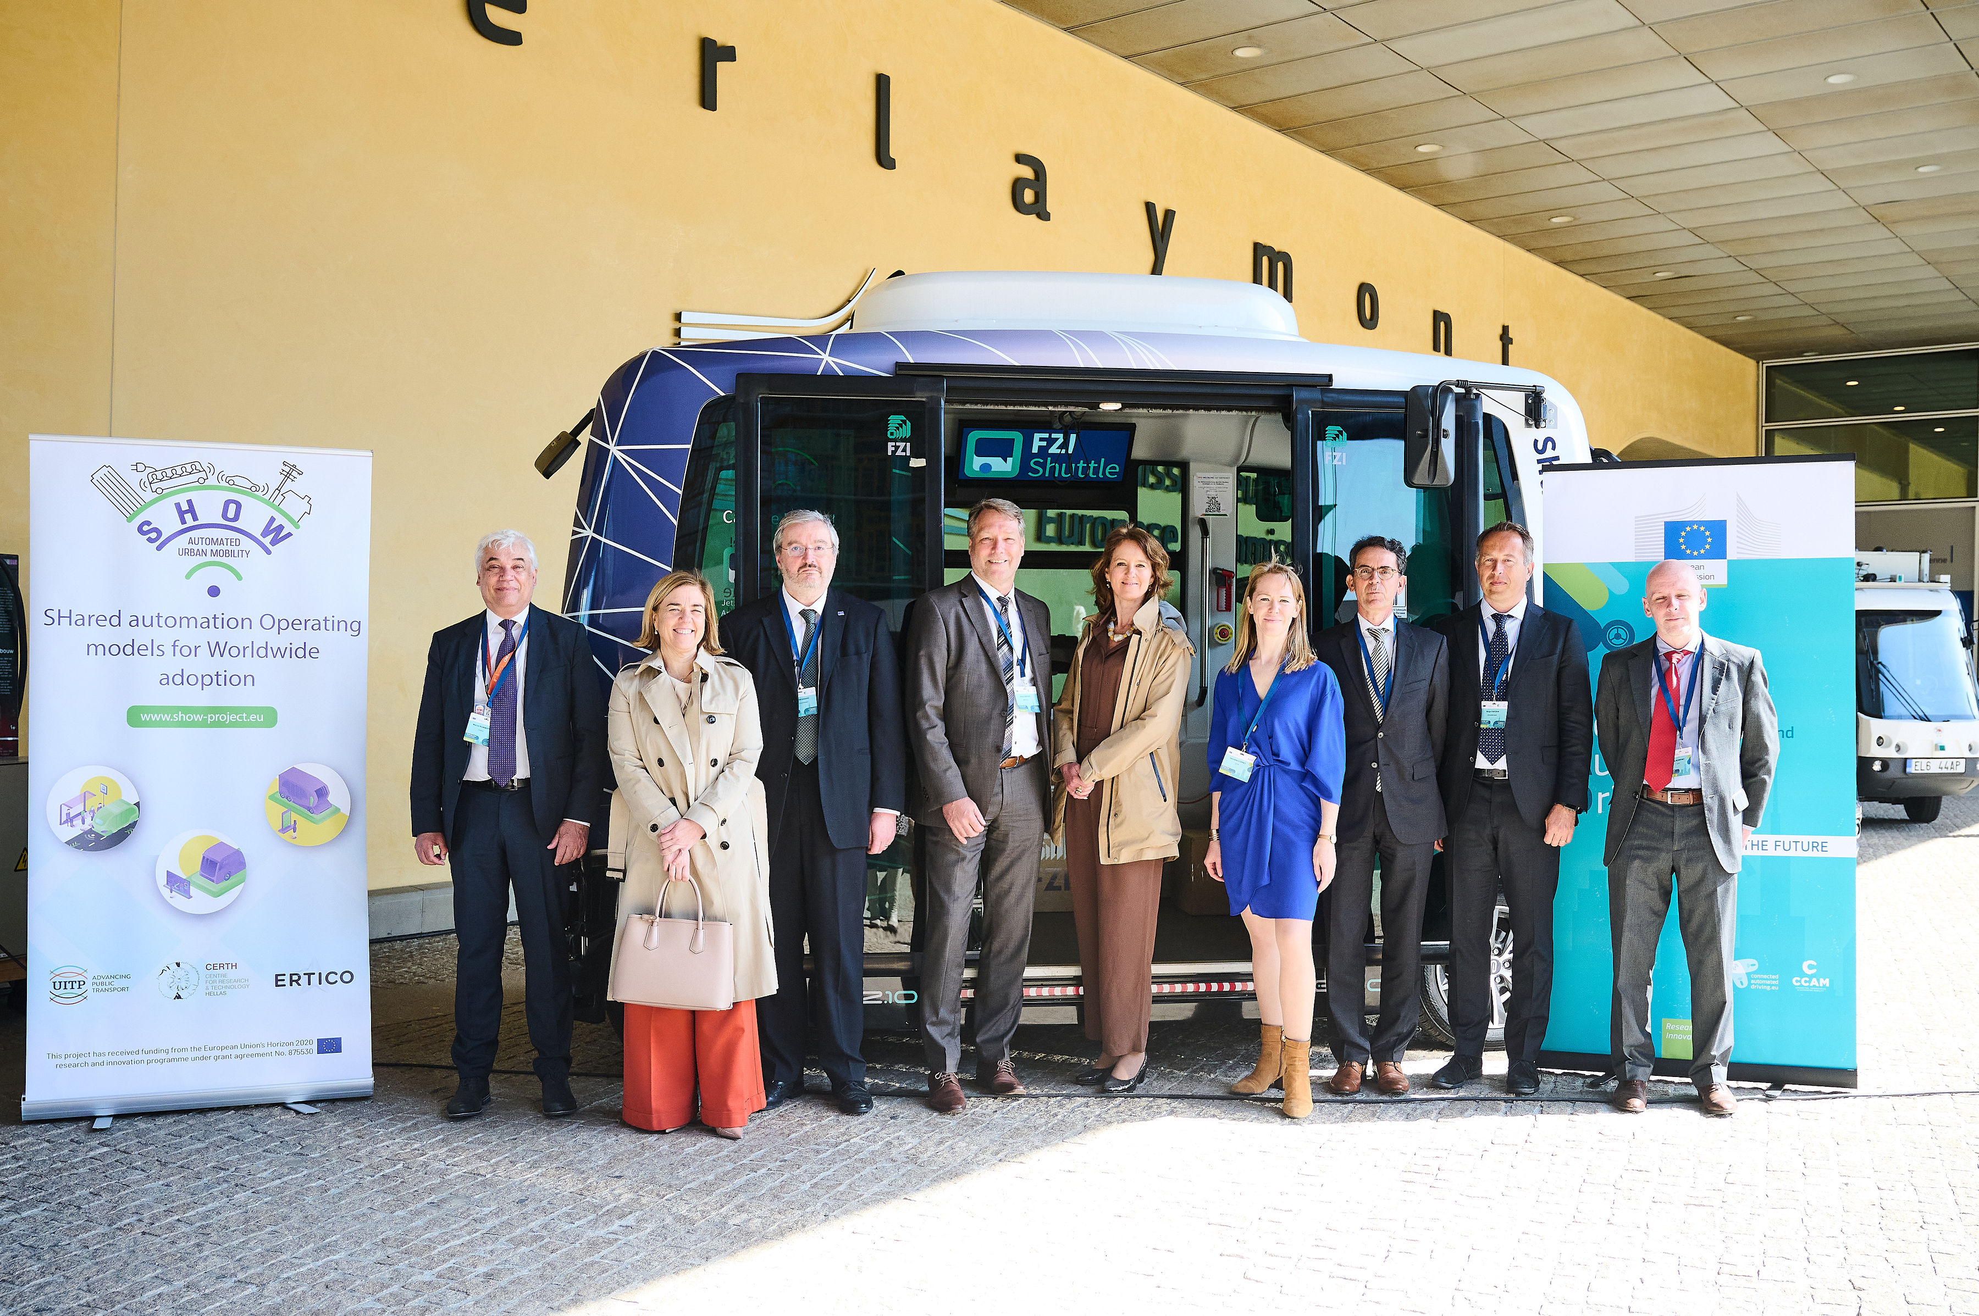
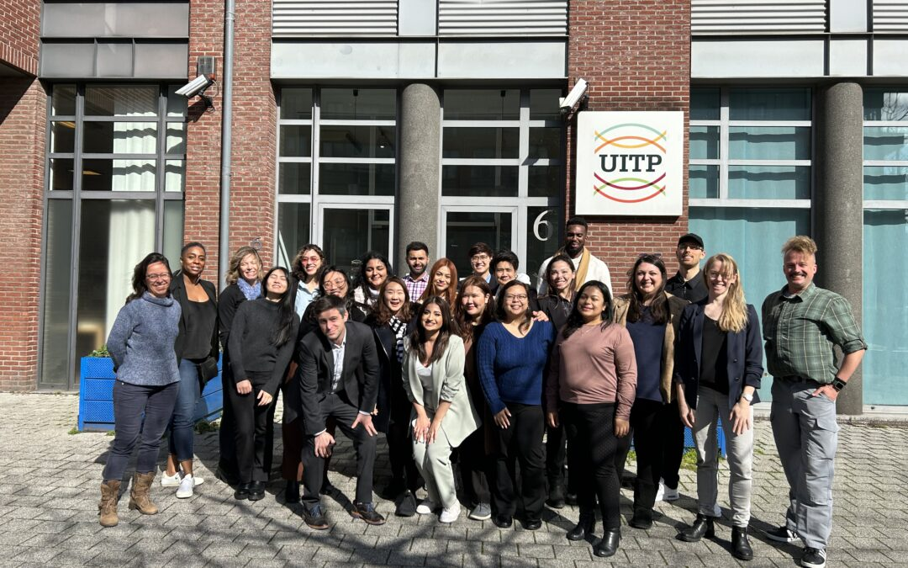
Dissemination activities
Demo videos on YouTube
3000 views*
Podcast
1200 downloads*
All-public articles
https://show-project.eu/insights/
Ideathons
With students & citizens
V.I.P. events
https://show-project.eu/news/
*Accessed in May 2023

Slide 13
Dr Henriette Cornet
henriette.cornet@uitp.org
Thematic Area Leader Automated Mobility
UITP – International Association of Public Transport
https://www.uitp.org/

