Slide 1
Vehicle stability systems and tyre explosion Safety recommendation from Norwegian Safety Investigation Authority (NSIA)
Submitted by the expert
from Norway
Informal document GRVA-16-25 16th GRVA, 22-26 May 2023
Provisional agenda item 11
By Norwegian Public Road Administration

Slide 2
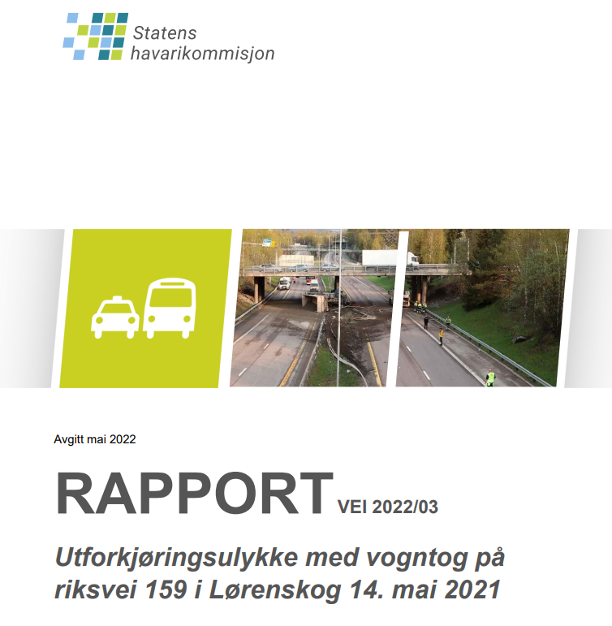
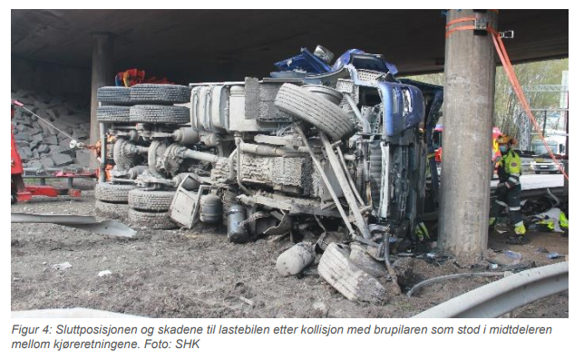
Link to report summary:
Report on run-off-the-road accident on the RV 159 road in Lørenskog on 14 May 2021 | nsia
Exploded tyre

Slide 3
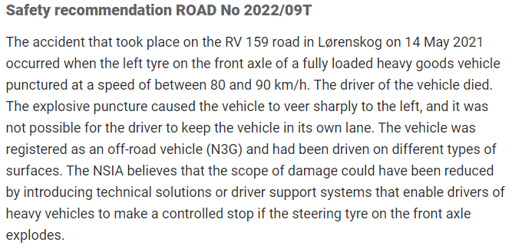

Slide 4
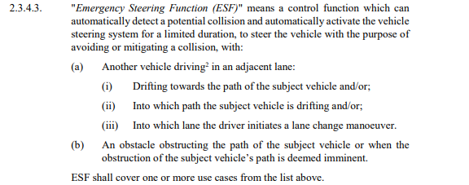
Can vehicle stability be supported by emergency systems after a tire explosion? Is ESC or ESF active after a tire explosion? From Reg. 79:

Slide 5
Can vehicle stability be supported by emergency systems after a tire explosion? Could MRM or EM support vehicle stability after a tire explosion? From Reg. 157

