Slide 1
Informal Document GRSP-73-57
(73rd GRSP, 15.-19. Mai 2023, agenda item 22)
Submitted by the Leader of GRSP TF-AVRS (Germany)
Status Report
Task Force
Automated Vehicles–Regulatory Screening
(TF-AVRS)
of UN Regulations and GTRs under responsibility of
GRSP

Slide 2
1. Background
At the 71st meeting of GRSG, the secretariat, on behalf of WP.29, asked GRSP to start evaluating the UN Regulations and GTRs falling under the responsibility of GRSP
Report of the Working Party on Passive Safety on its seventy-first session, Geneva, 9–13 May 2022
ECE/TRANS/WP.29/GRSP/71
XX. Exchange of views on vehicle automation (agenda item19)
36. At the request of WP.29 (ECE/TRANS/WP.29/1164, paragraphs 27 to 30), a majority of GRSP experts agreed to establish a task force with Germany as coordinator and OICA as secretariat, that would in Autumn 2022, start to screen the UN Regulations and UN GTRs under its responsibility. Screening would be related to drivers, to accommodate for autonomous driving. The task force would include experts from China, France, Germany, Japan, Netherlands, Republic of Korea, Spain, United States, EC, CLEPA and OICA for the time being.
Report of the World Forum for Harmonization of Vehicle Regulations on its 186th session ECE/TRANS/WP.29/1164
Intelligent Transport Systems and coordination of automated vehicles related activities (agenda item 2.3)
….
30. WP.29 requested all GRs to perform a screening of the UN Regulations and UN GTRs of relevance until March 2023 and agreed to resume consideration of a coordinated approach for reporting to AC.2 and WP.29.
WP.29 on its March 2023 session endorsed the request of GRSP Chair to postpone to the June session of the World Forum the outcome of results of its Task Force on Autonomous Vehicle Regulatory Screening.

Slide 3
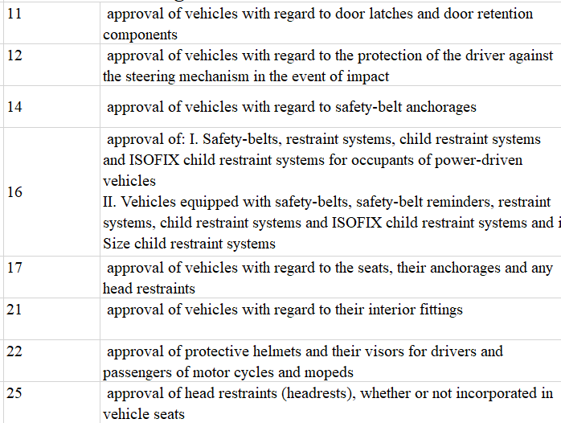
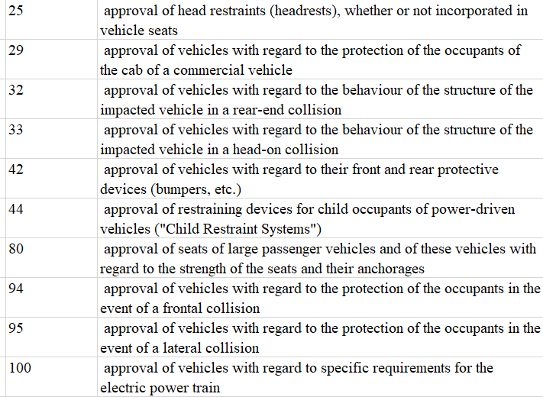
2. Overview affected UN Regulations and GTRs
UN-R

Slide 4
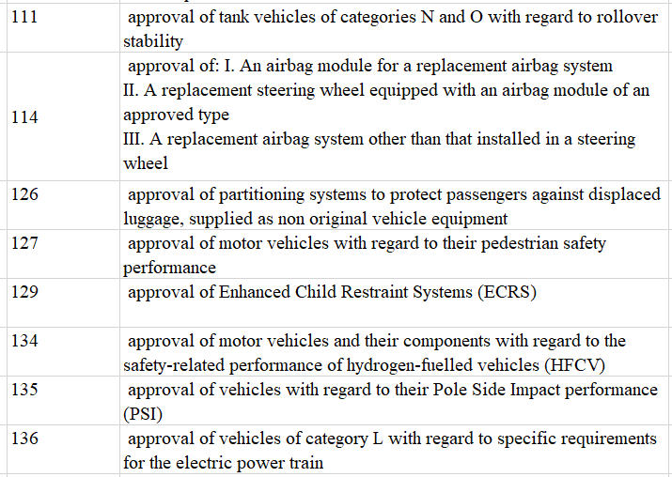
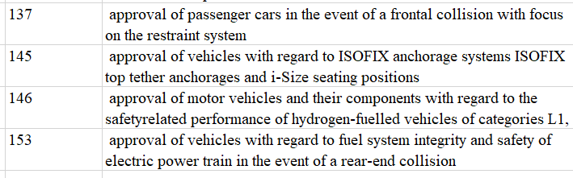
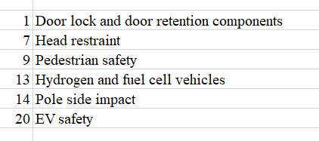
2. Overview affected UN Regulations and GTRs
UN-R
GTR

Slide 5
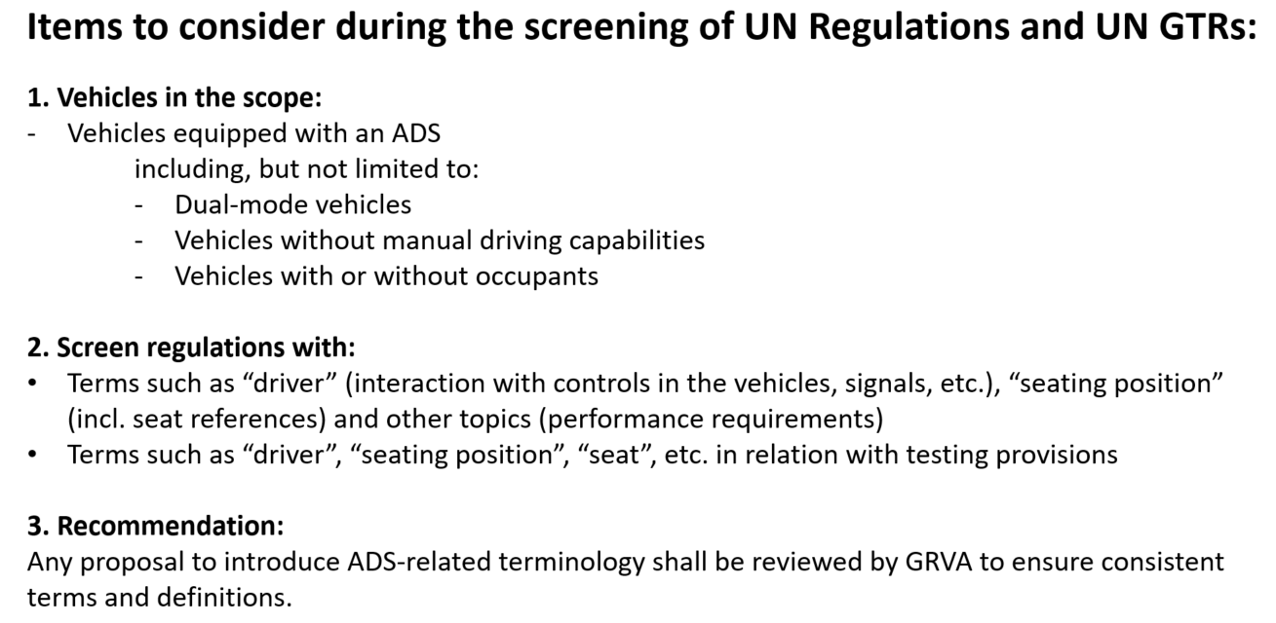
3. Interaction with other GR’s
GRVA-14-54/Rev.1 - (Secretariat) Automated Vehicles Regulatory Screening of UN Regulations and GTRs - Guidance

Slide 6
3. Interaction with other GR’s
At the 124th meeting of GRSG the Chairs of the TF of GRSG, GRVA and GRSP decided to have a meeting with the chairs and secretaries of all other GR’s to align the work in all GR’s of WP.29 on base of a clear scope and the same forms.
This meeting took place on 11th of November 2022
It was concluded in a first step to scan the regulations word by word to find,
terms such as “driver” (interaction with controls in the vehicles, signals, etc.), “seating position” (incl. seat references) and other topics (performance requirements),
tasks to be done by a “driver” etc.
responsibilities of a “driver” etc.
provisions not relevant for or in contradiction to vehicles with an ADS
This shall be done by converting the complete regulation or at least the part where an issues has been detected into an excel file, to document the results

Slide 7
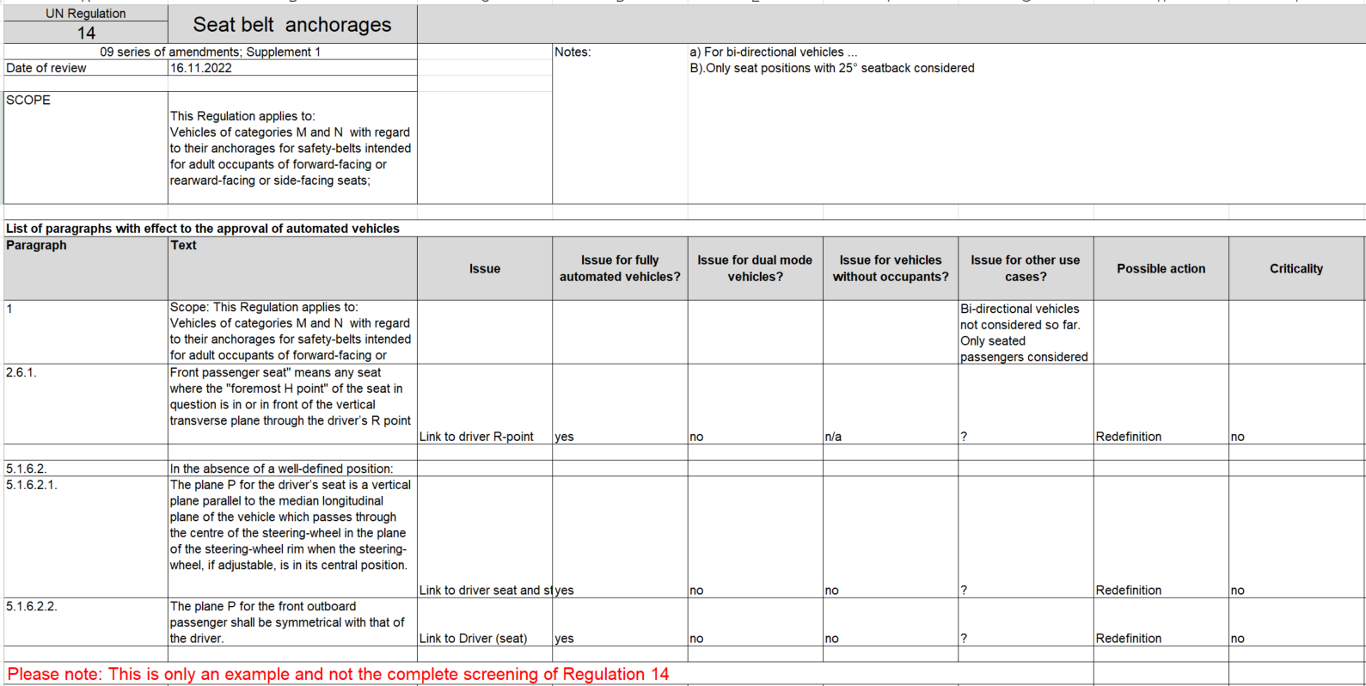
3. Interaction with other GR’s

Slide 8
3. Interaction with other GR’s
In a second step for each regulation a sheet has been prepared to serve as a high level summary of the findings to be delivered to WP.29. in March 2023.
The form should base on a form presented by OICA during WP.29, which still has to be improved and decided at a second meeting of the TF Leaders and Secretaries of the different GR TF’s on 30th of November 2022.
On the second meeting of the TF Leaders and Secretaries of the different GR TF’s it was concluded as proposed by the GRSP TF to integrate this summery sheet in the excel file .

Slide 9
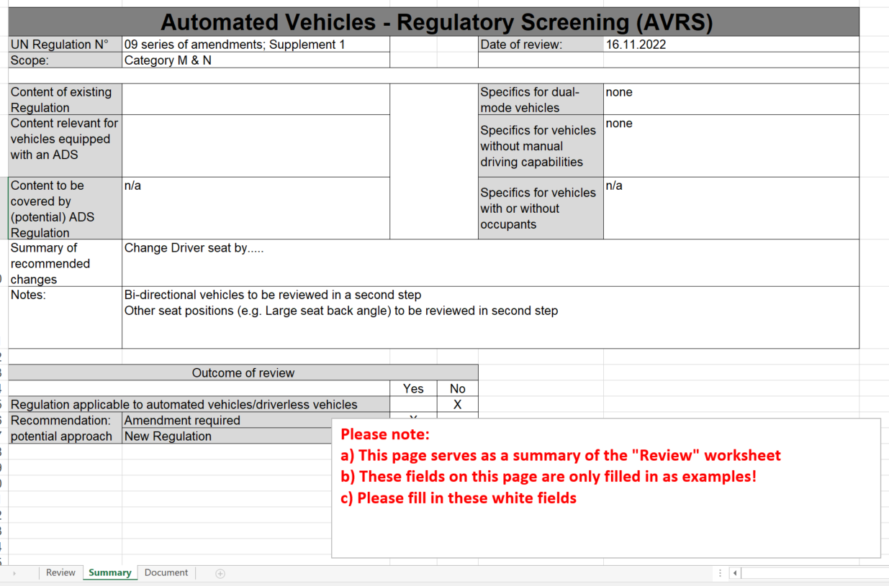
GRSP-TF-AVRS-01
3. Interaction with other GR’s

Slide 10
4. Meetings of the GRSP TF-AVRS
1st meeting 24th of November 2022
tasks were assigned to CPs and NGOs
2nd meeting 30th January 2023
outcome of the screening has been discussed regulation by regulation
3rd meeting 16th February 2023
outcome of the screening has been discussed regulation by regulation
4th meeting 14th March 2023
Thanks to the participants of the Task Force, for all of the 30 UN regulations and 6 GTR’s under GRSP the screening could be finalized after the 4th meeting
All excel files with the results are uploaded on the UNECE wikipage of the GRSP TF-AVRS
https://wiki.unece.org/pages/viewpage.action?pageId=188285257

Slide 11
5. General findings and next steps
Some of the findings can be fixed by rewording; e.g. references to “driver”, “steering control”, “Driver R-Point” etc.
→ GRSP task in a next step
Other findings need a general solution for all concerned UN Regulations.
  Tell tales and warnings for example. It has to be discussed, who has to be informed, by tell tales and warnings when the vehicle has no driver.
  What shall happen with driver tasks, like in case of a seatbelt reminder, when no responsible driver is in a vehicle
  Which crash tests shall be required for vehicles without occupants (compatibility, electrical safety)
  → next step discussion in GRVA or FRAV or WP.29
For some situations like transport of children alone in a vehicle without driver it has to be discussed if this should be permitted
→ Next step discussion in WP.29 or WP.1
For new interior concepts like relax seats, existing test devices have to be validated, new devices have to be developed or simulation tools have to created
→ Next step discussion in GRSP and VMAD

Slide 12
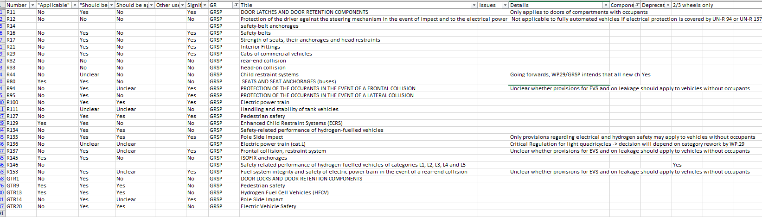
5. General findings and next steps
Romain Pessia, Task Force Leader of the ADS screening TF in GRVA volunteered to take of the part, to present the the screening results of all task forces in WP.29 in June 2023.
He prepared an excel file with an overview about the results of the scanning of all regulation under WP.29 (FADS-08-05)
During GRVA 22.-26. Mai 2023 the TF Leader of GRSP and GRVA will finally work on the comment made in the right part of the Table

Slide 13
Finally,
the Task Force Leader can only say thank to all the experts from all over the world, who did a great job during the last month and a special thank you also to my secretary Ansgar Pott

