Slide 1
Submitted by the expert from Republic of Korea
Informal document GRSP-73-23-Rev.1
(73rd GRSP, 15-19 May 2023
agenda item 3)
[GRSP]
Proposing methods to shorten verification test time of expected on-road performance
and performance durability for Compressed Hydrogen Storage System under GTR No.13
[First topic]
A Filler Method of Reducing Hydrogen Storage Container Volume to Shorten Gas Pressure Cycling Test Time
Korea Gas Safety Corporation
Hyundai Motor Company
2023.05

Slide 2
▣ Outline
2023. 05.
Korea Gas Safety Corporation
Hyundai Motor Company
Background and purpose of research (Pneumatic)
Research Contents
Test concept
Test process
Test result & Proposal

Slide 3
▣ Background and purpose of research (Pneumatic)
2023. 05.
Korea Gas Safety Corporation
Hyundai Motor Company
Verification Test takes a lot of time and cost
Ambient and Extreme Temperature Gas Pressure Cycling Test
Roughly months to a year, almost few hundreds of millions.
GTR No.13 |  | SAE J2579
500 cycles, 1st + 2nd Group Hydrogen gas temperature ≤-40℃ Stabilize environment for at least 24 hours Pressure: 20 (+0/-10) bar to target pressure (±10 bar) Fill rate: 3min ramp, < 60g/s (Fill rate↓ when gas temperature 85℃) |  | 500 cycles for light-duty, 1st + 2nd Group Hydrogen gas temperature ≤-35℃ Stabilize environment for at least 24 hours Pressure: 20 (+0/-10) bar to target pressure Maintain Exhaust Speed (Manufacturer Presented)
Test
procedure
1st Group (250cycles)
2nd Group (250cycles)
1st Group (250cycles)
2nd Group (250cycles)
Stabilize environment : ≤-40℃ ▷ Tank conditions … ≥NWP X 80% ▷ Gas conditions … First 5cycles, ≥20±5℃ … Next 5cycles, ≤-40℃
Stabilize environment : ≥50℃, 95% RH ▷ Tank conditions … NWP X 125% ▷ Gas conditions … First 5cycles, ≤-40℃
Stabilize environment : 20±5℃ ▷ Tank conditions … NWP X 125%
Stabilize environment : ≥50℃, 95% RH ▷ Tank conditions … ≥NWP X 125%
Stabilize environment : ≤-40℃ ▷ Tank conditions … NWP X 80%
Stabilize environment : 20±5℃ ▷ Tank conditions … NWP X 125%
Stabilize environment : ≤-40℃ ▷ Tank conditions … First 10cycles, ≥NWPX80% … remnants, ≥NWP X 100% ▷ Gas conditions … First 5cycles, ≥20℃ … Next 5cycles, ≤-35℃
Stabilize environment : ≥50℃, 95% RH ▷ Tank conditions … ≥NWP X 125% ▷ Gas conditions … First 5cycles, ≤-35℃
Stabilize environment : 20±5℃ ▷ Tank conditions … NWP X 125%
Stabilize environment : ≥50℃, 95% RH ▷ Tank conditions … ≥NWP X 125%
Stabilize environment : ≤-40℃ ▷ Tank conditions … ≥NWP X 80% (first time) … ≥NWP X 100%
Stabilize environment : 20±5℃ ▷ Tank conditions … NWP X 125%
25cycles
25cycles
25cycles
25cycles
(5%)
(5%)
(5%)
(5%)
25cycles
25cycles
25cycles
25cycles
(5%)
(5%)
(5%)
(5%)
200cycles
200cycles
200cycles
200cycles
(40%)
(40%)
(40%)
(40%)

Slide 4
▣ Research Contents_Test Concept
2023. 05.
Korea Gas Safety Corporation
Hyundai Motor Company
ISO 19881:2018 “Gaseous hydrogen — Land vehicle fuel containers”
17.3.13.2 Procedure
The hydrogen gas cycling test shall be performed in accordance with the following procedure.
The container shall be pressure cycled using hydrogen from 2 MPa ± 1 MPa to 125 % of the nominal working pressure for 1 000 cycles. The end boss at the valve end (the end where the fill/discharge occurs) may be grounded. Each cycle shall consist of filling and venting of the container. The fill rate shall not exceed 60 g/s and the maximum allowable gas temperature shall not be exceeded. The defueling rate shall be specified by the container manufacturer.
The first 500 cycles shall be conducted at the ambient temperature, followed by a static hold at 115 % of the nominal working pressure (±1 MPa) at 55 °C for a minimum of 30 h. The second 500 cycles shall be conducted with the container at an ambient temperature of −30 °C (250 cycles) and at 50 °C (250 cycles).
Subscale specimens may be used for this test with diameters reduced by as much as 20 % and lengths reduced by as much as 50 %.
Save time and cost using subscale specimens
ISO/FDIS 19884 “Gaseous hydrogen — Cylinders and tubes for stationary storage”
8.3.3 Pressure vessel tests
8.3.3.2 Use of subscale units
Where indicated, tests may be performed on full scale diameter pressure vessels of shorter length; however, the L/D ratio of sub-scale units shall be greater than 2,5. If the full scale cylinder L/D ratio is less than 2,5, a full scale cylinder is required. The winding pattern of the sub-scale unit shall be the same as the full scale pressure vessel.
Full-scale pressure vessels containing a filler material to reduce the internal volume may also be used.
Our choice
Save time and cost using containing a filler

Slide 5
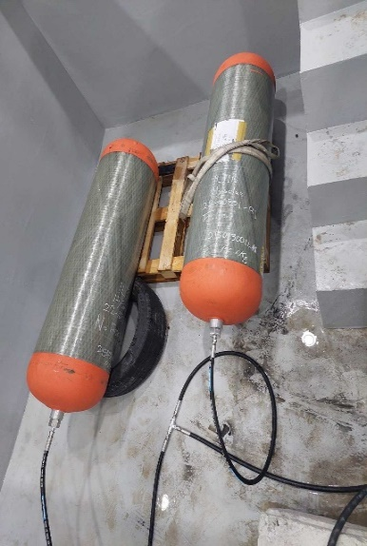
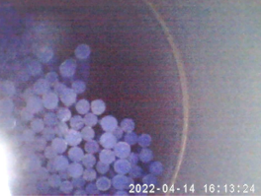
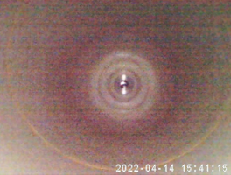
▣ Research Contents_Test process
2023. 05
Korea Gas Safety Corporation
Hyundai Motor Company
Comparison of the volume reduced storage container(40% filler inserted, 70L) and the normal storage container by brief test
Container (filler O) | Container (filler X)
Volume 105L (175*0.6) | Volume 175L
Internal insertion filler
(Liner-like material)
Validation of the volume reduction method for reducing test time
Verification of the durability of the storage container through repeated hydraulic cycling test
Sample | Volume | - | GTR No.13 |  |  | - | EC 79/2009 | GTR No.13 | -
 |  | Leak test | Permeation test | Pressure cycling Test (Gas/Brief) | Permeation test | Internal inspection | Pressure cycling Test (Hydraulic) | Permeation test | Internal inspection after cutting
Container (filler O) | 105L (175L*60%) | ▪ 10 Mpa to 87.5 Mpa | ▪ High temperature (55℃) ▪ First permeation rate① measurement | ▪ Ambient(20±5℃) High(55℃) Low(-40℃) temperature Perform 5 times each | ▪ High temperature (55℃) ▪ Middle Permeation rate② measurement | ▪ Physical Damage Check | ▪ Ambient temperature (20℃) ▪ 125% NWP ▪ 5,000 cycles | ▪ High temperature (55℃) ▪ Final permeation rate③ measurement | ▪ Physical Damage Check
Container (filler X) | 175L

Slide 6
▣ Research Contents_Test result and Proposal
2023. 05.
Korea Gas Safety Corporation
Hyundai Motor Company
The filler method test time reduction verification (up to 77%), No internal damage caused by fillers
Sample | Volume | Leak test | First permeation rate ⓐ (cc/hr/L) | Average test time | Middle Permeation rate ⓑ (cc/hr/L) | Internal inspection | Pressure cycling Test (Hydraulic) | Final permeation rate ⓒ (cc/hr/L) | Internal inspection after cutting
Container (filler O) | 105L | No leak | 4.57 (9.9% compared to the limit) | 54min/cycle (@20℃) 67min/cycle (@55℃) 224min/cycle (@-40℃) | 6.37 (13.8% compared to the limit) | No damage | ▪ Pass | 6.34 (13.8% compared to the limit) | No damage
Container (filler X) | 175L |  | 2.09 (4.5% compared to the limit) | 109min/cycle (@20℃) 91min/cycle (@55℃) 979min/cycle (@-40℃) | 5.52 (12% compared to the limit) |  |  | 5.28 (11.5% compared to the limit)
2
4
4
1
3
Depending on the container manufacturing deviation, the first permeation rate is different, and the middle permeation rate after the pressure cycling(Gas/Brief) test both satisfies the GTR No.13 (values ⓐ and ⓑ)
Check the test method for shorter time, lower temperature means higher effect (@20℃ 50%, @-40℃ 77%)
There is little effect on leakage even if the pressure cycling test(Hydraulic) is carried out with fillers in it (small difference in values ⓑ and ⓒ)
Checked the inside of the container and found no physical damage
1
2
3
4

Slide 7
[GRSP]
Proposing methods to shorten verification test times of expected on-road performance
and performance durability for Compressed Hydrogen Storage System under GTR No.13
[Second topic] A Research for reducing High temperature static pressure test time for hydrogen storage containers
Korea Gas Safety Corporation
2023.05

Slide 8
▣ Outline
2023. 052
Korea Gas Safety Corporation
Background and purpose of research (Hydraulic)
Research Contents
Test concept
Test process and result

Slide 9
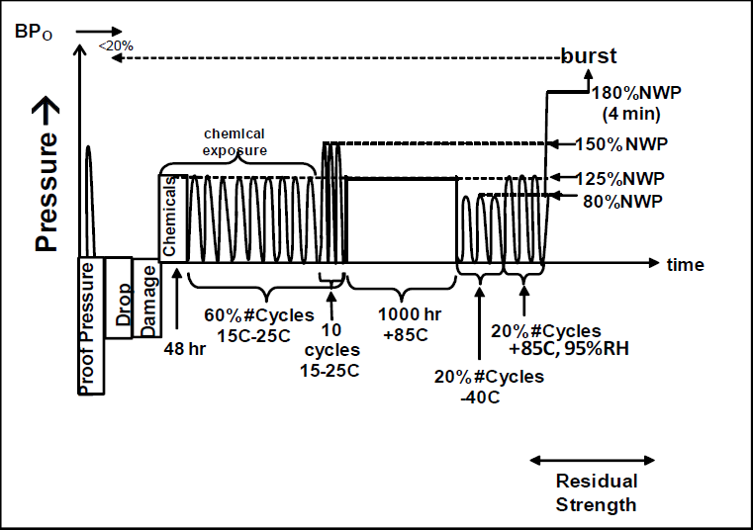
▣ Background and purpose of research (Hydraulic)
2023. 052
Korea Gas Safety Corporation
Verification Test takes a lot of time
High temperature static pressure test (HTSPT)
To reduce test time, We are looking for ways to shorten a test method that takes 1,000 hours for one test
GTR No.13
Test time : 1,000 hour Fluid temperature : +85℃ Fluid Pressure : 875 bar Fluid type : Non-corrosive fluid Stabilize environment for at least 24 hours
Test
procedure
Before High temperature static pressure test - Proof Pressure test - Drop test - Damage test - Chemical exposure and ambient-temperature pressure cycling test
High temperature static pressure test - test time : 1,000 hour - minimum test time : almost 42 days
After High temperature static pressure test - Extreme temperature pressure cycling test - Hydraulic residual pressure test - Residual burst strength test

Slide 10
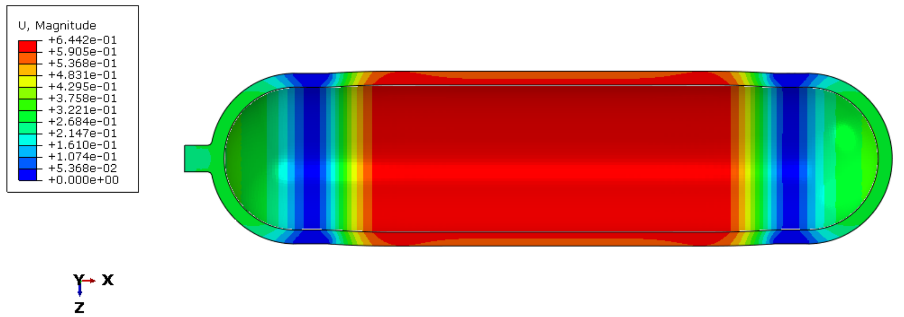
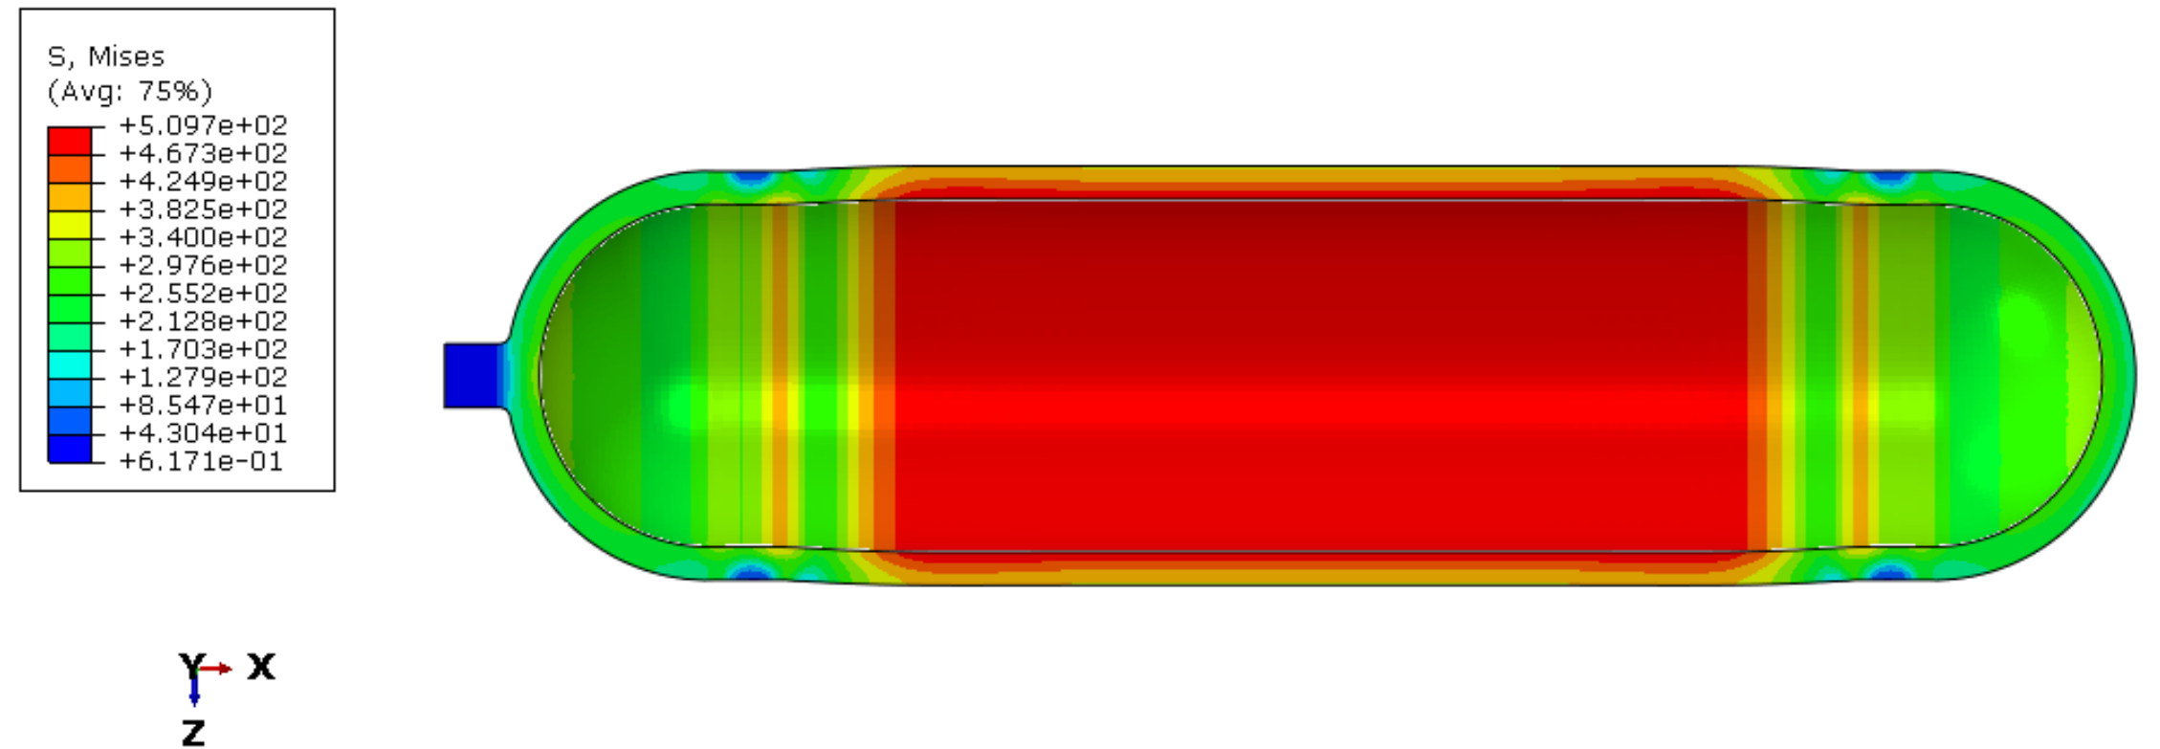
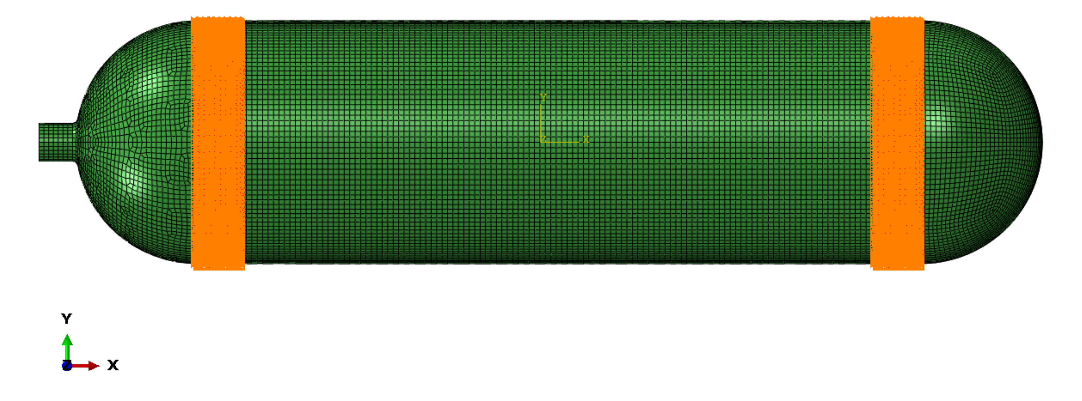
▣ Research Contents_Test process and result
2023. 05
Korea Gas Safety Corporation
Hydrogen Storage Container structural analysis for high temperature static pressure test
Hydrogen Storage Container information - Weight : 120 kg - Length : 1.8 m Analysis method - Input : material properties (600h, 800h, 1000h) - Pressure : 875 bar
Maximum displacement : 0.644mm
Maximum stress : 5,097 bar
< Maximum displacement >
< Maximum stress >
Result of structural analysis according to properties
CFRP Properties according to temperature and test time
No. |  |  | 1(BASE) | 2 | 3 | 4
CFRP material |  | Hour | - | 600 | 800 | 1,000
 |  | Temp (℃) | 20 | 85 | 85 | 85
Result | Max. Stress (MPa) |  | 509.7 | 508.5 | 508.6 | 509.7
 | Max. Displacement (mm) |  | 0.644 | 0.608 | 0.620 | 0.622
No. |  |  | 1(BASE) | 2 | 3 | 4
CFRP material |  | Hour | - | 600 | 800 | 1,000
 |  | Temp (℃) | 20 | 85 | 85 | 85
Result | Tensile Strength (MPa) |  | 2,671.25 | 2,535.10 | 2,539.67 | 2,582.93
 | Elastic Modulus (GPa) |  | 149.06 | 157.54 | 154.42 | 154.42
 | Poisson’s ratio |  | 0.31 | 0.32 | 0.32 | 0.31
In the structural analysis of the container material and the tensile test that simulated in, it was confirmed that the hydrogen sotorage container for 600 and 800 hours were more vulnerable than the high-temperature static pressure for 1,000hours.

Slide 11
▣ Research Contents_Test process and result
2023. 05
Korea Gas Safety Corporation
Comparison of demonstration tests for actual hydrogen Storage Container
 | Bus Hydrogen Storage container After HTSPT (600h)
 | Bus Hydrogen Storage container After HTSPT (1,000h)
Bus Hydrogen Storage container
Before HTSPT
Bus Hydrogen Storage container
Residual burst strength test
Validation of the test time reduction method for reducing test time
Sample | Test Time (hour) | GTR No.13
 |  | Before HTSPT | HTSPT | After HTSPT | Residual burst strength test | Burst pressure (Mpa)
Container (decrease) | 600 | - | Temperature : 85℃ Pressure : 875 bar (125% NWP) | - | 0 MPa to burst pressure | The test In progress
Container (general) | 1,000 |  |  |  |  | 187.5
Based on findings of the research, we would like to propose initiating a discussion on reducing the duration time of the high temperature static pressure test.

Slide 12
Thank you.
E-mail : kalma4935@kgs.or.kr

